Slide 1
BODY PERFORMANCE
ML ANALYTICS SYSTEM
Classification | Feature Engineering | Regression | SHAP Explainability
13,393
75.29%
0.9193
0.7841
Records
Best Accuracy
ROC-AUC
Best R²
Hossam Elnagar | Khaled Metwalie | Hazem Mohamed | Hazem Shokr | Bassem Salah
Introduction to AI and ML — Course Project | March 2026

Slide 2
From Raw Data to AI Insights
5-phase pipeline — each phase owned by a dedicated team member
01
02
03
04
05
EDA &
Cleaning
→
Feature
Engineering
→
Model
Training
→
Model
Evaluation
→
Regression
& App
Hossam
Khaled
Hazem M.
Hazem S.
Bassem
30 Classification Configs | 30 Regression Configs | 5 Classifiers | 5 Regressors | 6 Feature Subsets | Zero Data Leakage

Slide 3
01
EDA & DATA
UNDERSTANDING
Exploratory analysis, quality checks, and statistical profiling

Slide 4
Dataset Overview
13,393
12
Feature Categories
Demographics:
age, gender
Body Composition: height, weight, body fat %
Cardiovascular: systolic / diastolic BP
Physical Performance: grip strength, flexibility, sit-ups, broad jump
Target:
4 performance levels (A=best to D=lowest)
Total Records
Feature Attributes
4
~25%
Performance Classes
Per-Class Balance

Slide 5
Dataset Description
The Body Performance Dataset contains 13,392 records of physical fitness evaluations across 12 attributes.
Features include body composition (age, gender, height, weight, body fat %), cardiovascular health (systolic/diastolic BP), and physical performance (grip strength, flexibility, muscular endurance, explosive power).
The target variable class categorizes participants into four performance levels: A (best) through D (lowest). Classes are nearly perfectly balanced at ~25% each.

Slide 6
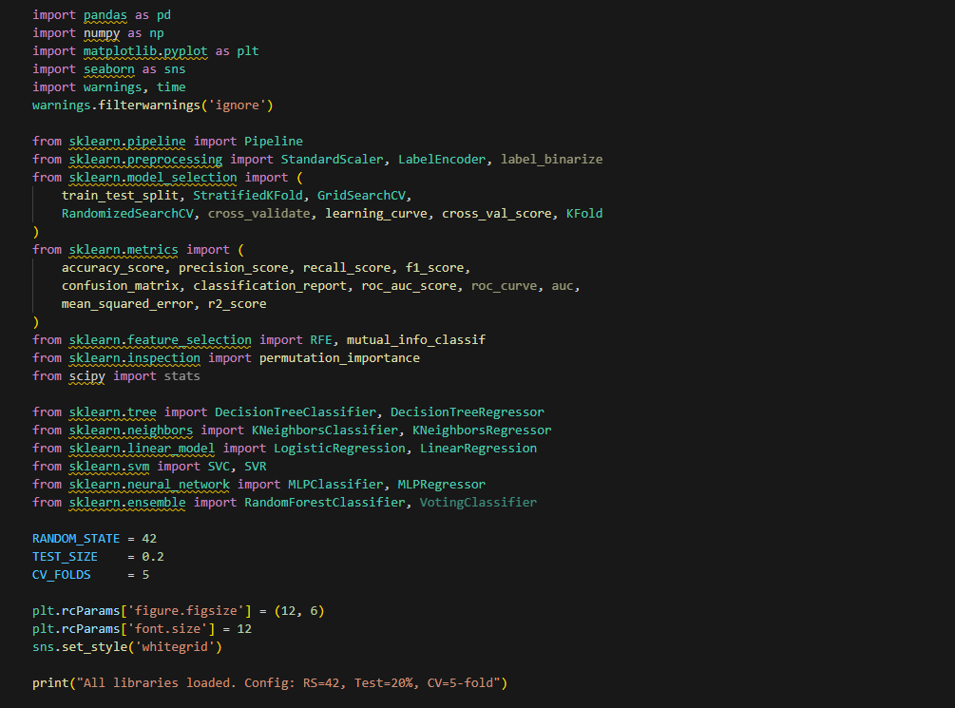
Import Libraries & Configuration

Slide 7
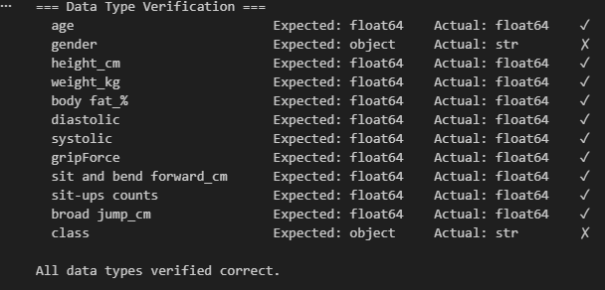
Data Type Verification

Slide 8
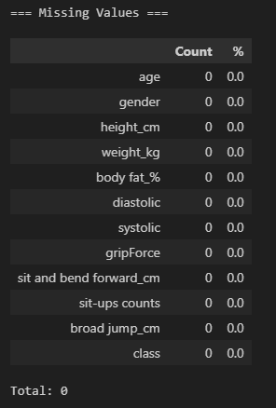
Missing Values Analysis

Slide 9
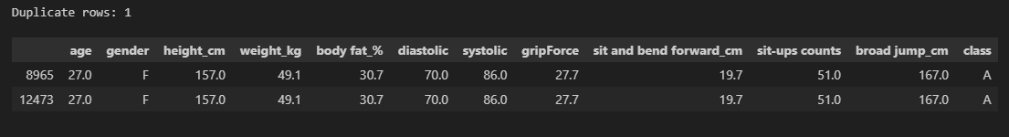
Duplicate Detection & Data Validity

Slide 10
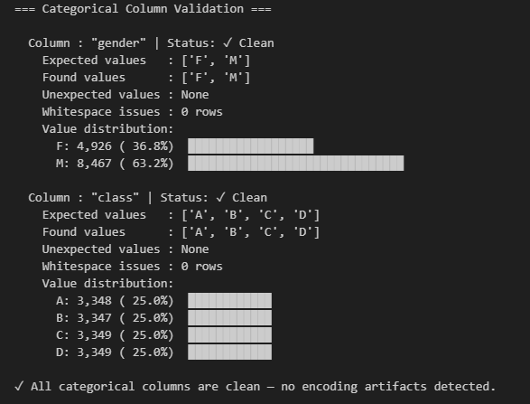
Categorical Column Validation

Slide 11
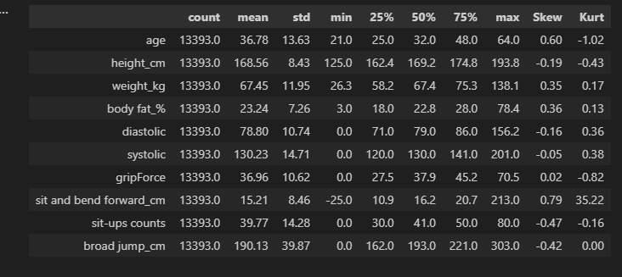
Univariate Analysis

Slide 12
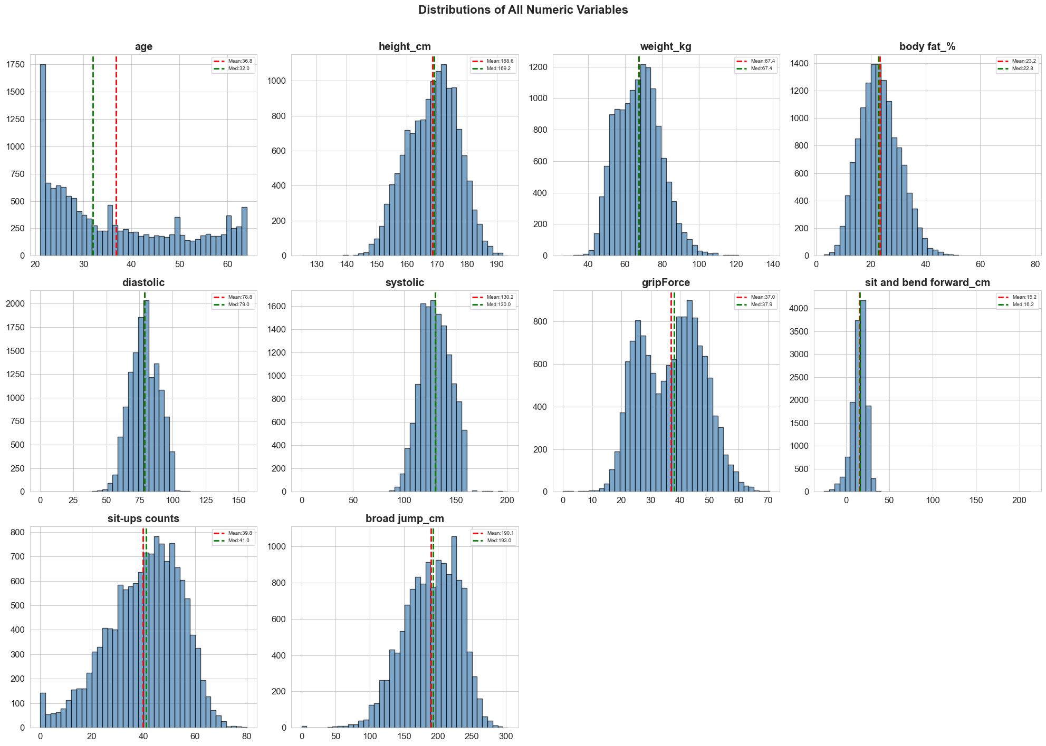
Distribution Analysis — Histograms

Slide 13
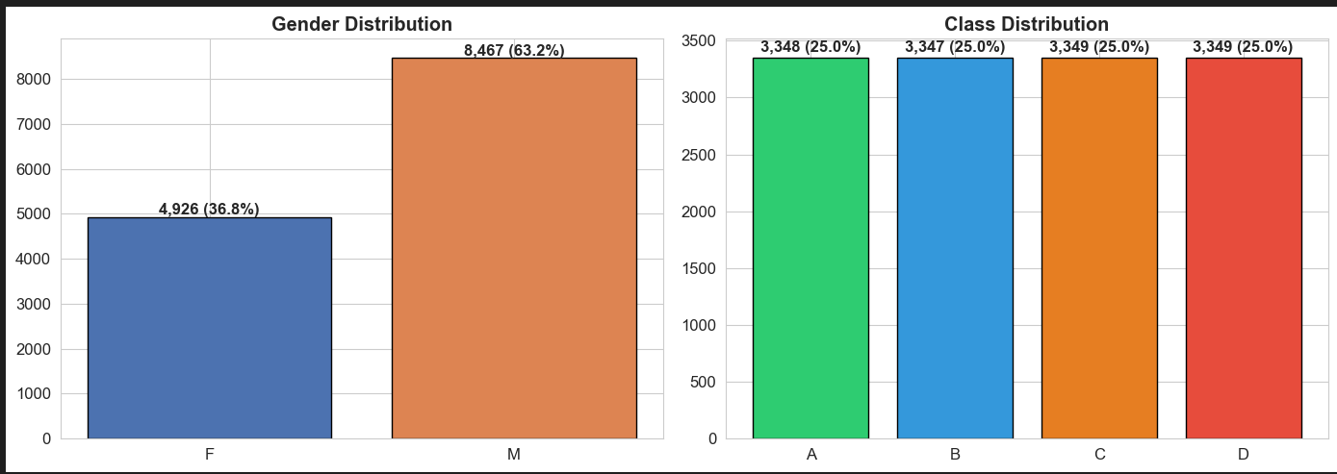
Distribution Analysis — Density

Slide 14
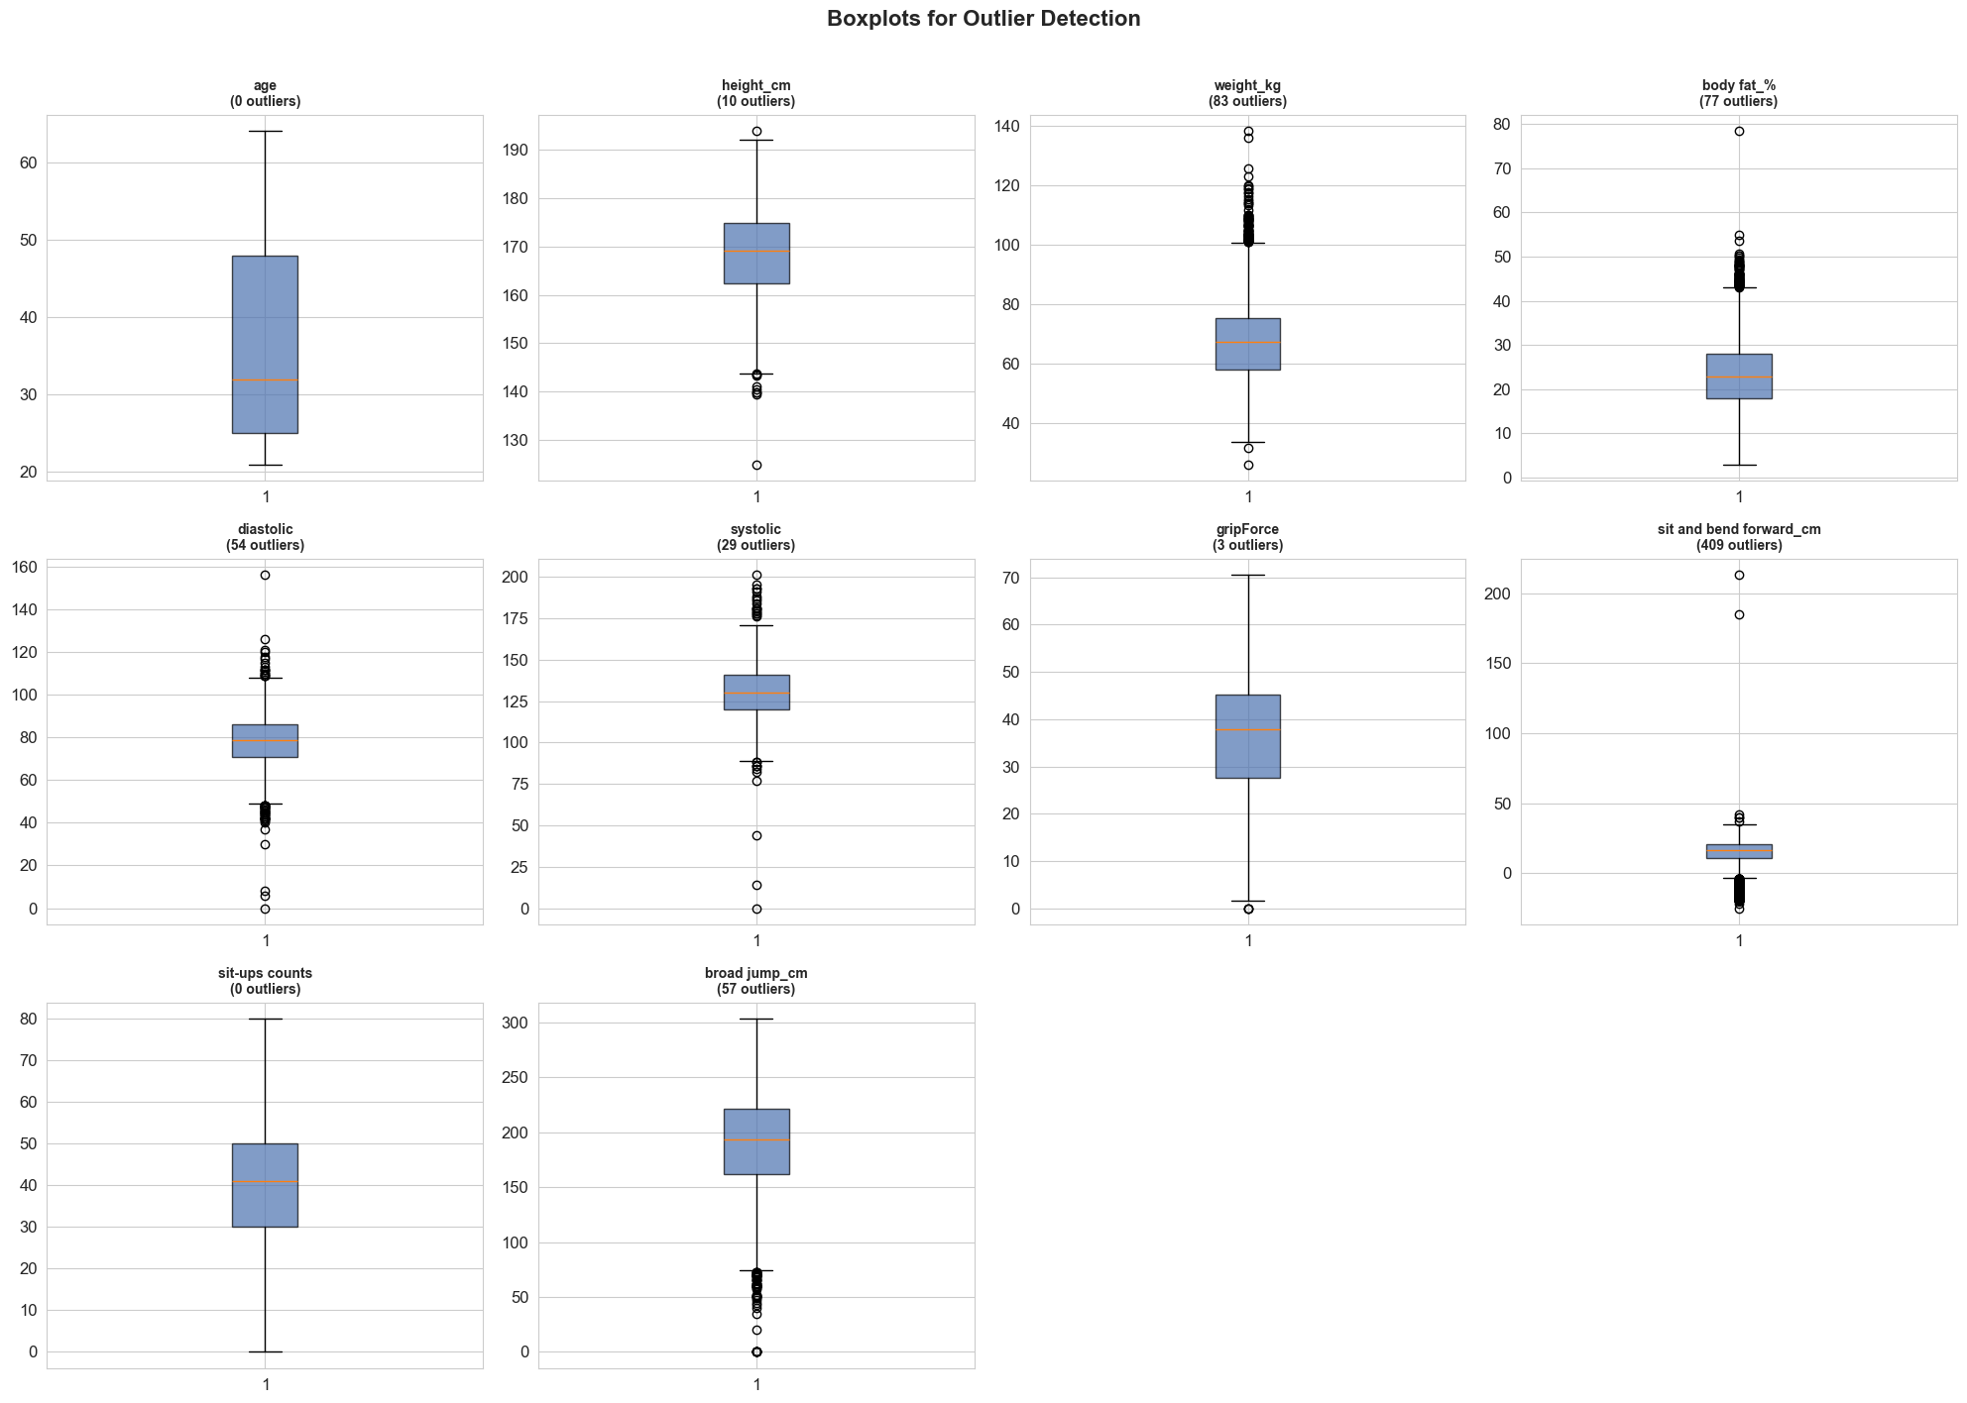
Outlier Detection & IQR Winsorization

Slide 15
IQR Winsorization Implementation

Slide 16
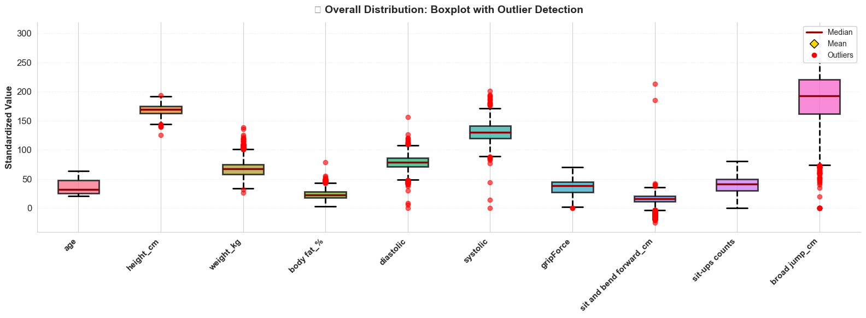
Post-Winsorization Boxplot Analysis

Slide 17
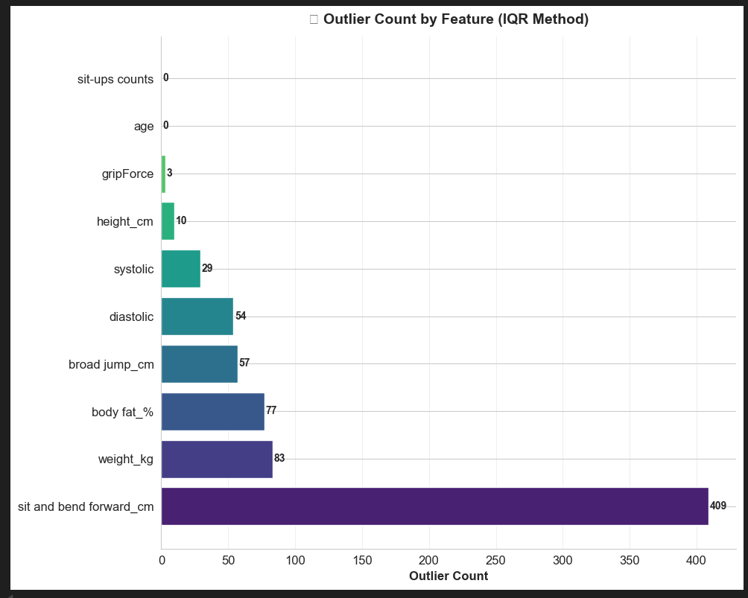
Outlier Count by Feature

Slide 18
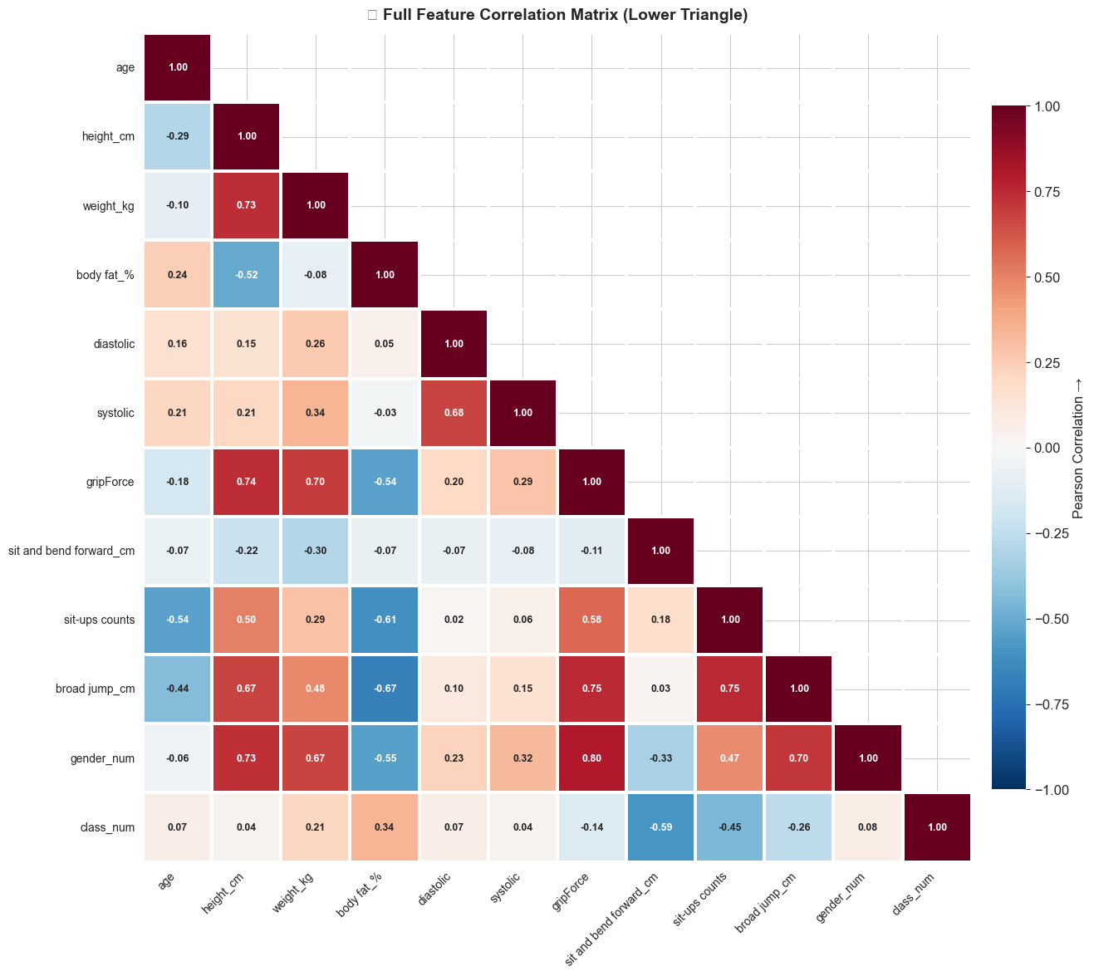
Correlation Analysis — Heatmap

Slide 19
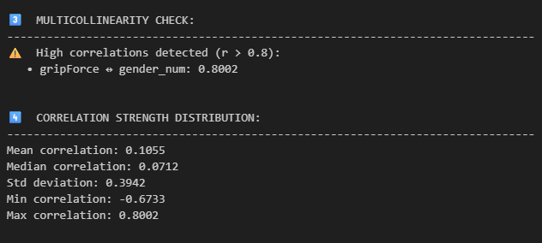
Correlation Analysis — Pairwise

Slide 20
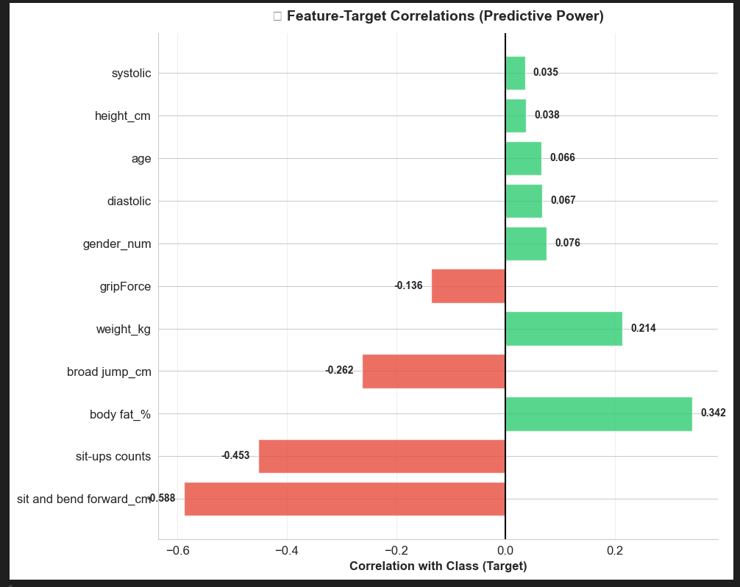
Correlation Analysis — Feature Pairs

Slide 21
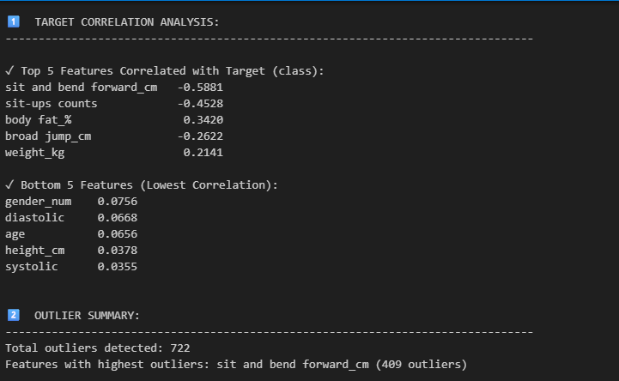
Correlation Analysis — Scatter Matrix

Slide 22
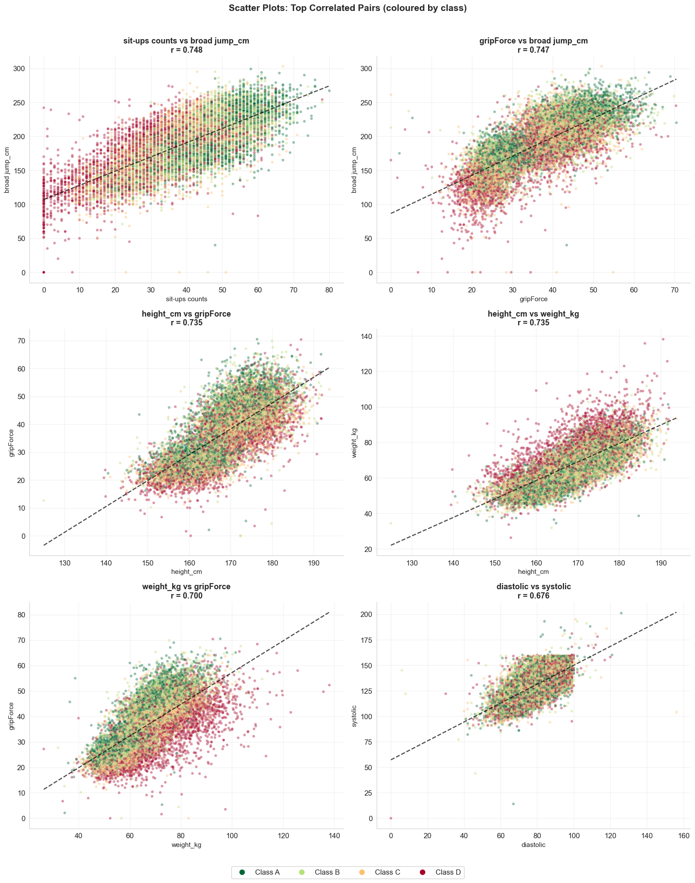
Correlation Analysis — Detailed View

Slide 23
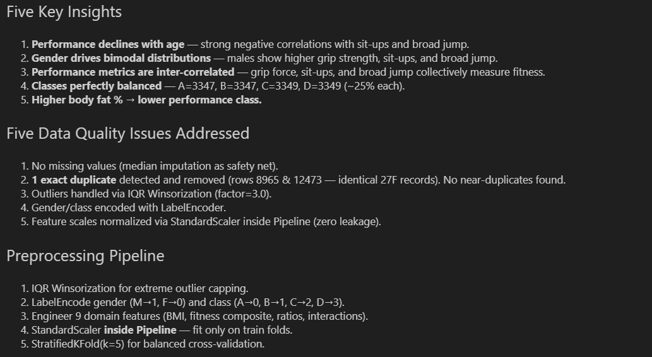
Final EDA Summary

Slide 24
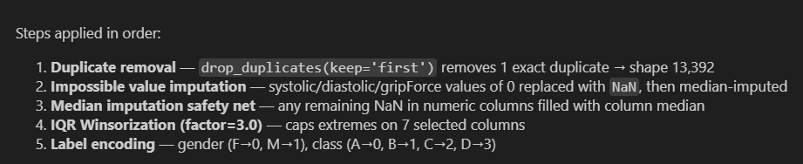
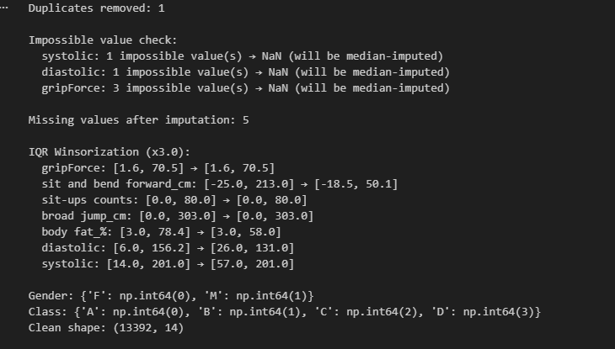
Data Cleaning Pipeline

Slide 25
02
FEATURE
ENGINEERING
9 domain-driven features grounded in exercise science

Slide 26
Feature Engineering — 9 Domain-Driven Features
Lead: Khaled Metwalie — grounded in exercise science
Feature | Formula | Rationale
BMI | weight / (height/100)² | WHO body composition standard
strength_per_kg | gripForce / weight | Relative strength normalised
jump_per_kg | broad_jump / weight | Explosive power per body mass
cardio_index | systolic - diastolic | Cardiovascular health proxy
fitness_composite | (grip + situps + jump) / 3 | Overall fitness score
flexibility_ratio | bend_forward / height | Height-normalised flexibility
endurance_strength | situps × gripForce | Combined interaction term
age_bmi | age × BMI | Age-adjusted composition
body_fat_age | body_fat × age | Aging effect on fat
IMPACT: fitness_composite achieves r=0.979 with broad_jump. Subset-20 outperforms Subset-11 by ~2 pp across ALL models.

Slide 27
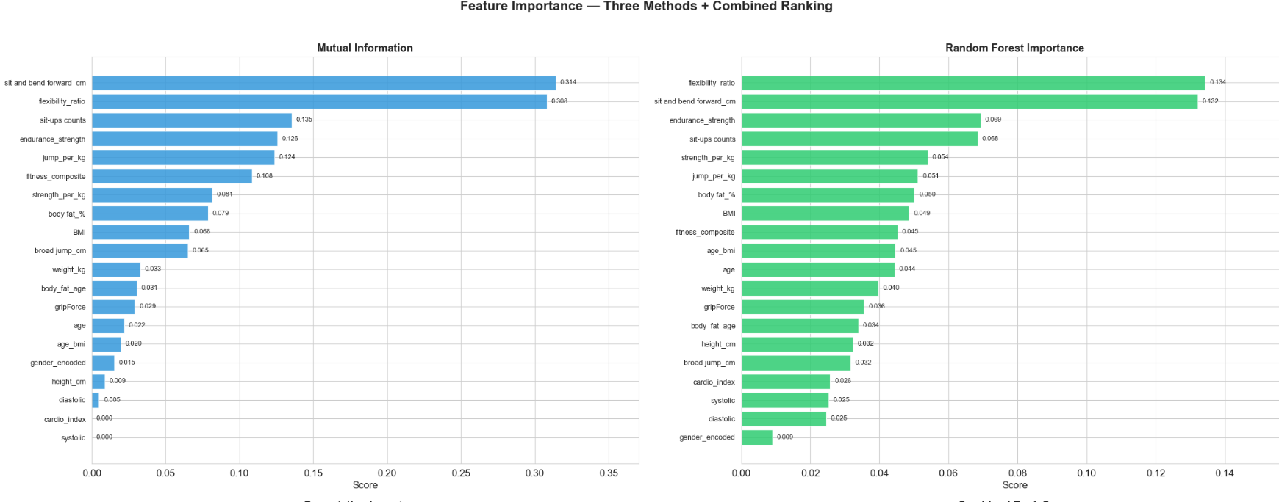
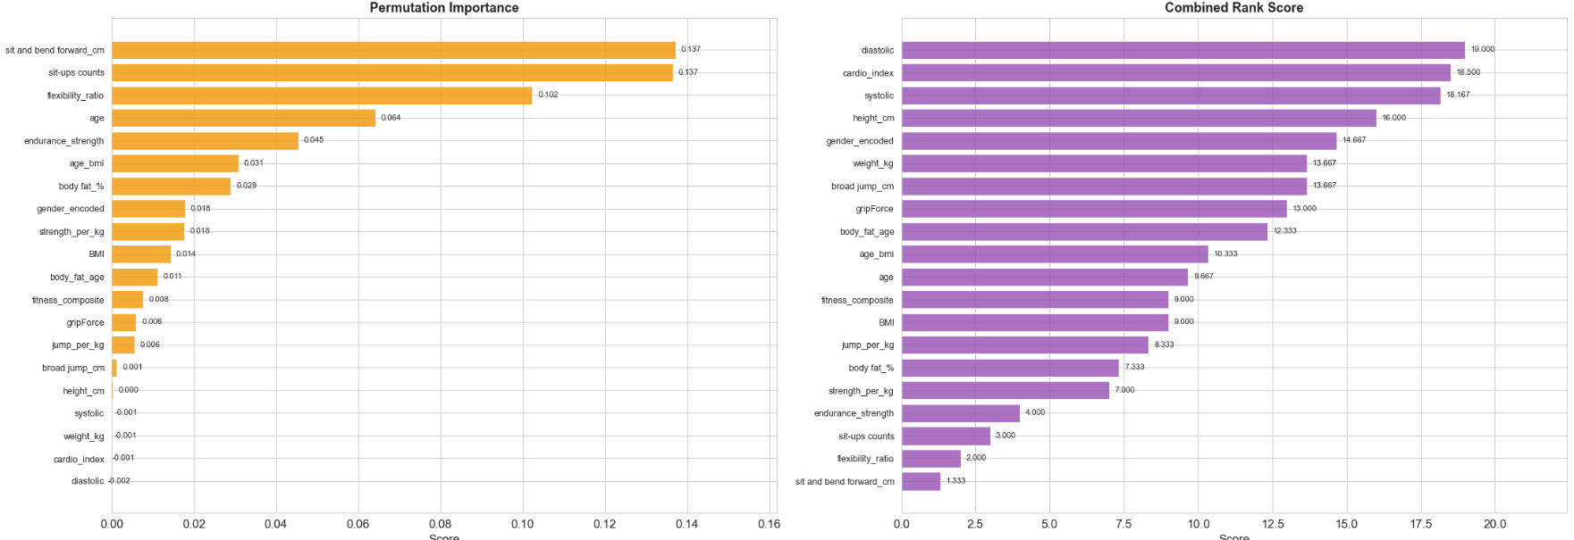
Feature Ranking — Importance Scores

Slide 28
Feature Selection — 4 Methods, 6 Subsets
Mutual Info
RF Importance
Permutation
RFE
Non-linear statistical
relationships
Tree-based split
scores (100-tree)
F1 drop when shuffled
— model-agnostic
Recursively eliminates
least important
Subset | # | Description
Subset-5 | 5 | Top 5 features — minimal baseline
Subset-7 | 7 | Top 7 from combined ranking
Subset-11 (Base) | 11 | Original features, no engineering
Subset-11 (RFE) | 11 | Top 11 by Recursive Feature Elimination
Subset-15 | 15 | Top 15 from combined ranking
Subset-20 ★ | 20 | All 11 original + 9 engineered — BEST

Slide 29
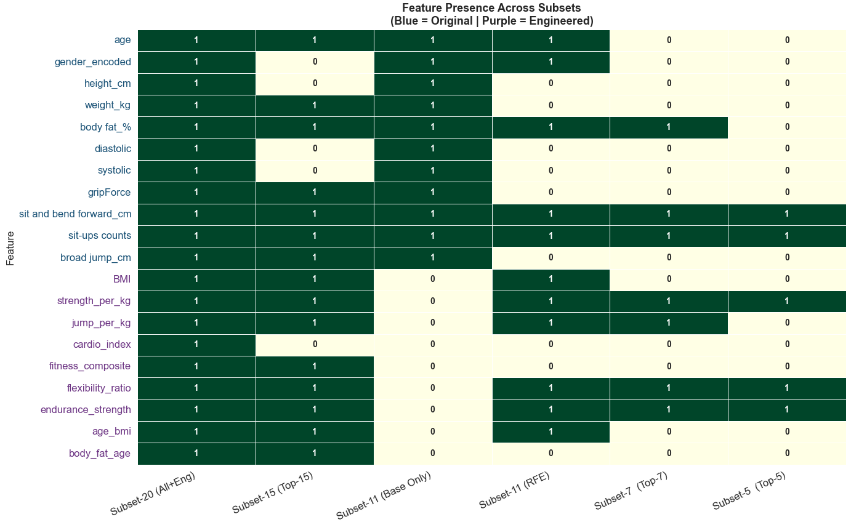
Feature Selection — Visual Analysis

Slide 30
03
CLASSIFICATION
MODELING
5 classifiers × 6 subsets — 30 configurations with hyperparameter tuning

Slide 31
Classification — 30 Model Configurations
Lead: Hazem Mohamed — 5 classifiers × 6 subsets with hyperparameter tuning
Decision Tree
GridSearchCV
max_depth, min_samples_split/leaf, criterion
72
KNN
GridSearchCV
n_neighbors, weights, metric
20
Logistic Reg.
GridSearchCV
C, penalty (L1/L2/ElasticNet)
8
SVM (RBF)
RandomizedSearch
C, kernel, gamma
15
Neural Net
RandomizedSearch
hidden_layers, activation, alpha, LR
20
GridSearchCV: exhaustive for small spaces (DT, KNN, LR) | RandomizedSearch: efficient for large spaces (SVM, MLP)

Slide 32
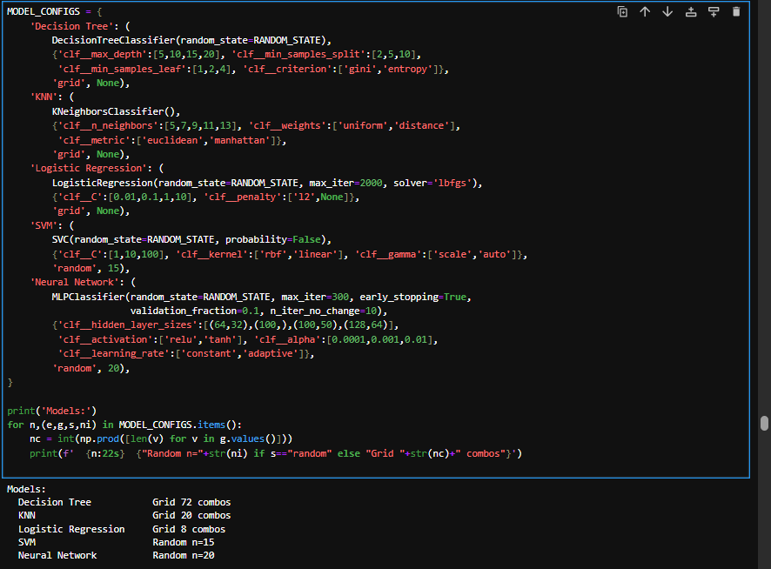
Classification — 30 Model Configurations

Slide 33
Classification Results — Model Comparison
Top 5 Configurations
1 ★
Neural Network
Subset-20
75.29%
2
Neural Network
Subset-15
~74.1%
3
Neural Network
Subset-11
~73.0%
4
SVM (RBF)
Subset-20
~72.0%
5
SVM (RBF)
Subset-15
~71.0%
KEY: Non-linear models dominate — NN and SVM-RBF outperform linear models by 10-15 pp. Feature engineering adds ~2 pp across ALL models.

Slide 34
Best Model — Neural Network Deep Dive
Lead: Hazem Shokr — MLP (128, 64) with tanh activation on all 20 features
Architecture
75.29%
0.7519
0.9193
Hidden Layers
(128, 64)
Accuracy
F1-Score
ROC-AUC
Activation
tanh
Confusion Matrix Insights
Learning Rate
adaptive
Most errors between adjacent classes (A-B, C-D)
Class B hardest (F1=0.64) — overlaps A and C
Class D easiest (F1=0.86) — highly distinctive
Ordinal structure preserved
Regularisation
alpha=0.001 (L2)
Early Stopping
Yes (patience=10)
Feature Set
Subset-20
Adjacent-class confusion confirms the ordinal nature of performance levels — the model learns real physiological gradients.

Slide 35
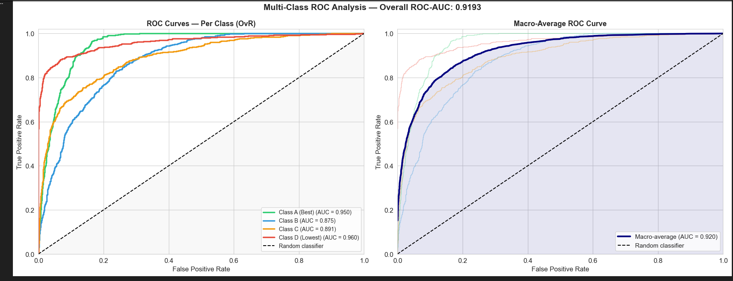
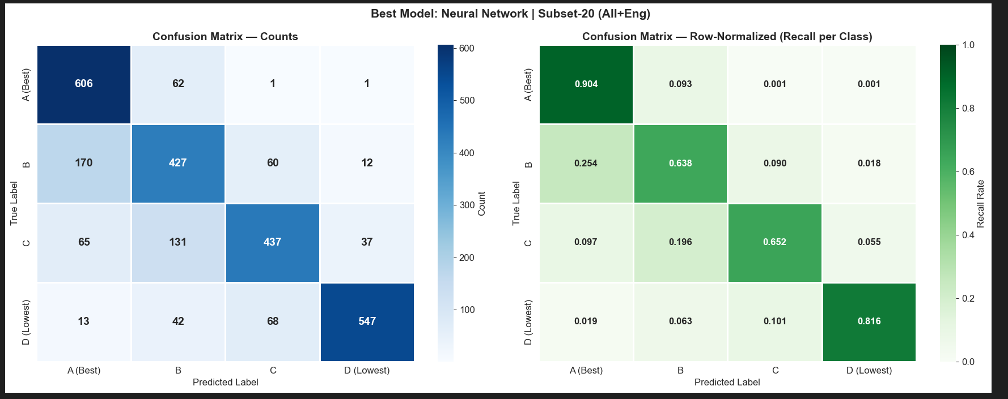
Confusion Matrices & Classification Reports

Slide 36
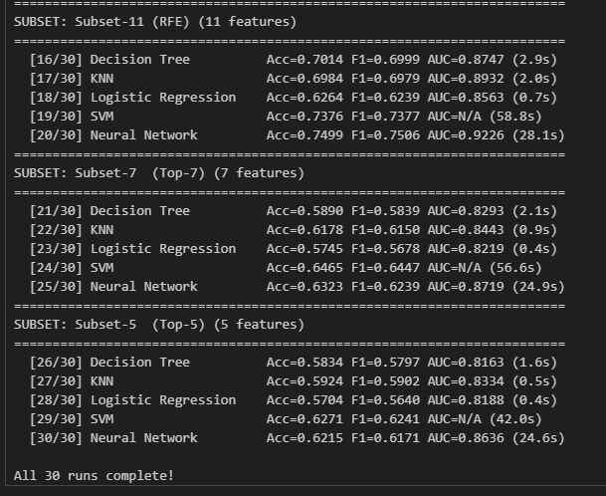
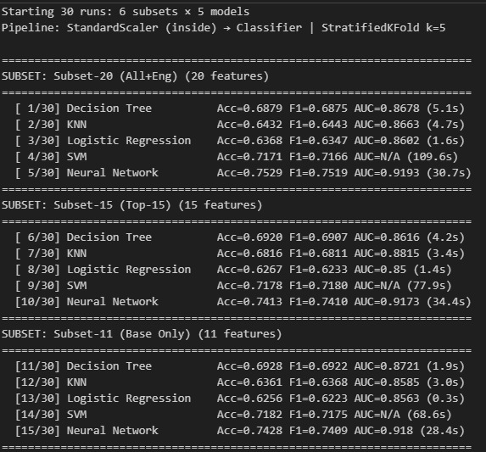
ROC Curves & Learning Curves

Slide 37
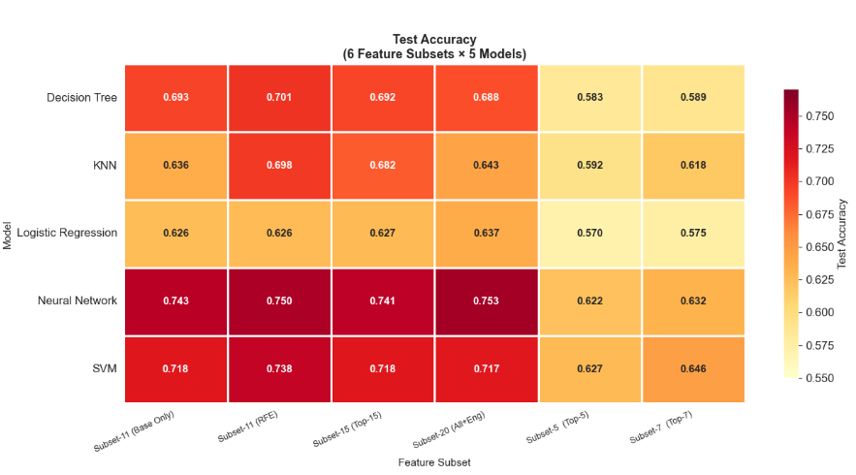
Model Evaluation — Detailed Metrics

Slide 38
SHAP Explainability — What Drives Predictions?
sit-ups counts
0.145
Key Findings
broad jump corr
0.132
sit-ups = #1 predictor
4 of top 10 are engineered features (cyan bars)
High fitness + low fat + young age → Class A
Inverse pattern → Class D
Physiologically meaningful patterns — not statistical noise
gripForce
0.118
fitness_composite
0.112
body fat_%
0.098
age
0.087
endurance_strength
0.079
BMI
0.065
strength_per_kg
0.058
height_cm
0.048
SHAP confirms the model learned real physiological gradients — engineered features provide complementary signal.

Slide 39
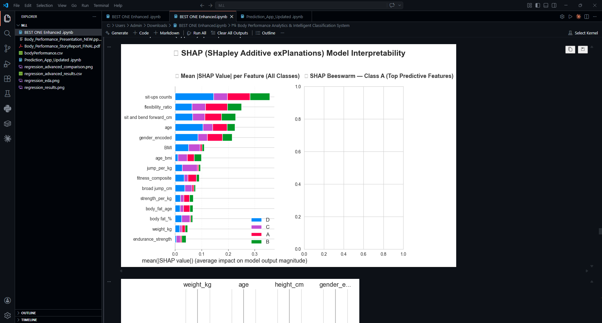
SHAP — Detailed Explanation Plot

Slide 40
04
REGRESSION
MODELING
Predicting broad jump distance with 17 leak-free features

Slide 41
Regression — Predicting Broad Jump Distance
Lead: Bassem Salah — 17 safe features (leakage-free)
190.13 cm
39.87 cm
0-303 cm
Leakage Prevention
3 features excluded: jump_per_kg, fitness_composite, broad_jump
Mean
Std Dev
Range
Model | R² | RMSE
★ SVR (RBF) | 0.7817 | 18.62
Neural Network | 0.7812 | 18.64
Linear Regression | 0.7763 | 18.85
KNN | 0.7647 | 19.33
Decision Tree | 0.7549 | 19.73

Slide 42
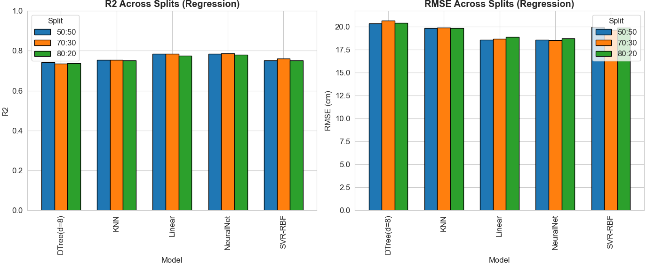
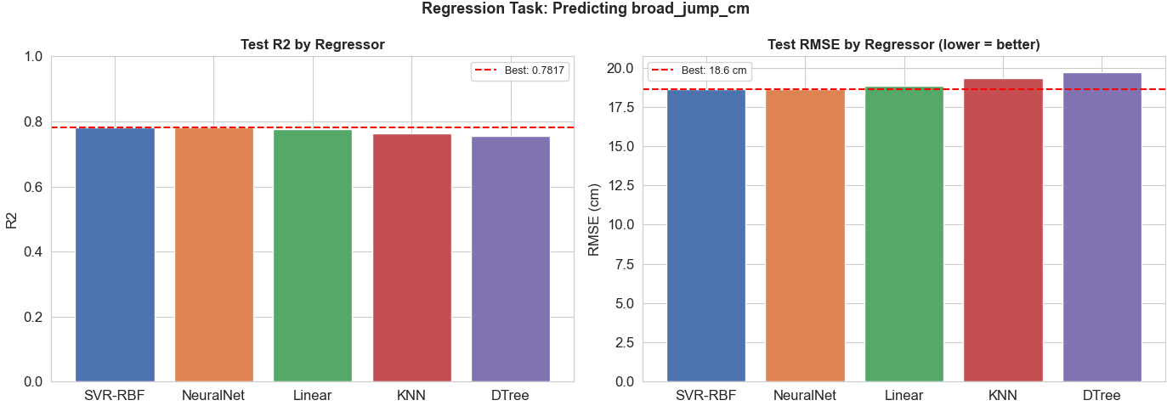
Regression — Residual Analysis

Slide 43
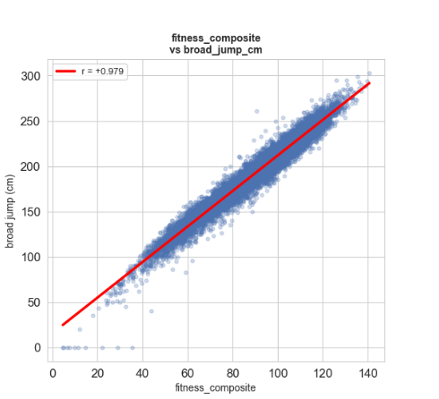
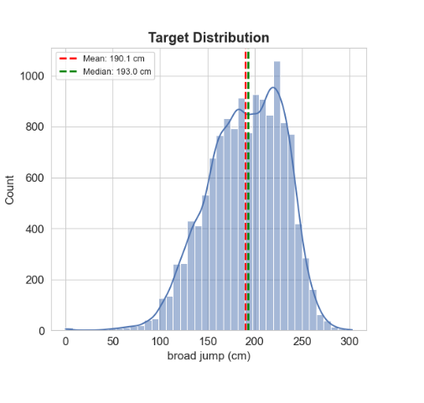
Regression — Model Comparison Plots

Slide 44
Advanced Regression — 6 Variants × 5 Models
Linear Regression with rich polynomial features wins — a surprising result
Top 3 Advanced
1 ★
V6: All Enhanced (39f)
Linear Reg. | R²=0.7841 | RMSE=18.52
2
V4: Log+Poly (33f)
Linear Reg. | R²=0.7837 | RMSE=18.55
3
V3: Poly-Int (32f)
Linear Reg. | R²=0.7832 | RMSE=18.58
SURPRISING: Linear Regression + polynomial features (39f) beats SVR-RBF and Neural Network. Simpler models + rich features > complex models + simple features.

Slide 45
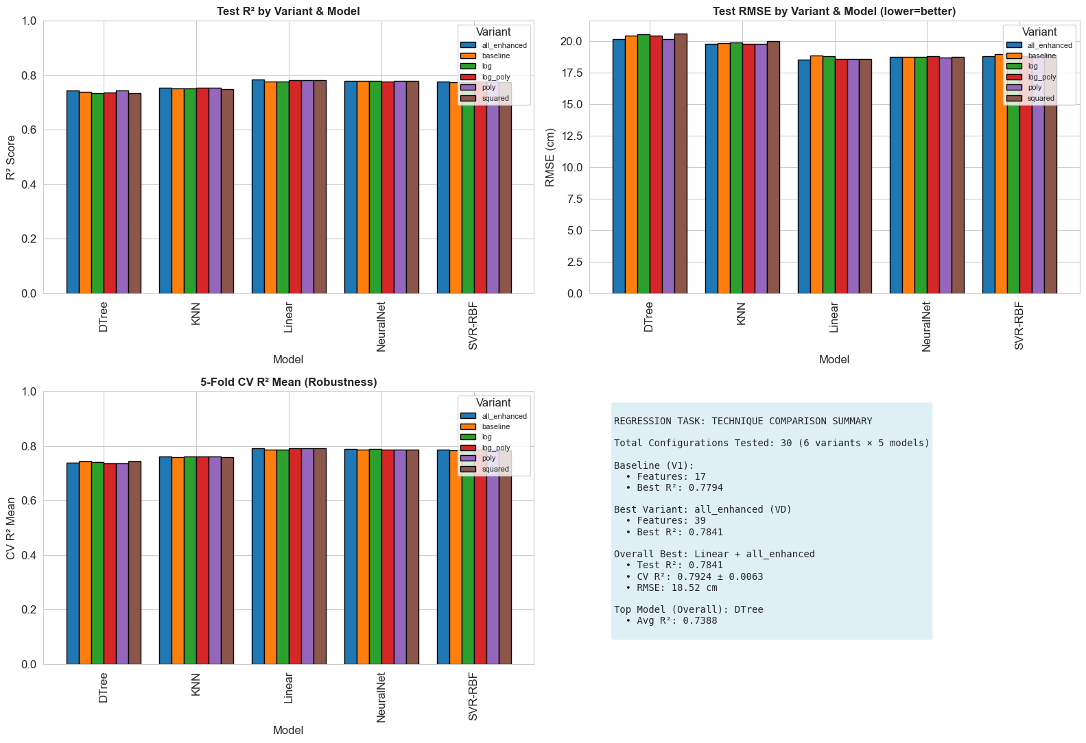
Advanced Regression — Full Results

Slide 46
Prediction App — Gradio Interface
Built by Bassem Salah — interactive web app for real-time predictions
11 Input Fields
Dual Prediction
Real-Time Output
Deploy-Ready
Age, gender, height, weight,
body fat, BP, grip, flexibility,
sit-ups, broad jump
Classification (A/B/C/D)
+ Regression (predicted
broad jump in cm)
Instant prediction with
confidence scores and class
probability distribution
Gradio interface — deployable
to HuggingFace Spaces
for public access
User Input
(11 metrics)
→
Feature Eng.
(9 features)
→
Scaling
→
Neural Net
→
Class +
Jump Est.

Slide 47
Business Impact & Real-World Applications
Sports Screening
Personal Training
Health Insurance
Rapid athlete classification for talent identification without expensive lab tests
Coaches assign personalised programs based on ML-assessed performance level
Objective fitness scoring for risk assessment — replacing subjective evaluations
Corporate Wellness
Clinical Rehab
Public Health
Employee fitness tracking at scale with automated classification
Track rehabilitation progress objectively — predict target performance
Population-level fitness monitoring for epidemiological studies

Slide 48
Key Findings & Takeaways
Classification
Regression
Neural Network wins: 75.29% — 3× random baseline
Feature engineering adds ~2 pp across ALL models
Class B hardest (F1=0.64) — Class D easiest (F1=0.86)
ROC-AUC = 0.9193 — excellent discrimination
Non-linear models beat linear by 10-15 pp
SVR-RBF wins basic: R²=0.7817, RMSE=18.62 cm
Linear Reg. wins advanced: R²=0.7841 (39 features)
All models converge at R²~0.78 — data ceiling
Polynomial interactions add +0.003 R²
RMSE ~18-19 cm — practical for screening
75.29%
0.9193
0.7841
30+
Accuracy
ROC-AUC
Best R²
Configs

Slide 49
Future Work & Recommendations
More Data
Collect 50k+ records from diverse populations — break the 75% ceiling
1
Deep Learning
Try TabNet / ResNet-inspired tabular models — potential +2-3% accuracy
2
Ensemble Methods
Stack NN + SVM-RBF + XGBoost predictions — potential +1-2% F1-score
3
Gender-Specific
Train separate models per gender group — address bimodal distributions
4
Deployment
Deploy Gradio App to HuggingFace Spaces — real-world validation at scale
5

Slide 50
Team Contributions
End-to-end ML pipeline built from scratch
H
K
H
H
B
Hossam Elnagar
Khaled Metwalie
Hazem Mohamed
Hazem Shokr
Bassem Salah
EDA & Data Cleaning Lead
Feature Engineering Lead
Model Training Lead
Evaluation Lead
Regression & App Lead
Data quality audit, cleaning pipeline, EDA visualisations
9 engineered features, 4 selection methods, 6 subsets
5 models × 30 configs, hyperparameter search spaces
Confusion matrices, SHAP, ROC-AUC, learning curves
Full regression pipeline + Gradio prediction app

Slide 51
Thank You!
Body Performance ML Analytics System
Questions & Discussion
75.29%
0.9193
0.7841
Accuracy
ROC-AUC
Best R²
Introduction to AI and ML — Course Project | March 2026

