Slide 1
Stuff

Slide 2
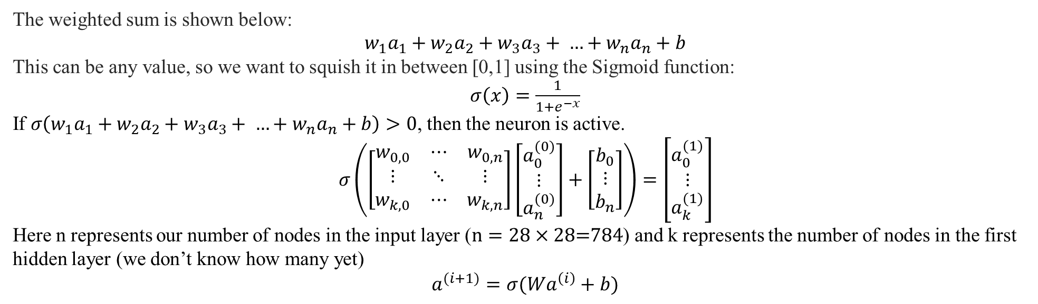
The weighted sum is shown below:
$$w_{1}a_{1}+w_{2}a_{2}+w_{3}a_{3}+ …+w_{n}a_{n}+b$$
This can be any value, so we want to squish it in between [0,1] using the Sigmoid function:
$σ\left(x\right)=\frac{1}{1+e^{−x}}$
If $σ\left(w_{1}a_{1}+w_{2}a_{2}+w_{3}a_{3}+ …+w_{n}a_{n}+b\right)>0$, then the neuron is active.
$$σ\left(\left[\begin{matrix}w_{0,0} & ⋯ & w_{0,n} \\ ⋮ & ⋱ & ⋮ \\ w_{k,0} & ⋯ & w_{k,n}\end{matrix}\right]\left[\begin{matrix}a_{0}^{(0)} \\ ⋮ \\ a_{n}^{(0)}\end{matrix}\right]+\left[\begin{matrix}b_{0} \\ ⋮ \\ b_{n}\end{matrix}\right]\right)=\left[\begin{matrix}a_{0}^{(1)} \\ ⋮ \\ a_{k}^{(1)}\end{matrix}\right]$$
Here n represents our number of nodes in the input layer ($n=28×28\text{=784}$) and k represents the number of nodes in the first hidden layer (we don’t know how many yet)
$$a^{(i+1)}=σ(Wa^{\left(i\right)}+b)$$

Slide 3

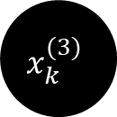
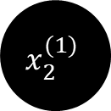
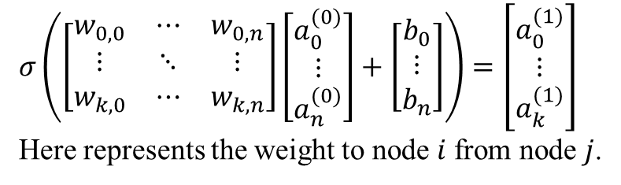





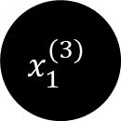





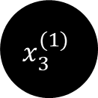



MLP Model
$$x^{(1)}$$
$$x_{1}^{(1)}$$
$$w^{(1)}$$
$$x^{(2)}$$
$$x_{1}^{(2)}$$
$$w^{(2)}$$
$$σ\left(\left[\begin{matrix}w_{0,0} & ⋯ & w_{0,n} \\ ⋮ & ⋱ & ⋮ \\ w_{k,0} & ⋯ & w_{k,n}\end{matrix}\right]\left[\begin{matrix}a_{0}^{(0)} \\ ⋮ \\ a_{n}^{(0)}\end{matrix}\right]+\left[\begin{matrix}b_{0} \\ ⋮ \\ b_{n}\end{matrix}\right]\right)=\left[\begin{matrix}a_{0}^{(1)} \\ ⋮ \\ a_{k}^{(1)}\end{matrix}\right]$$
Here represents the weight to node $i$from node $j$.
$$x^{(3)}$$
$$x_{2}^{(1)}$$
$$x_{1}^{(3)}$$
$$x_{2}^{(2)}$$
$$x_{3}^{(1)}$$
$$⋮$$
784
10
$$⋮$$
$$⋮$$
$$x_{k}^{(3)}$$
$$a^{(i+1)}=σ(Wa^{\left(i\right)}+b)$$
$$x_{k}^{(2)}$$
$$x_{n}^{(1)}$$

