Slide 1
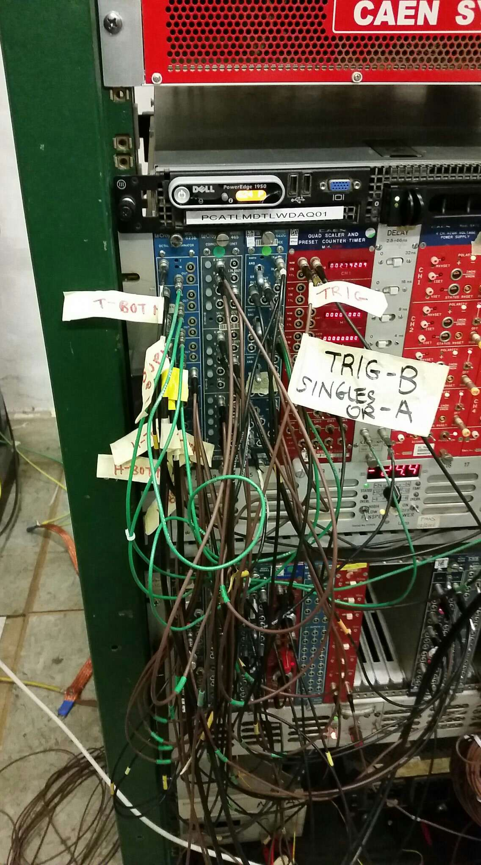
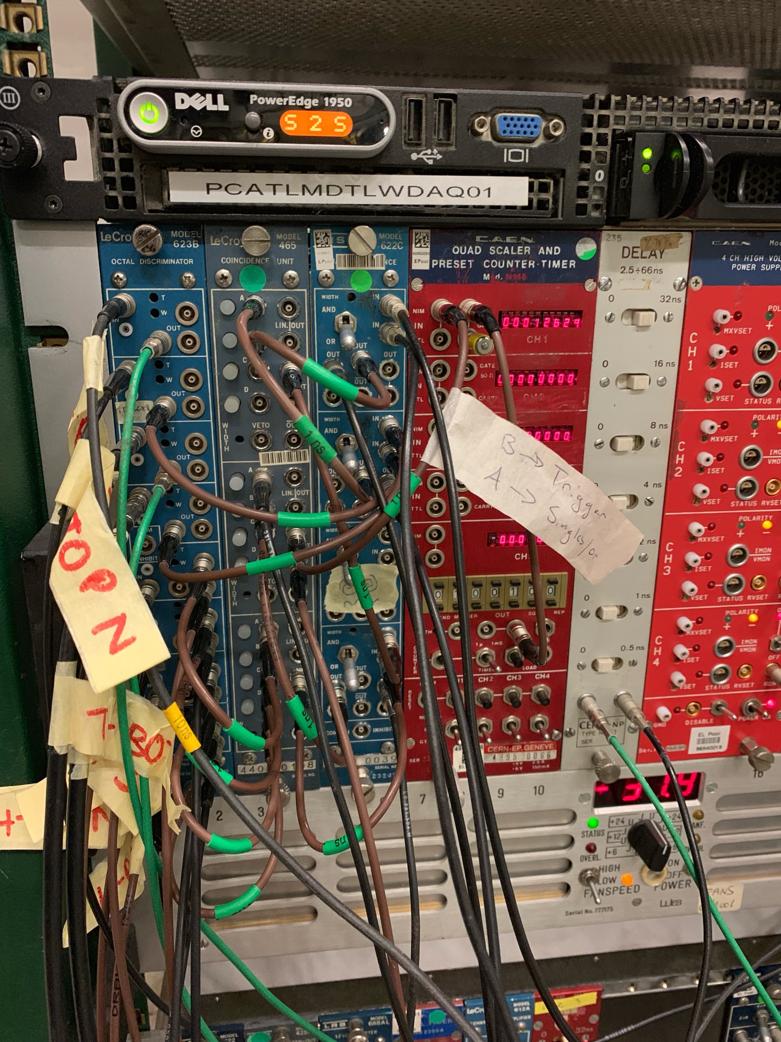
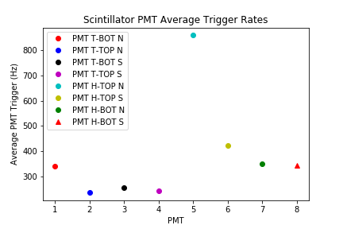
KA
KAHLIL WASSELL’S RECENT PROJECTS
The start of this week I have been working pretty intensely with the two sets of scintillators in the lab.
Cooper, Zach, and I rewired the scintillator setup so that the wires were shorter, because the initial cords were far too long. This made figuring where each set of wires went much easier than before.
Cooper and I also gathered quite a bit of data using the scintillators to make sure that they were working correctly, as well as the associated machinery. We discovered that one of the scintillators has a light leak.

