Slide 1
Select campaign based on lead’s type
Choose one from below.
L2
L3
L4
Proceed

Slide 2
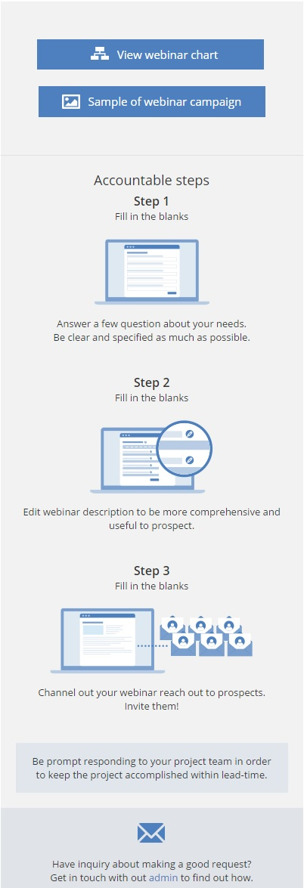

L3 - Webinar
Introduction Video
About Webinar campaign
You can proceed this in 15 sec…

Slide 3
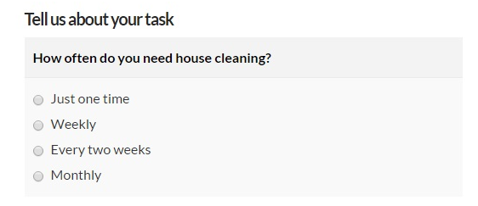
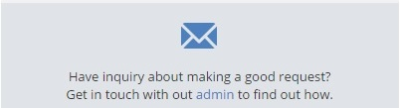
Fill in Webinar Brief
Webinar brief video
Webinar brief
Please fill in the questionnaire in below.
Define objective
Introduction of the webinar
What are the unique selling points that prospects would discover from the webinar? Give 3.
(Refer to https://docs.google.com/document/d/1ku5La5wDURxvEdMbj-tkH_HLmUNfo6rBX7XNOrzhcS4/edit)
Save & Continue it later
Submit >

Slide 4
WEBINAR CHART
CAMPAIGN - WEBINAR
SETUP
WEBINAR BRIEF
I’m here!
EVENT PAGE
PRE-
1 OCT
! Warning
You should first complete the event page ☺
PPC
SOCIAL
EMAIL SIGNATURE
3 OCT
3 OCT
2 OCT
EMAIL BLAST
PRESO DECK
7 OCT
31 OCT
LIVE
DURING
5 NOV
DOWNLOAD PAGE
6 NOV
POST-
CLOSE
7 NOV
Notes:
After submission’s interface - http://mira.quintiq.com/job-setup/job-request-structure.php?id=36437&sequenceID=1

Slide 5
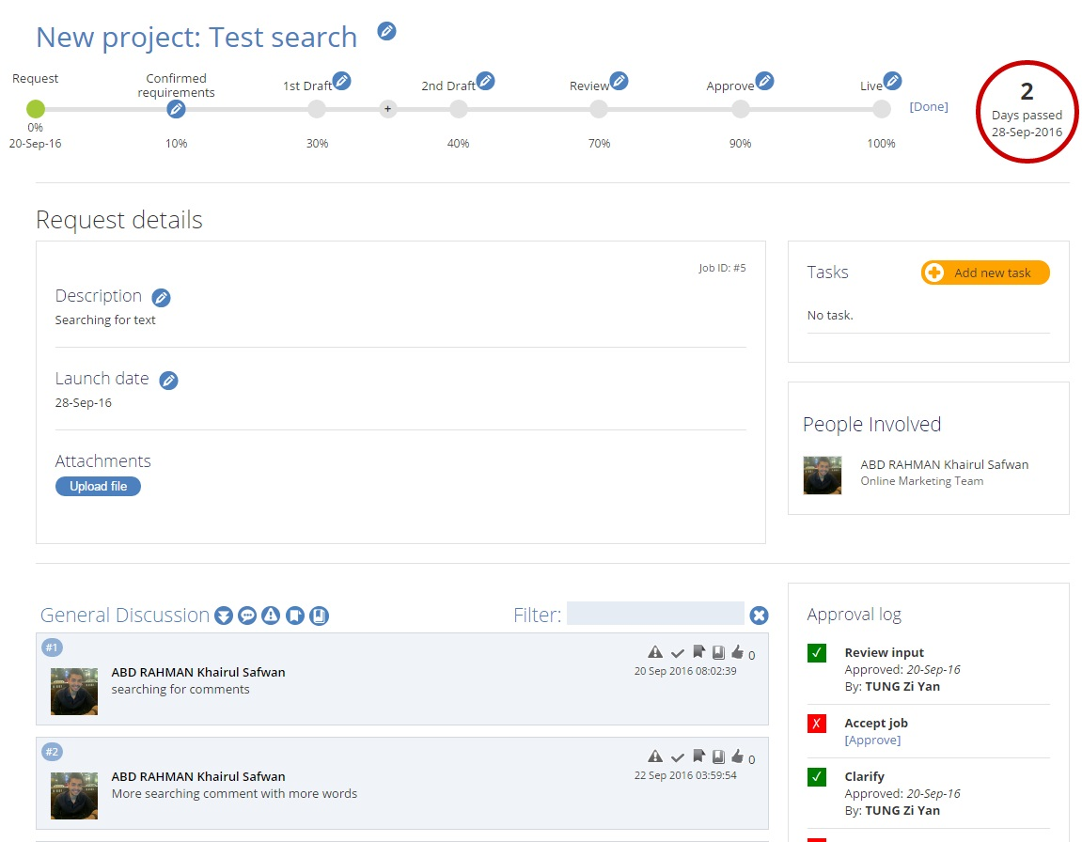
EDUCATIONAL VIDEO FOR EVENT PAGE
Event page video
Guidelines
Write your webinar’s brief to make it informative but concise explain about why you want to host a webinar to prospects
Work with copywriter to ensure the content is edited professionally fit on Quintiq.com
You should go through the content from top to bottom just to ensure it fits your requirements
Approve it if you are very confident that the event page is good to go live.
Start with my event page>

Slide 6
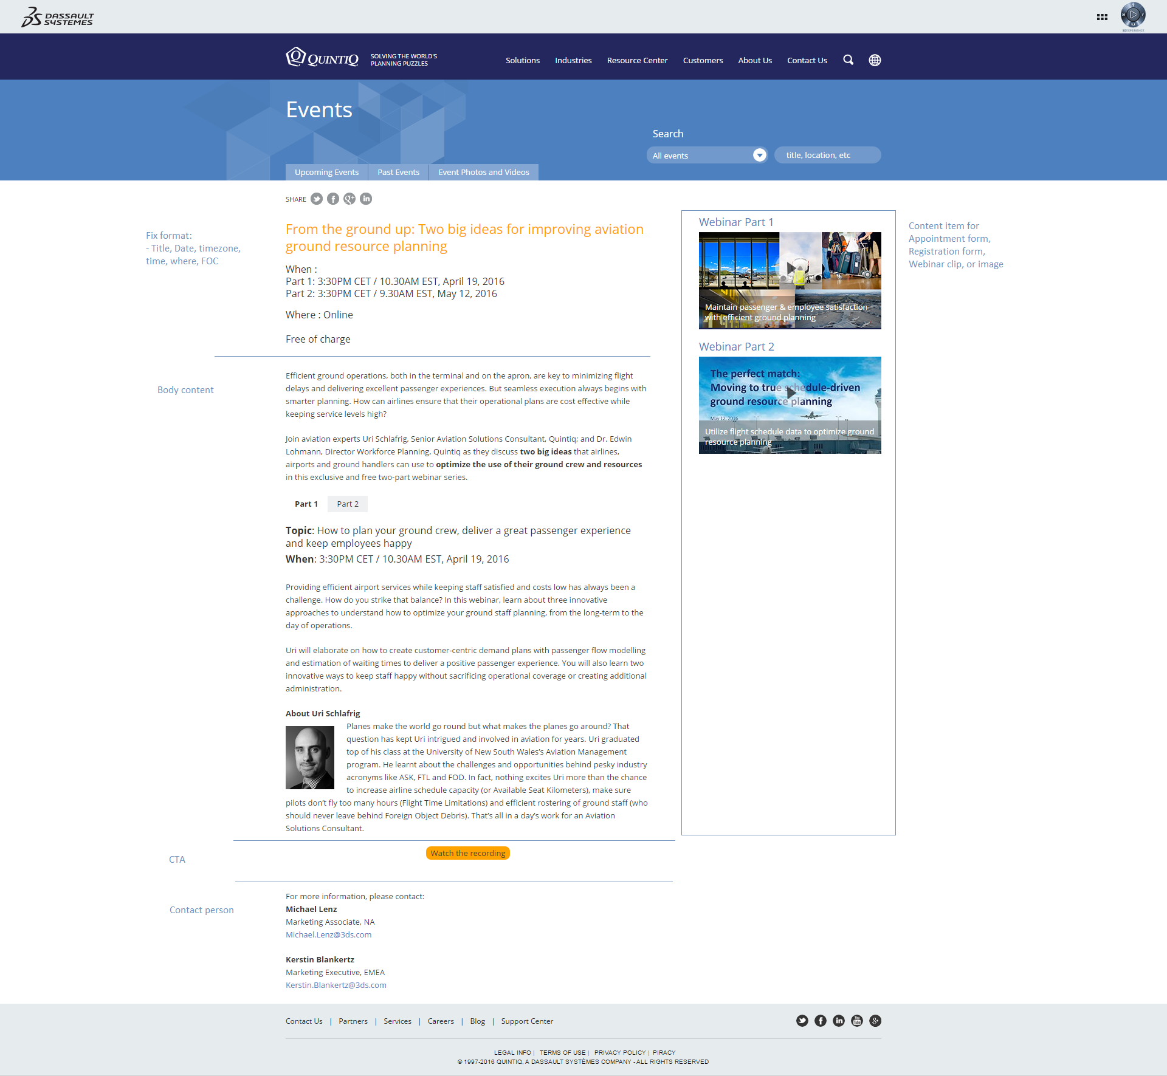
EDIT IN CMS
MIRA
Preview
Slide 8
Slide 7
SAVE
SAVE
SAVE

Slide 7
EDIT IN CMS
MIRA
Preview
Slide 7
Slide 8
Do you want to confirm the event page’s description is final now and aligned to BU’s direction?
SAVE
Hold on. I need more time to fine-tune
Confirmed to proceed >
SAVE
Slide 10 with “Not ready” statement in progress
Slide 10 with “Confirmed” statement in progress
SAVE

Slide 8








EVENT PAGE IN MIRA
Webinar brief
Self-explanatory video
I’m here!
20 SEP
ETA
ETA
ETA
3
ETA
1
OCT
MIRA
Setup
Copy
Image
Form
Approval
Launch
Assigned
in
People involved
Edit page
Live event page
Requester
Event page’s progress log
Monique has just confirmed event page’s description (dd.mm.yyyy)
Event page is being reviewed (dd.mm.yyyy)
John is assigned to copywriting (dd.mm.yyyy)
Auto-tagged
Executor
Auto-tagged
Auto-tagged
Threads
LOG
Notes:
http://maas.quintiq.com/modules/project-summary.php?id=5

Slide 9
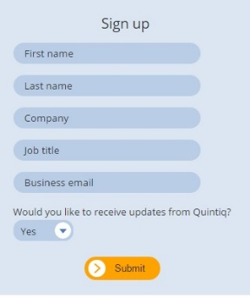
EVENT PAGE PREVIEW
Edit event page >
Confirm

Slide 10
AUTO-CALCULATE LAUNCH DATE
CAMPAIGN - WEBINAR
SETUP
EVENT PAGE
PRE-
I’m here!
PPC
SOCIAL
EMAIL SIGNATURE
EMAIL BLAST
PRESO DECK
LIVE
DURING
DOWNLOAD PAGE
POST-
CLOSE
Notes:
Lead-time : 7 business day

Slide 11

EMAIL SIG. BANNER IN MIRA
Webinar brief
Event page URL
I’m here!
20 SEP
ETA
ETA
ETA
2
OCT
MIRA
Setup
Design
Publish
Approval
Launch
People involved
See slide 11
Requester
(Accountable message)
Email signature banner is being progressed. Banner will be posted by designer soon. Stay tuned!
Guideline on how to download email signature banner
Guideline on how to attach banner into email
Design lead
Design Executor
Threads
LOG
Notes:
download email signature banner
http://www.omt-gdc.com/banners/email-signature.php
how to attach banner into email
http://www.quintiq.com/brand/content/downloads/signature/Quintiq%20signature%20for%20Outlook%20email.docx

Slide 12
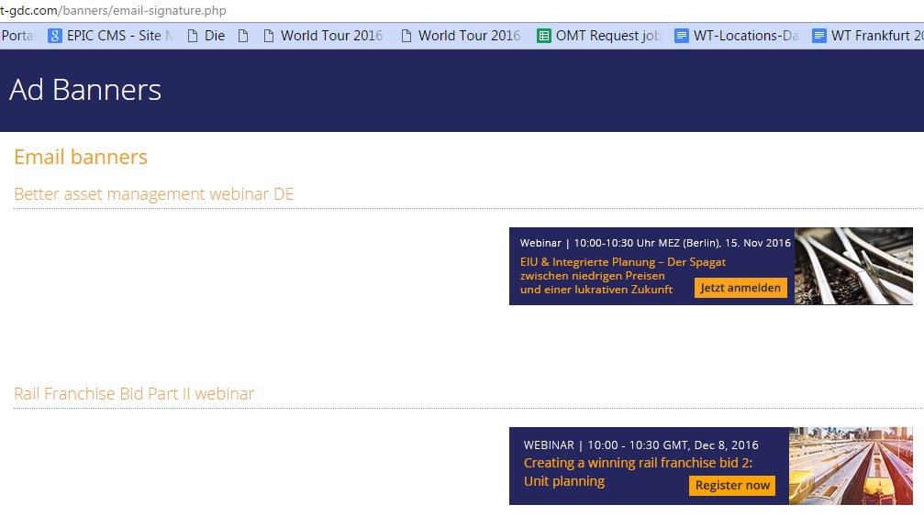
Feature
Add in filters (Search)
Categories (Search)
Archived
Notes:
http://www.omt-gdc.com/banners/email-signature.php

Slide 13
AUTO-CALCULATE LAUNCH DATE
CAMPAIGN - WEBINAR
SETUP
EVENT PAGE
PRE-
PPC
SOCIAL
EMAIL SIGNATURE
I’m here!
EMAIL BLAST
PRESO DECK
LIVE
DURING
DOWNLOAD PAGE
POST-
CLOSE
Notes:
Lead-time : 7 business day

Slide 14
EDUCATIONAL VIDEO FOR EMAIL BLAST
Self-explanatory video
Guidelines
Decide segmentation or name accounts who you want them to join webinar
Draft your message and provide with your speakers and some highlights about webinar in Email invites
Work with writer later to get your message edited and checked
Check if everything is all set
Give your approval
Submit >

Slide 15
EMAIL BLAST
Webinar brief
Event page URL
Self-explanatory video
I’m here!
20 SEP
ETA
ETA
ETA
7
OCT
MIRA
Setup
Copy
Approval
Blast
Launch
Assigned
in
People involved
(Accountable message)
Salesforce campaign ID
Marketo campaign ID
GotoWebinar ID (Applicable for only Quintiq registration form)
Requester
See slide 15
Auto-tagged
Auto-tagged
Executor
Add new feature
Threads
LOG
Notes:
Standard email x 3
First invite
Invitation reminder
Last chance
Thank you for attending*
No show*

Slide 16
Feature
First invite [Standard release date]
Invitation reminder [Standard release date]
Last chance [Standard release date]
Notes:
Issue:
1. Lost track
Forth and back to upload, review, and install email copy, in different time and day
2. Confusion by different terms and language
To requesters, it's all called emails invites
To writers - Invite 1, First reminder, second invite bla
In Marketo - different labels (Invitation, Invitation Reminder, Inviation Last Chance)
3. Nobody knows the status
Whether gotoWebinar/ SF is already created

Slide 17
PRESO DECK
Webinar brief
Event page URL
I’m here!
20 SEP
ETA
ETA
27
OCT
MIRA
Setup
Format
Approval
Launch
(Accountable message)
Your project team will assist to format your webinar deck for presentation use. The purpose of formatting is to make the deck neat and reader-friendly during the live time of presentation.
Please note that content and notes in your deck are not be in the scope of edit and format.
*We do not entertain a half-baked deck to avoid redundancy
Please upload your final presentation deck.
People involved
Uploader
Requester
Lorraine
Execute designer
Event page’s progress log
Monique has just submitted presentation deck (dd.mm.yyyy)
Deck is being reviewed (dd.mm.yyyy)
Lorraine has checked-in to pick up the formatting job (dd.mm.yyyy)
Threads
LOG
Notes:
Standard

Slide 18
DOWNLOAD PAGE
Webinar brief
Event page URL
Preso Deck
I’m here!
20 SEP
ETA
ETA
ETA
ETA
27
OCT
MIRA
Setup
Copy
Thumbnails
Video
editing
Download page
setup
Launch
(Accountable message)
There is a standard process to get webinar video published on Quintiq website as following:
BU first to submit in with webinar recording
Project team can then proceed to prepare for the publish. The publish efforts cover editing webinar recording, writing a generic teaser copy for download page, and also set up a landing page in order to publish.
BU, please provide the link that you upload with webinar recording.
People involved
Slide 20
Requester
Eugene
Execute writer
Execute designer
Publisher
URL field
Webinar download page’s progress log
Formatted preso deck is available (dd.mm.yyyy)
Monique has just submitted webinar recording (dd.mm.yyyy)
Request is being reviewed (dd.mm.yyyy)
John has checked-in to pick up the copywriting (dd.mm.yyyy)
Celine has checked-in to pick up the design (dd.mm.yyyy)
Eugene has checked-in to pick up the video editing (dd.mm.yyyy)
Threads
LOG

Slide 19
Info for Webinar recording upload
We avoid using direct-upload method because it might corrupt your recording or occur that the recording has problem to download in other countries.
Please use 3DS Transfer, or VIMEO. Do ensure you have tested the download is fine and no corrupt in file.

Slide 20
Timeline
5-WEEK
PRE-
POST-
2 weeks
3 weeks
2 days
Leads-
Gen
period
1
2
3
4
Webinar Brief Submission in MIRA
Set up & Launch campaigns
Webinar
Day
Download page

Slide 21
Service items reference (lead-time)
Event page (6)
Email signature banner (1)
Email blast (5)
DAA (2)
Social (5)
Preso deck (3)
Download page (3)

Slide 22
CONCLUSION
2 weeks complete all launch for Pre- items
2 days for Post- item
3 weeks leads-gen period
In general, < 1.5 months to accomplish a webinar campaign

