Slide 1
Lecture 1 Introduction to Python
ITP4869 Analysis with Programming Tools
(AY 2018/19)
Dr. Johnny Cheng

Slide 2
Module Intended Learning Outcomes
On completion of the module, students are expected to be able to:
Identify basic data types, program structures, and build-in libraries of Python;
Utilize popular packages with Python to solve data analysis problems;
Visualize data with Python; and
Develop programs to solve analytic tasks on Apache Spark.

Slide 3
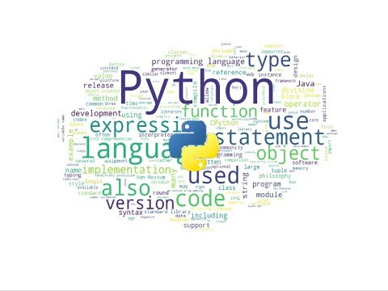
Lesson Intended Learning Outcomes
On completion of this lesson, students are expected to be able to:
Identify the language basics of Python.
Install Python on PC systems.
Get started with Python.

Slide 4

Language Basics
What is Python?
Timeline of Programming Languages
Popularity of Python
Applications for Python

Slide 5
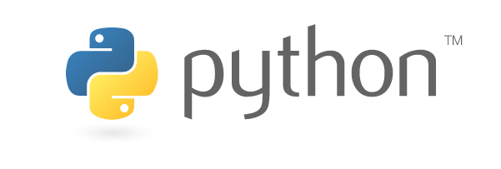
What is Python?
Python is a widely used high-level, general-purpose, interpreted, dynamic programming language.
Its design philosophy emphasizes code readability, and its syntax allows programmers to express concepts in fewer lines of code than possible in languages such as C++ or Java.
The language provides constructs intended to enable clear programs on both a small and large scale.

Slide 6
What is Python? (cont.)
Python
def hello():
print("Hello World!")
Java
class HelloWorld {
public static void main(String args{}) {
System.out.println("Hello World!");
}
}
C++
#include <iostream.h>
main() {
cout << "Hello World!" << endl;
return 0;
}

Slide 7
What is Python? (cont.)
Python supports multiple programming paradigms, including:
Object-oriented
Procedural
Functional
It features a dynamic type system and automatic memory management.
It has a large and comprehensive standard library.

Slide 8
Timeline of Programming Languages
1957
Fortran
1959
LISP
1960
COBOL
1964
BASIC
1970
Pascal
1972
C
Prolog
SQL
1980
Ada
1983
C++
1991
Python
1993
R
1995
Java
PHP
JavaScript

Slide 9
Popularity of Python
The popularity of Python has risen steadily over the past 15 years, finally breaking the top 5 on the Tiobe Index a few years ago.
This is because Python is a major language in some of most exciting technologies today.
Machine learning, artificial intelligence (AI), Big Data, and Robotics all rely heavily on Python.
Robotics also relies on C for its use in systems programming.
Cyber Security, one of the top software challenges of our time, is also driven by Python.

Slide 10
Popularity of Python
It’s surprising how simple Python is to learn.
It’s now the most popular introductory language taught in universities.
It’s often picked up by experienced developers as a second or third language.

Slide 11
Applications for Python
Web and Internet Development
Database Access
Scientific and Numeric
Education
Desktop GUIs
Software & Game Development
Network Programming
Data Analysis
Machine Learning
Data Mining

Slide 12
Installing Python
Installing Standard Python
Alternative Bundles

Slide 13
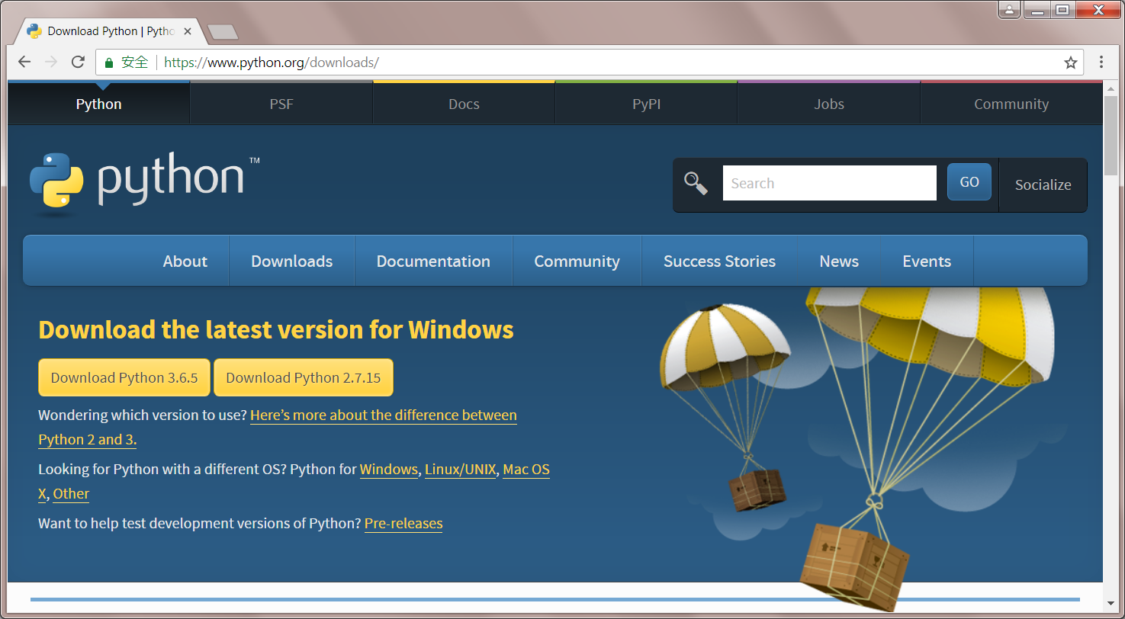
Installing Standard Python
Download the latest version for Windows:
https://www.python.org/downloads/
Install Python:
Navigate to the download location on your computer, double clicking the file and pressing Run when the dialog box pops up.

Slide 14
Alternative Bundles
ActivePython
Installer with multi-platform compatibility, documentation, PyWin32
Anaconda (https://www.anaconda.com/download/)
Popular scientific modules (such as numpy, scipy and pandas) and the conda package manager.
Canopy
A “comprehensive Python analysis environment” with editors and other development tools.
WinPython
Windows-specific distribution with prebuilt scientific packages and tools for building packages.

Slide 15
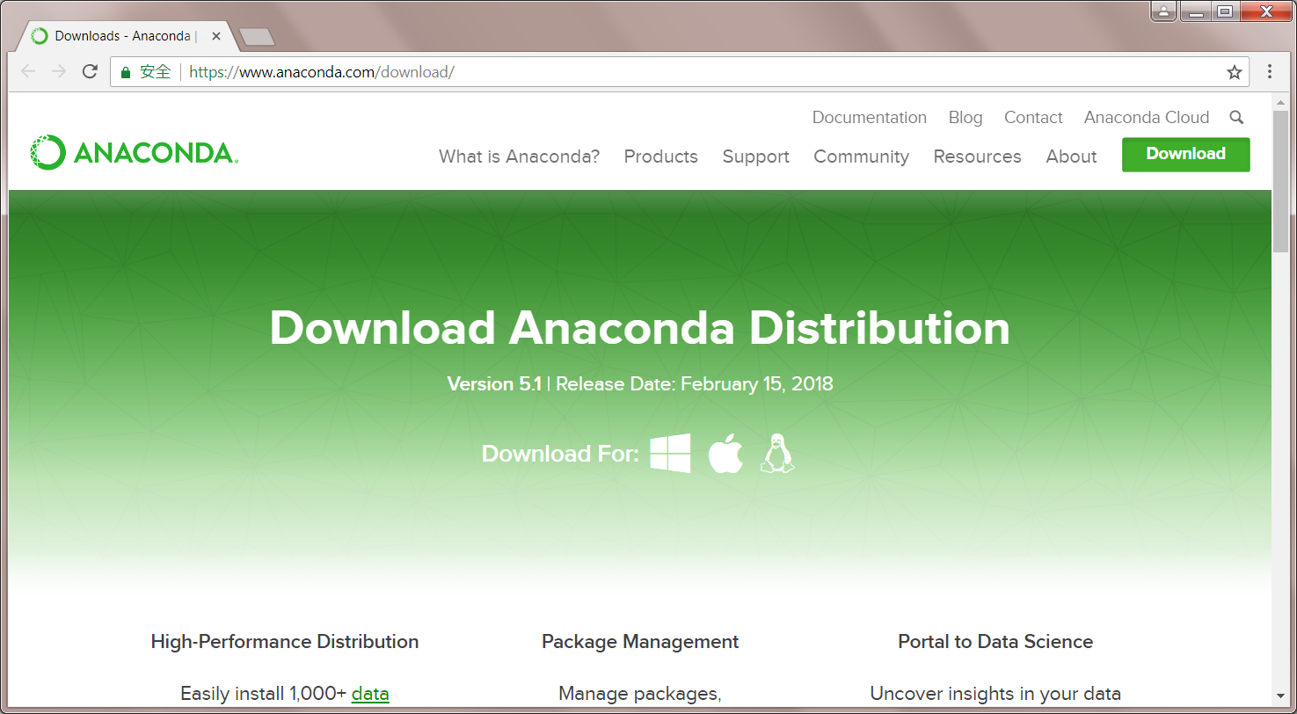
Anaconda

Slide 16
Getting Started with Python
Starting the Python Interpreter
Writing Python Scripts
Modules and Functions in Python
Saving a Python Script into a File
Executing a Python Script

Slide 17
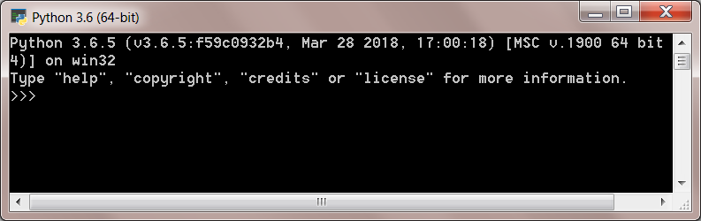
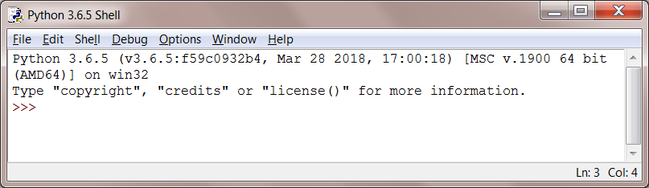
Starting the Python Interpreter
Open the Python’s Interpreter by pressing “Start” and navigating “Python 3.6” and selecting the “Python 3.6 (64-bit)” or “IDLE (Python 3.6 64-bit)”.

Slide 18
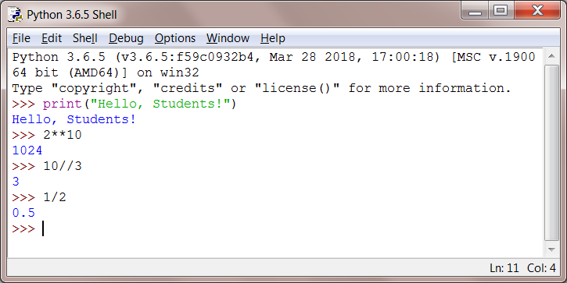
Writing Python Scripts
Try to write some scripts as follows:

Slide 19
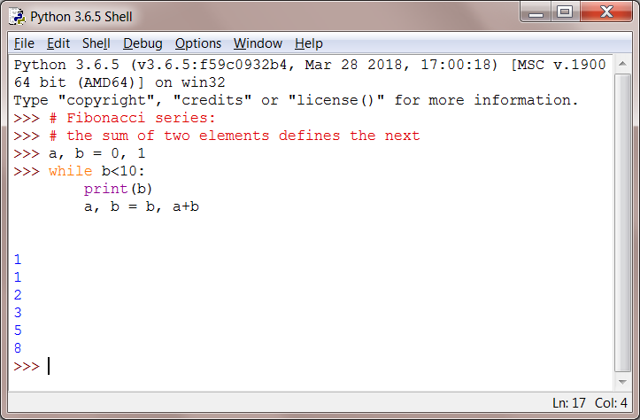
Writing Python Scripts (cont.)
Try some other scripts:

Slide 20
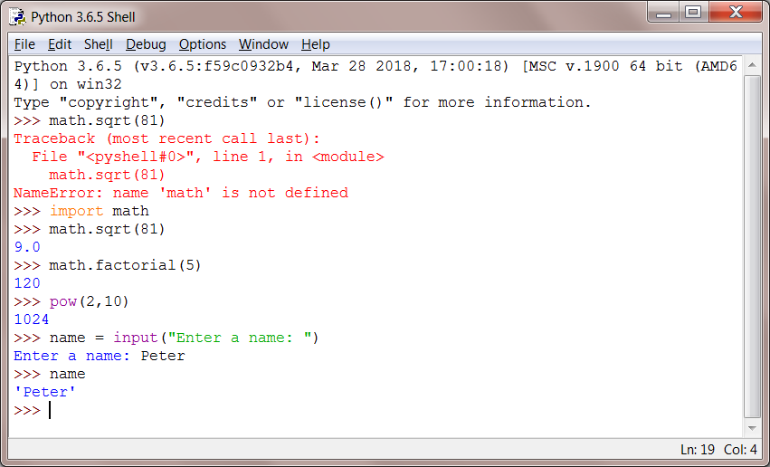
Modules and Functions in Python
Try the following scripts:
‘math’ is a module and ‘sqrt’ & ‘factorial’ are functions of ‘math’

Slide 21
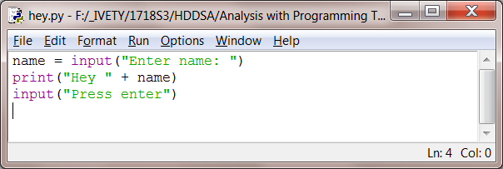
Saving a Python Script into a File
Create a new Python script file from the Python Shell:
File → New File (or Ctrl+N)
Enter some Python script
Save it with a file extension “py”

Slide 22
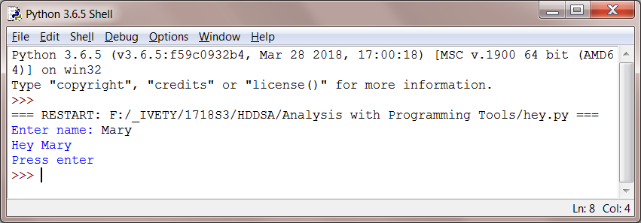
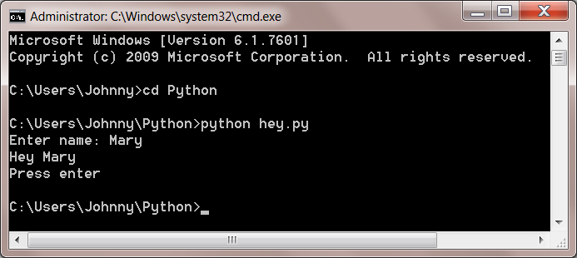
Executing a Python Script
Run your Python script at:
Run → Run Module OR
Command Window (python hey.py)

Slide 23
Self Study Guide

Slide 24
Self Study Guide
Reference
Tony Gaddis (2018). Starting Out with Python, 4th ed., Pearson.
(Read Ch. 1.5, 2.3, 2.6, and 2.7)
Wikipedia
https://en.wikipedia.org/wiki/Python_(programming_language)
Python Official Website
http://www.python.org
Python Documentation
https://docs.python.org/3.6/

