Slide 1
Lecture 2 Data Types and Objects
ITP4869 Analysis with Programming Tools
(AY 2018/19)
Dr. Johnny Cheng

Slide 2
Lessons Intended Learning Outcomes
On completion of this lesson, students are expected to be able to:
Distinguish among the major data objects in Python, including numbers, strings, lists, dictionaries, tuples, and sets;
Identifies the properties of various objects;
Perform the basic operations of various objects; and
Perform the basic string formatting.

Slide 3
Types and Objects
Types versus Objects
Checking Object Types
Object Assignment in Python

Slide 4
Types versus Objects
Objects are Python’s abstraction for data.
All data in a Python program is represented by objects or by relations between objects.
Every object has an identity, a type and a value.
An object’s identity never changes once it has been created; you may think of it as the object’s address in memory.
The ‘is’ operator compares the identity of two objects.
The id() function returns an integer representing its identity, i.e., the memory address of the object.

Slide 5
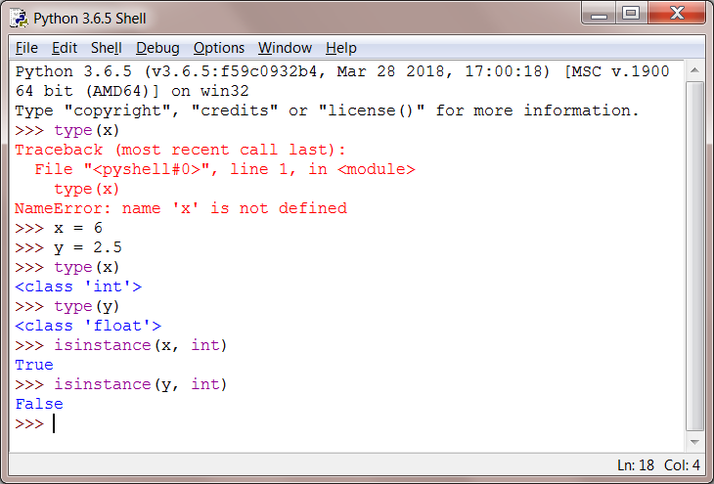
Checking Type of an Object
The type() function returns the type of an object.
The isinstance() function determines whether an object belongs to a specific type.

Slide 6
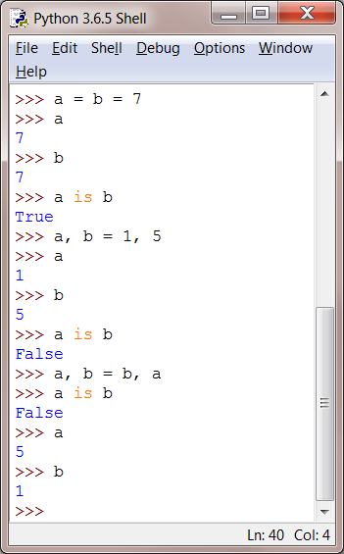
Object Assignment in Python
We are the assignment statement to place a value into a variable.
amount = 500
Do not confuse the assignment operator (=) with the equality operator (==).
Multiple assignments
a = b = 5 //right to left
a, b = 1, 5
a, b = b, a
//Evaluate the entire RHS first

Slide 7
Numbers
Types of Numbers
Basic Arithmetic
Mathematical Functions

Slide 8
Types of Numbers
Python has various "types" of numbers (numeric literals).
We'll mainly focus on integers and floating point numbers.
Integers are just whole numbers, positive or negative.
For example: 2 and -2 are examples of integers.
Floating point numbers in Python are notable because they have a decimal point in them, or use an exponential(e) to define the number.
For example: 1.2, -0.5, 2e2, 3E-2
3×10⁻²=0.03

Slide 9
Basic Arithmetic
Basic arithmetic operators: +, -, *, /, //, **, %.
Note: / - division
// - integer division or floor division
% - remainder
** - power
Operation | Output
2+1 | 3
2-1 | 1
3*2 | 6
3/2 | 1.5
Operation | Output
7/5 | 1.4
7//5 | 1
7%4 | 3
2**5 | 32

Slide 10
Mathematical Functions
Python has a standard library that provides functions and data types for your code.
Python’s standard library is organized into modules.
Related functions and data types are grouped into the same module.
Python’s math module includes a number of mathematical functions.
For example,
>>> from math import sqrt
>>> sqrt(16)
4.0
>>> import math
>>> math.sqrt(16)
4.0
OR

Slide 11
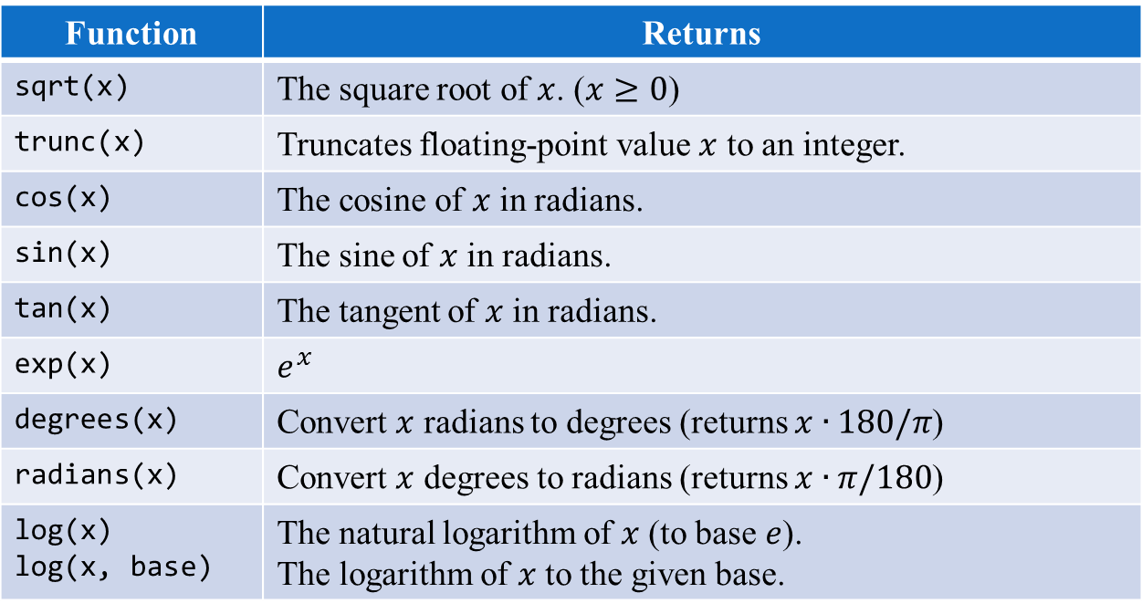
Mathematical Functions
Selected Functions in the math Module
Function | Returns
sqrt(x) | The square root of $x$. ($x≥0$)
trunc(x) | Truncates floating-point value $x$ to an integer.
cos(x) | The cosine of $x$ in radians.
sin(x) | The sine of $x$ in radians.
tan(x) | The tangent of $x$ in radians.
exp(x) | $$e^{x}$$
degrees(x) | Convert $x$ radians to degrees (returns $x∙180/π$)
radians(x) | Convert $x$ degrees to radians (returns $x∙π/180$)
log(x) log(x, base) | The natural logarithm of $x$ (to base $e$). The logarithm of $x$ to the given base.

Slide 12
Strings
Representation of Strings
String Indexing & Slicing
Built-in String Operations

Slide 13
Representation of Strings
Strings are used in Python to record text information, such as name.
Strings in Python are actually a sequence.
For example, Python understands the string ‘hello’ to be a sequence of letters in a specific order.
This means we will be able to use indexing to grab particular letters (like the first letter, or the last letter).
Note that strings in Python are immutable (unchangeable).
Once a string is defined, we cannot change any part of its contents.

Slide 14
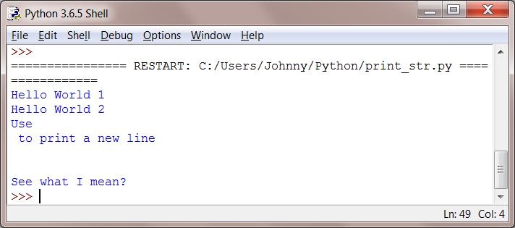
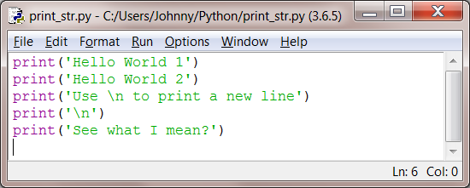
Representation of Strings
Here are some examples of strings.
s = ‘This is a string’
t = “This is also a string”
We can use a print statement to print a string.

Slide 15
String Indexing & Slicing
We know strings are a sequence, which means Python can use indexes to call parts of the sequence.
In Python, we use brackets [] after an object to call its index.
We should also note that indexing starts at 0 for Python.
Let's create a new object called s and the walk through a few examples of indexing and slicing.

Slide 16
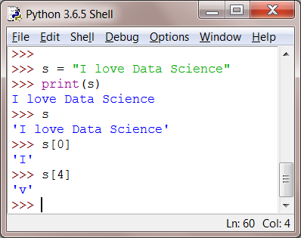
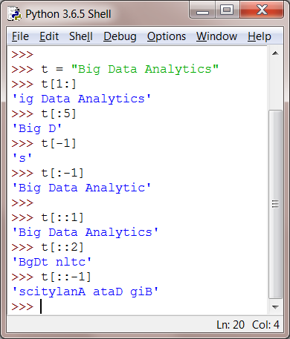
String Indexing & Slicing (cont.)
Slicing
Indexing

Slide 17
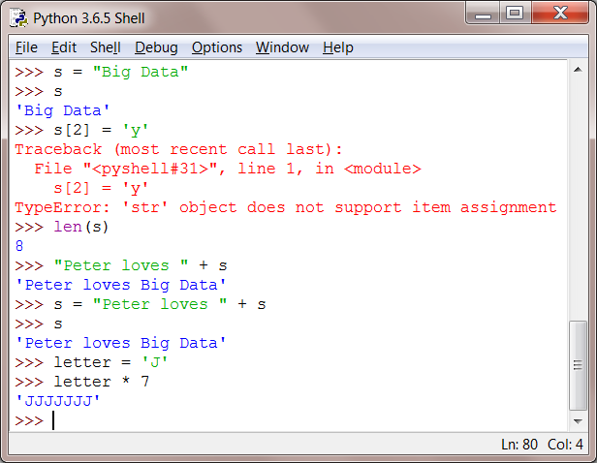
Built-in String Operations
Immutable

Slide 18
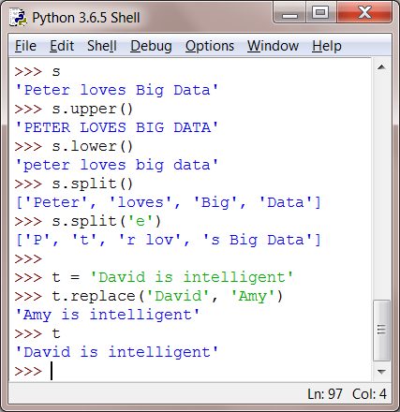
Built-in String Operations (cont.)
Here are some more examples of built-in operations in strings:

Slide 19
Print Formatting

Slide 20
Print Formatting
We will briefly cover the various ways to format your print statements.
You can use the %s to format strings into your print statements.
>>> s = 'PYTHON'
>>> print('Place another string like this: %s' %(s))
Place another string like this: PYTHON
Integers can be formatted as follows:
>>> print('Integer: %1d' %(12345))
Integer: 12345
>>> print('Integer: %10d' %(12345))
Integer: 12345

Slide 21
Print Formatting (cont.)
Floating point numbers can be formatted as follows:
>>> print('floating point numbers: %1.2f' %(123.456))
floating point numbers: 123.46
>>> print('floating point numbers: %1.0f' %(123.456))
floating point numbers: 123
>>> print('floating point numbers: %1.5f' %(123.456))
floating point numbers: 123.45600
>>> print('floating point numbers: %10.2f' %(123.456))
floating point numbers: 123.46

Slide 22
Print Formatting (cont.)
Two methods %s and %r actually convert any python object to a string.
>>> print('Here is a number: %s. Here is a string: %s' %(123.1,'hi'))
Here is a number: 123.1. Here is a string: hi
>>> print('Here is a number: %r. Here is a string: %r' %(123.1,'hi'))
Here is a number: 123.1. Here is a string: 'hi'
>>> print('First: %s, Second: %1.2f, Third: %r' %('hi!',3.14,22))
First: hi!, Second: 3.14, Third: 22

Slide 23
Print Formatting (cont.)
The best way to format objects into your strings for print statements is using the format method.
The syntax is:
'String here {var1} then also {var2}'.format(var1 = 'something1',var2 = 'something2')
Lets see some examples:
>>> print('Object 1: {a}, Object 2: {b}, Object 3: {c}'.format(a=1, b='two', c=12.3))
Object 1: 1, Object 2: two, Object 3: 12.3
That is the basics of string formatting!

Slide 24
Lists
List Basics
List Operations
Nesting Lists
List Comprehension

Slide 25
List Basics
Lists can be thought of the most general version of a sequence in Python.
Unlike strings, they are mutable, meaning the elements inside a list can be changed!
Lists are constructed with brackets [] and commas separating every element in the list.
>>> my_list = [1, 2, 3]
>>> len(my_list)
3
Let's go ahead to see more examples!

Slide 26
List Operations
Indexing and slicing works just like in strings.
>>> my_list = ['one','two','three',4,5]
>>> my_list[0]
'one'
>>> my_list[1:]
['two', 'three', 4, 5]
>>> my_list[:3]
['one', 'two', 'three']
>>> my_list + ['new item']
['one', 'two', 'three', 4, 5, 'new item']
>>> my_list = my_list + ['add new item permanently']
>>> my_list
['one', 'two', 'three', 4, 5, 'add new item permanently']
>>> my_list * 2
['one', 'two', 'three', 4, 5, 'add new item permanently', 'one', 'two', 'three', 4, 5, 'add new item permanently']

Slide 27
List Operations (cont.)
Lists in Python however, tend to be more flexible than arrays in other languages for a two good reasons:
They have no fixed size, and
They have no fixed type constraint.
Use the append method to permanently add an item to the end of a list:
>>> l = [1,2,3]
>>> l.append('append me!')
>>> l
[1, 2, 3, 'append me!']

Slide 28
List Operations (cont.)
Use pop to "pop off" an item from the list.
By default pop takes off the last index, but you can also specify which index to pop off.
>>> l
[1, 2, 3, 'append me!']
>>> l.pop(0)
1
>>> l
[2, 3, 'append me!']
>>> l.pop()
'append me!'
>>> l
[2, 3]

Slide 29
List Operations (cont.)
We can use the sort method and the reverse methods to also effect your lists:
>>> new_list = ['a','e','x','b','c']
>>> new_list.sort()
>>> new_list
['a', 'b', 'c', 'e', 'x']
>>> new_list.reverse()
>>> new_list
['x', 'e', 'c', 'b', 'a']

Slide 30
List Nesting
A great feature of Python data structures is that they support nesting.
This means we can have data structures within data structures.
For example: A list inside a list.
>>> # Let's make three lists
>>> lst_1=[1,2,3]
>>> lst_2=[4,5,6]
>>> lst_3=[7,8,9]
>>> # Make a list of lists to form a matrix
>>> matrix = [lst_1,lst_2,lst_3]
>>> matrix
[[1, 2, 3], [4, 5, 6], [7, 8, 9]]

Slide 31
List Nesting (cont.)
Indexing of nested list is done as follows:
>>> matrix[1]
[4, 5, 6]
>>> matrix[2][2]
9
More operation on list:
>>> matrix * 2
[[1, 2, 3], [4, 5, 6], [7, 8, 9], [1, 2, 3], [4, 5, 6], [7, 8, 9]]

Slide 32
Dictionaries
Dictionary Basics
Dictionary Operations

Slide 33
Dictionary Basics
We’re now going to switch from sequences to mappings.
You can think of these Dictionaries as hash tables.
Mappings are a collection of objects that are stored by a key.
Mappings won't retain order since they have objects defined by a key.
A Python dictionary consists of a key and then an associated value.
That value can be almost any Python object.

Slide 34
Dictionary Basics (cont.)
An empty dictionary without any items is written with just two curly braces, like this: {}.
>>> d = {}
>>> d
{}
Here are some constructions of dictionaries.
>>> my_dict = {'key1':'value1','key2':'value2'}
>>> my_dict['key2']
'value2'
>>> my_dict = {'key1':123,'key2':[12,23,33],'key3': ['item0','item1','item2']}
>>> my_dict['key3']
['item0', 'item1', 'item2']
>>> my_dict['key3'][1]
'item1'

Slide 35
Dictionary Operations
There are a few methods we can call on a dictionary.
Let's get a quick introduction to a few of them:
>>> d = {'key1':1,'key2':2,'key3':3}
>>> d.keys()
dict_keys(['key3', 'key2', 'key1'])
>>> d.values()
dict_values([3, 2, 1])
>>> d.items()
dict_items([('key3', 3), ('key2', 2), ('key1', 1)])
Nesting with dictionaries:
>>> d = {'key1':{'nestkey':{'subnestkey':'value'}}}
>>> d['key1']['nestkey']['subnestkey']
'value'

Slide 36
Tuples
Tuple Basics
Tuple Operations

Slide 37
Tuple Basics
In Python tuples are very similar to lists.
However, unlike lists they are immutable meaning they can not be changed.
You would use tuples to present things that shouldn't be changed, such as days of the week, or dates on a calendar.
The construction of a tuples use () with elements separated by commas. For example:
>>> t = (1,2,3)
>>> len(t)
3
>>> t = ('one',2)
>>> t[0]
'one'

Slide 38
Tuple Operations
Note that tuples are immutable.
Tuples have built-in methods, but not as many as lists do.
Lets look at two of them:
>>> t = (1,2,3,1,5,3,2,1)
>>> t.index(5)
4
>>> t.count(1)
3
>>> t.count(2)
2

Slide 39
Sets
Set Basics and Operations

Slide 40
Set Basics and Operations
Sets are an unordered collection of unique elements.
We can construct them by using the set() function.
Let's go ahead and make a set to see how it works.
>>> x = set((1, 3, 2, 4, 2, 3, 1, 2, 1))
>>> x
{1, 2, 3, 4}
>>> x = set([1, 3, 2, 4, 2, 3, 1, 2, 1])
>>> x
{1, 2, 3, 4}
>>> y = {1, 2, 3, 4}
>>> type(y)
<class 'set'>

Slide 41
Set Basics and Operations (cont.)
More examples on set operations:
>>> x = set()
>>> x
set()
>>> x.add(2)
>>> x.add(1)
>>> x.add(2)
>>> x
{1, 2}
>>> l = [1,1,2,2,3,4,5,6,1,1]
>>> set(l)
{1, 2, 3, 4, 5, 6}

Slide 42
Booleans
Boolean Basics and Operations

Slide 43
Boolean Basics and Operations
Python comes with Booleans (with predefined True and False displays that are basically just the integers 1 and 0).
Let's walk through a few quick examples of Booleans.
>>> a = True
>>> a
True
>>> type(a)
<class 'bool'>
>>> int(a)
1
>>> 4 > 5
False

Slide 44
Boolean Basics and Operations
We can use None as a placeholder for an object that we don't want to reassign yet:
>>> b = None
>>> type(b)
<class 'NoneType'>

Slide 45
Self Study Guide

Slide 46
Self Study Guide
Reference
Tony Gaddis (2018). Starting Out with Python, 4th ed., Pearson.
(Read Ch. 2.5~2.9, and Ch. 7~9)
Python Official Website
http://www.python.org
Python Documentation
https://docs.python.org/3.6/

