Slide 1
AI-Assisted Diagnosis on HAM10000
The effect of loss functions and sampling on imbalanced skin-cancer classification
Ömer Kahyaoğlu
Student no: 090240741 · kahyaoglu20@itu.edu.tr
MYZ 309E - Artificial Intelligence in Mathematical Engineering · CRN 23577 · Lecturer: Prof. Muhammed Kurulay, PhD · Istanbul Technical University · May 2026

Slide 2
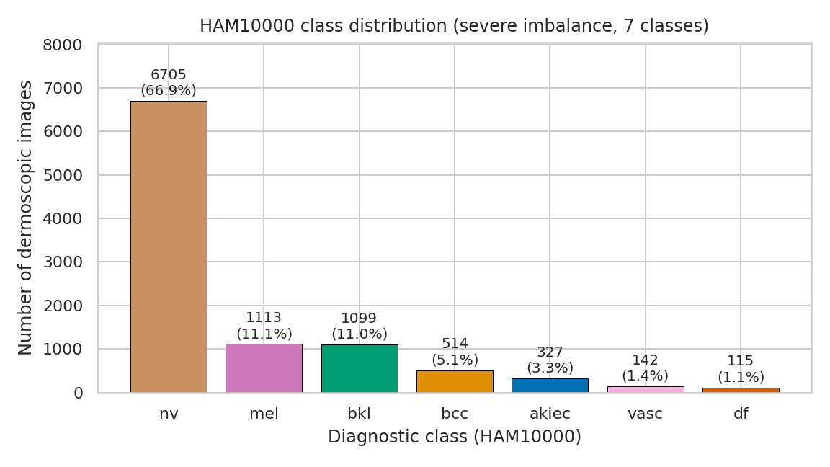
What happens when 67% of your data is one class?
HAM10000: 10,015 dermoscopic images, 7 diagnostic classes
67%
Majority class
(melanocytic nevi)
1.1%
Rarest class
(dermatofibroma)
58x
Imbalance ratio
(majority : minority)
MYZ 309E - HAM10000 Imbalance Study | Kahyaoğlu
2

Slide 3
What does the pipeline look like?
Kaggle download -> stratified 70/15/15 split -> CNN -> imbalance-aware metrics
Local
HAM10000
(10,015)
64x64
Resize + Norm
Conv-BN-ReLU
x 4 blocks
GlobalAvgPool
+ Dropout/FC
Macro-F1
Per-class recall
>
>
>
>
CNN architecture (106,391 trainable parameters)
Conv 3->16 + BN + ReLU + MaxPool 2 (16 x 32 x 32)
Conv 16->32 + BN + ReLU + MaxPool 2 (32 x 16 x 16)
Conv 32->64 + BN + ReLU + MaxPool 2 (64 x 8 x 8)
Conv 64->128 + BN + ReLU + MaxPool 2 (128 x 4 x 4)
GlobalAvgPool -> Dropout(0.4) -> FC 128->64 -> ReLU -> Dropout(0.4) -> FC 64->7
MYZ 309E - HAM10000 Imbalance Study | Kahyaoğlu
3

Slide 4
What if we change the loss function or sampling?
Five configurations - same model, same optimiser, same seed
Experiment | Idea
Standard CE | Baseline; no rebalancing
Weighted CE | Upweight rare classes
Focal Loss | De-emphasise easy examples
Class-Balanced CE | Effective number of samples
Std CE + Sampler | Sampling-side fix
MYZ 309E - HAM10000 Imbalance Study | Kahyaoğlu
4

Slide 5
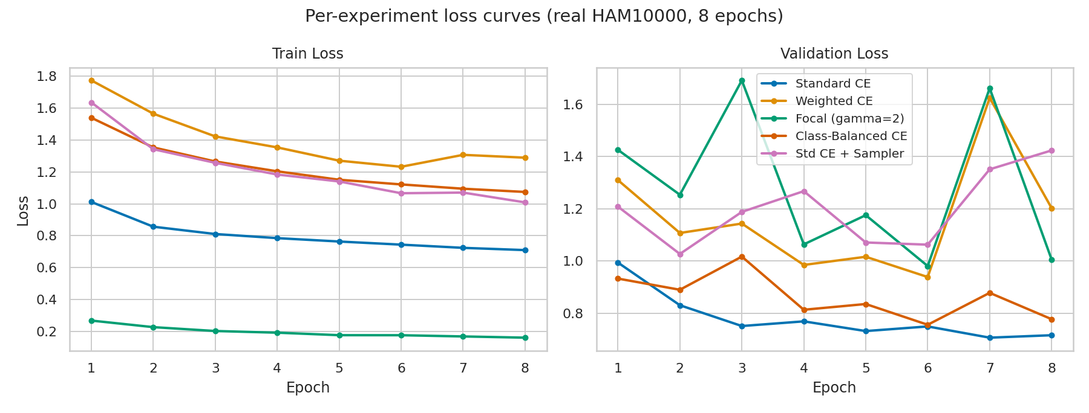
What if we plot the loss across epochs?
Train (left) and validation (right) loss for all five configurations
Reading the curves
Standard CE:
lowest train + val loss - by exploiting the 67% nv prior
Focal:
smallest absolute scale because (1-p_t)^gamma collapses easy examples
Reweighted:
noisier val loss; class weights amplify minority gradient noise
MYZ 309E - HAM10000 Imbalance Study | Kahyaoğlu
5

Slide 6
What if we look beyond accuracy?
Standard CE: 73.6% accuracy AND 0% recall on the rarest class
Experiment | Accuracy | Bal. Acc. | Macro F1 | 'df' Recall
Standard CE | 0.736 | 0.352 | 0.381 | 0.000
Weighted CE | 0.521 | 0.505 | 0.341 | 0.056
Focal Loss (gamma=2) | 0.622 | 0.538 | 0.443 | 0.389
Class-Balanced CE | 0.718 | 0.447 | 0.395 | 0.056
Std CE + Sampler | 0.464 | 0.537 | 0.391 | 0.389
Macro F1 = arithmetic mean of per-class F1 - equal weight to every class. Balanced Acc = mean of per-class recall.
MYZ 309E - HAM10000 Imbalance Study | Kahyaoğlu
6

Slide 7
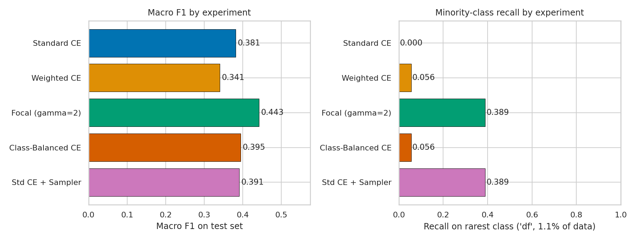
What if we visualise rare-class recall?
Standard CE never predicts df; only Focal and the Sampler meaningfully recover it
MYZ 309E - HAM10000 Imbalance Study | Kahyaoğlu
7

Slide 8
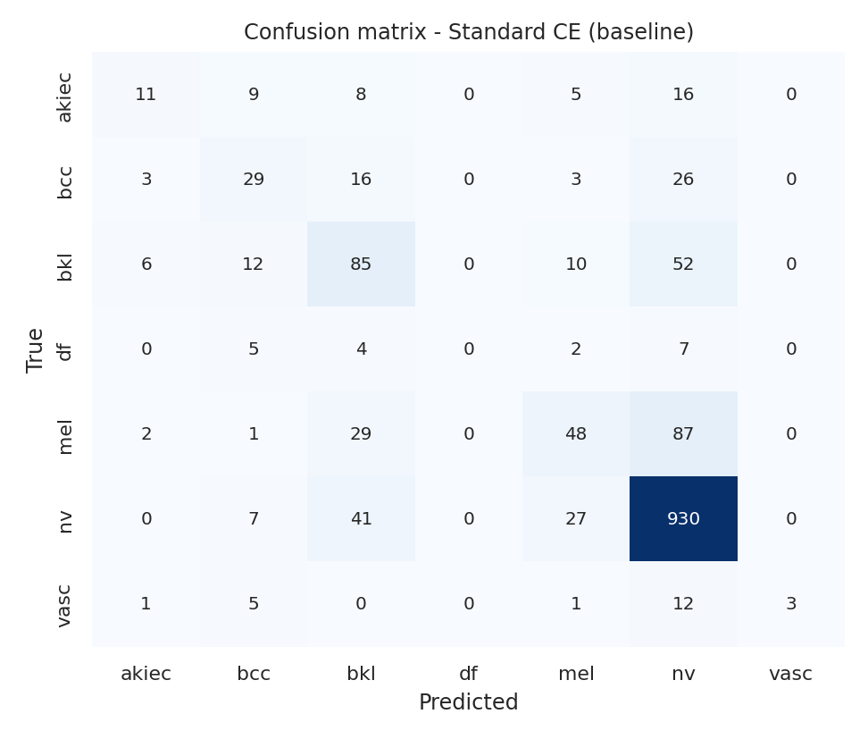
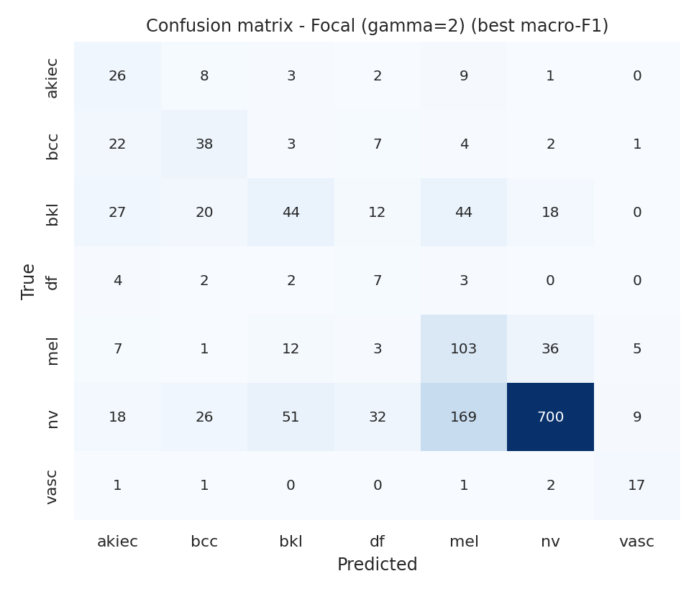
What if we look at the confusion matrix?
All three test-set 'df' samples collapse onto 'nv' in the baseline
Standard CE - df column entirely empty
Focal Loss (best macro F1 = 0.443)
MYZ 309E - HAM10000 Imbalance Study | Kahyaoğlu
8

Slide 9
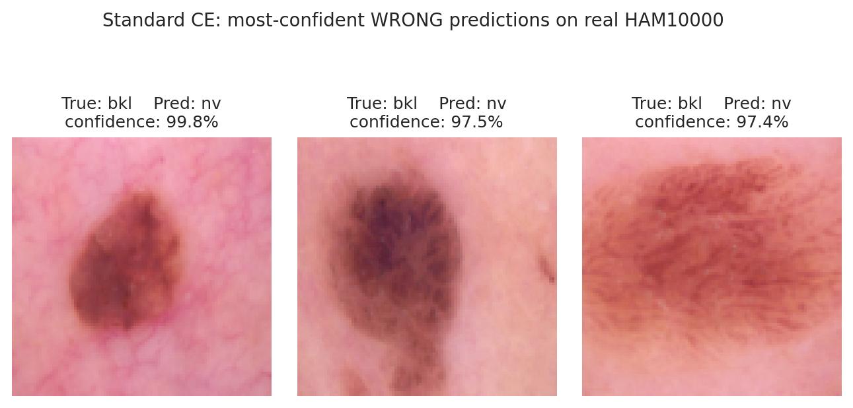
What if we look at where the baseline fails?
Three most-confident WRONG predictions of Standard CE - all true 'bkl' lesions called 'nv' at 97-99.8% confidence
Network has effectively learnt: 'when in doubt, predict the majority class'. Loss reweighting and oversampling fix exactly this.
MYZ 309E - HAM10000 Imbalance Study | Kahyaoğlu
9

Slide 10
What did we learn?
Three findings transferable to any imbalanced classification task
Accuracy is misleading
Standard CE reaches 73.6% accuracy yet 0% recall on the rarest class df, 13.6% on vasc. Always report macro F1 + per-class recall on imbalanced data.
Focal loss wins decisively
Focal reaches macro F1 = 0.443 vs 0.381 for Standard CE; the only loss-side fix that recovers df recall (0% -> 38.9%).
Loss vs sampling: not a tie
WeightedRandomSampler matches Focal on minority recall (38.9%) but at a much larger accuracy cost (46% vs 62%). Pure Weighted CE under-performs both within an 8-epoch budget.
MYZ 309E - HAM10000 Imbalance Study | Kahyaoğlu
10

Slide 11
Thank you - Questions?
What if we kept iterating? Future work below.
- Replace the from-scratch backbone with pretrained ResNet-50 / EfficientNet-B0
- Add the Convolutional Autoencoder denoising stage (hairs, ruler markings, vignettes)
- Calibrate predicted probabilities (temperature scaling) for clinically meaningful confidence
- Test stronger sampling/augmentation: SMOTE-in-feature-space, MixUp, CutMix
- Hierarchical decision: malignant-vs-benign first, subtype second
Ömer Kahyaoğlu · kahyaoglu20@itu.edu.tr · MYZ 309E - May 2026

