Slide 1
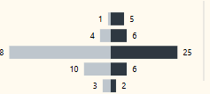

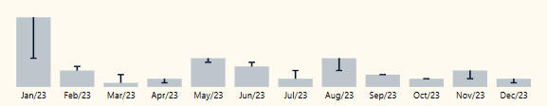



Days of Week
Months of Year
Quarters of Year
Date
150Eur Revenue
350Eur Net Sales
200Eur Total Cost
1000 Sales Volume
Vs PY: +27%
Vs PY: +27%
Vs PY: +27%
Vs PY: +27%
Product Hierarchy
CW vy PY CW per product
Actuals + Predicted Revenue/BG
Promotion
Geography
Actuals + Pred Net Sales/BG
Act + Pred Total Cost/BG
Act + Pred Volume/BG

