Slide 1
Cloud based testing (Android)
October madness 27.10.2016
Kai Molander
Software / Test Automation Developer
VALA Group

Slide 2
Brief
Introduction to three different cloud test platforms
TestDroid (BitBar), Amazon AWS Device Farm and Google Firebase Test Labs
Example project that has a ready made test and works with all three
Instructions for setup on all three (create a project, create a user, enable billing, etc.)
Example test runs on all three

Slide 3
TestDroid (BitBar)
Used via TestDroid Gradle plugin
https://github.com/bitbar/testdroid-gradle-plugin
Create a free account
https://cloud.testdroid.com/
Create a project
Create a device group
(Note that the default groups might not work)
Configure Gradle plugin based on the created settings (account, password, project, device group etc).

Slide 4
TestDroid (continued)
testdroid {
username 'user'
password 'pw'
deviceGroup 'Devices1'
cloudUrl = 'https://cloud.testdroid.com' // Optional - Used for PrivateCloud configs
projectName "CloudDemo" // Optional - Default: create a new project
mode "FULL_RUN" // FULL_RUN / APP_CRAWLER / UI_AUTOMATOR
if (project.hasProperty('argTestRunName')) {
testRunName = project.property('argTestRunName') // Optional
}
scheduler "SINGLE" // Optional - PARALLEL or SERIAL default: PARALLEL
// Optional - Custom settings for test execution
fullRunConfig {
instrumentationRunner = "android.support.test.runner.AndroidJUnitRunner"
limitationType = "PACKAGE"
limitationValue = "com.octoberm.cloudtestdemo.test.testcases"
}
}

Slide 5
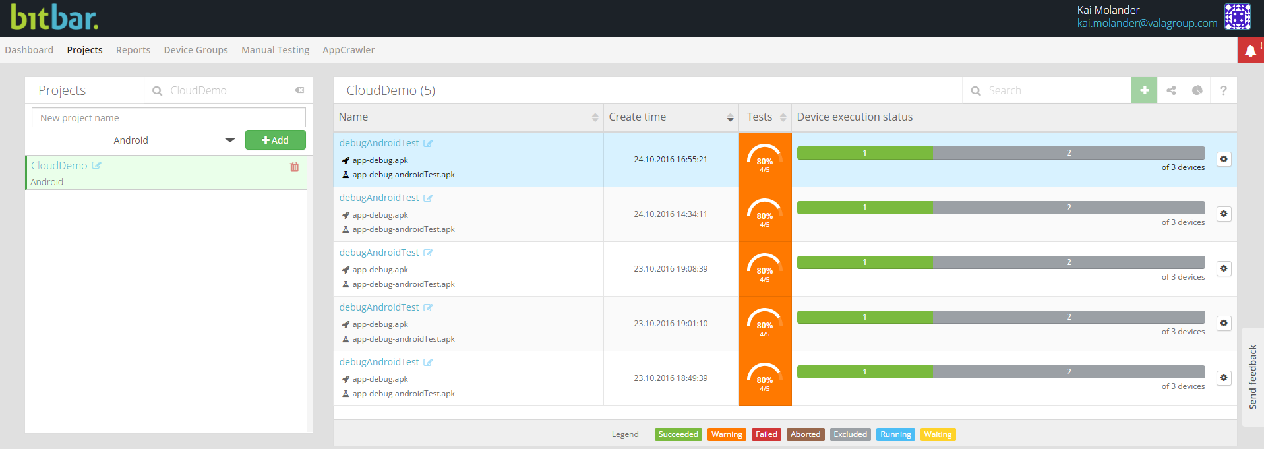
TestDroid (continued)

Slide 6
AWS Device Farm (Amazon)
Used via AWS Device Farm Gradle Plugin
https://github.com/awslabs/aws-device-farm-gradle-plugin
NOTE: Make sure you add the AWS SDK to the top level in Gradle!
Create an AWS account
https://aws.amazon.com/account/
Billing needs to be enabled (first 250 minutes are free)
Create a project
Create a device pool (or use the default "Top Devices")
http://docs.aws.amazon.com/devicefarm/latest/developerguide/how-to-create-device-pool.html

Slide 7
AWS Device Farm (continued)
Generate a proper IAM user
https://github.com/awslabs/aws-device-farm-gradle-plugin
Attach the policy: AWSDeviceFarmFullAccess (this is the only policy related to device farm)
Configure Gradle plugin based on the created settings (access key, secret key, project, device group etc).

Slide 8
AWS Device Farm (continued)
devicefarm {
projectName "CloudDemo" // required: Must already exists.
devicePool "Devices1" // optional: Defaults to "Top Devices"
authentication {
accessKey "access"
secretKey "secret"
}
// optional block, radios default to 'on' state, all parameters optional
devicestate {
wifi "on"
bluetooth "off"
gps "on"
nfc "off"
latitude 60.1653464
longitude 24.94292561
}
// Instrumentation
// See AWS Developer docs for filter (optional)
// instrumentation { filter "my-filter" }
}

Slide 9
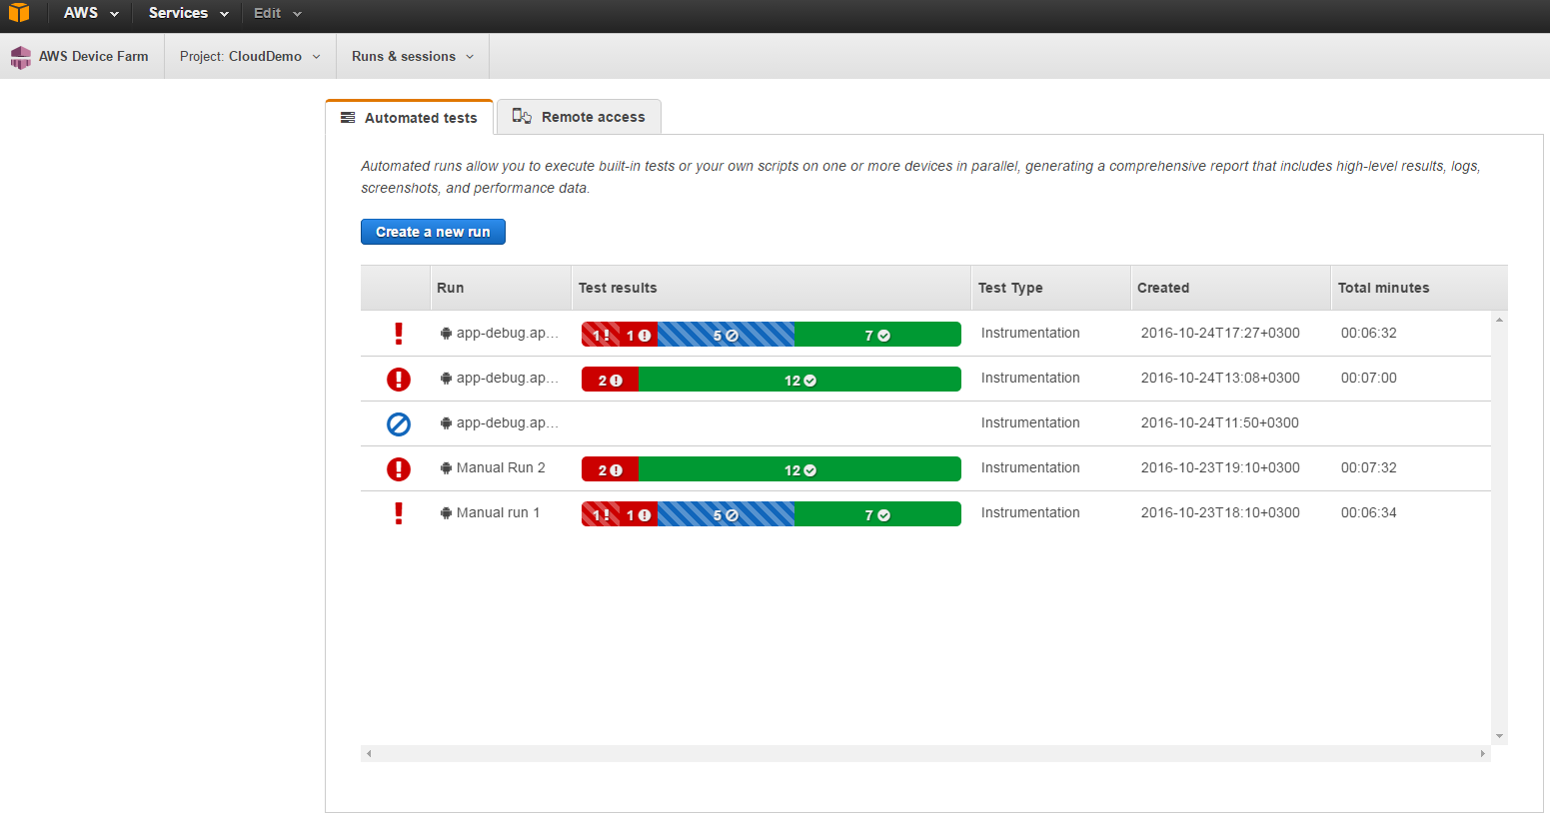
AWS Device Farm (continued)

Slide 10
Firebase Test Lab for Android (Google)
Used via gcloud command-line client
https://firebase.google.com/docs/test-lab/command-line
Billing needs to be enabled. A Firebase "Blaze" plan is required to use Test Lab (note that you will be charged)
If not present, install the Google Cloud SDK on your local system.
Make sure your Cloud SDK installation is up to date and includes the gcloud beta commands:
gcloud components update beta

Slide 11
Firebase Test Lab for Android (continued)
Set your current gcloud project to your project ID:
gcloud config set project <YOUR-PROJECT-ID>
Make sure your authentication credentials are current:
gcloud auth login
Build the APK's
Run the test script ./google-firebase.demo.sh
(make sure the paths in the script are correct)

Slide 12
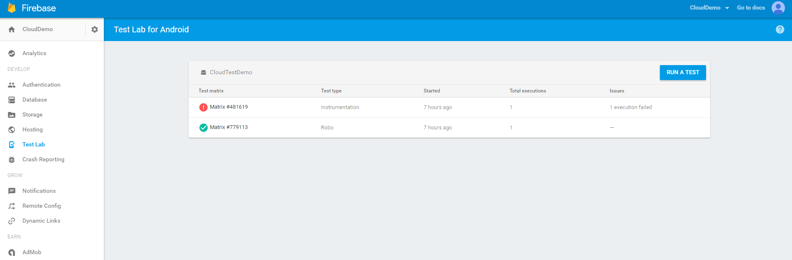
Firebase Test Lab for Android (continued)

Slide 13
Comparisons – Firebase
+ Running through the gcloud CLI gives you the ability to wait for tests to complete
+ Easy to read summary of the current "test matrix"
+ Easy to read separate test results
+ Video recording for each test
You have to pay to try it (although its cheap)
No CPU usage (?)
No memory usage (?)
Extremely low number of devices and API levels available

Slide 14
Comparisons – TestDroid
+ Greatest selection of devices (low as API 10, 2.3.3, two devices)
+ Can try it for free, easy to setup
+ Easy to use Gradle plugin
+ CPU and memory usage
+ Easy to read summary of the current "test summary"
+ What looks like a powerful API

Slide 15
Comparisons – TestDroid (continued)
Extremely bad web interface for test failure logs.
Hard to read with several failures
Individual test failures cannot be separated. Screenshots can be hard to match to the failure.
No video available (TestDroid say they can enable it for paying customers)
Gradle plugin does not have the option to wait for tests to complete and print results on command line

Slide 16
Comparisons – Amazon
+ Second best selection of devices (low as API 17, 4.2.2)
+ Can try it for free (first 250 minutes of device time), easy to setup
+ Easy to use Gradle plugin (setup may cause difficulties, add AWS SDK to top level in Gradle)
+ Easy to read summary of the current "test run"
+ What looks like a powerful API
+ Best pricing model (250 / month per device slot, concurrency meaning how many devices can be tested at a time, no hourly limit etc)

Slide 17
Comparisons – Amazon (continued)
Gradle plugin also does not have the option to wait for tests to complete and print results on command line
Video FPS is low, can be difficult to tell what the problem actually was
Other: CPU and memory usage sometimes seems to be reporting incorrect values

Slide 18
Comparisons – All of them
No provider seems to have a working implementation for generating summaries from multiple weeks etc.
TestDroid is the only one that theoretically supports this but I was unable to produce anything usable from the summary generation.

Slide 19
Pricing – Firebase
https://firebase.google.com/pricing/
Device hours $5/physical, $1/virtual
Meaning 60 hours / 300$

Slide 20
Pricing – TestDroid
http://bitbar.com/testing/pricing/public-cloud/
10 hours at $ 99 / month with $0.17 per Extra Minute
60 hours at $ 499 / month with $0.15 per Extra Minute
250 hours at $ 1799 / month with $0.13 per Extra Minute
Custom - Ask for Quote

Slide 21
Pricing – Amazon
https://aws.amazon.com/device-farm/pricing/
Pay as you go at $0.17/minute
Unlimited test & access at $250/device slot/month
Device slots correspond to concurrency. For instance, if you purchase ten automated test Android device slots and schedule a run on 100 Android devices, Device Farm will execute your tests on up to ten devices at a time until all tests are completed on your selected devices.

Slide 22
Fin.
Kai Molander
Software / Test Automation Developer
VALA Group

