Slide 1
Firestore
THCNTT3 - OmniCare
ArduinoAir
ArduinoRoute
NodeMCU
Radio
Server (HTTPS)
ArduinoPIR
Radio
ArduinoFire
ArduinoRadio
App

Slide 2
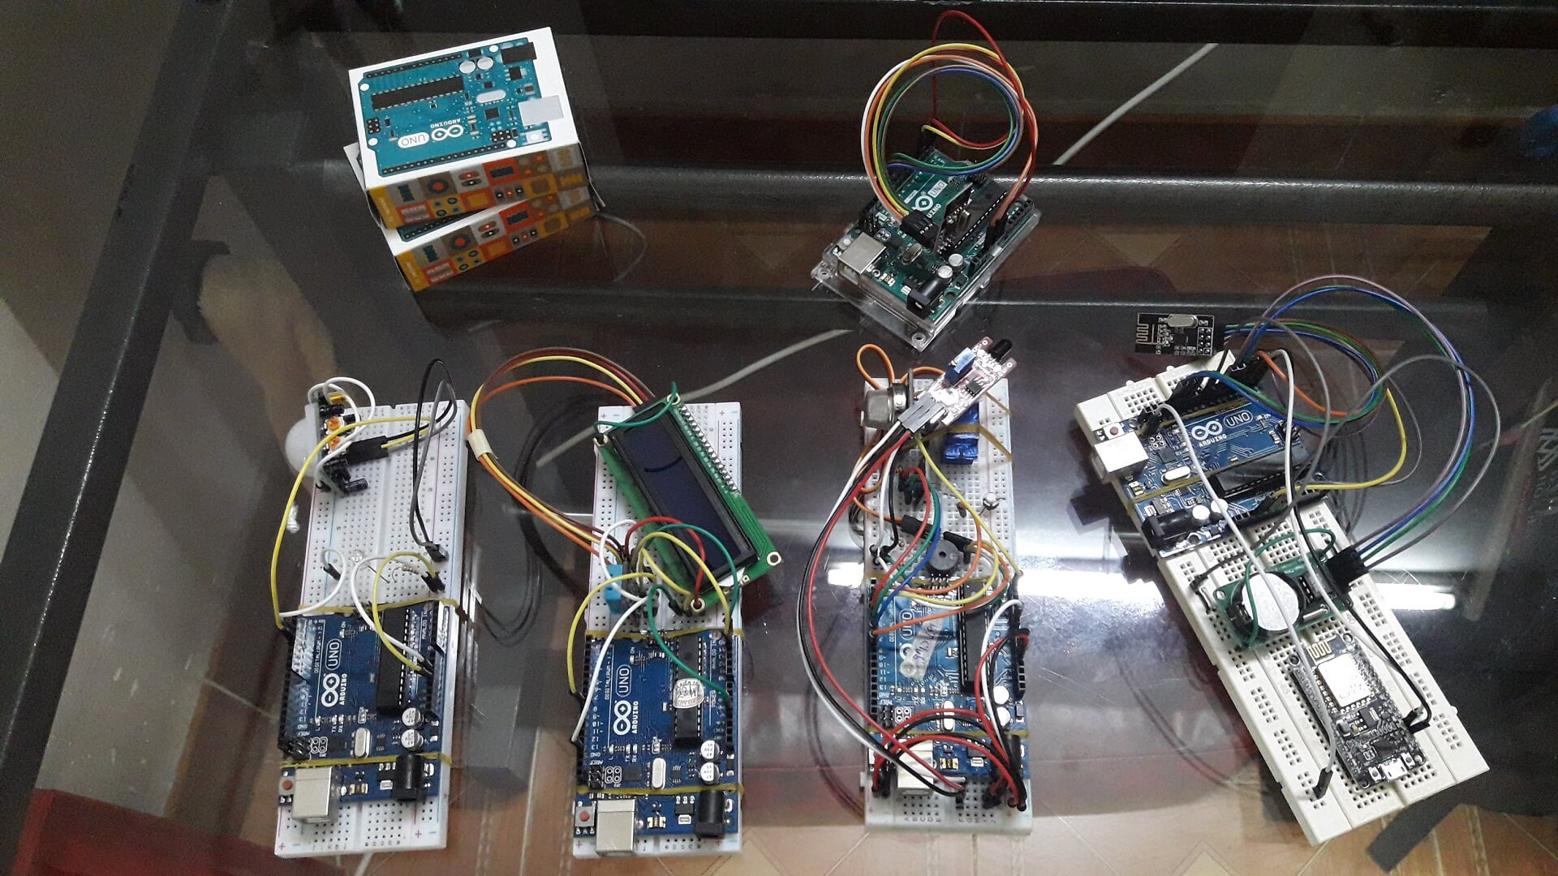
ArduinoRadio
ArduinoRoute
ArduinoAir
ArduinoPIR
ArduinoFire
NodeMCU

