Slide 1










DEMO UI
MG 1
MG 2
SOC:
97 %
PV forecast:
300 kWh
Consumption:
450 kWh
SOC:
15 %
PV forecast:
0 kWh
Consumption:
650 kWh
DEMO UI
VPP information
Market data
PSO information
VPP market participation
(Market offers)
MG1 EMS
Optimizer
MG2 EMS
Optimizer
MG3 EMS
Optimizer
Start distributed EMS optimization
Notes:
Only roof of canopy BIPV
SIT targets 1.3 MW for P1 and P2 combined

Slide 2
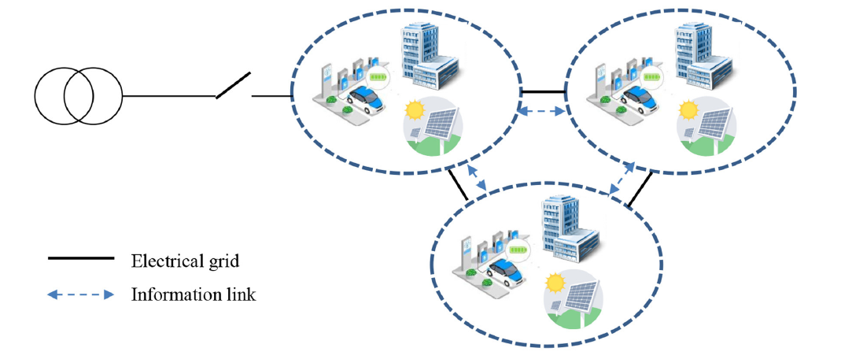
Background
P4 DEMO UI
MG 1
MG 2
SOC:
15 %
PV forecast:
200 kWh
Consumption:
400 kWh
SOC:
15 %
PV forecast:
0 kWh
Consumption:
650 kWh
VPP information
Market data
A P2P distributed optimizer for networked
Microgrids transactions and scheduling with:
Privacy conservation
Global optimality
Robust scheduling
PSO information
VPP market offers
Start distributed EMS optimization
Notes:
Only roof of canopy BIPV
SIT targets 1.3 MW for P1 and P2 combined

Slide 3
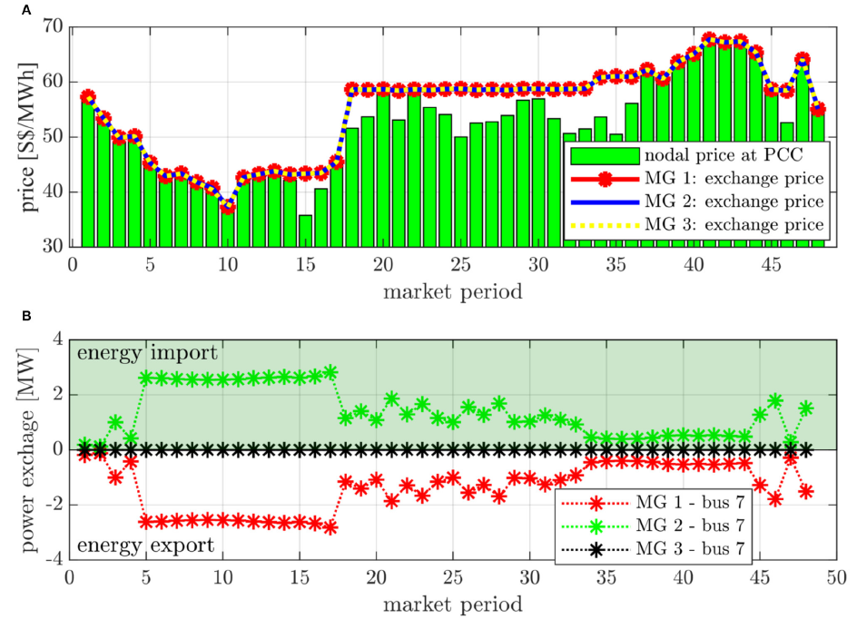
MG1 EMS
Optimizer
Result:
Current exchange quantity: 40 kWh
Price: 120 $/MWh
MG1 EMS
Optimizer
Notes:
Only roof of canopy BIPV
SIT targets 1.3 MW for P1 and P2 combined

