Slide 1
FMU Investigation Presentation
December 1, 2023
Undergraduate: Kai Adams
Graduate Mentor: Shane Kosieradzki

Slide 2
Current Goals:
Efficiently create and export Functional Mockup Units (FMU)
Programmatically customize the physical parameters of the system model to impact the outputs
Use FMPy as a Functional Mockup Interface (FMI) to programmatically alter and examine our system model
Future work: Upload FMU to microcontroller to make use of our generated and customized ‘digital twin’ to accurately predict behavior of the system.

Slide 3
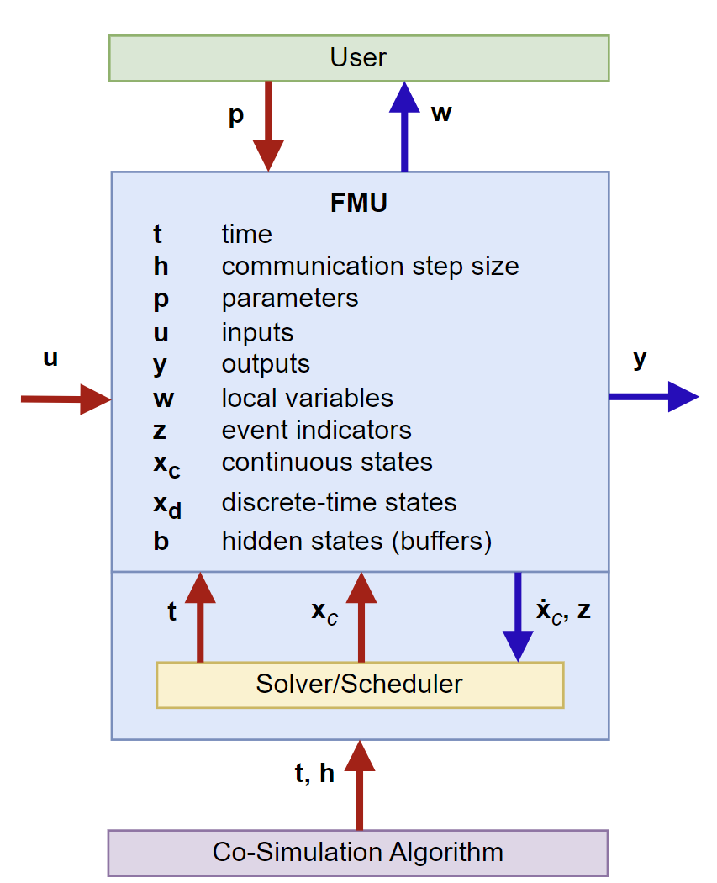
What are FMU?
Functional Mockup Unit is an open-source standard for a compilation of data representing a function/model and included dependencies.
The generated .fmu are essentially standardized .zip files, which we can rename them as such to open them. Within, the .c and .h files can be found, as well as a .xml file of the data, and a .dll file if compiled.
We can use these to model physical systems, so long as we can characterize them.
We are continuing to use Simulink, a ‘high-level’ tool, to create and export these models
We are currently using cosimulation, but aim to move towards model exchange in the future, which would allow us to implement our own custom solver
This image is from the Functional Mockup Interface (FMI) documentation and shows how a cosimulation FMU is simulated

Slide 4
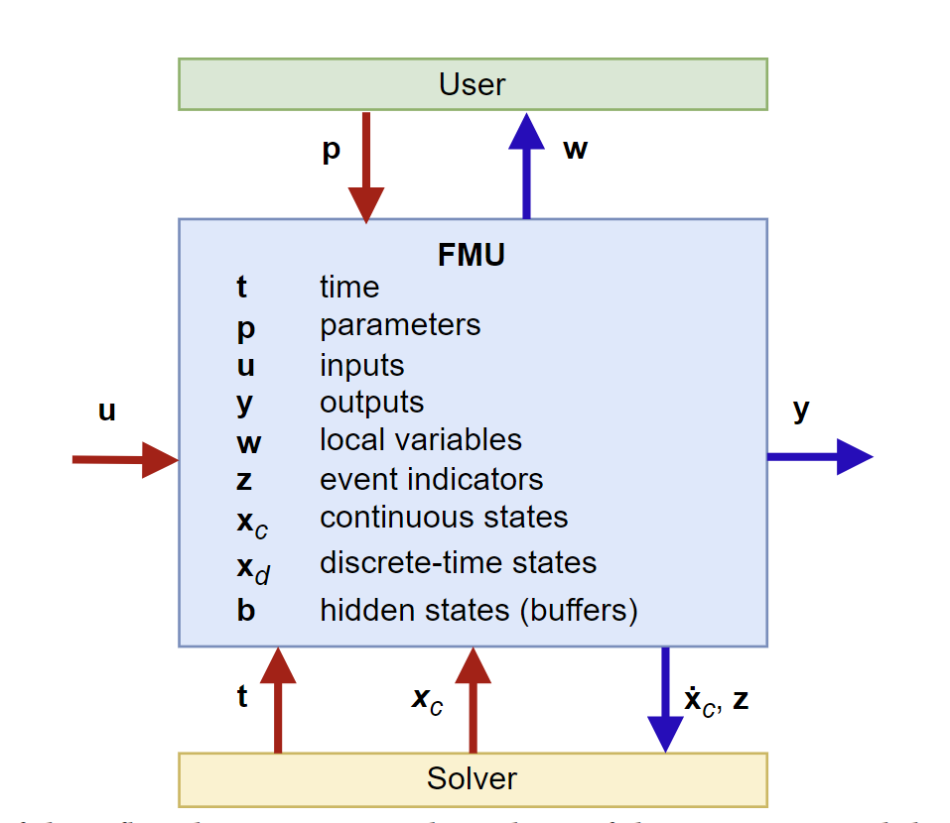
Co-Simulation vs. Model Exchange

Slide 5
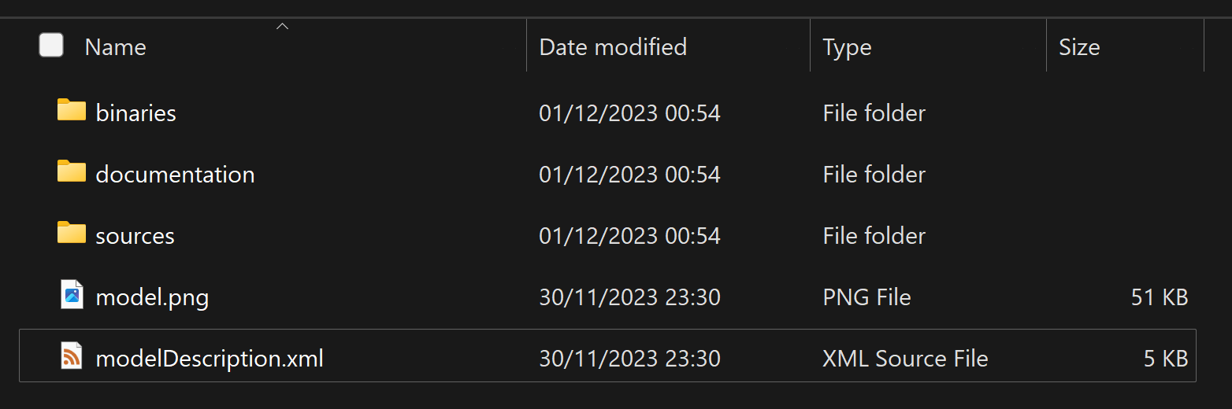
What’s inside the FMU?

Slide 6
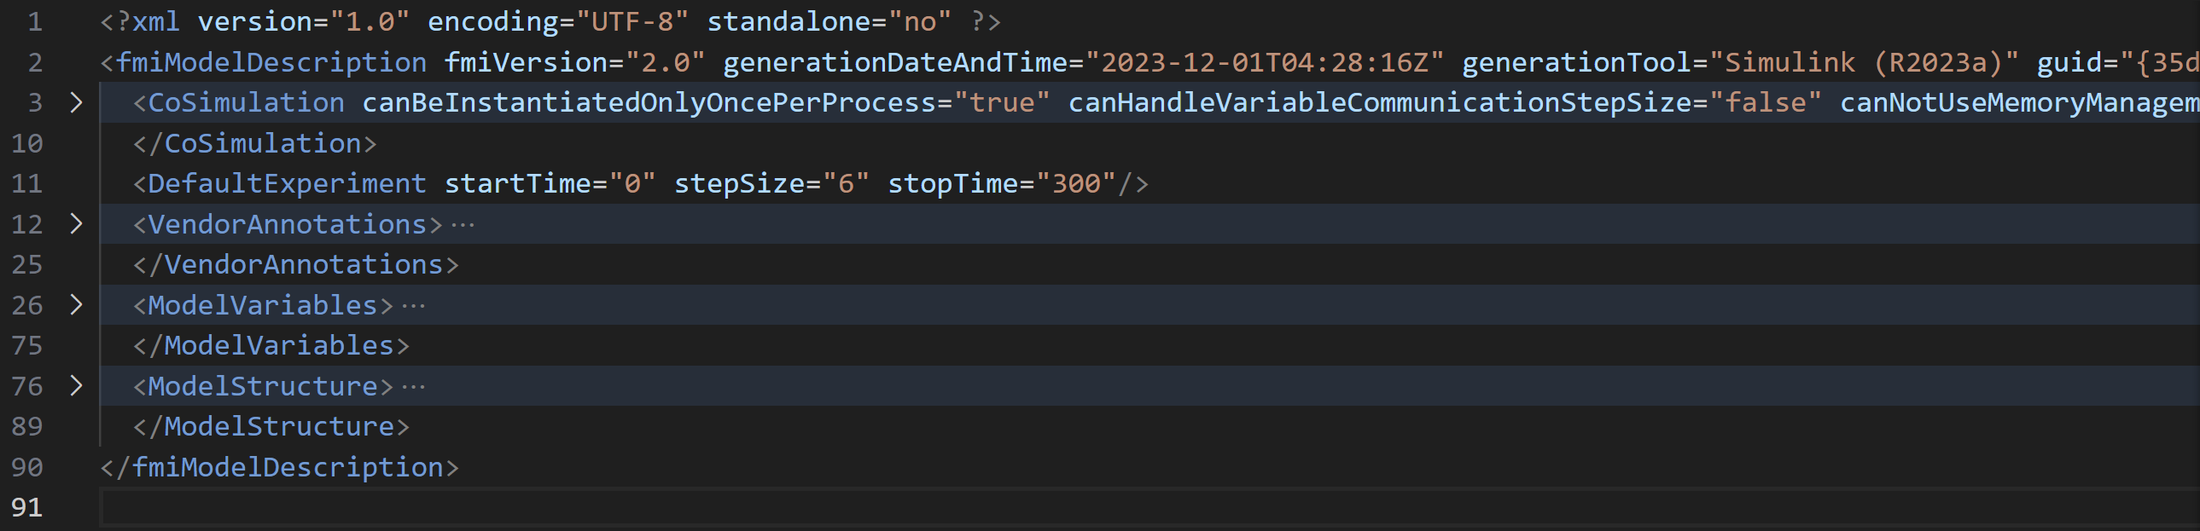
Within the .xml file

Slide 7
Approach:
Previously, FMPy, a python library for interpreting and simulating FMU, was used to open a GUI where some, but not all parameters could be altered quickly, but temporarily
While this was a quick and easy method to change certain parameters, it was much less consistent and gave much less control than programmatically altering the values when simulating.
The gui gave us less flexibility with controlling the system, and we want full control
Currently, we are using FMPy programmatically to alter the physical parameters within the system.

Slide 8
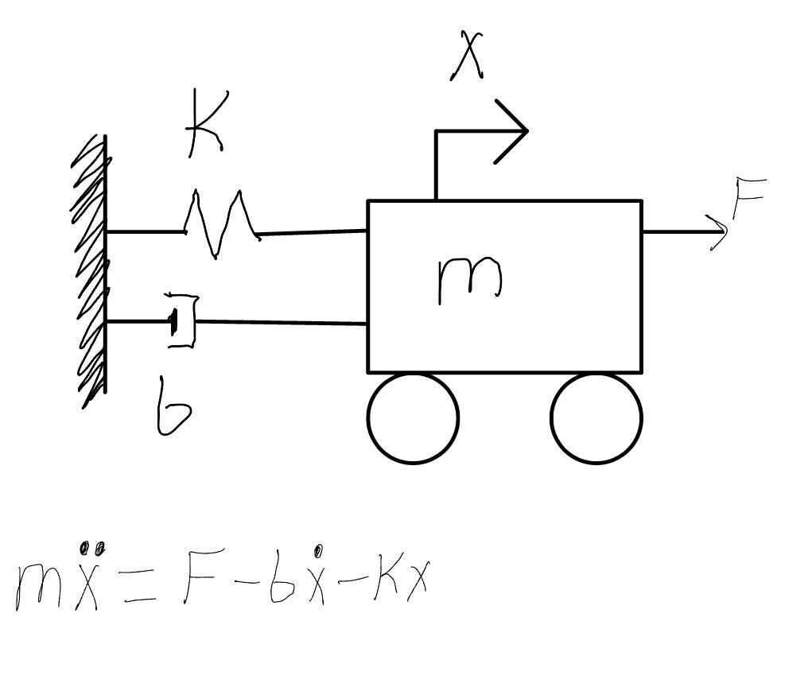
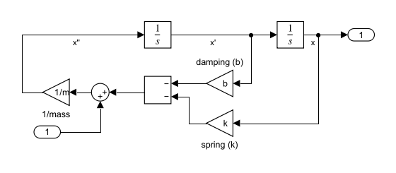
First Model Created

Slide 9
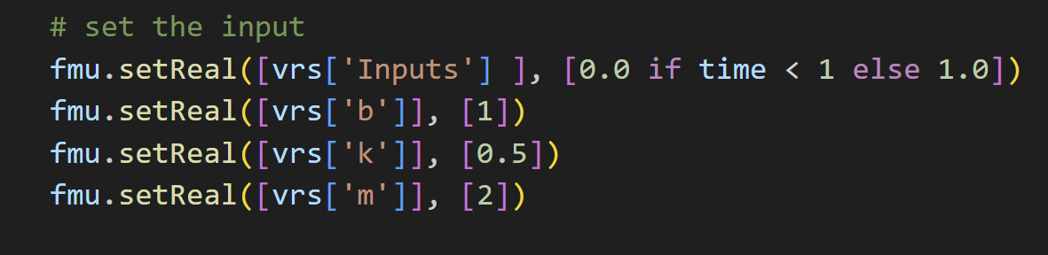
Model 1 Custom Parameters

Slide 10
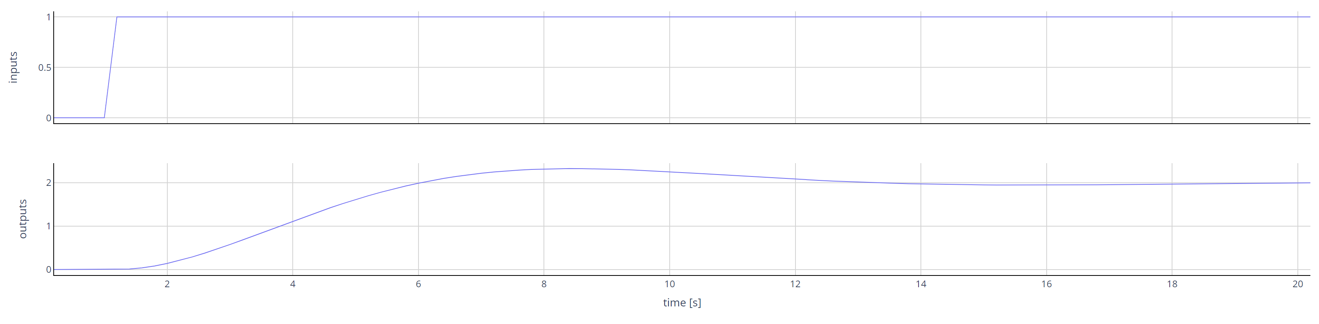
Results

Slide 11
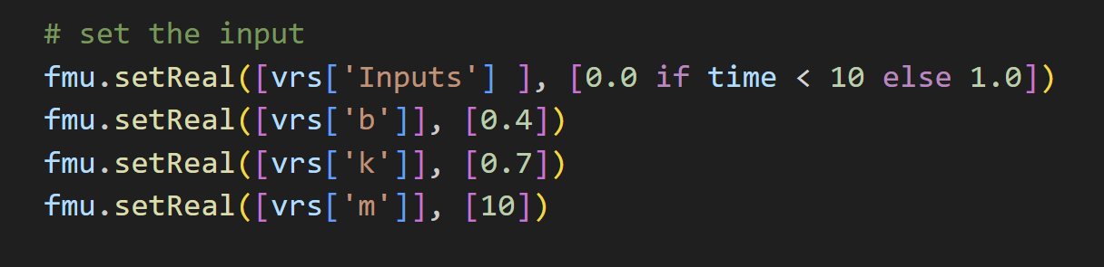
Parameters

Slide 12
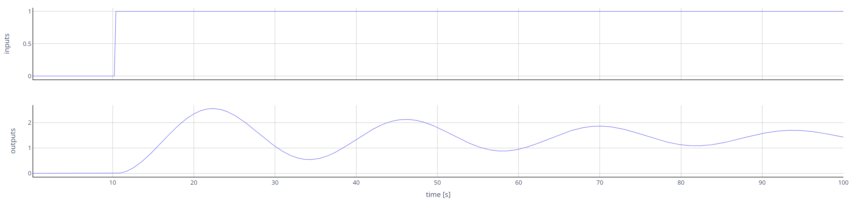
Result

Slide 13
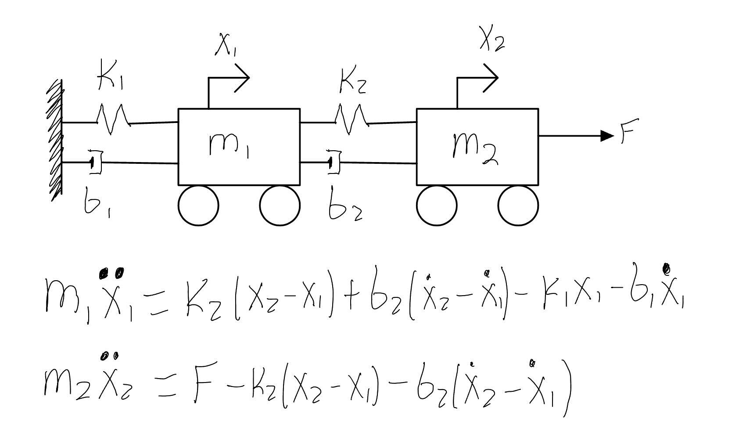
New Model to test for multiple outputs

Slide 14
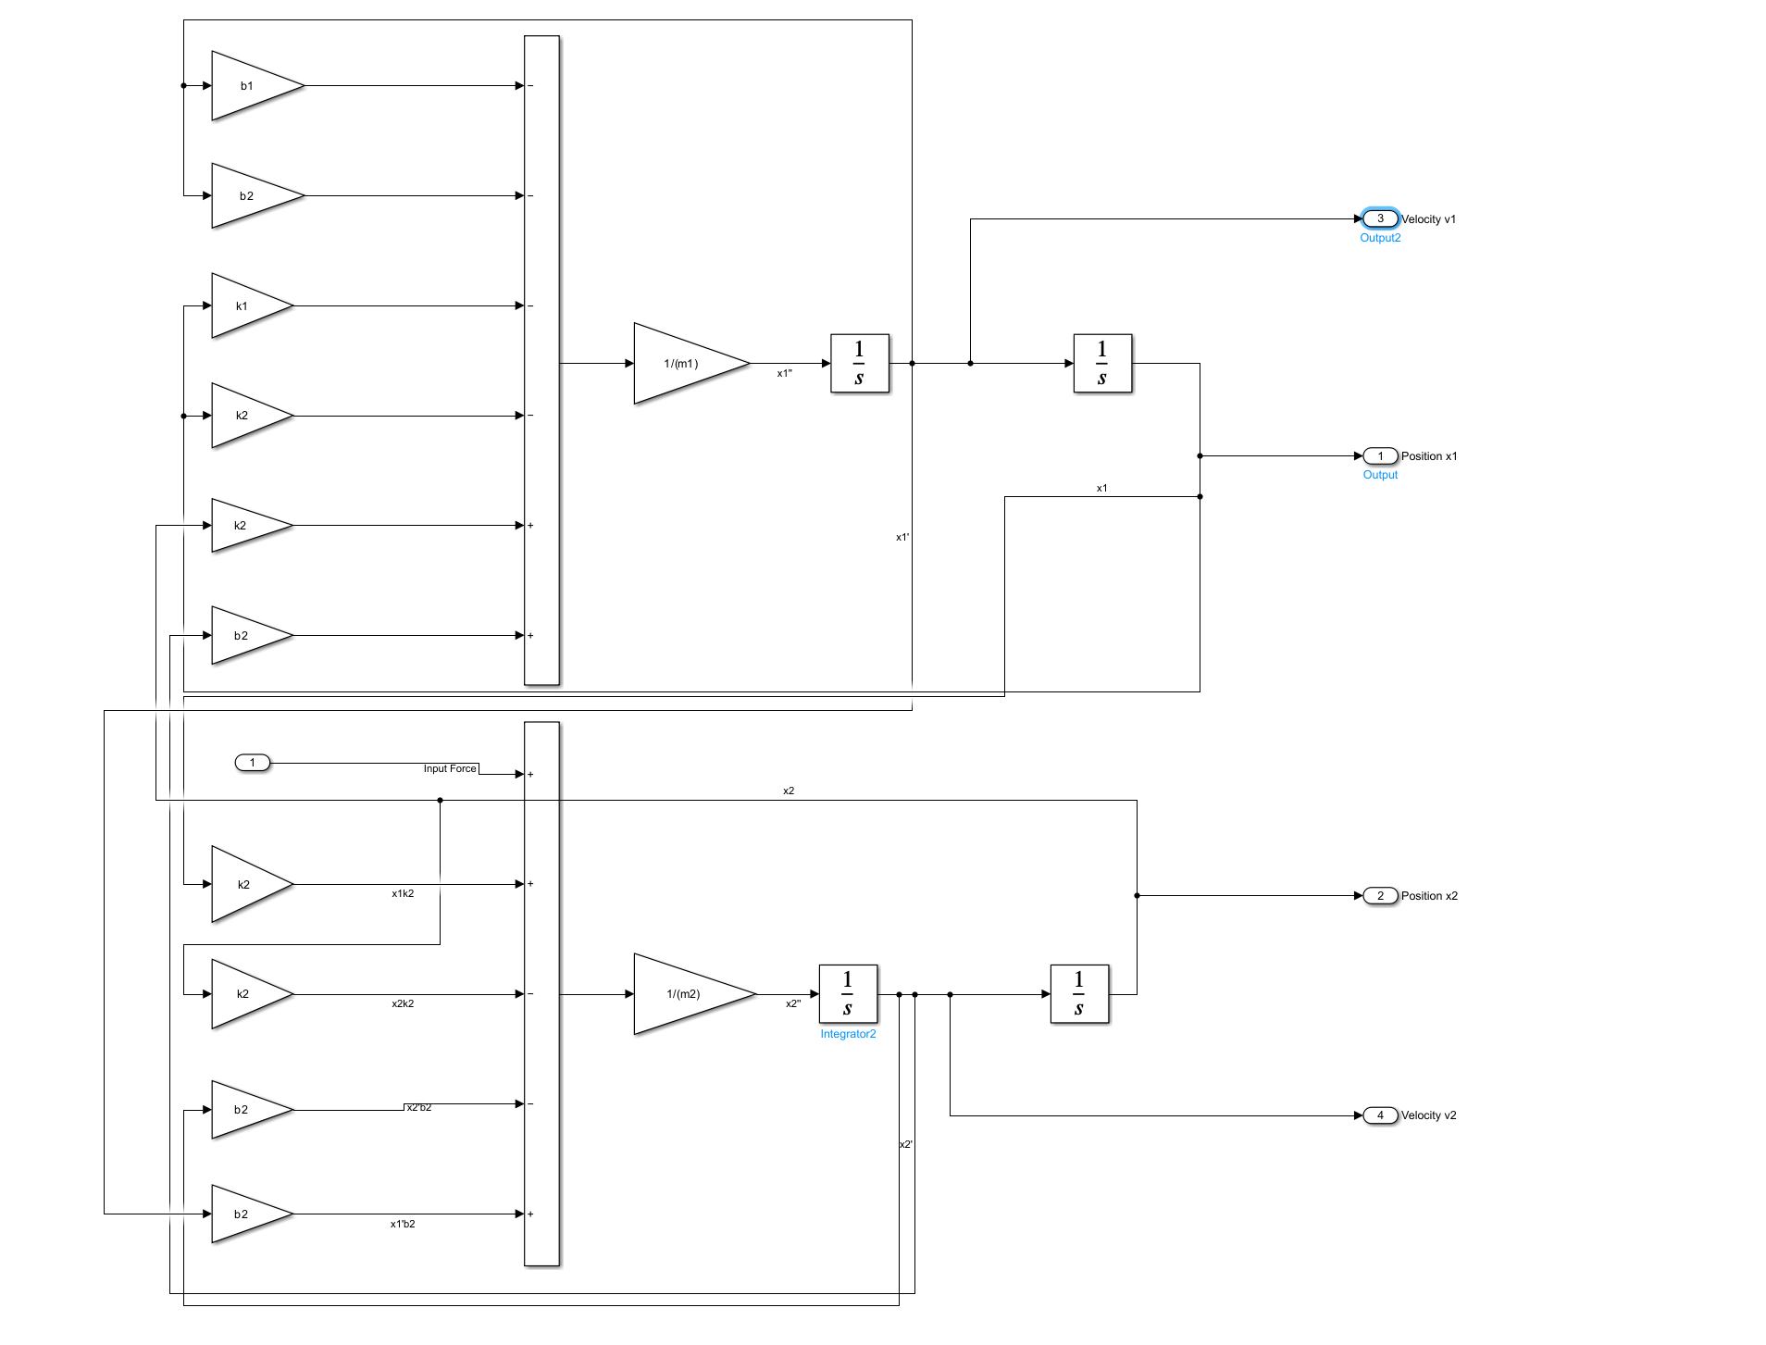
Simulink model of 2MSD

Slide 15
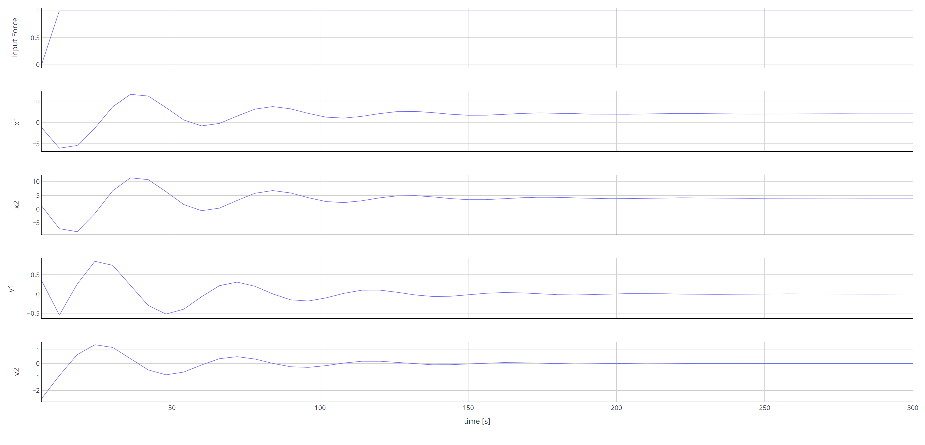
Using custom inputs in FMPy:

Slide 16
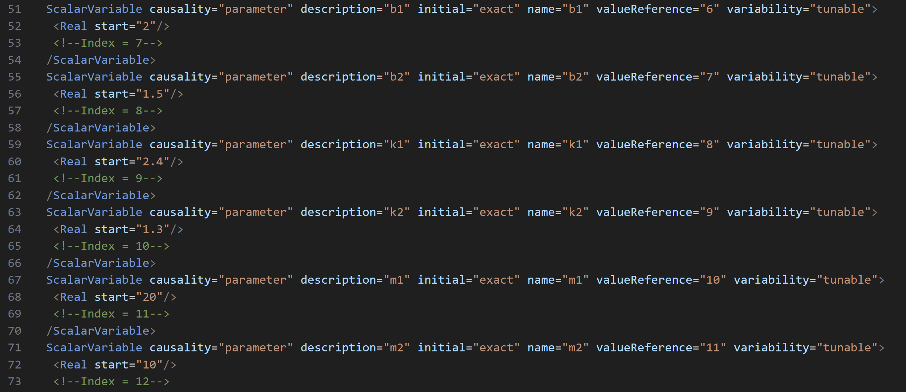
ScalarVariable within the FMU

Slide 17
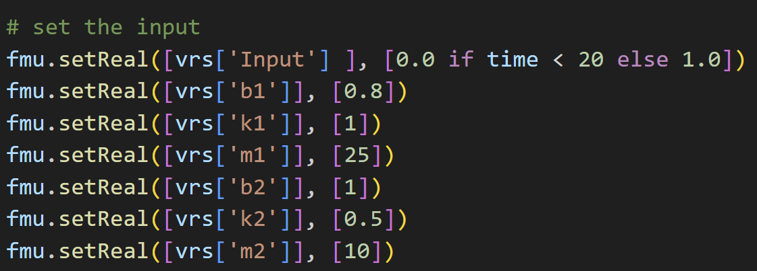
Programmatic customization of variables within the FMU

Slide 18
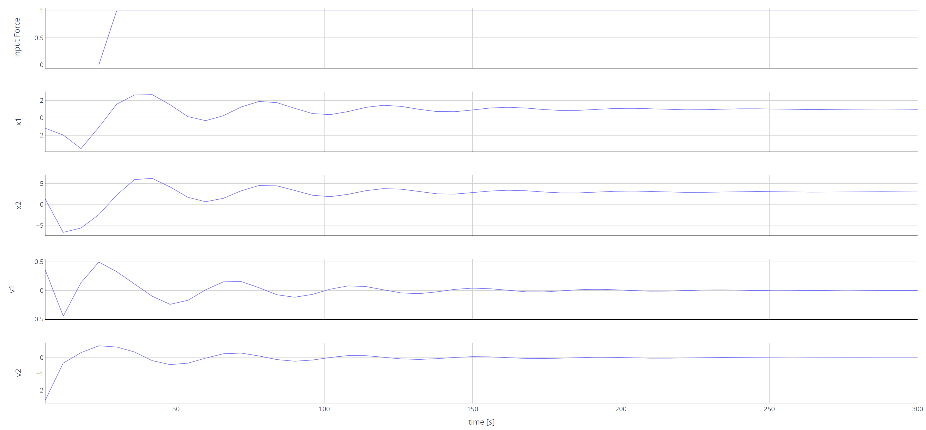
Results of custom parameters

Slide 19
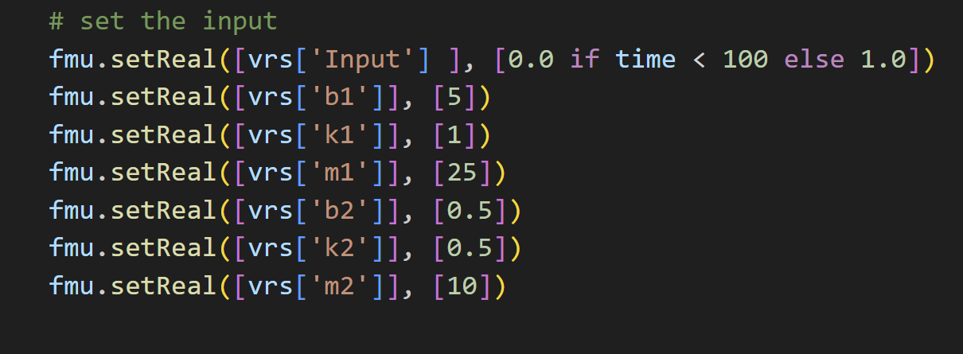
Late step force, High damping

Slide 20
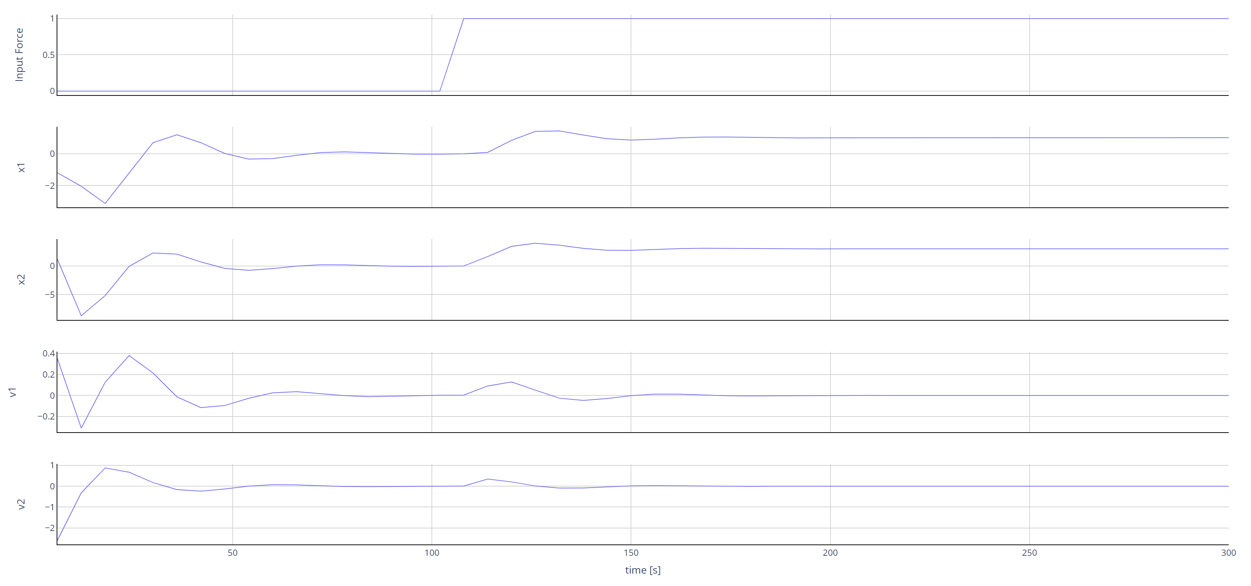
Graphical results

Slide 21
Challenges faced:
Gaining an understanding of the data structure of the FMU and their associated .xml files was a challenge, but was instrumental in learning how to programmatically change the variables within
Sometimes the solver step size does not match the step size it is instructed to use within the code, and this caused errors
The custom input did not work with the original model, likely due to an error in the setup of the model before it was exported. This was fixed through a simple recreation of the model

Slide 22
Future work:
Shift towards the usage of Model Exchange interface type in order to implement encryption
Implement encryption/encrypted solver into the code – specifically within the ‘simulation loop’ segment of our code
Use the encrypted system and solver to securely simulate our system
Implement our code in a microcontroller to use our ‘digital twin’ in real time using the ‘create cmake project’ function of FMPy on our model.

Slide 23
Questions?

