Slide 1
FMU Investigation Presentation
December 1, 2023
Undergraduate: Kai Adams
Graduate Mentor: Shane Kosieradzki

Slide 2
Current Goals:
Efficiently create and export Functional Mockup Units (FMU)
Programmatically customise the physical parameters of the system model to impact the outputs
Use FMPy as a Functional Mockup Interface (FMI) to programmatically alter and examine our system model
Future work: Upload FMU to microcontroller to make use of our generated and customised ‘digital twin’ to predict behaviour of the system.

Slide 3
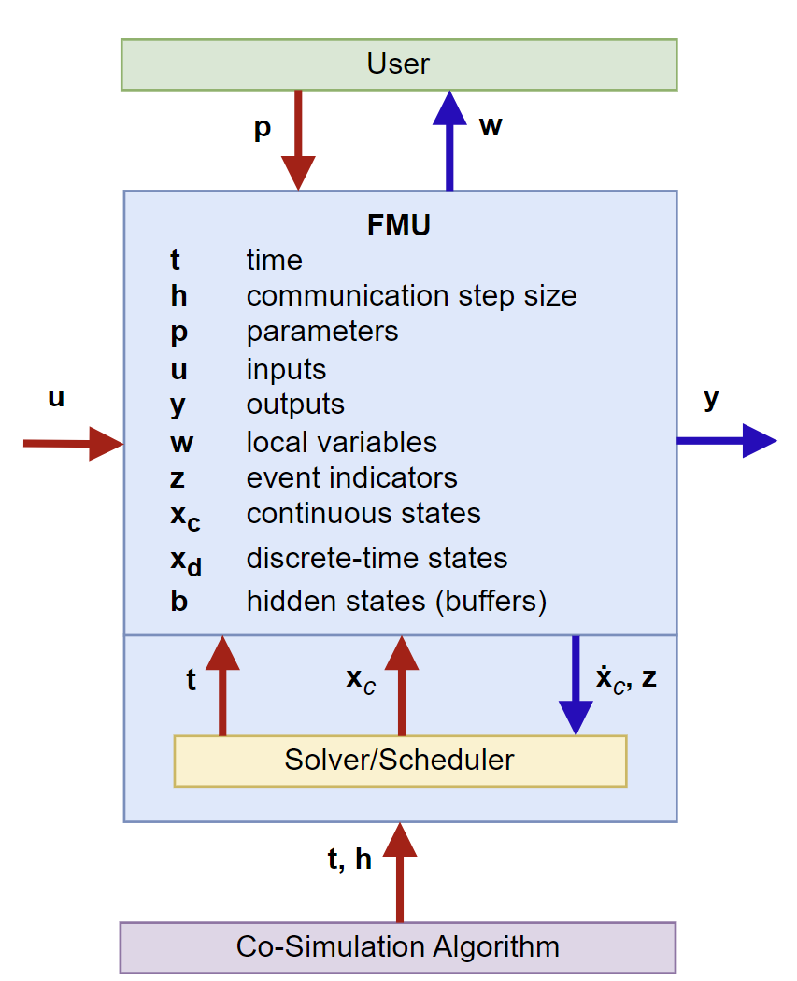
What are FMU?
Functional Mockup Unit is an open-source standard for a compilation of data representing a function/model and included dependencies.
The generated .fmu are essentially standardized .zip files, which we can rename them as such to open them. Within, the .c and .h files can be found, as well as a .xml file of the data, and a .dll file if compiled.
We can use these to model physical systems, so long as we can characterize them.
We are continuing to use Simulink, a ‘high-level’ tool, to create and export these models
This image is from the Functional Mockup Interface (FMI) documentation and shows how a cosimulation FMU is simulated

Slide 4
Approach:
Previously, FMPy, a python library for interpreting and simulating FMU, was used to open a GUI where some, but not all parameters could be altered
While this was a quick and easy method to change certain parameters, it was much less consistent and gave much less control than programmatically altering the models.
Now, we are using FMPy programmatically to alter the physical parameters within the system.

Slide 5
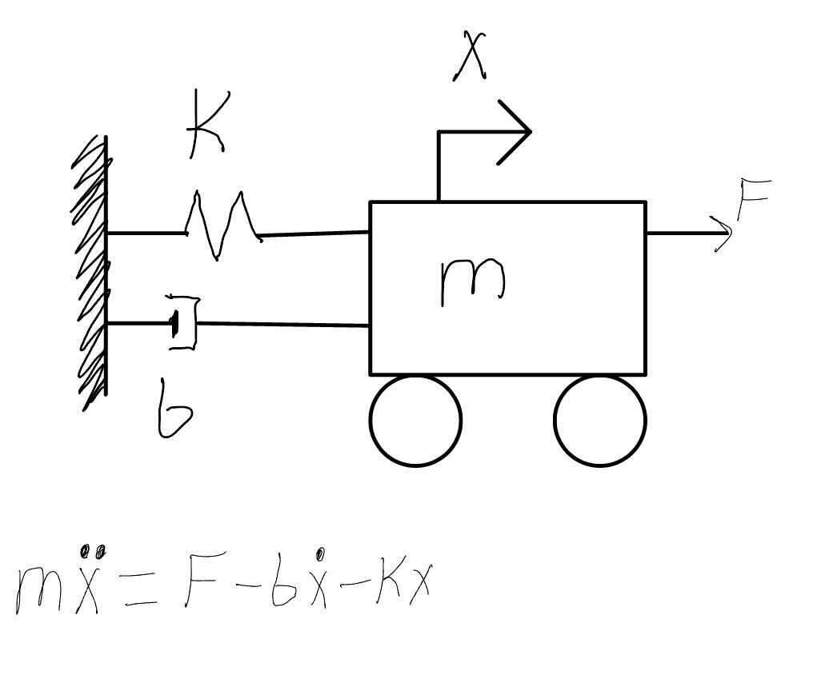
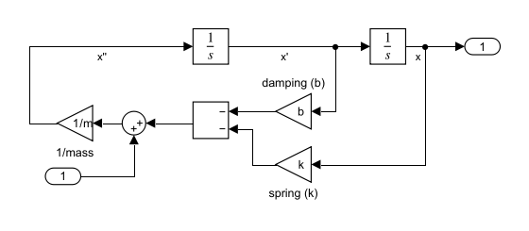
First Model Created

Slide 6
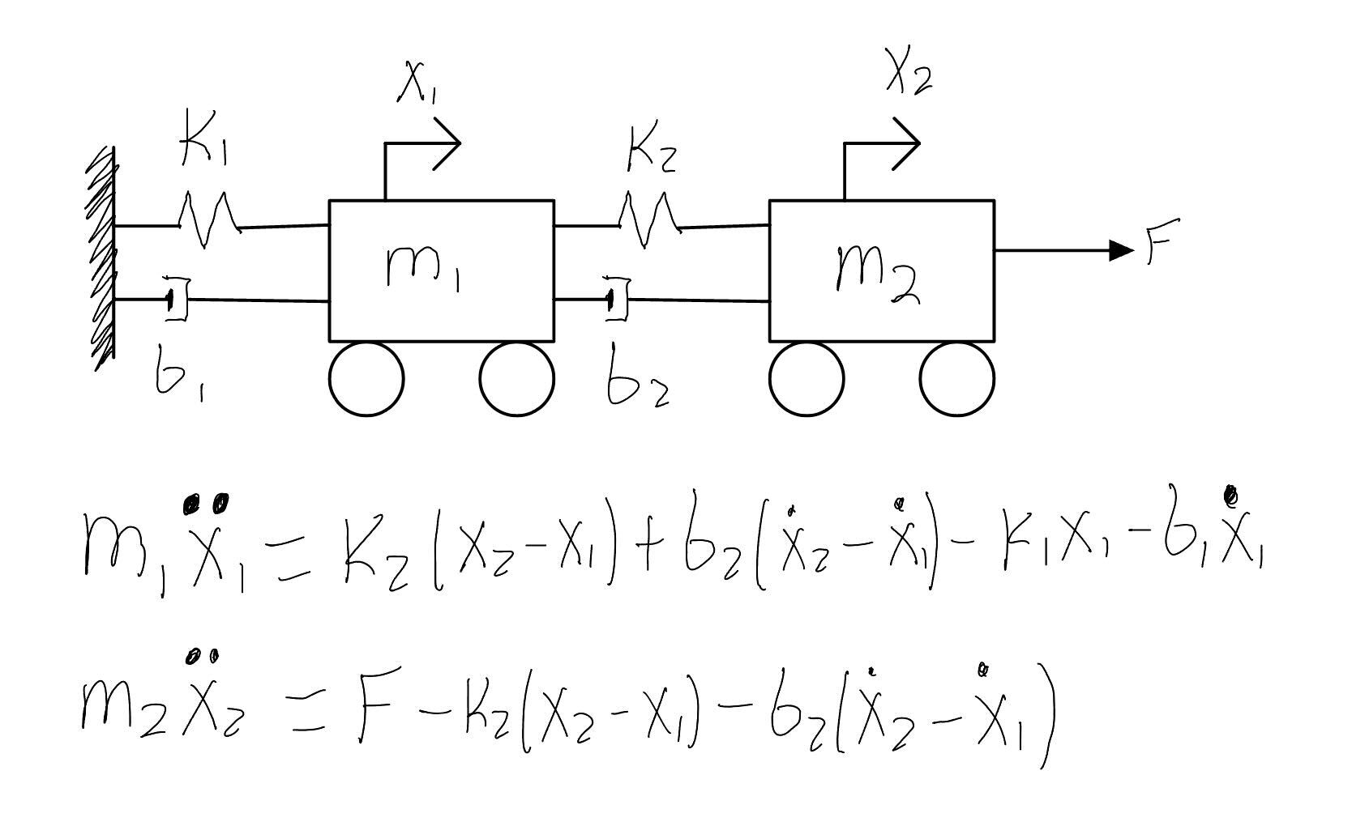
New Model to test for multiple outputs

Slide 7
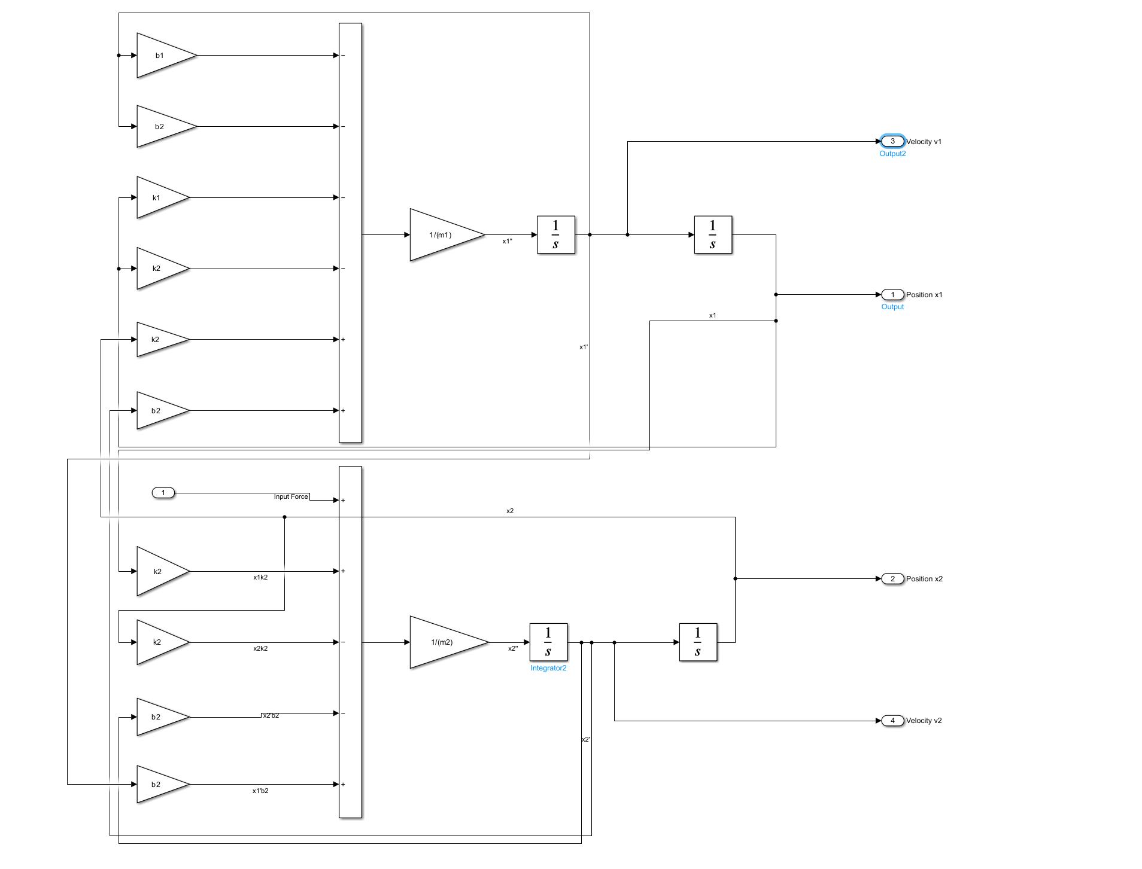
Simulink model of 2MSD

Slide 8
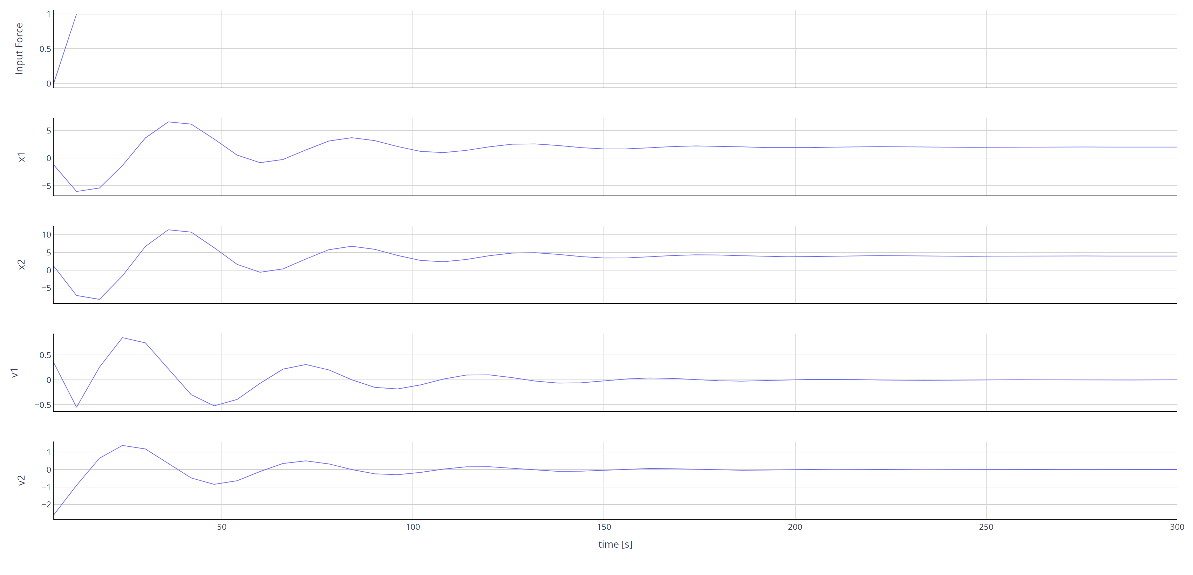
Using custom inputs in FMPy:

Slide 9
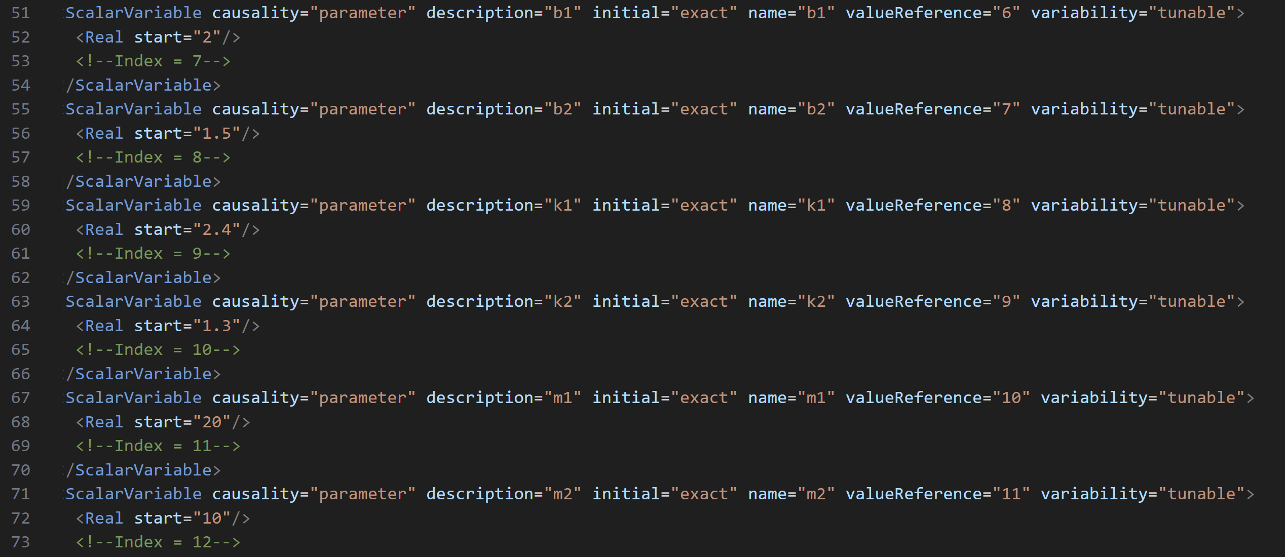
ScalarVariable within the FMU

Slide 10
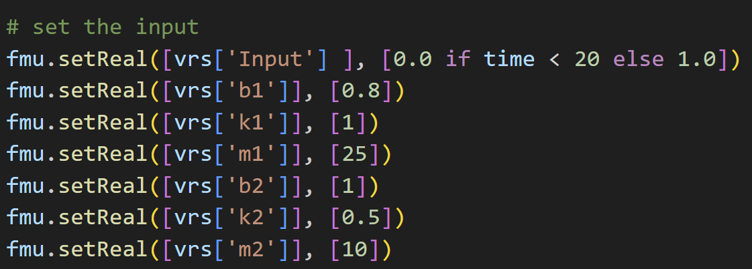
Programmatic customization of variables within the FMU

Slide 11
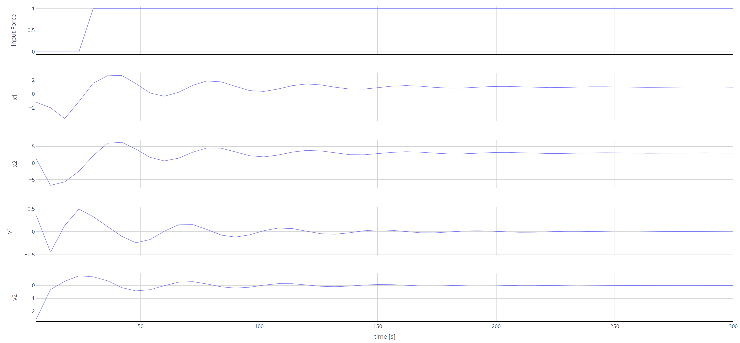
Results of custom parameters

Slide 12
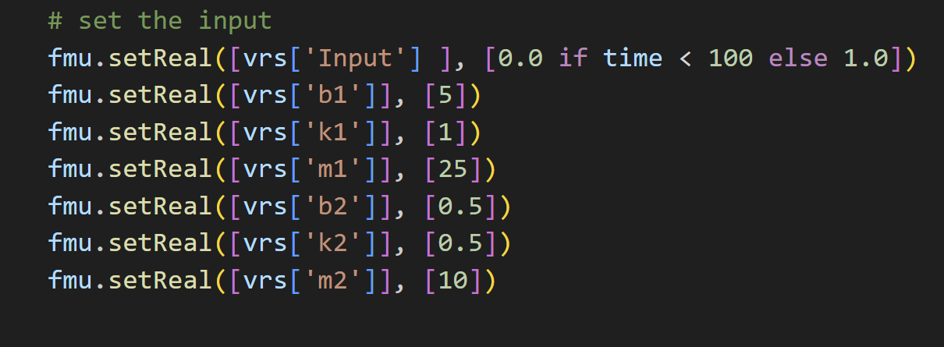
Late step force, High damping

Slide 13
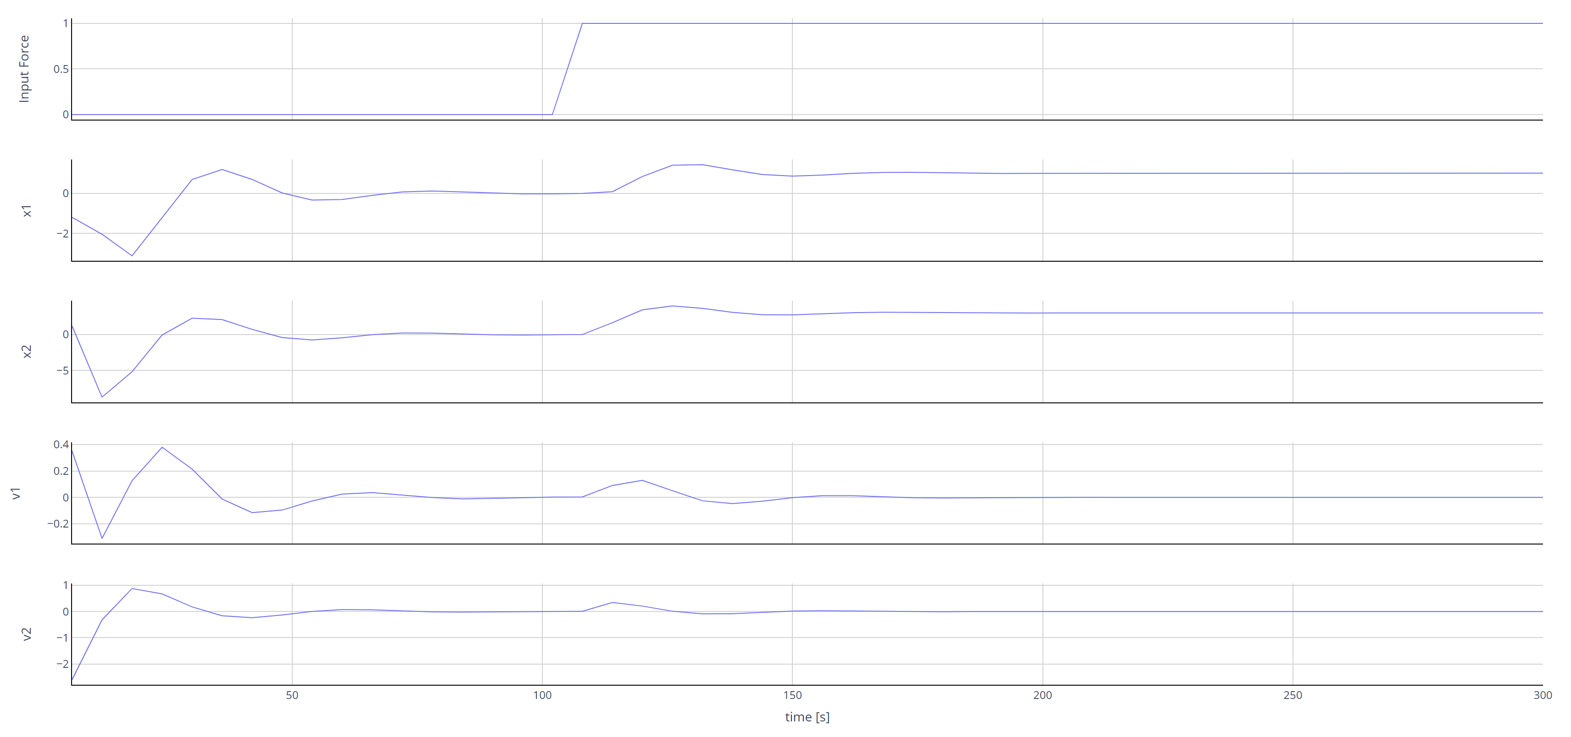
Graphical results

