Slide 1
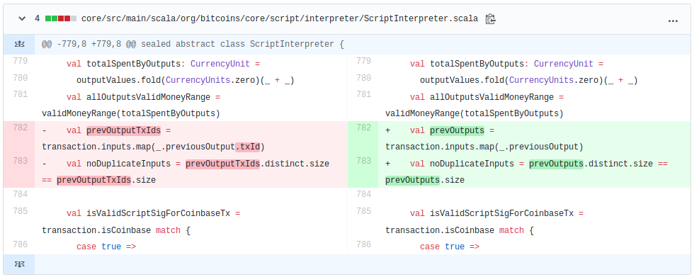
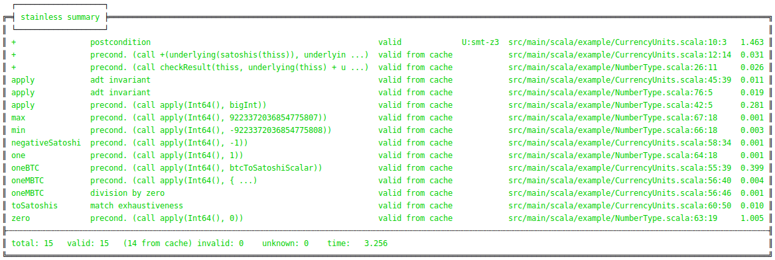
Goal
In this thesis we experiments in formal verification and try to verify a Scala code. We verify a fragment of Bitcoin-S-Core, the Scala implementation of the Bitcoin protocol, using the verification framework Stainless.
Bitcoin-S-Core
Firstly, we identify a property which we want to verify:
a non-coinbase transaction cannot generate new coins
We should transform the code to functional so that Stainless can accept it.
Our research has shown that the code implementing this property has many dependencies. Thus, a large part of the code must be rewritten what needs a lot of time and capacity.
So, we turn our analysis to the other functionality:
coin addition with zero results in the same value
To verify this functionality we rewrites the code needed for the coin addition and defines the formal specification with Stainless functions require and ensuring.
def +(c: CurrencyUnit): CurrencyUnit = { require(c.satoshis.underlying == Int64.zero) Satoshis(satoshis.underlying +
c.satoshis.underlying) } ensuring(res => res.satoshis ==
this.satoshis)
Results
During the work we found a bug in Bitcoin-S-Core in the function checking the transaction correctness. Its implementation didn’t allow transactions that reference two or more outputs of the same previous transaction. We fixed it and made a pull request which has been merged by developers of the Bitcoin-S project.
Furthermore, we verified the coin addition with zero. For this purpose we extracted two classes and rewrote their code.
Components
Formal verification is a method to check the correctness of a program based on the formal specification. All possible inputs can be explored using a verification tool.
Stainless
As a verification tool we take the framework Stainless. The framework:
takes as an input a Scala code written according to the functional paradigm allowing some imperative features
explores all possible inputs
reports inputs for which a program fails
gives counterexamples which violate a given specification
or confirms the correctness of a program
Experiments in Formal Verification of Scala Code
Graduate(s): | Ramon Boss Anna Doukmak
Professor: | Kai Brünnler
Expert: | Urs Keller
Bachelor Thesis 2019 Degree Programme Computer Science

