Slide 1
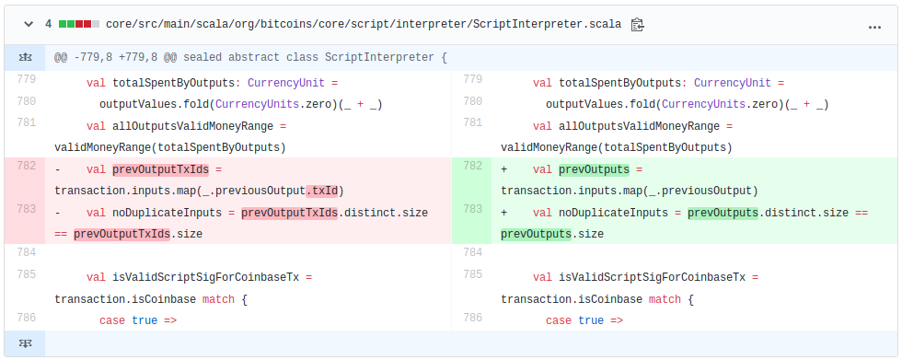
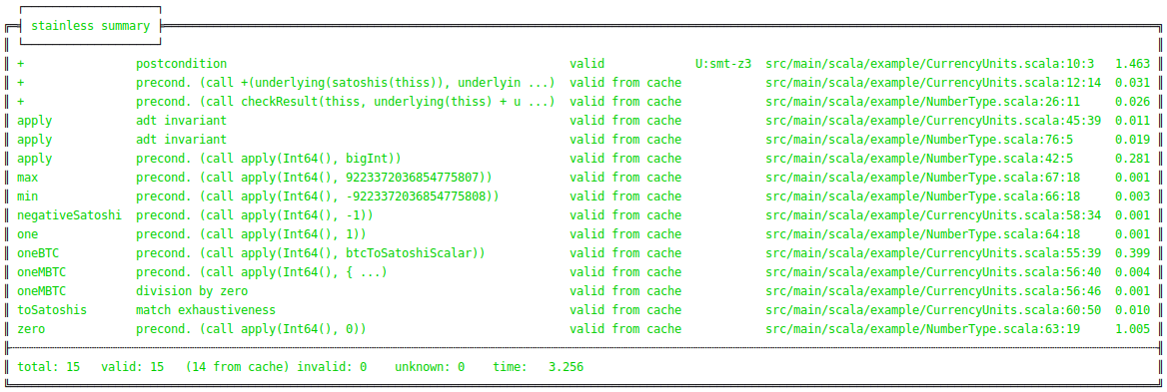
Goal
In this thesis we experiment in formal verification and try to verify Scala code.
We verify a fragment of Bitcoin-S. Bitcoin-S is a Scala implementation of the Bitcoin protocol.
To verify the code we use Stainless.
Bitcoin-S
First, the property we want to verify:
a non-coinbase transaction cannot generate new coins
We transform the code to functional code so Stainless can verify it.
Our research has shown that the code implementing this property has many dependencies. Thus, a large part of the code must be rewritten which needs a lot of time.
So, we turn our analysis to another functionality of Bitcoin-S:
coin addition with zero results in the same value
To verify this functionality we rewrite the code needed for the addition and define the formal specification with Stainless functions require and ensuring.
def +(c: CurrencyUnit): CurrencyUnit = { require(c.satoshis == Satoshis.zero) Satoshis(
satoshis.underlying + c.satoshis.underlying
) } ensuring(
res => res.satoshis == this.satoshis
)
Results
During the work we found a bug in Bitcoin-S in the function checking the correctness of a transaction. Its implementation didn’t allow transactions that reference two or more outputs of the same previous transaction. We fixed it and made a pull request which has been merged by developers of the Bitcoin-S project.
Furthermore, we verified the coin addition with zero. For this purpose we extracted two classes and rewrote their code.
Here the output of the verified code:
Components
Formal verification is a method to check the correctness of a program based on the formal specification. Using a verification tool, all possible inputs can be explored, in contrast to unit testing, where the inputs must be specified separately.
Stainless
We use Stainless as our verification tool.
It takes Scala code, written in functional style allowing some imperative features, as input
Explores all possible inputs
Reports inputs for which a program fails
Gives counterexamples which violate the specification
or confirms the correctness of a program
Experiments in Formal Verification of Scala Code
Graduate(s): | Ramon Boss Anna Doukmak
Professor: | Kai Brünnler
Bachelor Thesis 2019 Degree Program Computer Science

