Slide 1
Audio-Visual Representation Learning: Audio-Visual Correspondence Task
Kai Chieh (Jeff) Chang
ECE 549 Final Project

Slide 2
Roadmap
Introduction
Method
Architecture
Evaluation Tasks
Dataset
Results
Future Work

Slide 3
Introduction: Audio-Visual Correspondence (AVC)
Research typically focuses on audio or images
Abundance of videos
Mostly unlabeled
Audio-Visual Correspondence (AVC)
Pretrain method
Learn correspondence between frame and audio clip
Finetune on audio, image, or even video tasks

Slide 4
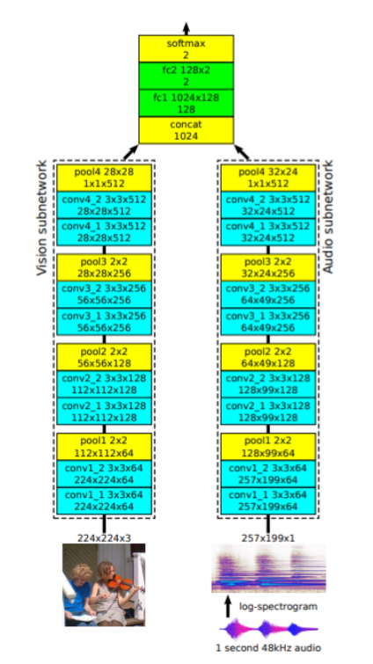
Method: Architecture
Binary classification task
0 = no correspondence
1 = correspondence
VGG Structure
BatchNorm and ReLU

Slide 5
Method: Evaluation Tasks
Audio classification
ESC-50: Environmental sound classification
50 classes
2000 waveforms, 5 seconds each
Image classification
ImageNet
1000 classes
50000 images (from validation split)

Slide 6
Method: Dataset
Pretrain: Flickr-SoundNet
2 million videos
Only found 5000 pairs
Audio Classification: ESC-50
2000 waveforms, 5 second each
80:20 split
Image Classification: ImageNet
Only use the validation set (50000 images)

Slide 7
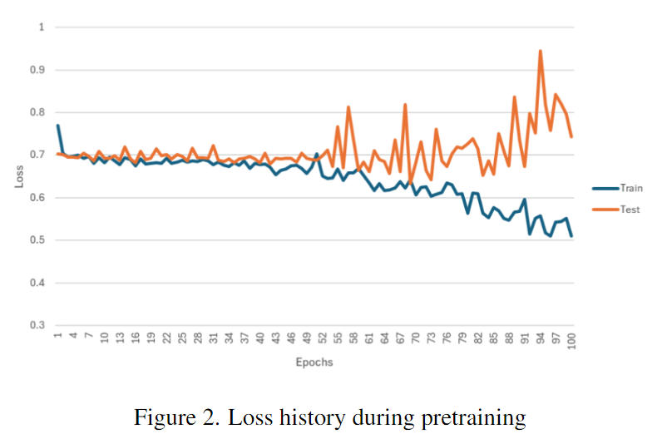
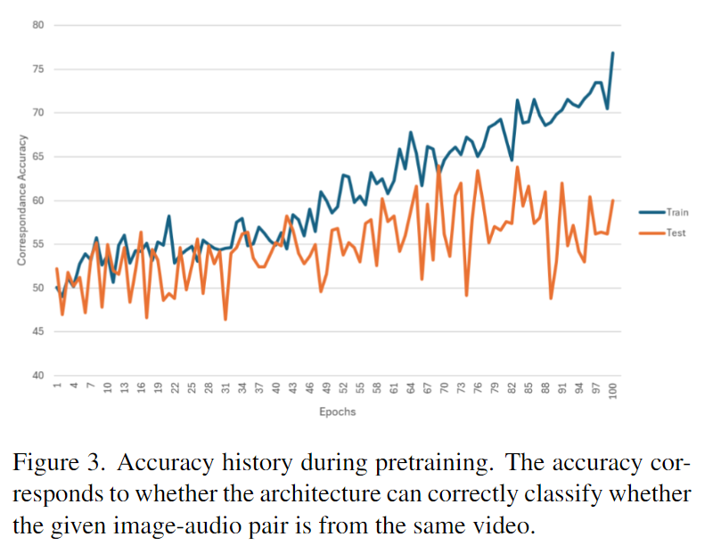
Results: Pretrain

Slide 8
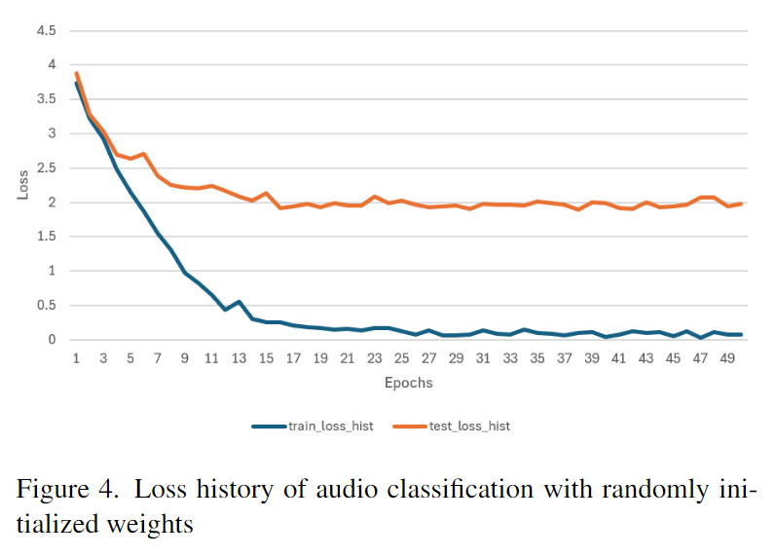
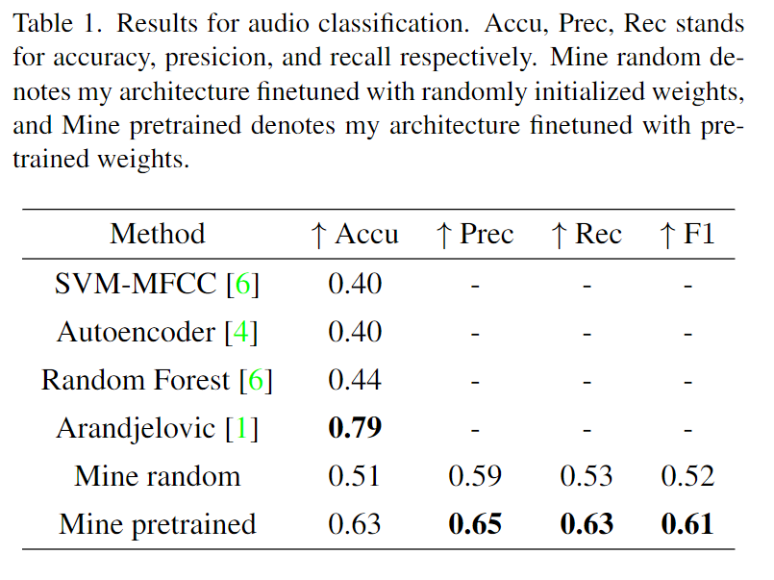
Results: Audio Classification

Slide 9
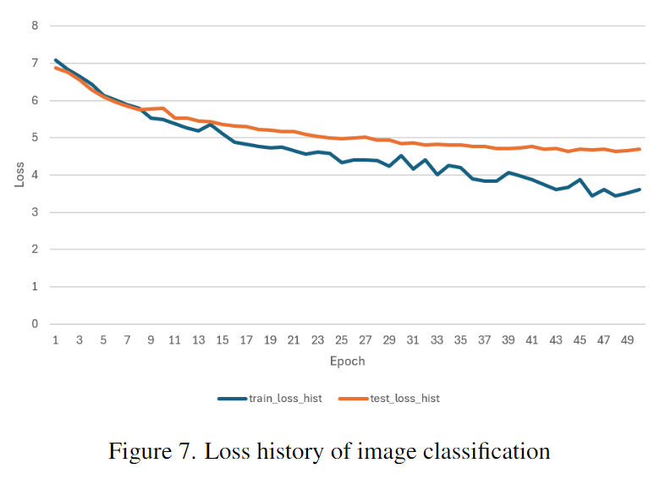
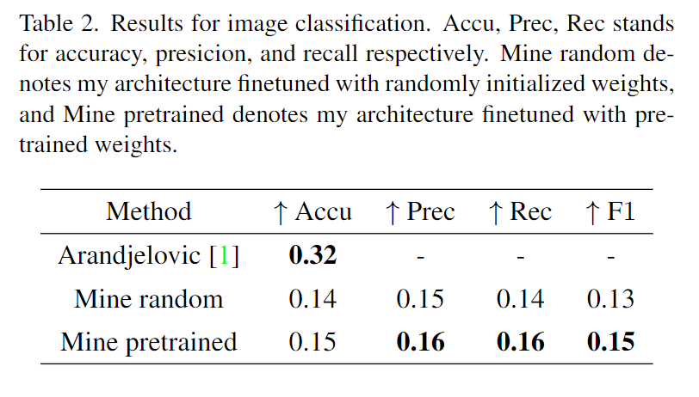
Results: Image Classification

Slide 10
Future Work
Pretrain: Flickr-SoundNet
Find datasets with image frames
Train for longer on better hardware
Audio Classification: ESC-50
Mel Spectrogram
Time information
Image Classification: ImageNet
Scale up image dataset

Slide 11
Thank you

