Slide 1

MedCube
吳均庭、黃楷傑、卓伯鴻、蕭晨豪

Slide 2
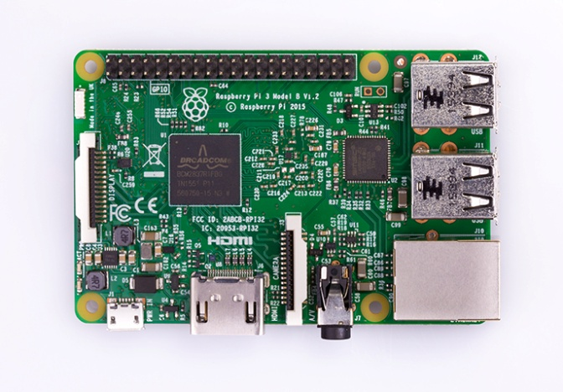
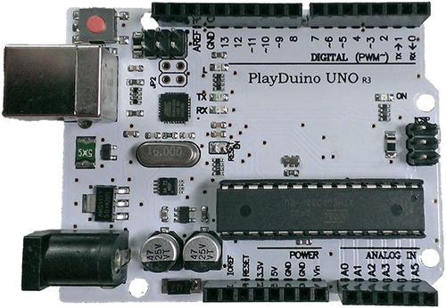
Tools
PlayDuino UNO R3 x2
Raspberry Pi 3 x2
Azure Face API
Azure MSSQL Database
Azure Sentgrid mail service

Slide 3

FaceAPI
MS SQL
SendGrid
Data
Face
Result
Register, Query
Notification
MedCube
Query
Medicine

Slide 4
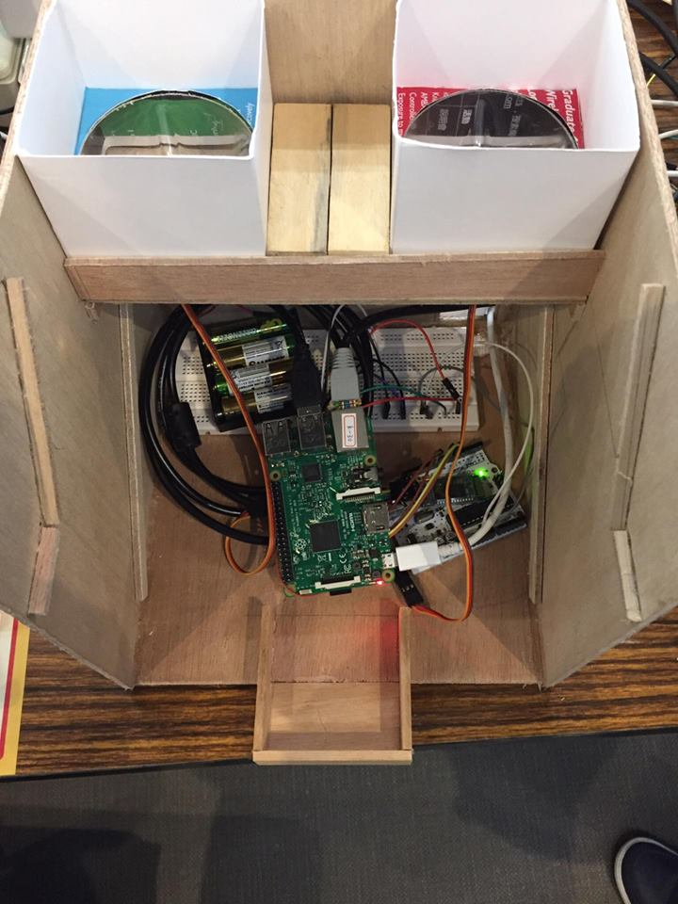
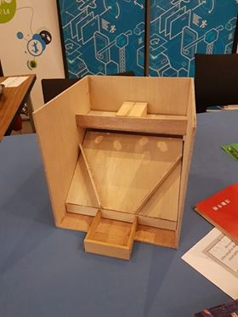
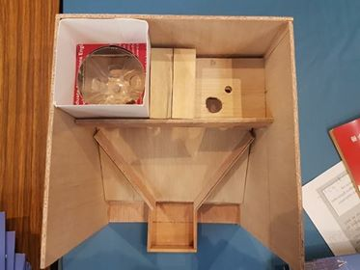
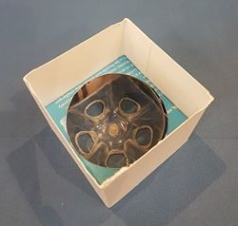

Slide 5
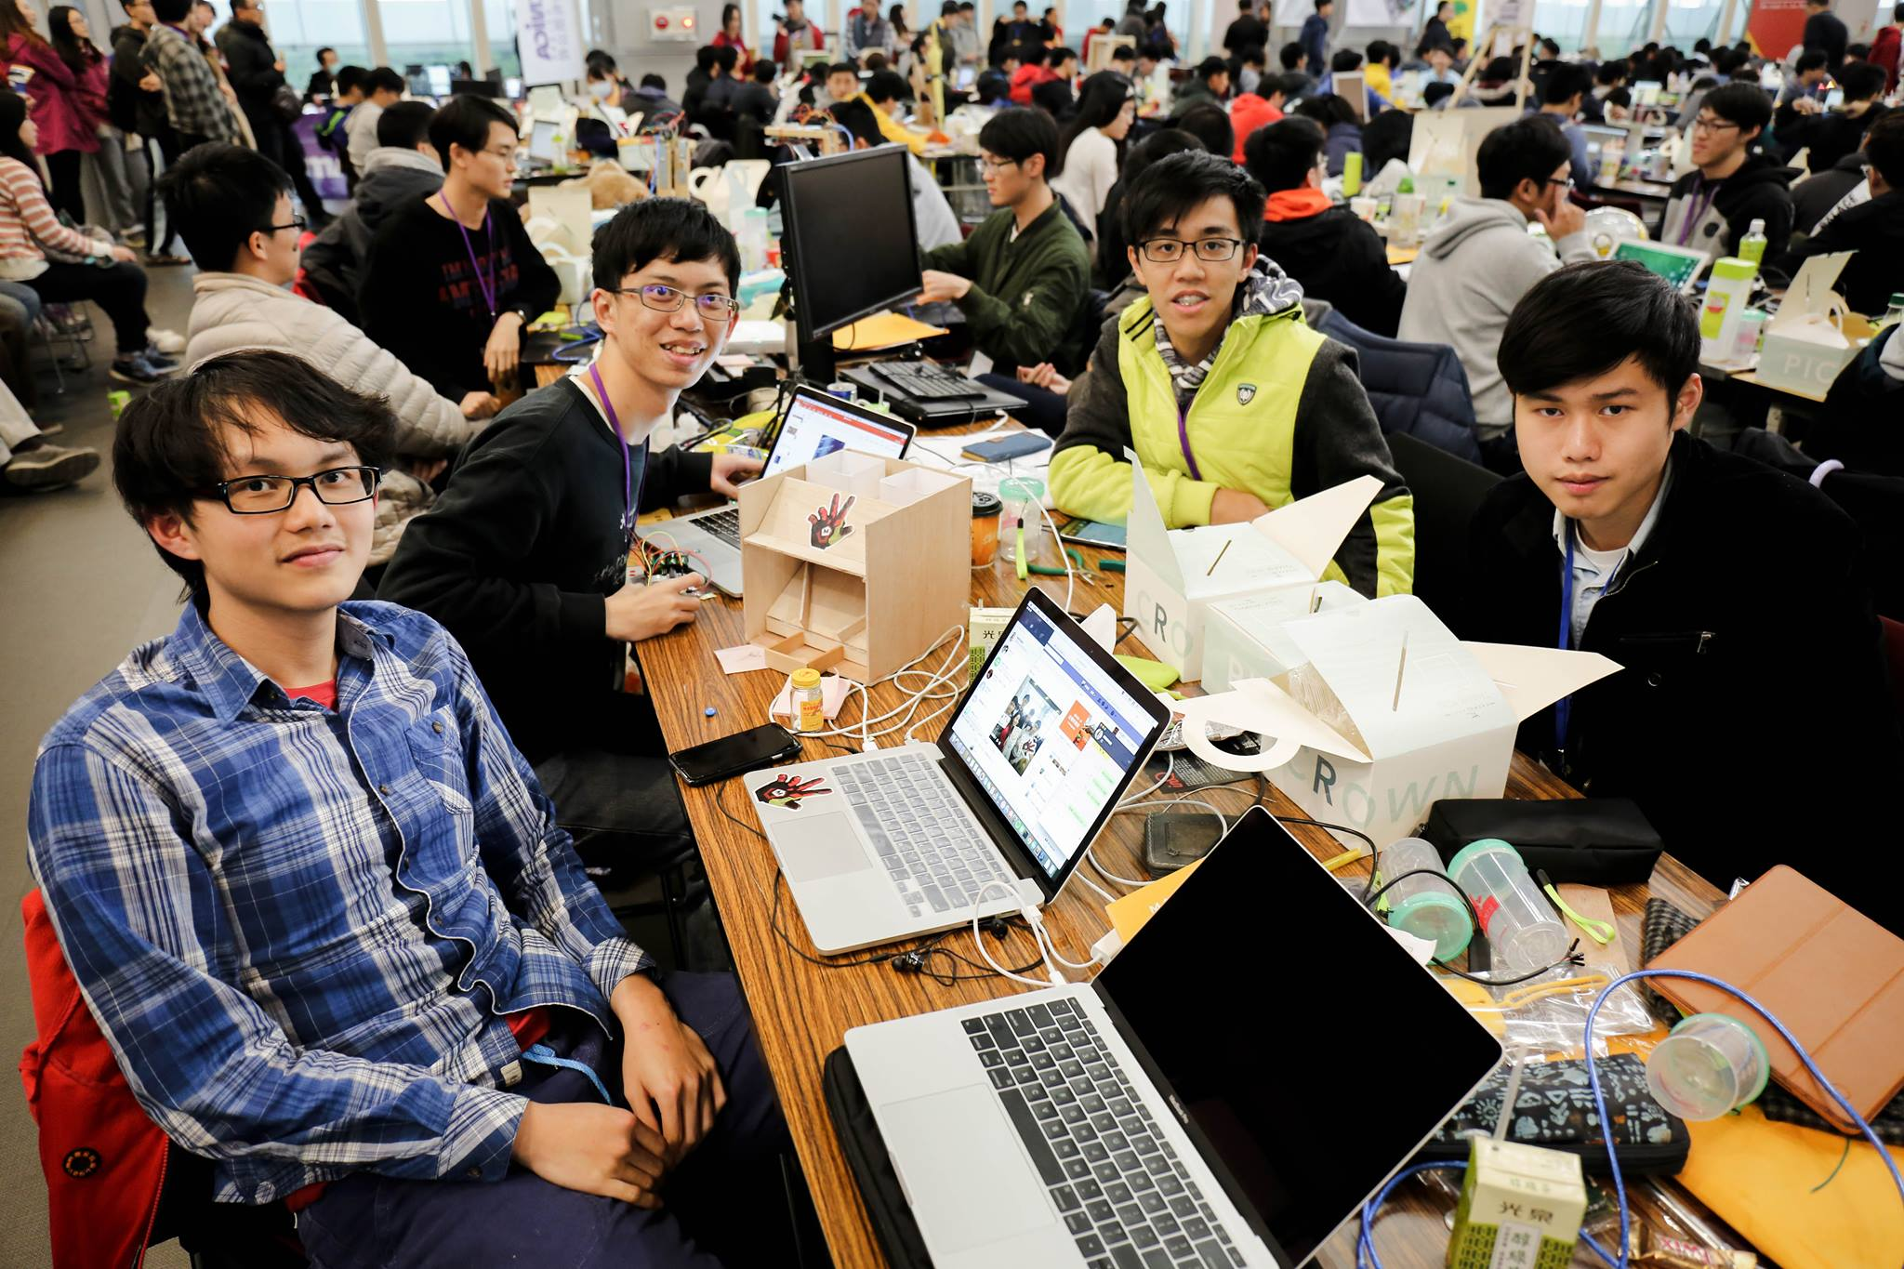

Slide 6
Thank You!

