Slide 1
Utilising Generative Model to Synthesise Writer Unique Handwriting Dataset
BT4222 AY22/23 Semester 1
Project Proposal
Group 8
Lam Cheng Jun | A0183311R
Nguyen An Khanh | A0200693L
Tang Kai Yi, Karin | A0221233Y
Tey Kai Cong | A0203512Y
Tong Chen Rong | A0215126R

Slide 2
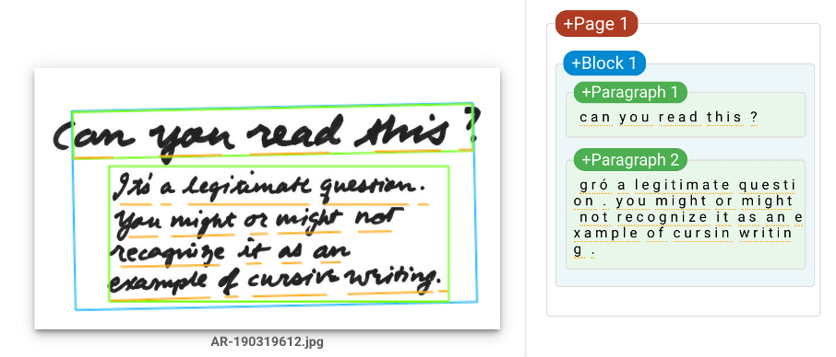
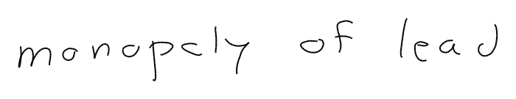
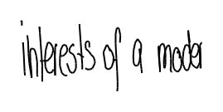
What is our project about?
Handwriting Recognition (HWR) is the task of converting handwritten text into digital text.
This task is difficult because:
Every writer’s style is unique.
Each writer displays variability when writing the same alphabet.

Slide 3
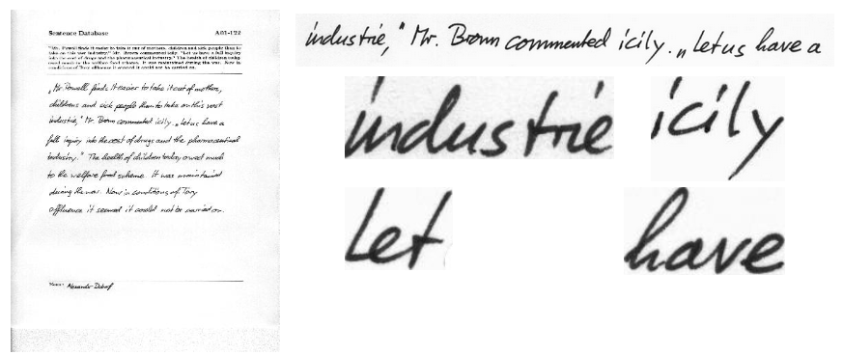
What is our project about?
HWR models are mostly trained on handwriting from multiple authors.
Sample Handwriting from IAM Handwriting Database
This leads to overgeneralisation:
Model “understands” the general representation of handwriting.
Does not account of unique style of unseen author and hence underperforms.

Slide 4
How can we “learn” style?
HWR models specialized at predicting handwriting from individual authors.
Image: Real handwriting from Author 107, “monopoly of lead”.
This is achieved by further training model with one author’s handwriting.
However, it is difficult to obtain annotated handwriting data from each author!

Slide 5
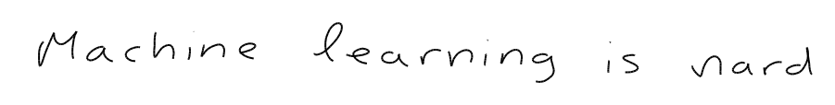
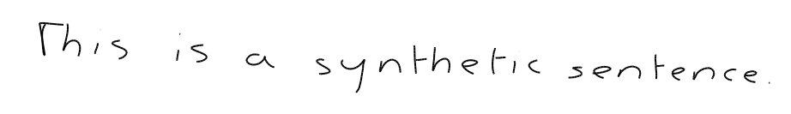
How do we get more handwriting data?
“This is a synthetic sentence.”
Input: User defined String
Input: Real handwriting from Author 107, “monopoly of lead”.
Feature: Synthetic Handwriting
Label: User Defined String
Generative Adversarial Network
Synthetic Handwriting Dataset for Author 107
Output: Multiple Synthetic handwriting from Author 107.

Slide 6
How to get more data?
Input: Real handwriting from Author 107, “monopoly of lead”.
Generative Adversarial Model
Output: Multiple Synthetic handwriting from Author 107.

Slide 7
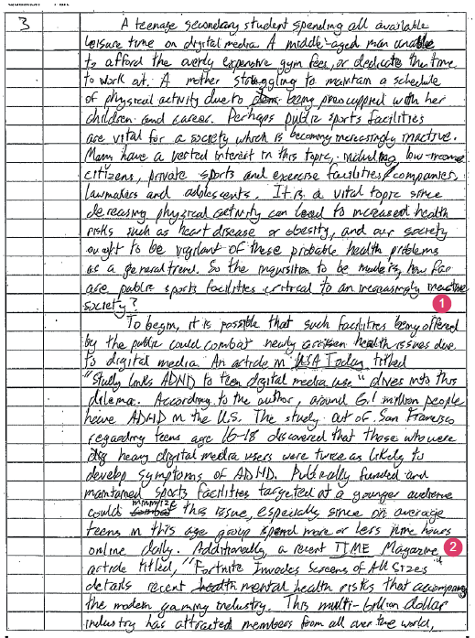
Why is our project significant?

Slide 8
How do we define success?

Slide 9
How do we define success?

