Slide 1
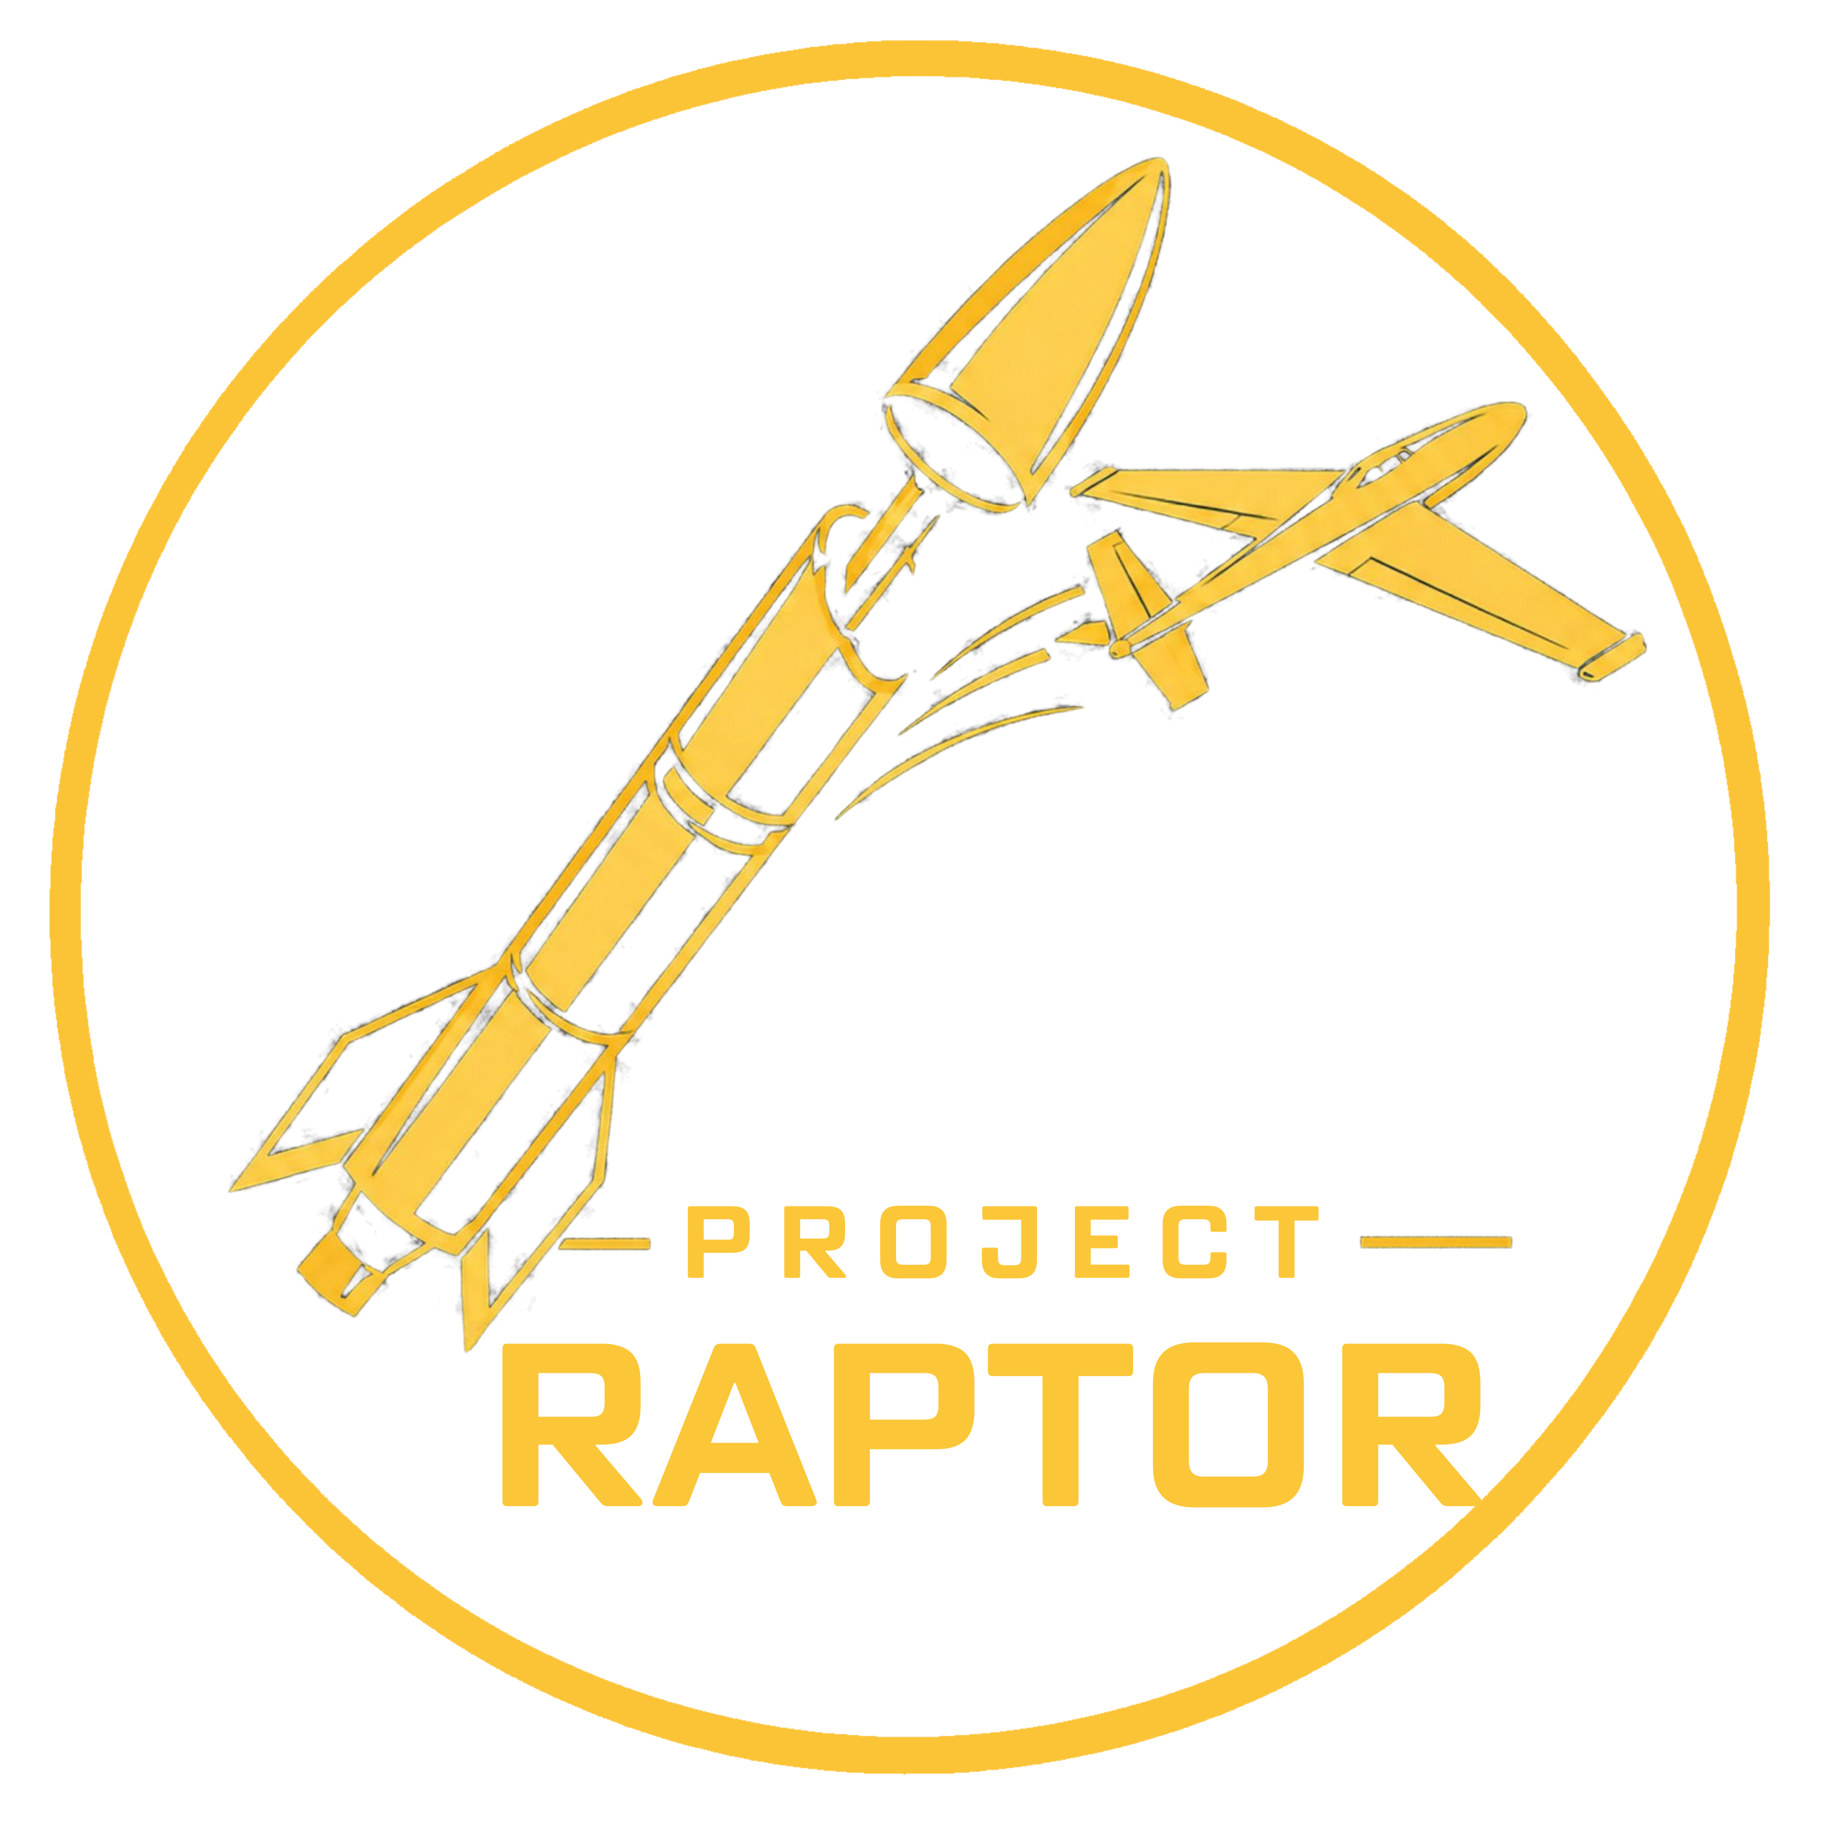

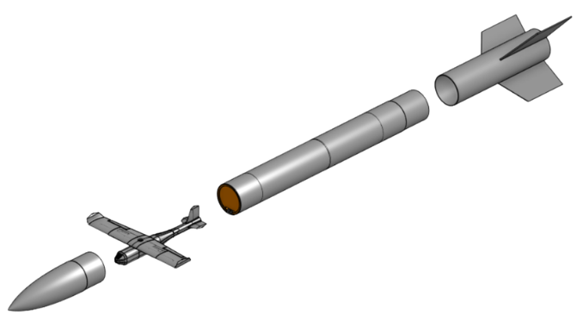
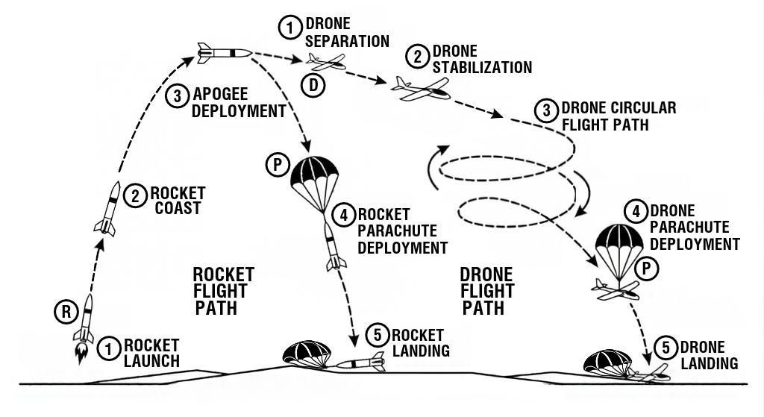
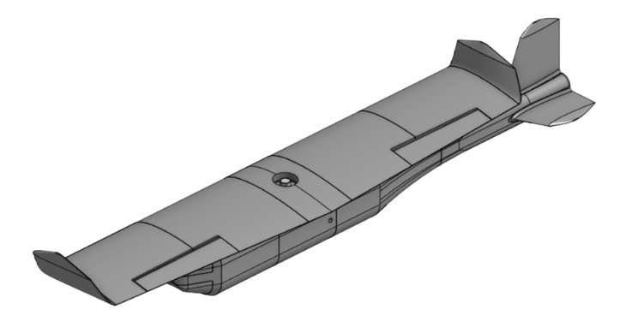
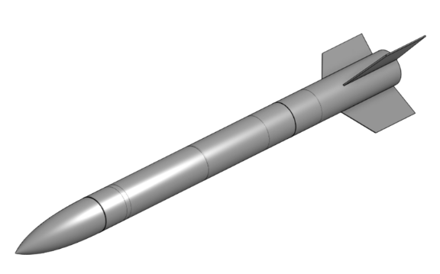
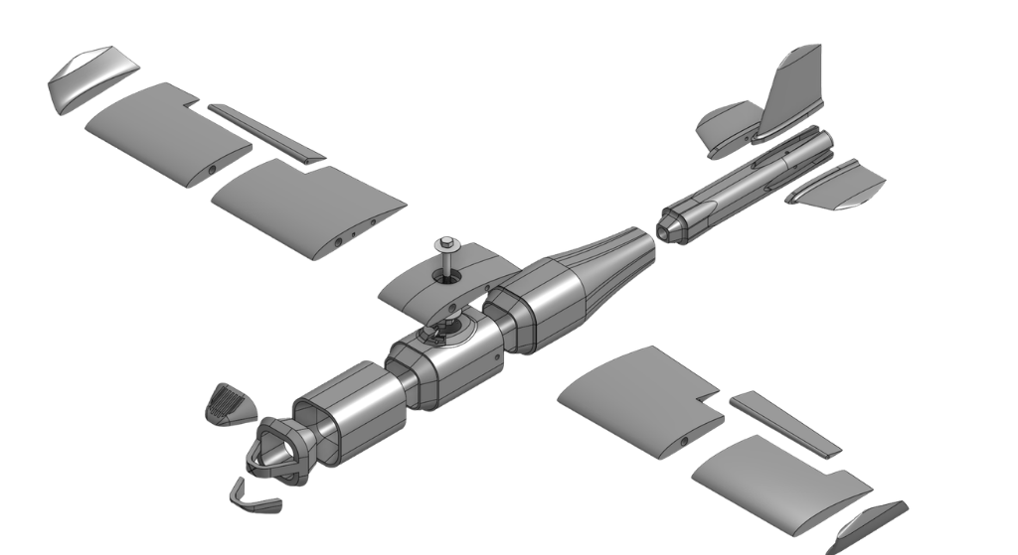
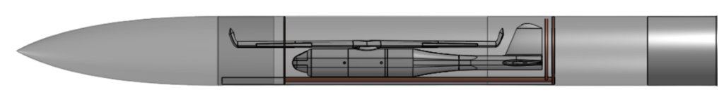

Project RAPTOR
Rocket Apogee Payload Transition to Optimal Return
Steve Sanghi
College of Engineering
Carter Novick, Dominic Hartman, Justin Fox, Kaidan Holliday, Rhett Yardley
Abstract
Mission Overview
Launch Vehicle & Payload Assembly
Project RAPTOR integrates an autonomous fixed-wing UAV payload deployment system within a custom high-powered rocket launch vehicle. At a target apogee of 1,500 to 2,000 ft. AGL, the RAPTOR Mega Rocket ejects the RAPTOR Mini UAV. Upon separation, the drone transitions into its flight orientation to execute the optimal flight path. This platform provides a cost-effective solution for rapid response and high-altitude imaging.
Figure 1 depicts the complete mission flight profile, illustrating the RAPTOR Mega launch to apogee, pneumatic payload separation, RAPTOR Mini descent and independent recoveries for both vehicles.
Figure 2 displays a 3D CAD of the post-deployment RAPTOR Mini drone with wings expanded, the stowed payload ejection sequence, and the complete modular 7.51-inch rocket airframe assembly.
RAPTOR Mega Rocket Module
RAPTOR Mini UAV Module
Airframe Architecture:
Custom 105-inch airframe with a 7.51-inch diameter, constructed from fiberglass reinforced phenolic tubing.
Preliminary estimated launch weight of ~22 lbs.
Trajectory & Motor:
Simulated in OpenRocket to verify aerodynamic stability with a ~1.6 caliber margin.
Thrust profiles generated using a 54 mm K-class solid rocket motor.
Avionics & Recovery:
Houses a dual-deployment electronics bay including a Blue Raven flight computer, Featherweight GPS and parachute recovery system.
Version 0 Proof of Concept:
Designed and manufactured initial wing rotation mechanism and fuselage for early testing and verification.
Version 1 Complete PETG Prototype:
Introduced segmented 3D modeling to fit in a 220 mm³ build plate.
Version 2 Flight Ready Design:
Completed ASA Aero airframe integrating carbon-fiber spars, control surfaces, and a Matek F405 flight controller.
Payload Ejection Module
Dual-Plate Guide Rail Assembly: Includes two plates of different diameters mounted to a central guide rail to actuate the apogee ejection phase.
Nose Cone Separation: The larger diameter plate travels 7 inches before striking a max-travel stopper, while actuating push rods and an ejection ring to separate the nose cone from the payload bay.
Drone Payload Deployment: The second plate extends through a full 30-inch travel, pushing the RAPTOR Mini completely out of the rocket airframe.
Figure 4 exhibits the guide rail, dual plate mechanism, push-rod nose cone separation assembly, and payload ejection assembly.
Website QR Code:
Figure 3 details an exploded view of the flight ready RAPTOR Mini, including the modular airframe and central wing-pivot mechanism.
Visit our website for information on the current progress and future work!

