Slide 1

Project RAPTOR
Rocket Apogee Payload Transition to Optimal Return
Midterm Progress Report
By: Dominic Hartman, Carter Novick, Justin Fox, Kaidan Holliday, Rhett Yardley,
Date: October 23, 2026

Slide 2
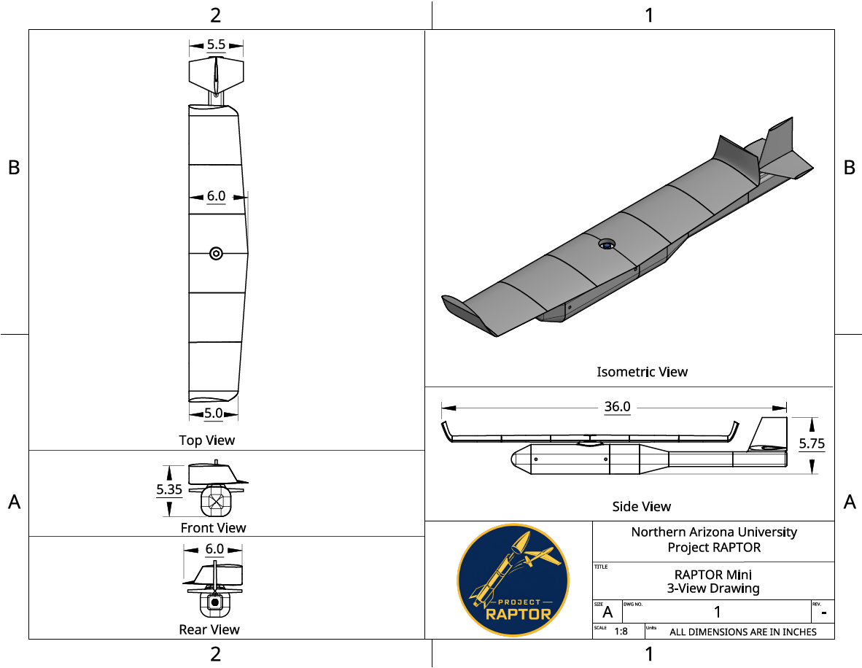
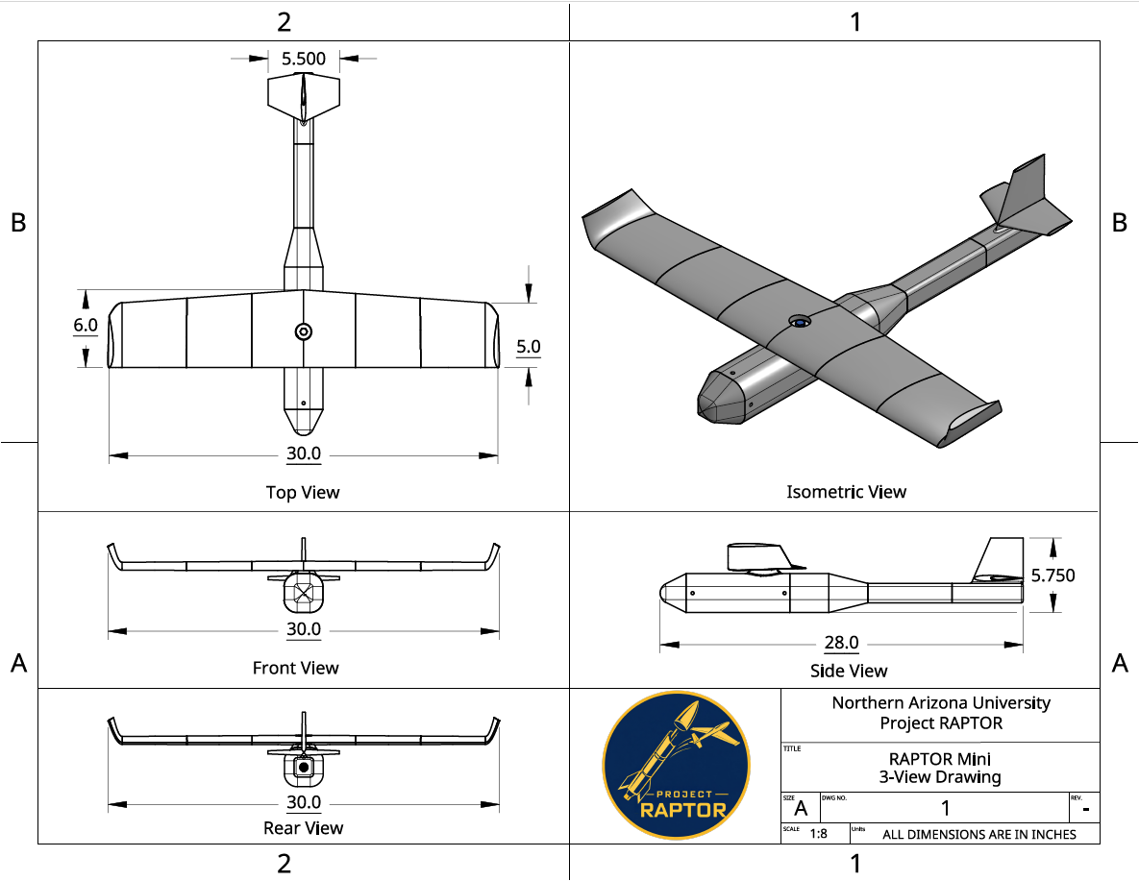
RAPTOR Mini Progress
Launch Stage Orientation
Developed a 3D-printable CAD model from a customer requirements and engineering constraints
Estimate maximum vehicle weight and sized wings to provide required lift
Designed the airframe to package the wings in a folded configuration
Flight Stage Orientation
Designed a folding wing mechanism to transition to the deployed flight configuration
Integrated a torsion spring to generate wing rotation torque
Incorporated nylon hardware and a locking mechanism to secure wing positioning
[1] Figure 1: UAV 3-View Launch Orientation Drawing
[2] Figure 2: UAV 3-View Flight Orientation Drawing
Notes:
Rhett’s Half (45 Seconds):
To begin this report, we will discuss the progress of RAPTOR Mini, the UAV module of Project RAPTOR. We’ve developed a 3D-Printable CAD model, incorporating customer requirements and translating them into engineering constrains. We estimated the maximum vehicle weight for sizing the wings to provide sufficient lift. From there, we designed the airframe to support the wing position during launch. Figure 1 shows the 3 View drawing of the launch stage orientation. We will now move on to Kaidan where he will cover the flight stage orientation.
Kaidan’s Half (45 Seconds):
Once deployed, the wings rotate into their flight configuration using a torsion spring to provide the necessary torque. The mechanism uses nylon hardware, and a locking feature is designed to hold the wings position. This allows us to transition from a compact launch configuration to a fixed wing glider while keeping the mechanism simple and compatible with our 3D printed design. Next, Justin will cover the Rocket’s Progress.

Slide 3
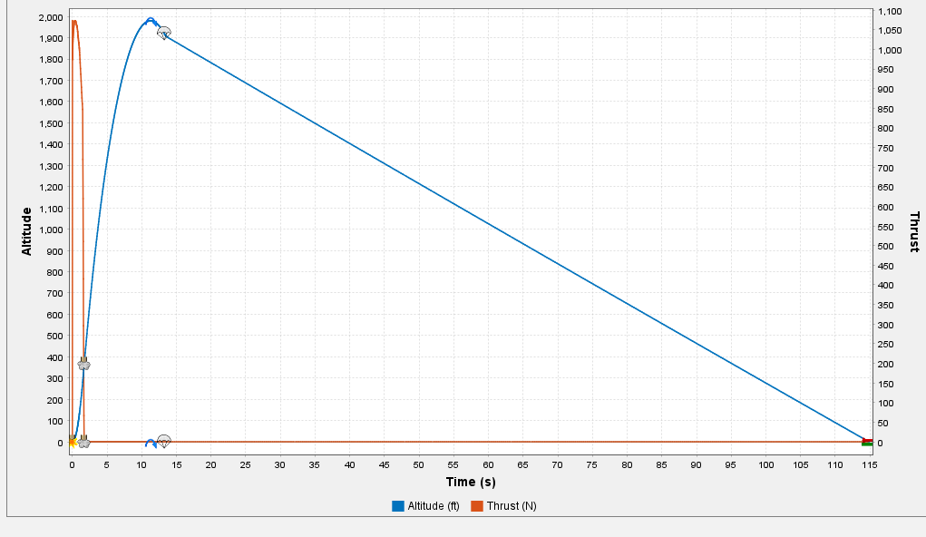
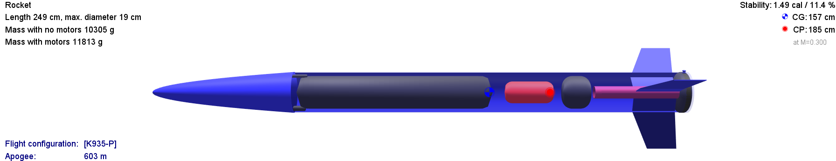
Rocket Progress
Rocket Design (Open Rocket)
Rocket Body Part Ordering
Initial On-Board Designs
  Ejection Systems
  Flight Computer / Telemetry
  External Camera
[3] Figure 3: Altitude Versus Time Sim
[4] Figure 4: Open Rocket Design
Notes:
Designed in open rocket based off the finalized mass and dimensions of the drone and internal components.
Rocket around 8 ft tall total, 25 lbs.
We ordered body tubes rocket components, construction to start soon.
We have started initial electrical designs .
Here is a simulation from open rocket…..

Slide 4
References
[1] Figure 1: UAV 3-View Launch Orientation Drawing made from OnShape.
[2] Figure 2: UAV 3-View Flight Orientation Drawing made from OnShape
[3] Altitude versus time graph of the rocket launch made with Open Rocket
[4] Figure 4: Open Rocket Design

Slide 5
Thank You

