Slide 1

Project RAPTOR
Rocket Apogee Payload Transition to Optimal Return
By: Rhett Yardley, Dominic Hartman, Carter Novick, Justin Fox, Kaidan Holliday
Date: September 18th, 2026
Notes:
Each introduce ourselves, then Justin says himself and acynumym

Slide 2
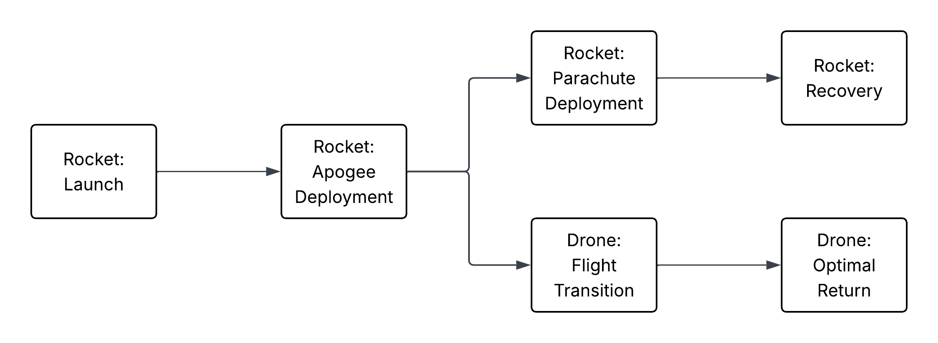
Project Overview
High Powered Rocket Module
Deployable Drone Module
Solid propellant motor rocket
Carries payload to the target altitude
  Designing for a target of 1,500 – 2,500 ft. AGL (Above Ground Level)
Supported by deployment module
Electronics for telemetry, communication, and deployment
Compact fixed wing aircraft that is housed within the rocket body
  Wings must collapse for storage and open after apogee deployment
Supported by controls module
Electronics for telemetry, communication, controls and power
Figure 1: Concept of Operations
Notes:
2 aeronautical components
Go slowly through the animations

Slide 3
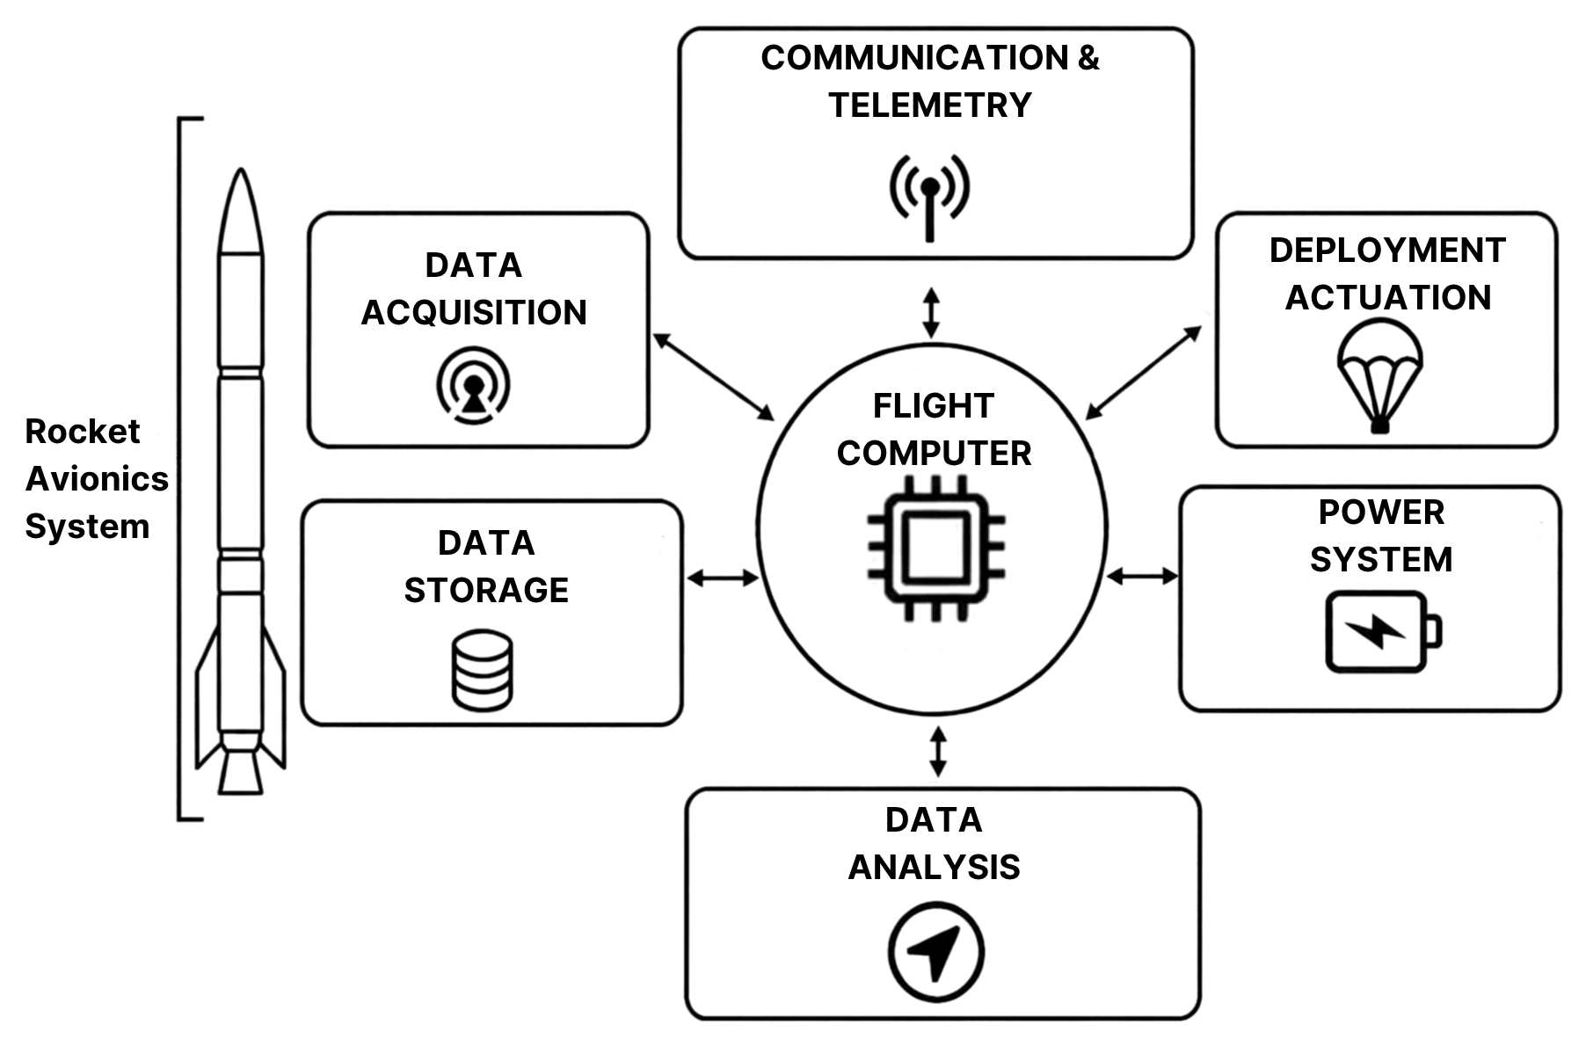
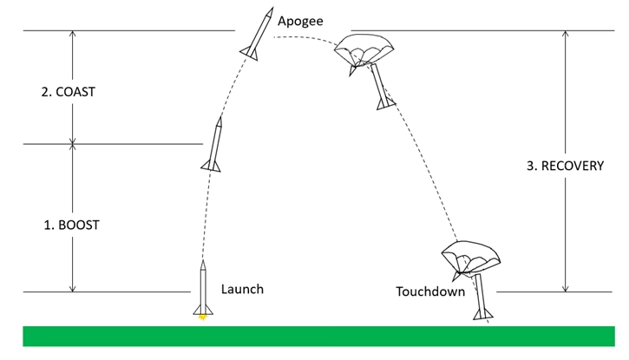
High Powered
Rocket Module
Avionic Components
  Flight computer
  Barometer
  Inertial measurement unit
  Communication
  Telemetry
  Deployment actuation
Mission Phases
  0) Pre-launch
  1) Launch
  1) Boost
  2) Coast
  2) Apogee
  3) Deployment
  3) Touchdown
  3) Recovery
Figure 2: Rocket Avionic Components
Figure 3: Rocket Flight Phases [1]
Notes:
First let talk about the rocket module
A high-powered rocket will have many electrical components these include;
More simple then the drone mod

Slide 4
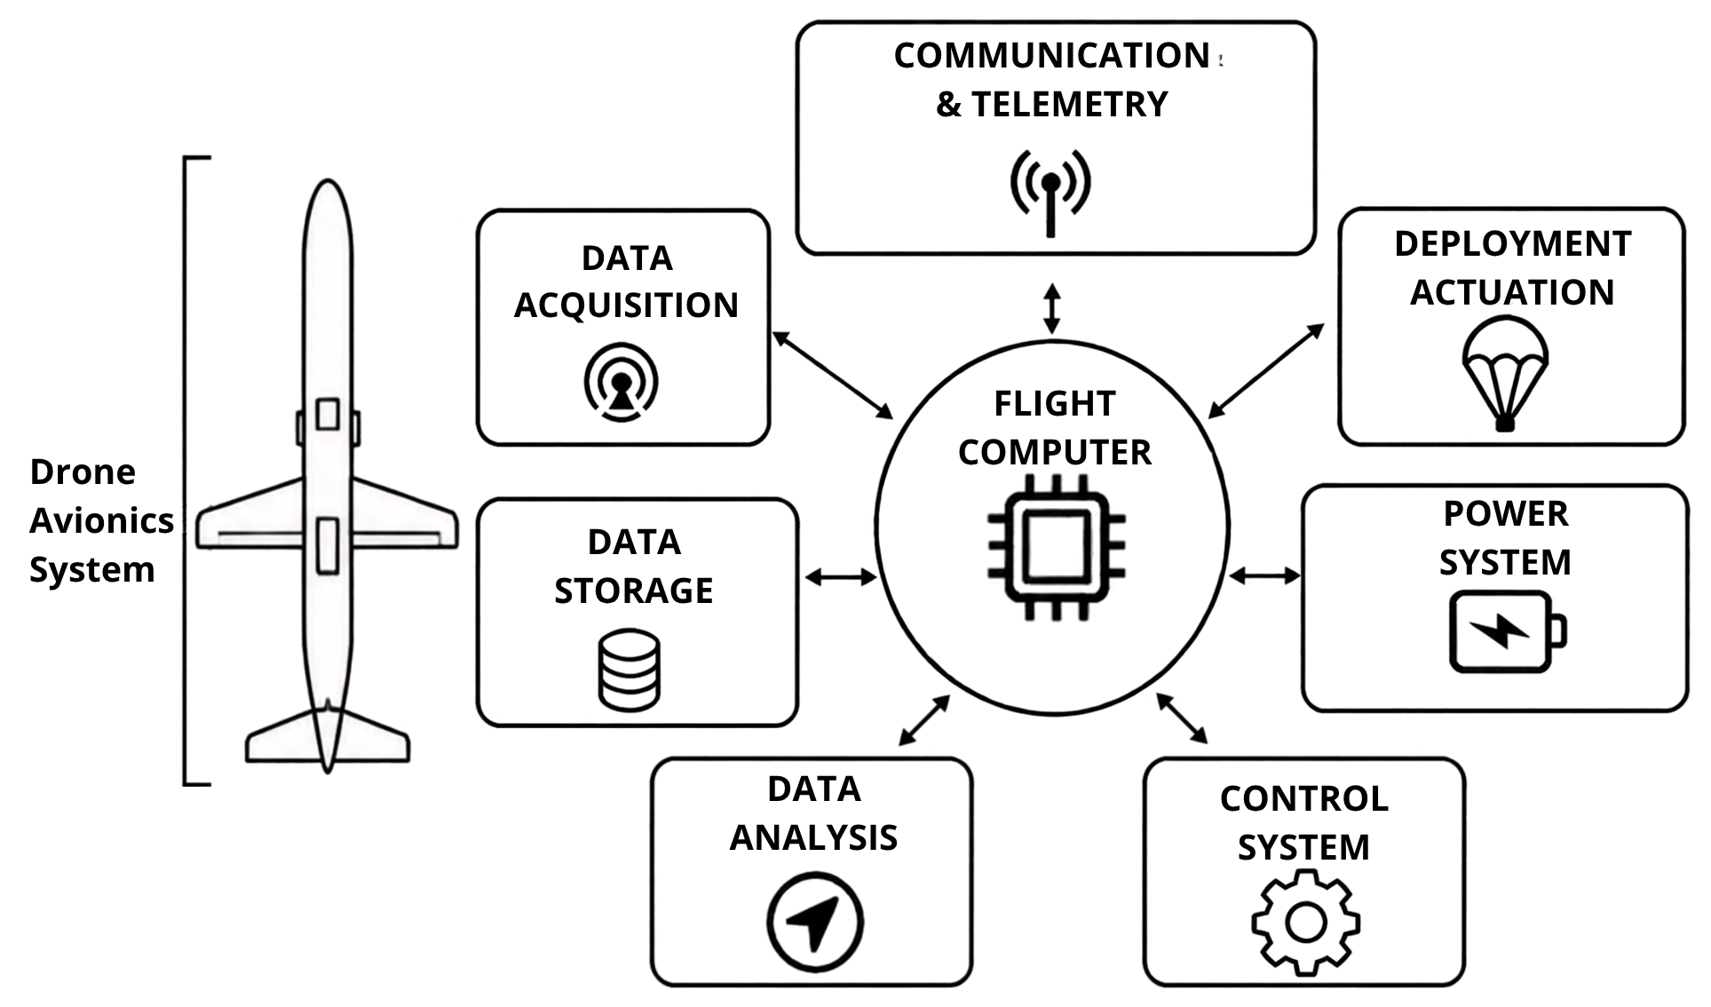
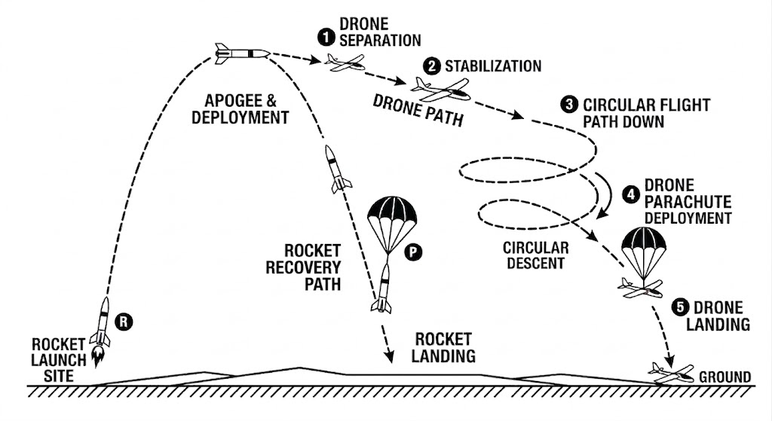
Deployable Drone
Module
Avionic Components
  Flight computer
  Electronic speed controller
  Barometer
  Inertial measurement unit
  Communication
  Telemetry
  Control system
Mission Phases
  1) Drone separation
  2) Stabilized flight
  3) Circular descent
  4) Parachute deployment
  5) Optimal landing
Figure 4: Drone Avionic Components
Figure 5: Drone Flight Phases
Notes:
The next major module for Project RAPTOR is the deployable drone. The drone will have a separate avionics system, centered around its flight computer. The flight computer will interface with the peripheral components for data acquisition, telemetry, communication, and the active control system.
The overall drone mission will be broken into five phases. The drone’s mission begins at apogee, where the drone separation occurs. Once the drone separates from the rocket, stabilized flight will quickly be established. This will be followed by a circular descending flight path. Stage 4 will involve a parachute deployment to safely establish phase 5, grounding the drone.

Slide 5
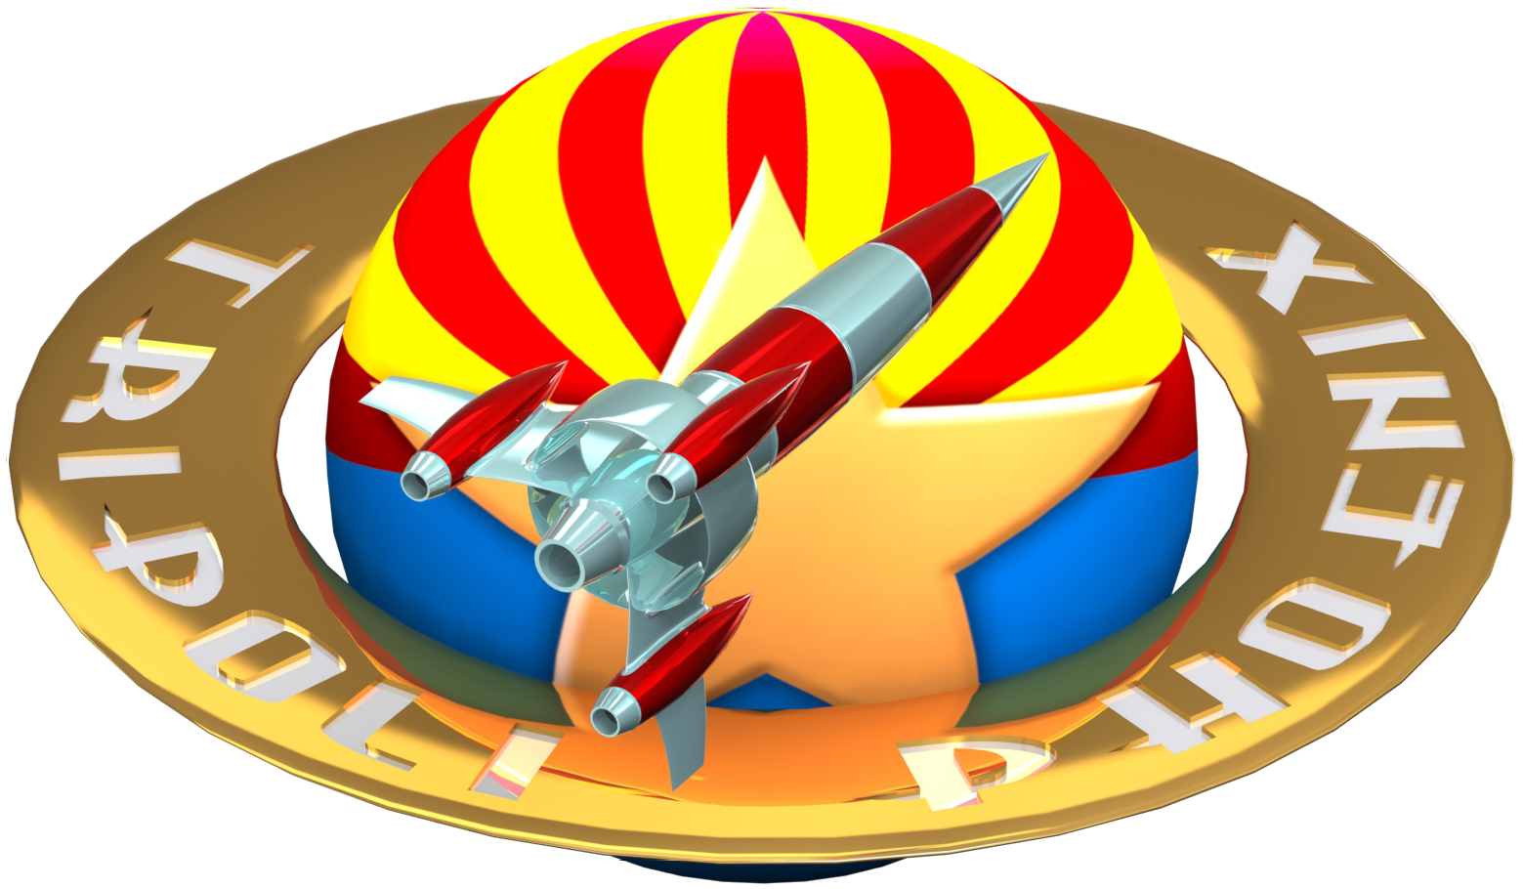
Requirements Overview
Integrated System: Build a flight-ready rocket with an internally carried/integrated glider.
Target Apogee: Reach 1,500–2,500 ft AGL; model trajectory, stability, and speed in RockSim.
Autonomous Deployment: Detect apogee autonomously and safely eject the glider.
Stable Transition: Demonstrate a clean, reliable shift from rocket release into glided flight.
Active Guidance: Actively steer the glider back toward a designated recovery zone.
Telemetry Data: Record flight performance, dynamics, and controls data for evaluation.
Mission Launch: Execute an integrated flight and recovery at the TRA Phoenix launch site.
Safety Compliance: Adhere strictly to Tripoli Rocketry Association (TRA) codes and ground testing.
Fig. 5 TRAPHX logo [2].

Slide 6
References
[1] “Solid Motor Rocket Propulsion | Science Project,” Science Buddies. Accessed: Sep. 15, 2026. [Online]. Available: https://www.sciencebuddies.org/science-fair-projects/project-ideas/Phys_p008/physics/model-rocket-propulsion
[2] Tripoli Phoenix, “TRAPHX Club Logo,” Tripoli Phoenix Club website. Accessed: Sep. 16, 2026. [Online]. Available: https://traphx.clubexpress.com/

Slide 7
Thank You

