Slide 1
Predicting heart failure readmission risk
Kaida Ning

Slide 2
Heart failure
Heart failure is a chronic condition in which the heart doesn't pump blood as well as it should. More than 200,000 US cases per year.
Symptoms
Shortness of breath (dyspnea) when you exert yourself or when you lie down
Fatigue and weakness
Swelling (edema) in your legs, ankles and feet
Chest pain if your heart failure is caused by a heart attack
…
Notes:
Source: https://www.mayoclinic.org/diseases-conditions/heart-failure/symptoms-causes/syc-20373142

Slide 3
Known risk factors for heart failure
High blood pressure. Your heart works harder than it has to if your blood pressure is high.
Coronary artery disease. Narrowed arteries may limit your heart's supply of oxygen-rich blood, resulting in weakened heart muscle.
Heart attack. A heart attack is a form of coronary disease that occurs suddenly. Damage to your heart muscle from a heart attack may mean your heart can no longer pump as well as it should.
Diabetes. Having diabetes increases your risk of high blood pressure and coronary artery disease.
Viruses. A viral infection may have damaged your heart muscle.
Alcohol use. Drinking too much alcohol can weaken heart muscle and lead to heart failure.
Tobacco use. Using tobacco can increase your risk of heart failure.
Obesity. People who are obese have a higher risk of developing heart failure.
Irregular heartbeats. These abnormal rhythms, especially if they are very frequent and fast, can weaken the heart muscle and cause heart failure.
Notes:
Source: https://www.mayoclinic.org/diseases-conditions/heart-failure/symptoms-causes/syc-20373142#:~:text=Heart%20failure%2C%20sometimes%20known%20as,to%20fill%20and%20pump%20efficiently.

Slide 4
Use real-world evidence (i.e. EHR data) to develop a risk stratification model
Recruit study subjects.
Collect demographic information, doctors’ notes, and information for factors associated with heart failure.
Follow up and monitor hospitalization due to heart failure.
Train a statistical model to predict risk of readmission.

Slide 5
Training statistical models
Models we can use:
Logistic regression
Neural network
Survival analyses (Cox proportional hazard model)
Model training and validation:
Use 80% data to train the model
Use 20% of the data to validate the model

Slide 6
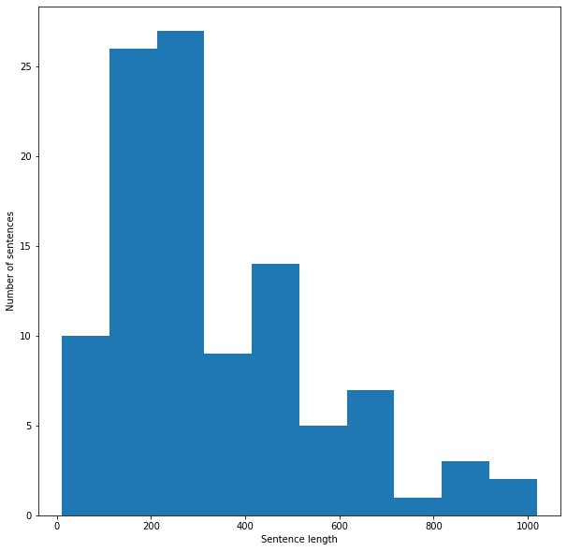
Electronic health records data
We collected doctors’ notes and descriptions for 104 patients.
33,913 words total, with a vocabulary size of 3,386.
How to extract useful information from the text?
Do we have labels?

Slide 7
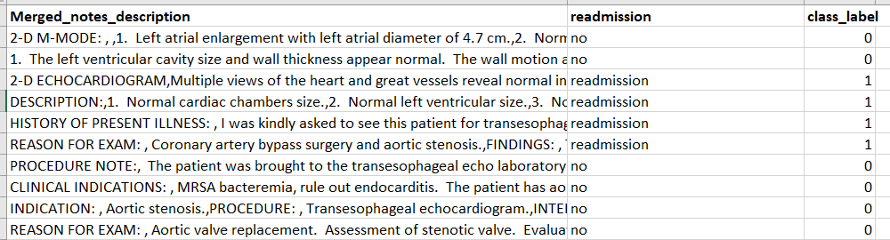
Electronic health records data
We assume that readmission data is available through follow up and carried out statistical models to classify readmission vs. non-readmission.

Slide 8
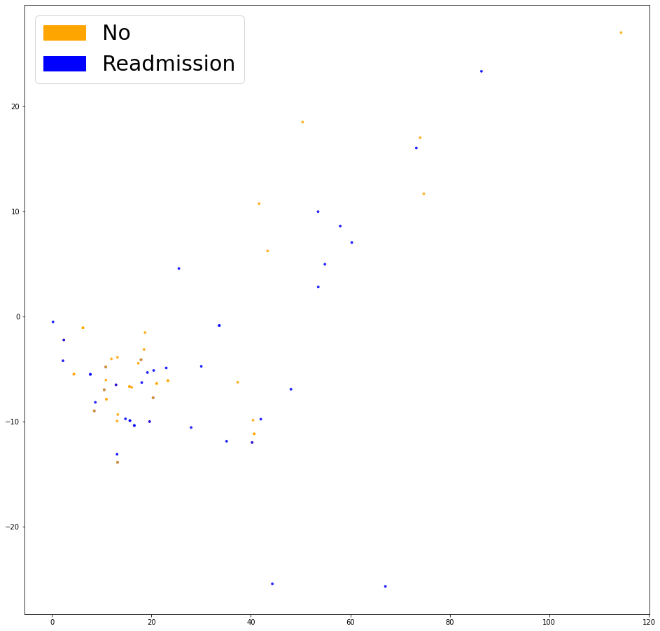
Logistic regression model
Apply bag of words representation to doctors’ notes and descriptions (embeds each sentence as a list of 0s, with a 1 at each index corresponding to a word presents in the sentence).
Principal component analyses of the embeddings

Slide 9
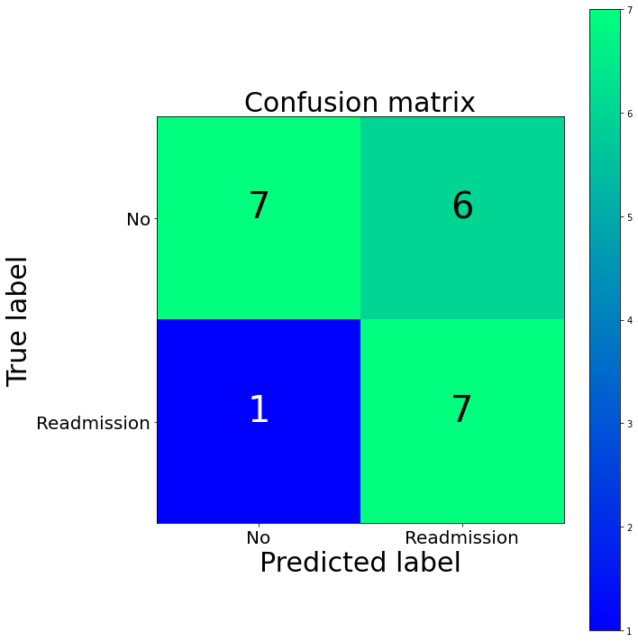
Logistic regression model
Split the samples into training and testing sets.
Train a logistic regression model with training data, where predictors are the 0/1 coded notes and descriptions.
Assess the performance using testing data.
(Python Sklearn library, refer to Kaida’s file NLP_notebook.ipynb).

Slide 10
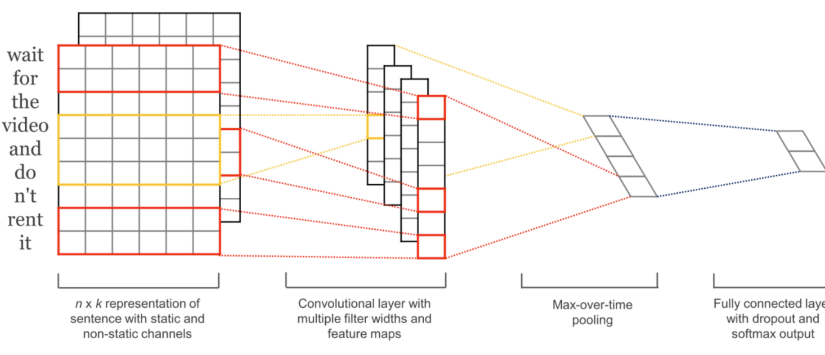
Neural network model
Apply Word2vec embeddings to doctors’ notes and descriptions to map words that are similar close to each other. Each word is represented by a 300-dimension vector (Google Word2vec).
Split the samples into training and testing sets.
Train a convolutional neural network model with training data.
Assess the performance using testing data.
(Python Keras library, refer to Kaida’s file NLP_notebook.ipynb).
Notes:
A neural network model preserves the order of words and learns valuable information to predict our target classes.

Slide 11
Other ways real world data can be leveraged to reduce the disease burden
For people with underlying diseases associated with heart failure (e.g., high blood pressure, diabetes), we can monitor and control the progression of these diseases.
We encourage people to develop good lifestyle habits such as adopting good sleep habits, eat nutritious food, and prevent themselves from virus infection by wearing face masks, etc.
Record and analyze data for patients’ daily behavior and identify potential risk factors.

