Slide 1
Probability: an introduction to modeling uncertainty
Kaidi Wang
kdwang@must.edu.mo
Office: O913
Office hour: 14:00 – 15:00 on Mon., Tue., Wed., Thu.

Slide 2
Events and probabilities
Random experiment
Sample space
Event
Probability of an event

Slide 3
Basic relationships of probability
Complement of A
Venn diagram
Union of A and B
Intersection of A and B
Addition law
Mutually exclusive events

Slide 4
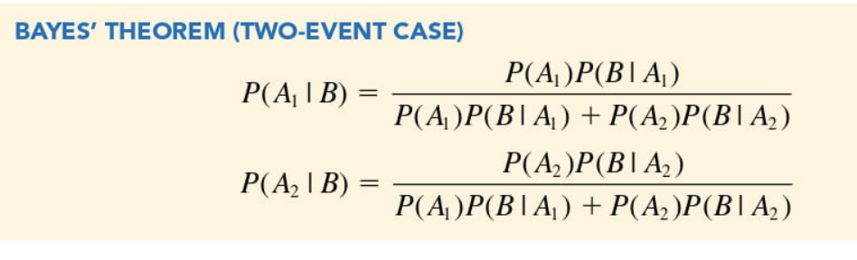
Conditional probability
Conditional probability
Joint probability
Marginal probability
Independent event
Multiplication law
Baye’s theorem
Prior probability
Posterior probability

Slide 5
Random variables
Discrete random variables
Continuous random variables

Slide 6
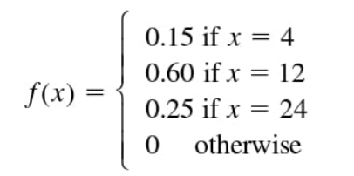
Discrete probability distributions
Probability distribution
Probability mass function – discrete variable
Empirical probability distribution – distribution generated from observations
Custom discrete probability distribution

Slide 7
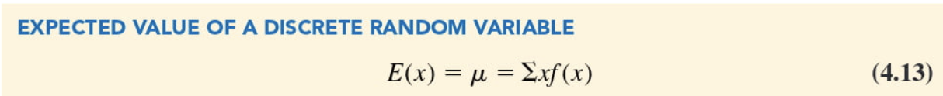
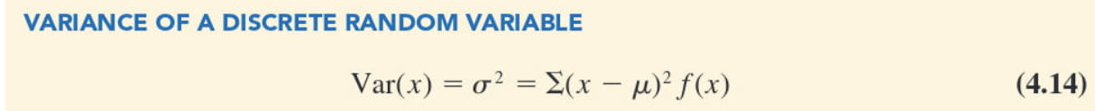
Expected value and variance
Excel - > SUMPRODUCT

Slide 8

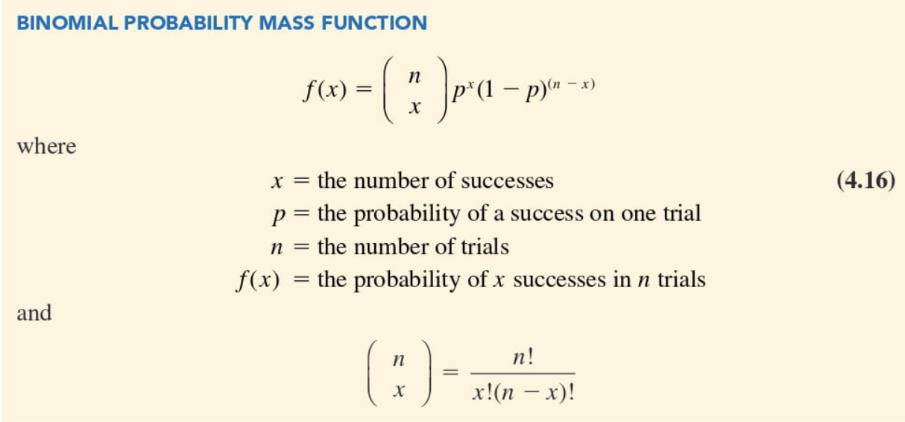
Discrete probability distribution
Excel - > BINOM.DIST

Slide 9
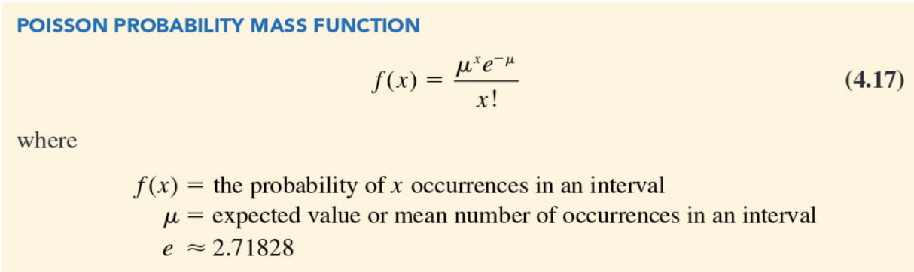
Discrete probability distribution
Excel - > POISSON.DIST
Two properties of applicable scenarios:
The probability of an occurrence is the same for any two intervals of equal length;
The occurrence or nonoccurrence in any interval is independent of the occurrence or nonoccurrence in any other interval.
Property of Poisson distribution: the mean of the distribution and the variance are always equal.
Notice:
When computing a Poisson probability for a different time interval, we must first convert the mean arrival rate to the period of interest and then compute the probability

Slide 10
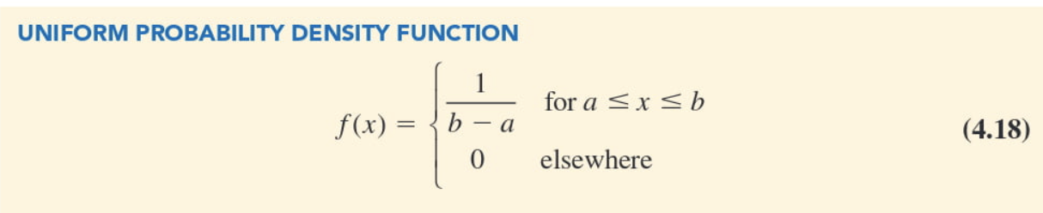
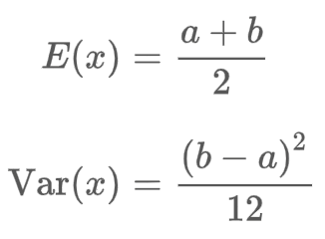

Continuous probability distributions
Probability density function: does not directly provide probability

Slide 11
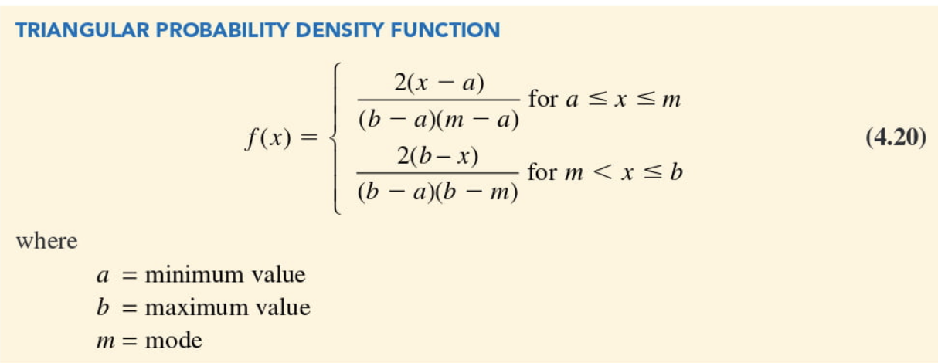
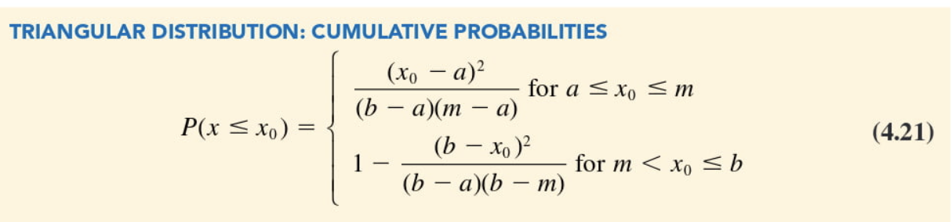
Continuous probability distributions
Triangular distribution is useful when only subjective probability estimates are available.

Slide 12
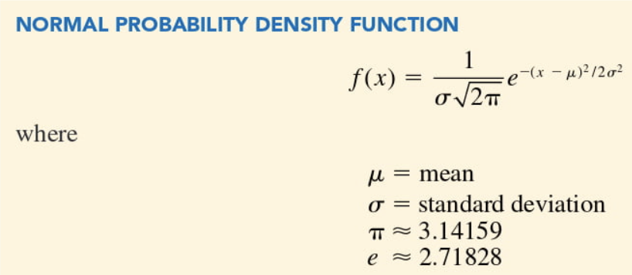
Continuous probability distributions
Mean (location), standard deviation (shape)
Highest point is at the mean, median and mode
Symmetric
Tails extend to infinity and never touch the horizontal axis
Larger standard deviation results in wider, flatter curves
Total area under the curve is 1
68.3%, 95.4%, and 99.7% of values are within -+ one std.
Excel -> NORM.DIST NORM.INV

Slide 13
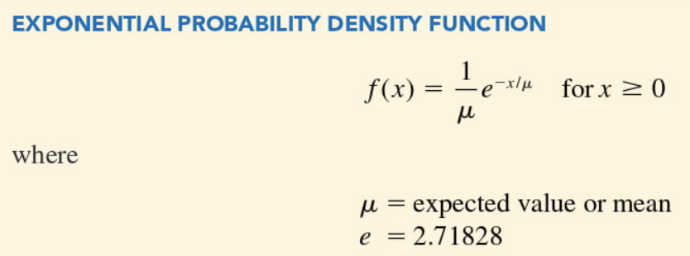
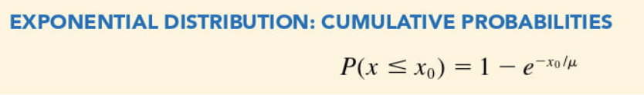
Continuous probability distributions
Exponential probability distribution may be used for random variables such as the time between patient arrival, the distance between major defects in a highway, etc.
Excel -> EXPON.DIST

