Slide 1
Introduction to Business Analytics
Kaidi Wang
kdwang@must.edu.mo
Office: O913
Office hour: 14:00 – 15:00 on Mon., Tue., Wed., Thu.

Slide 2
About me
Name: Kaidi Wang
Education:
Ph.D. in Planning, Governance, and Globalization, Virginia Tech
M.S. in Information Security, Beijing University of Posts and Telecommunications
B.S. in Information Security, Xidian University
Keywords: emerging mobility, transportation planning, simulation, machine learning, GIS
Interests: tennis, cooking, craft

Slide 3
How about you?
Name
Major
Something interesting about you?
What would you like to learn from the course?
Are you interested in any research topic?

Slide 4
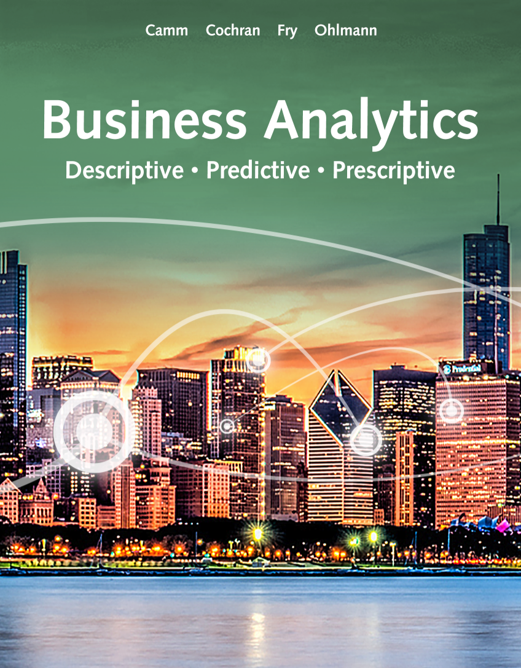
About the course
Course content
Descriptive Analytics
Data visualization
Modeling uncertainty
Descriptive Data Mining
Statistical Inference
Linear Regression
Time Series Analysis and Forecasting
Predictive Data Mining
Grading
Attendance (10%)
Participation or discussion (10%)
Assignment (30%)
Examination (50%)

Slide 5
Course policy
Attendance
You can be excused for one missed class without approval
Assignment submission:
1. Submissions later than 24 hours after the deadline are not accepted.
2. Each late submission within 12 hours after the deadline is penalized by 20 points.
3. Each late submission within 24 hours after the deadline is penalized by 50 points.
4. One late submission within 24 hours after the deadline is excused per student without penalty.

Slide 6
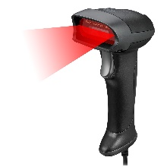


Why business analytics?
Technology advances: better understand customers and improve efficiency
Methodology development: faster algorithms, computational approaches for big data, advanced techniques for visualization
Explosion in computing power and storage capacity

Slide 7
Decision Making
Strategic decisions: overall direction of the organization, overall goals and aspiration for future
Tactical decisions: how to achieve the goals
Operational decisions: daily operations
Identify the problem
Select criteria for evaluation of the solutions
List alternative solutions
Evaluation the solutions
Choose an alternative

Slide 8



Business Analytics
Descriptive analysis:
Describe what happens
Visualization, dashboard, reports, descriptive statistics
Predictive analysis:
Build models using historical data and make predictions about the future
Regression models, time series analysis, data mining, simulation
Prescriptive analysis:
Prediction + rule
Process for transforming data into insights for decision making.
Data-driven and fact-based decision making.

Slide 9
Big data
What do you know about big data?
Volume: terabytes to exabyte
Velocity: streaming data
Variety: structured or unstructured
Veracity: inconsistency, incompleteness, etc.

Slide 10
Applications of data analytics
Financial Analytics
Human Resource (HR) Analytics
Marketing Analytics
Health Care Analytics
Supply-Chain Analytics
Analytics for Government and Nonprofits
Sports Analytics
Web Analytics

Slide 11
Ethical use of data analytics
5 PRINCIPLES OF DATA ETHICS FOR BUSINESS PROFESSIONALS
Ownership: an individual has ownership over their personal information
Transparency: data subjects have a right to know how you plan to collect, store, and use it
Privacy: ensuring data subjects’ privacy
Intention: asking do you really need the data
Outcomes: biased results
Good statistical practice is fundamentally based on transparent assumptions, reproducible results, and valid interpretations – INFORMS ethical guidelines

Slide 12
Descriptive statistics
Kaidi Wang
kdwang@must.edu.mo
Office: O913
Office hour: 14:00 – 15:00 on Mon., Tue., Wed., Thu.

Slide 13
Terms
Data: The facts and figures collected, analyzed, and summarized for presentation and interpretation.
Variable: A characteristic or a quantity of interest that can take on different values.
Observation: A set of values corresponding to a set of variables.
Variation: The difference in a variable measured over observations.
Random variable/uncertain variable: A quantity whose values are not known with certainty.
Table 2.1: Data for Dow Jones Industrial Index Companies
Company | Symbol | Industry
Apple | AAPL | Technology
American Express | AXP | Financial
Boeing | BA | Manufacturing

Slide 14
Terms (cont.)
Population: all element
Sample: a subset
Quantitative: numerical
Categorical: arithmetic operations cannot be performed
Cross-Sectional: collected from different entities at the same time
Time Series: data collected over time
Sources of Data: experimental or non-experimental (e.g., observational)

Slide 15
Distribution of data
Frequency Distributions for Categorical Data
Relative Frequency and Percent Frequency Distributions
Frequency Distributions for Quantitative Data
Histograms
Cumulative Distributions

Slide 16
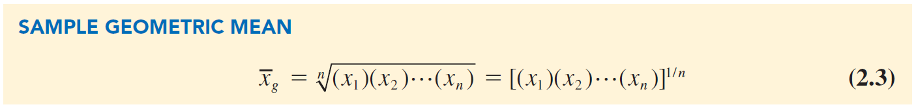
Measures of location
Mean (Arithmetic Mean)
Median
Mode
Geometric Mean

Slide 17
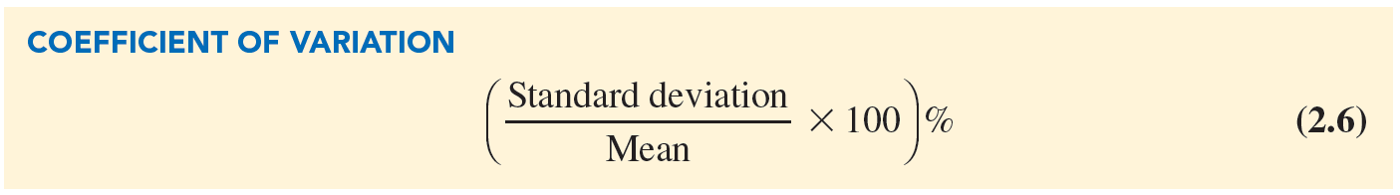



Measures of variability
Range
Variance
Standard Deviation
Coefficient of Variation
descriptive statistic that indicates how large the standard deviation is relative to the mean
$$S^{2}=\frac{\sum{{(x_{i}^{}−\overline{x})}^{2}}}{n−1}$$
Sample variance
Sample standard deviation
$$S= \sqrt{s^{2}}$$
Population variance
Population standard deviation
$$σ= \sqrt{σ^{2}}$$

Slide 18
Python
Install Python
Install Jupyter notebook
Read Python API
Introduce Pandas
Introduce Numpy
Introduce matplotlib

