Slide 1
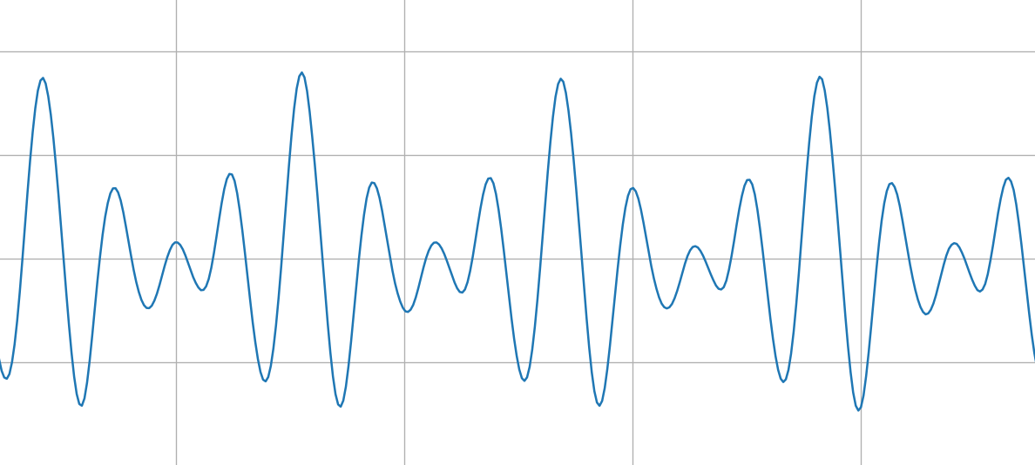
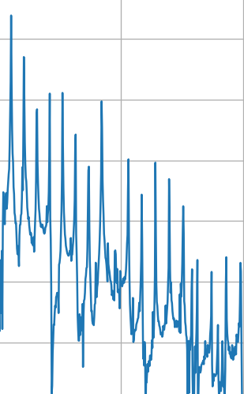


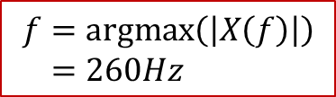
$$f=argmax\left(\left|X\left(f\right)\right|\right) \\ =260Hz$$
Sample Buffer
N-point FFT
$$x(t)$$
$$|X\left(f\right)|$$

