Slide 1
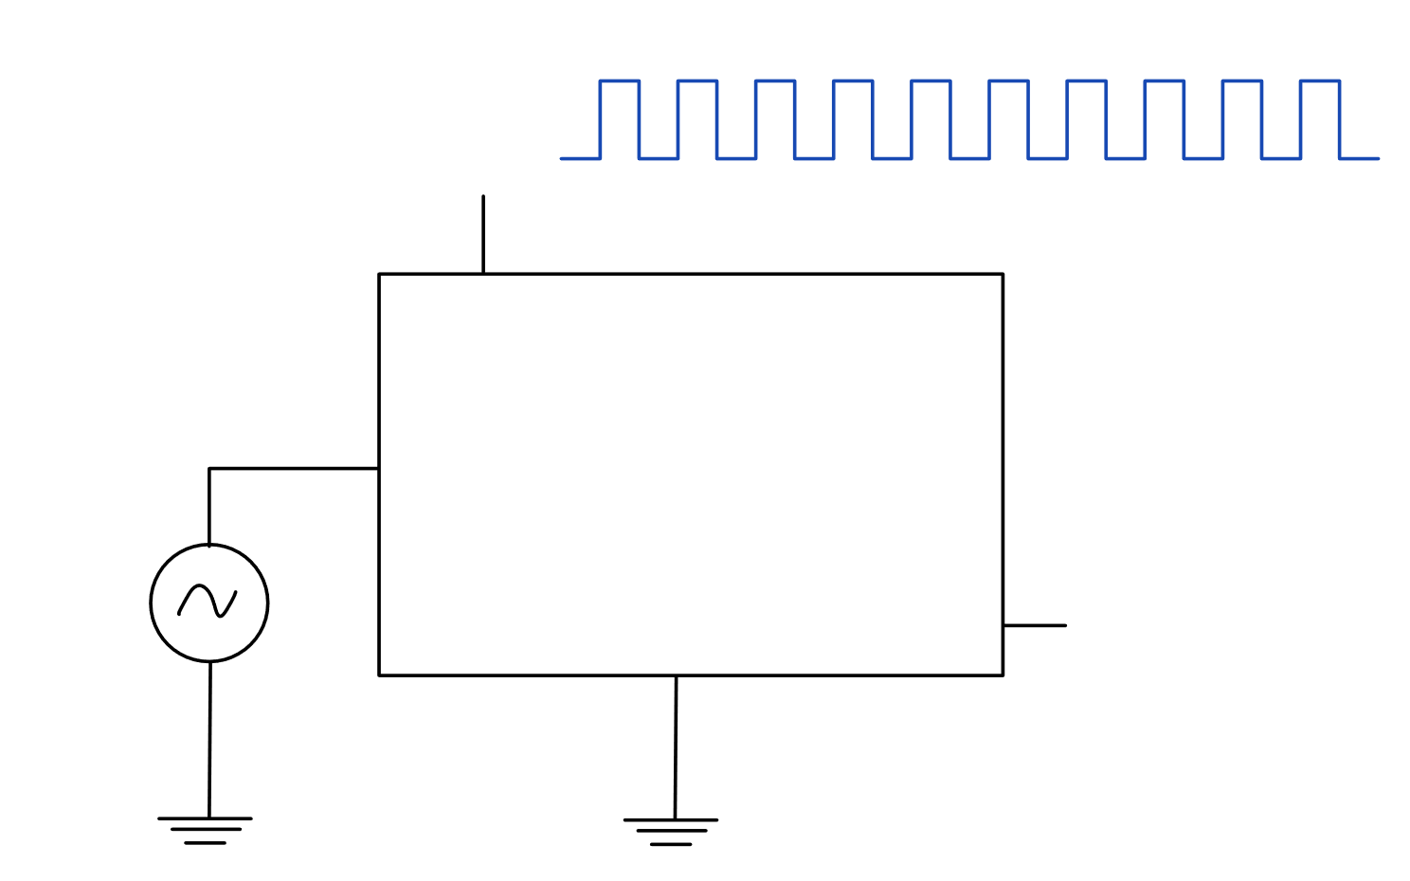



$$CLK:$$
Config & instructions
Analog-to-Digital Converter
Sampled Data
$$x(t)$$
$$u_{ref} \left(3.3V\right)$$

Slide 2
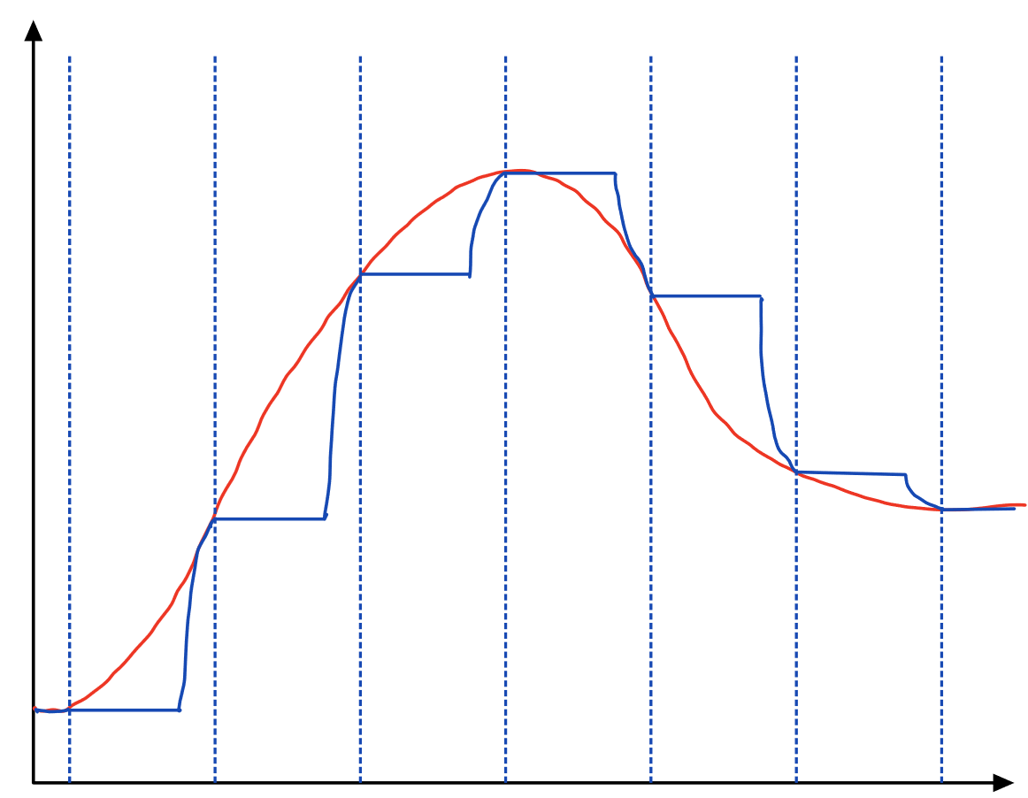













$$:sample phase$$
$$:hold phase$$
$$:analog input$$
$$:S\&H output$$
amplitude $x(t)$
$$t$$
$$1⋅T_{s}$$
$$2⋅T_{s}$$
$$3⋅T_{s}$$
$$4⋅T_{s}$$
$$5⋅T_{s}$$
$$6⋅T_{s}$$
$$7⋅T_{s}$$

Slide 3
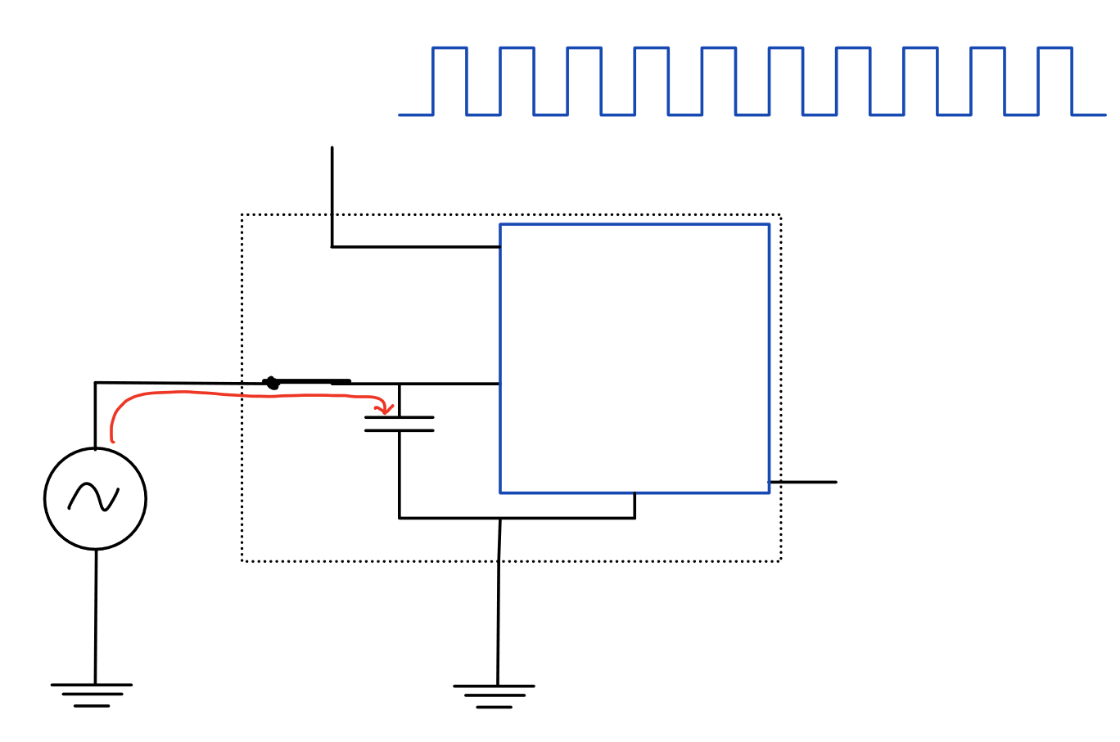





$$CLK:$$
Successive
Approximation
Register
$$v_{c}$$
$$x(t)$$
$$u_{ref} \left(3.3V\right)$$

Slide 4
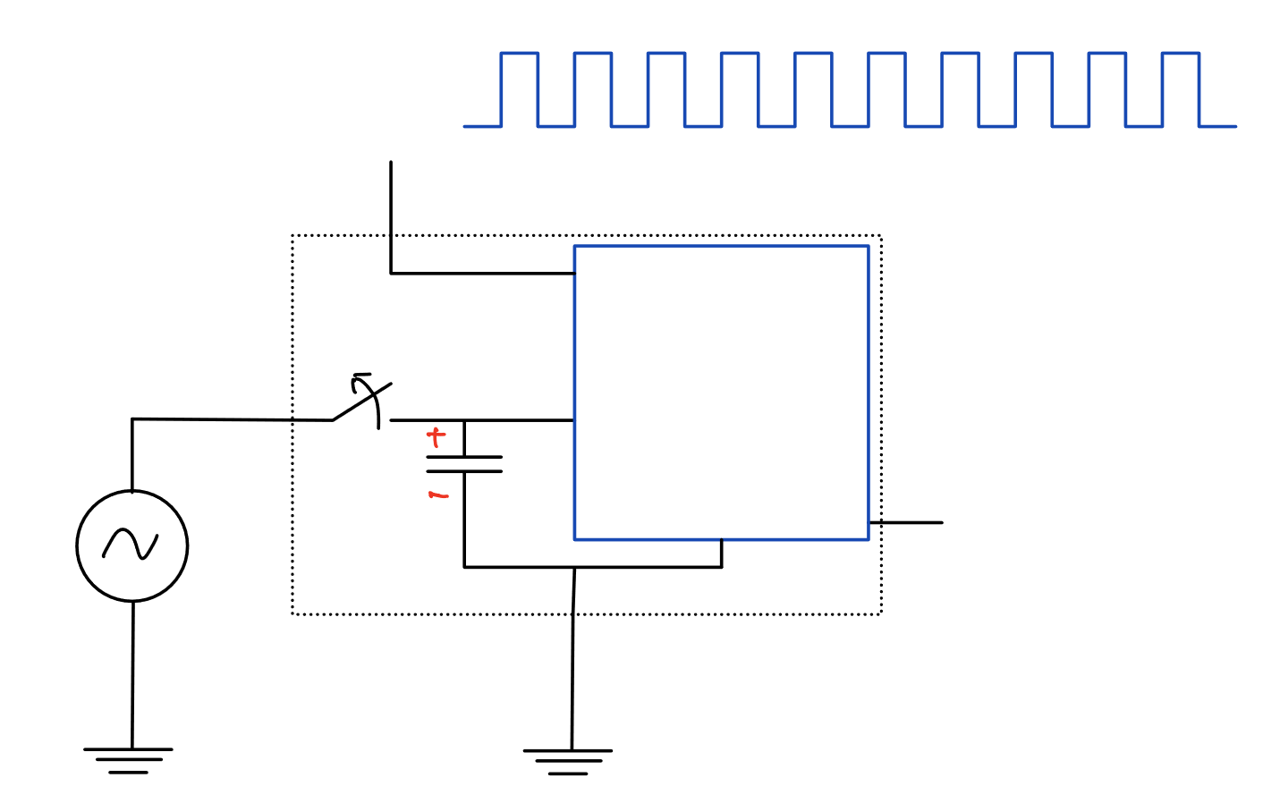









$$CLK:$$
Successive
Approximation
Register
$$t_{n}=n⋅T_{s}$$
$$010010$$
$$x[n]$$
$$x(t_{n})$$
$$v_{c}$$
$$x(t)$$
$$u_{ref} \left(3.3V\right)$$

Slide 5
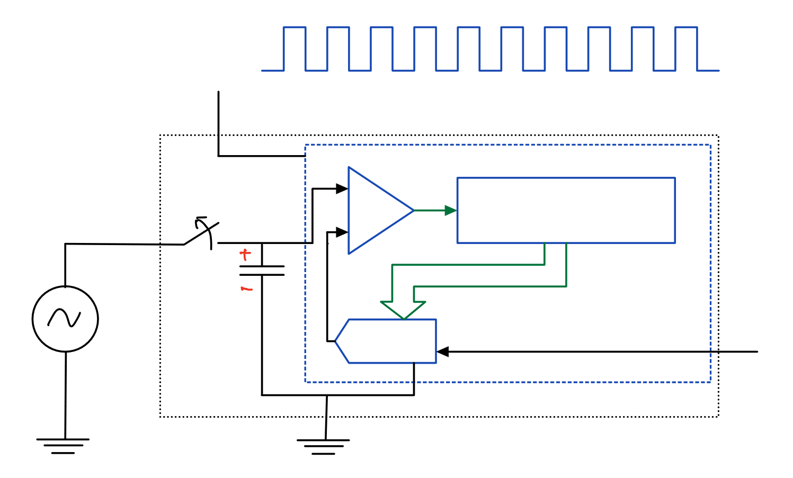











$$CLK:$$
$$t_{n}=n⋅T_{s}$$
$$+$$
$$1/0$$
$$Register:$$
$$comp$$
$$−$$
X | X | X | X | X | X
$$x(t_{n})$$
$$x(t)$$
$$u_{ref} \left(3.3V\right)$$
$$DAC$$

Slide 6



$$CLK:$$
$$t_{n}=n⋅T_{s}$$
$$+$$
$$1$$
$$Register:$$
$$comp$$
$$−$$
1 | 0 | 0 | 0 | 0 | 0
$$2.1V$$
$$x(t)$$
$$1.65V$$
$$u_{ref} \left(3.3V\right)$$

Slide 7


$$CLK:$$
$$t_{n}=n⋅T_{s}$$
$$+$$
$$0$$
$$Register:$$
$$comp$$
$$−$$
1 | 1 | 0 | 0 | 0 | 0
$$2.1V$$
$$x(t)$$
$$2.475 V$$
$$u_{ref} \left(3.3V\right)$$

Slide 8

$$CLK:$$
$$t_{n}=n⋅T_{s}$$
$$+$$
$$1$$
$$Register:$$
$$comp$$
$$−$$
1 | 0 | 1 | 0 | 0 | 0
$$2.1V$$
$$x(t)$$
$$2.0625 V$$
$$u_{ref} \left(3.3V\right)$$

Slide 9

$$CLK:$$
$$t_{n}=n⋅T_{s}$$
$$+$$
$$0$$
$$Register:$$
$$comp$$
$$−$$
1 | 0 | 1 | 1 | 0 | 0
$$2.1V$$
$$x(t)$$
$$u_{ref} \left(3.3V\right)$$
$$2.26875 V$$

Slide 10

$$CLK:$$
$$t_{n}=n⋅T_{s}$$
$$+$$
$$0$$
$$Register:$$
$$comp$$
$$−$$
1 | 0 | 1 | 0 | 1 | 0
$$2.1V$$
$$x(t)$$
$$u_{ref} \left(3.3V\right)$$
$$2.165625 V$$

Slide 11

$$CLK:$$
$$t_{n}=n⋅T_{s}$$
$$+$$
$$0$$
$$Register:$$
$$comp$$
$$−$$
1 | 0 | 1 | 0 | 0 | 1
$$2.1V$$
$$x(t)$$
$$u_{ref} \left(3.3V\right)$$
$$2.1140625 V$$

Slide 12



$$CLK:$$
$$t_{n}=n⋅T_{s}$$
$$+$$
$$Register:$$
$$comp$$
$$x\left[n\right]=2.0625V$$
$$−$$
1 | 0 | 1 | 0 | 0 | 0
$$2.1V$$
$$x(t)$$
$$2.0625 V$$
$$u_{ref} \left(3.3V\right)$$

