Slide 1
Project Proposal
On
Hospital Management
System
Guided By:-
Anuj Kumar
Created By:-
Name: MohdKaif,
Aditya Kushwaha
AFId :AF04971730,
AF04991818
Batch Code:ANPD2405
Course Code:ITPR

Slide 2
TABLE OF CONTENTS
S. No. | Chapter / Section | Page No
1 | Title Of The Project……. | 1
2 | Introduction…….. | 2
3 | Objectives | 3
4 | Project Category | 4
5 | Analysis ● Modules and Description ● Database Design ● ER Diagram ● Data Flow Diagram | 5-9
6 | Complete Structure ● Process Logical Diagram | 10
7 | Platform Used ●Hardware Requirement ●Software Requirement | 11
8 | Future Scope | 11
9 | Bibliography | 12

Slide 3
INTRODUCTION
A Hospital Management System (HMS) plays a vital role in improving the efficiency and quality of healthcare services by automating day-to-day operations within a hospital. In traditional hospital environments, many tasks such as maintaining patient records, scheduling appointments, and handling billing are performed manually, which often leads to errors, delays, and inconsistencies. To overcome these challenges, this project presents a computerized Hospital Management System developed using Java, SQL, and JDBC, providing an organized, reliable, and user-friendly platform for managing various hospital activities.
This system is built with Java as the front-end programming language due to its platform independence, strong security features, and object-oriented design structure. SQL is used as the backend database for storing and managing information related to patients, doctors, appointments, treatments, and payments. JDBC (Java Database Connectivity) acts as a bridge between the Java application and the SQL database, ensuring smooth and secure data transactions. Together, these technologies make the system robust, scalable, and capable of handling real-time hospital operations.
the effective use of Java technologies to solve real-world problems in the healthcare sector. By automating repetitive tasks and centralizing data management, the system enhances productivity, reduces operational costs, and contributes to a well-organized hospital environment. This project highlights the practical application of programming skills, database concepts, and software development techniques in creating a functional and meaningful solution.
1

Slide 4
OBJECTIVES
To automate hospital operations by replacing manual record-keeping with a computerized system that ensures faster and more efficient workflow.
To maintain accurate and organized patient records, including personal details, medical history, treatment information, and billing data.
To simplify appointment scheduling by allowing staff to efficiently manage doctor availability and reduce patient waiting time.
To support doctors and staff by providing quick access to essential information such as patient history, diagnosis details, and treatment plans.
To ensure secure and reliable data management using SQL databases and JDBC connectivity, preventing data loss and unauthorized access.
To reduce human errors related to documentation, calculations, and data entry through automated processes.
To streamline administrative tasks, including doctor management, room allocation, discharge process, and billing generation.
To improve decision-making for hospital administrators by generating detailed reports on patients, doctors, treatments, and finances.
To develop a user-friendly interface using Java that helps staff members operate the system easily with minimal technical knowledge.
To create a scalable system that can be expanded in the future with additional modules such as pharmacy management, laboratory services, and online patient portals.
3

Slide 5
Project Category
The Hospital Management System falls under the category
of Management Information System (MIS) or Healthcare Management Software. It is primarily a Database-Driven Application that integrates
software development, database management, and system automation to improve organizational efficiency in a healthcare environment.
Key points about the project category:
Type of Software: Desktop-based application (can be later extended to web-based or cloud-based).
Application Domain: Healthcare and hospital administration.
Technology Category:
  Programming Language: Java (for front-end and business logic)
  Database Management System: SQL (for storing and managing data)
  Connectivity: JDBC (for communication between Java application and database)
Functional Category: Administrative Management
System, as it focuses on hospital operations like patient management, doctor management, appointment scheduling, and reporting.
Purpose: Improves operational efficiency, reduces
human error, and ensures secure and structured data
management in hospitals.
4

Slide 6

Analysis
.
a)Modules and Description
1.Patient Management Module
● Add Patient
● View Patient
● Update Patient
● Delete Patient
2.Doctor Management Module
● Add Doctor
● View Doctor
● Update Doctor
● Delete Doctor
3. Staff Management Module
● Add Staff
● View Staff
● Update Staff
● Delete Staff
5

Slide 7
4.Medicine Management Module
● Add Medicine
● View Medicine
● Update Medicine
● Delete Medicine
5. Room Management Module
● Add Room
● View Room
● Update Room
● Delete Room
7.Appointment Management Module
● Book Appointment
● View Appointment
● Update Appiontment
● Cancel Appointment
6

Slide 8
b) Database Design
● Patient Table
Fields Datatype Properties
patient_id int PK,Auto Increment
patient_name varchar(30) not null
patient_age int not null
patient_gender varchar(10) nut null
● Doctor Table
Fields Datatype Properties
doctor_id int PK,Auto Increment
doctor_name varchar(30) not null
doctor_gender varchar(10) not null
specilization varchar(50) not null
● Staff Table
Fields Datatype Properties
staff_id int PK,Auto Increment
staff_name varchar(30) not null
staff_age int not null
staff_gender varchar(10) not null
salary double not null
● Medicine Table
Fields Datatype Properties
med_id int PK,Auto Increment
med_name varchar(30) not null
med_category varchar(30) not null
quantity int not null
price double not null
expiry_date date not_null
7

Slide 9
● Appointment Table
Fields Datatype Properties
appointment_id int PK,Auto Increment
doctor_id int Foreign Key
patient_id int Foreignt Key
appointment_date date not null
●Room Table
Fields Datatype Properties
room_id int PK,Auto Increment
staff_id int Foreign Key
patient_id int Foreignt Ke
.
8

Slide 10
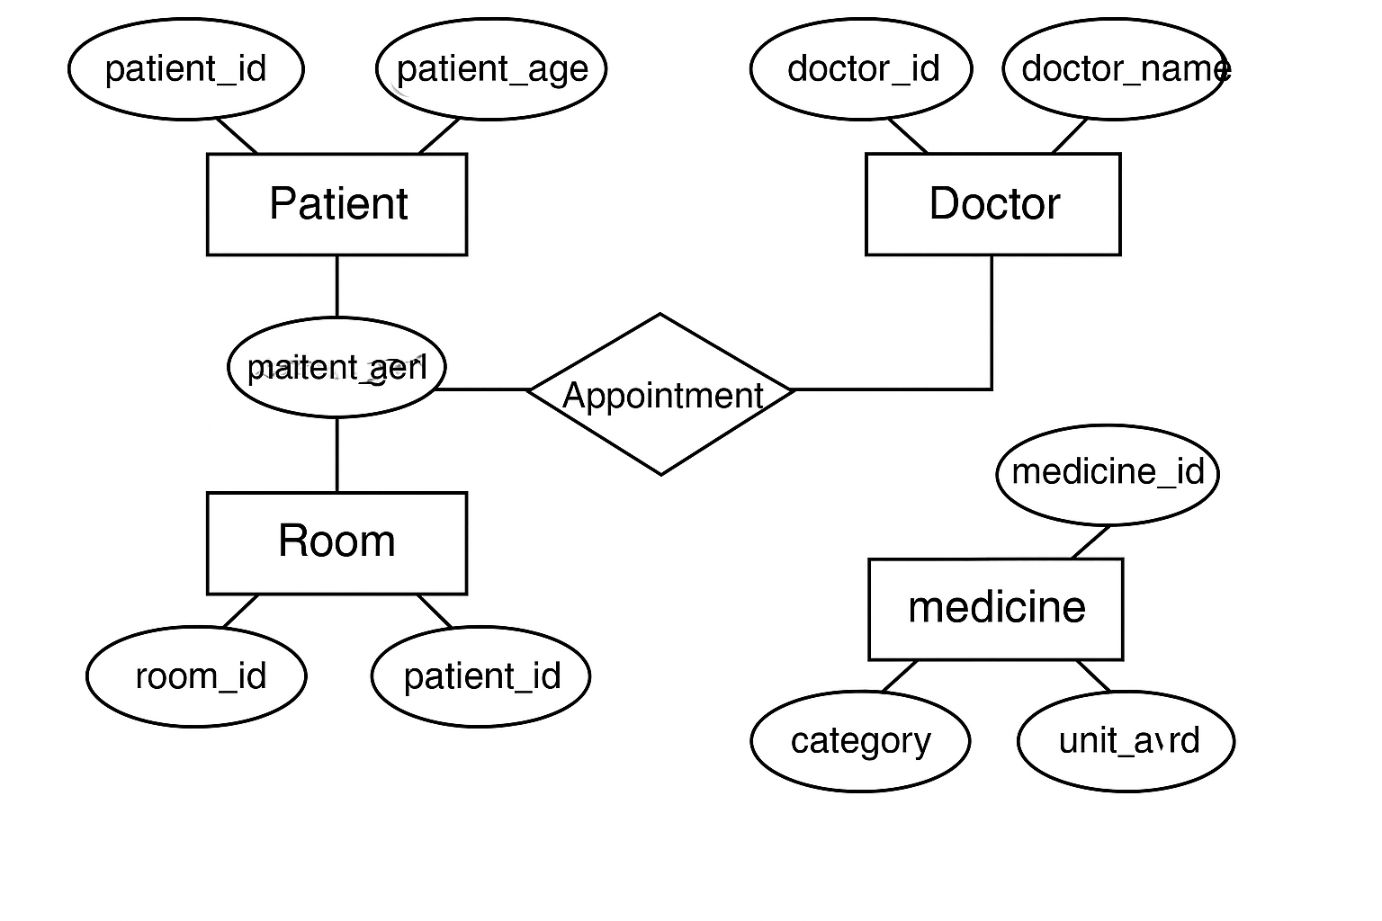
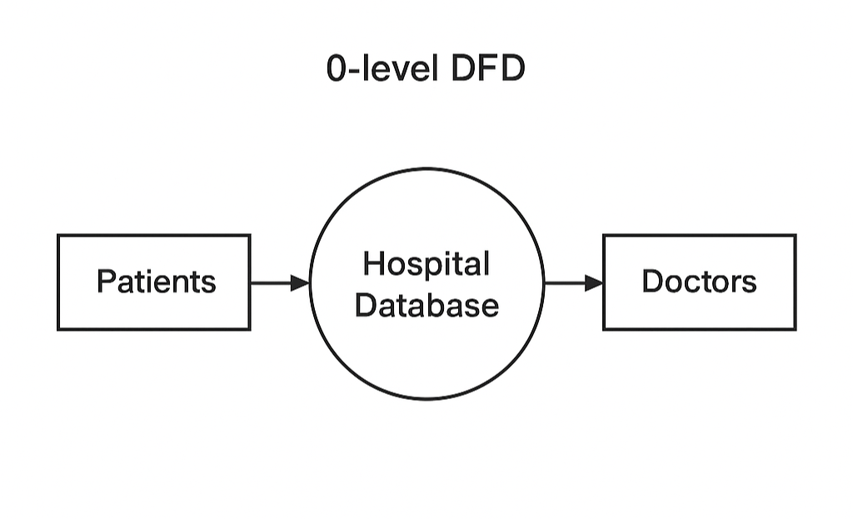
ER Diagram :-
Data Flow Diagram:-
1. Zero-Level DFD:
9

Slide 11
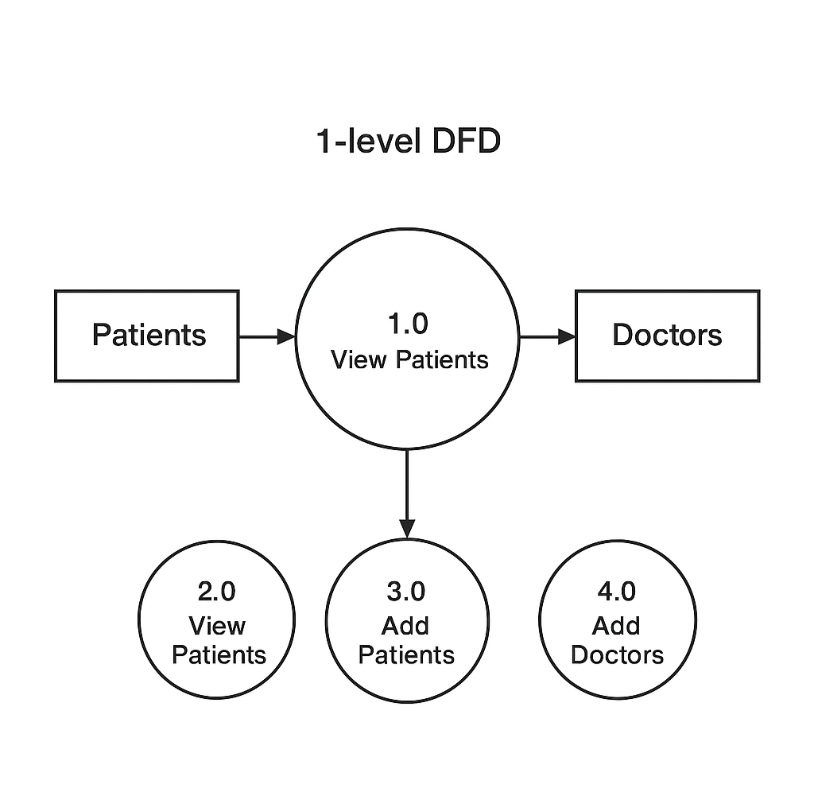
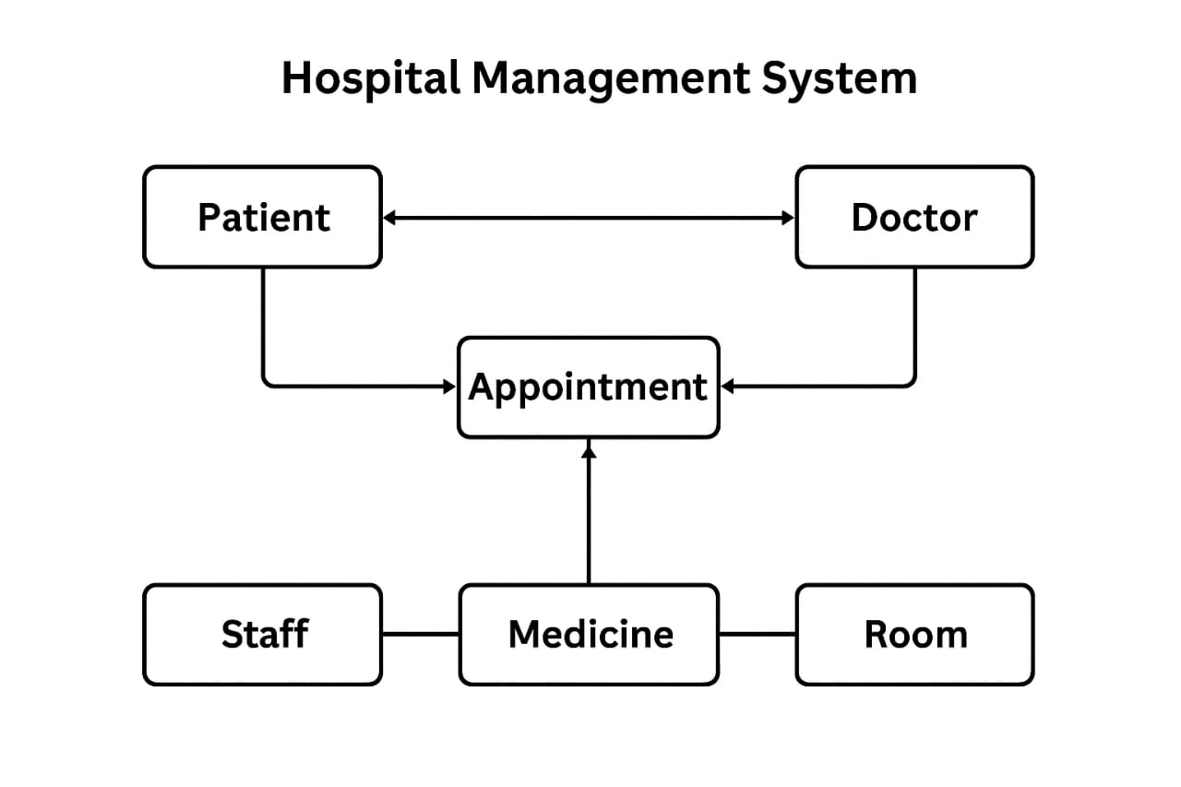
Process Flow Diagram

Slide 12
Platform Used
Hardware Requirement
  ● Processor:Intel i3 or higher
  ● RAM :Minimum 4GB
  ● Display:Standard Monitor
2. Software Requirement
  ● JDK (Java Development Kit
  ● Database: MySQL/ SQL Server
  ● Tools:VS Code/Eclipse/intelij
  ● Operating System:Windows/Linux
FututreScope
● Online appointment and patient portal
● Billing and insurance integration
● SMS/Email alerts
● Online prescription and medical reports
● Mobile app integration
● AI-based diagnosis support

Slide 13
BIBLIOGRAPHY
● Oracle Java Documantation
● MySQL Official Documantation.
● JDBC API Guide
● Refrence books on DBMS and Java
●Online Educational Resources
16

