Slide 1

Vel Tech Rangarajan Dr. Sagunthala R&D Institute of Science and Technology
School of Computing
Department of Computer Science and Engineering
10211CS224 / FULL STACK APPLICATION DEVELOPMENT (JAVA)
PROJECT REVIEW : MILESTONE PROJECT – 1
Date: 25-03-2026
AUTOMATED QUIZ ENGINE WITH PDF CERTIFICATE GENERATION
SDG: SDG 4 – Quality Education
Presented By:
A.KAIF – VTU25108 – 23UECS0647
Courses Handling Faculty:
Dr. HEMAMALINI. S- B.Tech.,M.Tech.,Ph.D.

Slide 2
INTRODUCTION
The Automated Quiz Engine with PDF Certification Generation addresses the challenges in programming education where students lack proper assessment tools, interactive practice, and instant feedback. Traditional systems rely heavily on manual processes, making evaluation and progress tracking inefficient. This project is important as it automates quiz conduction, provides immediate results, and generates certificates to validate user skills. It has real-world relevance in online learning platforms, technical recruitment, and educational institutions. The system allows users to register, attempt quizzes, and receive instant evaluation. It also stores results for future analysis and performance tracking. Overall, it provides a simple, efficient, and scalable solution for modern assessment needs.
1
2
3
4
5
6
7
8
9

Slide 3
PROBLEM STATEMENT
In current programming education systems, assessment and evaluation are often not fully automated and rely on manual processes. This leads to inefficiency in conducting quizzes, evaluating performance, and tracking student progress.
Students lack access to interactive platforms for practicing and receiving instant feedback, making it difficult to identify their strengths and weaknesses. Additionally, there is no simple and affordable way to generate certifications to validate their skills.
Therefore, there is a need for a reliable and automated system that can conduct quizzes, evaluate results instantly, and generate certificates while maintaining accuracy and efficiency.
1
2
3
4
5
6
7
8
9

Slide 4
OBJECTIVE(S)
To design and develop an Automated Quiz Engine with user authentication
To implement real-time quiz evaluation and scoring system
To improve learning through instant feedback and performance tracking
To generate PDF certificates for successful quiz completion
To evaluate performance of users using stored quiz results and scores
1
2
3
4
5
6
7
8
9

Slide 5
PROPOSED SYSTEM
A web-based Automated Quiz Engine that allows users to register, log in, and attempt quizzes
Fetches questions from a database and provides an interactive quiz interface
Implements instant evaluation and scoring after quiz submission
Generates PDF certificates automatically for users who pass the quiz
Stores user results to enable performance tracking and history viewing
Eliminates manual work by providing a fully automated assessment system
Provides quick feedback, helping users identify strengths and weaknesses
More efficient, scalable, and cost-effective compared to traditional manual systems
1
2
3
4
5
6
7
8
9

Slide 6
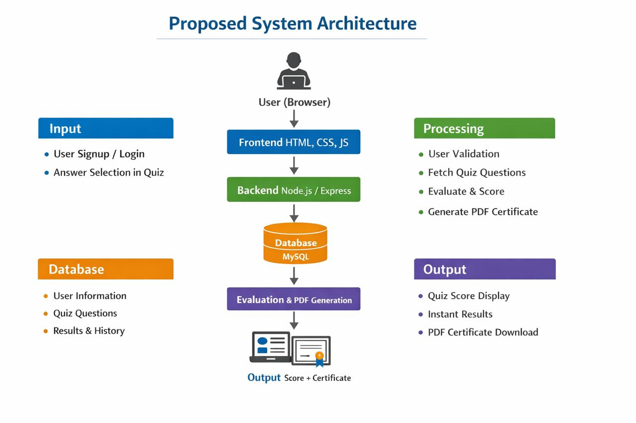
PROPOSED SYSTEM ARCHITECTURE
1
2
3
4
5
6
7
8
9

Slide 7
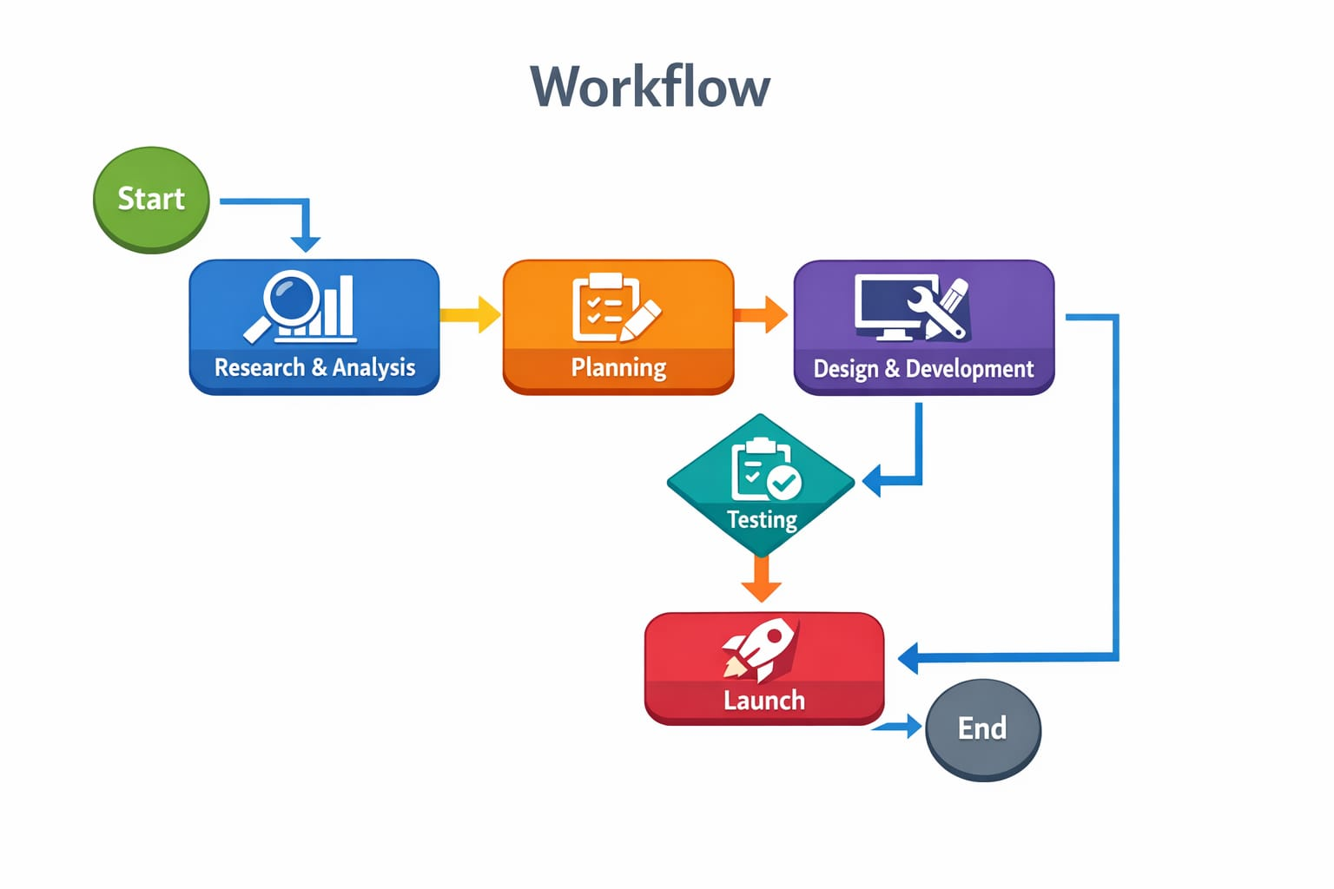
WORKFLOW
1
2
3
4
5
6
7
8
9

Slide 8
TECHNOLOGIES USED
Frontend:
HTML, CSS, JavaScript
Backend:
Node.js, Express.js
Database:
MySQL
Tools:
MySQL Workbench, VS Code, XAMPP, Web Browser
Hardware: Computer/Laptop, Minimum 4GB RAM
Software: Node.js, MySQL Server, Web Browser (Chrome)
1
2
3
4
5
6
7
8
9

Slide 9
MODULE DESCRIPTION
Module 1: User Management
Handles user registration, login, and profile management with secure authentication.
Module 2: Core Processing
Implements the main business logic and processes user inputs efficiently.
Module 3: Database Management
Manages data storage, retrieval, and ensures data integrity.
Module 4: Reporting & Analytics
Generates reports and visual insights for better decision-making.
1
2
3
4
5
6
7
8
9

Slide 10
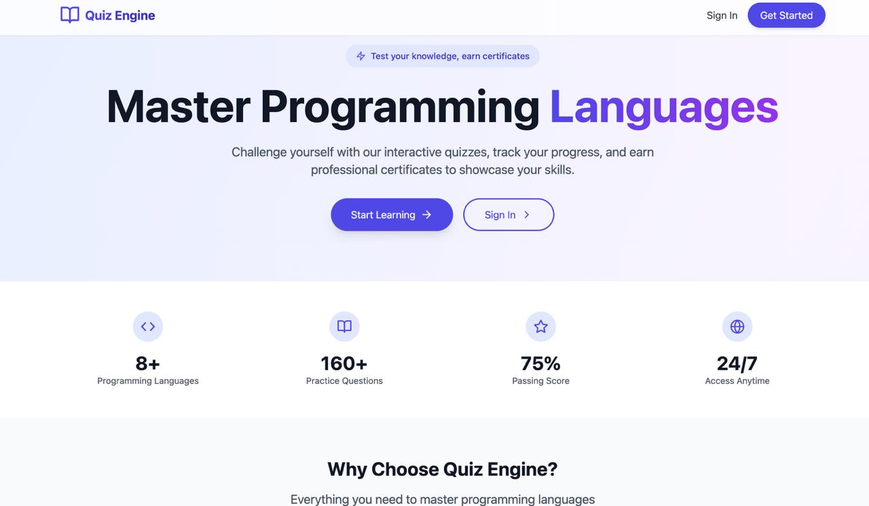
IMPLEMENTATION SCREENSHOTS
1
2
3
4
5
6
7
8(A)
9

Slide 11
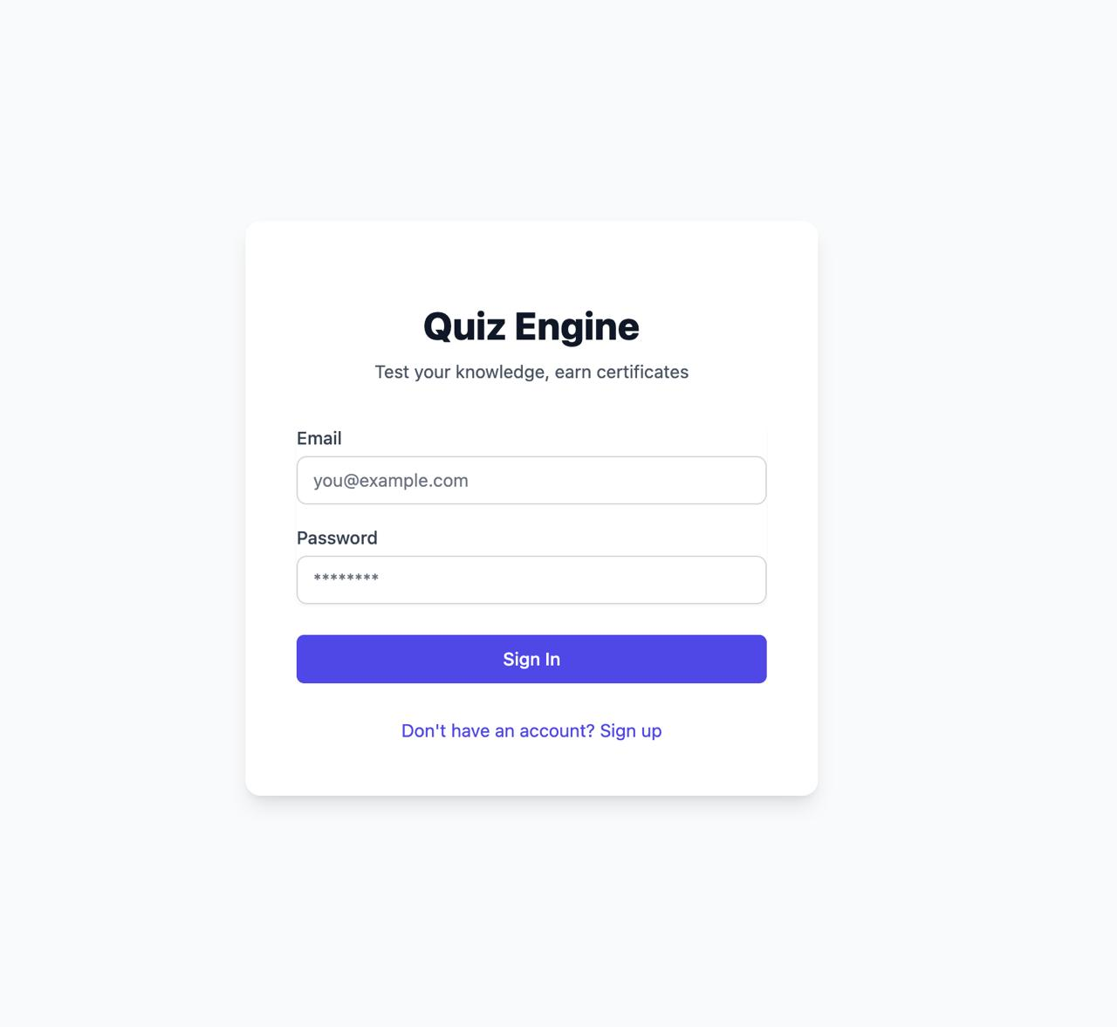
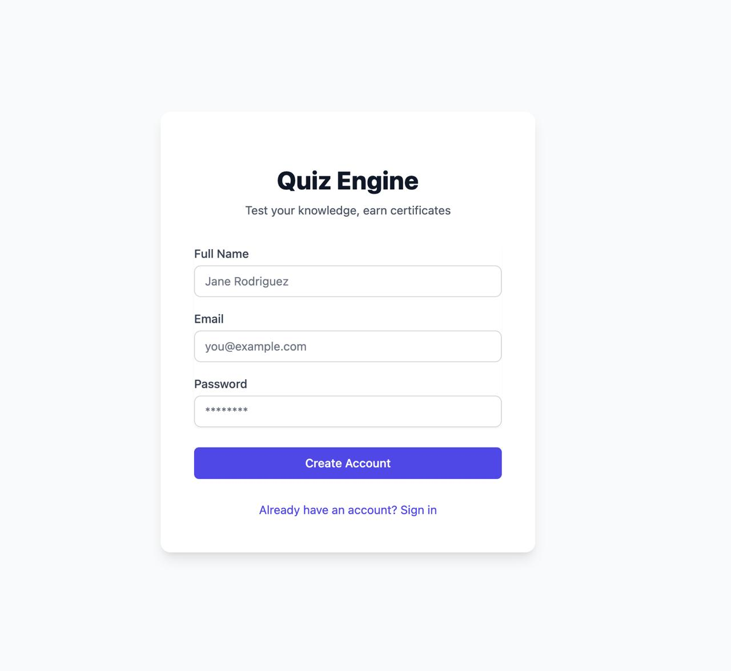
IMPLEMENTATION SCREENSHOTS
1
2
3
4
5
6
7
8(B)
9

Slide 12
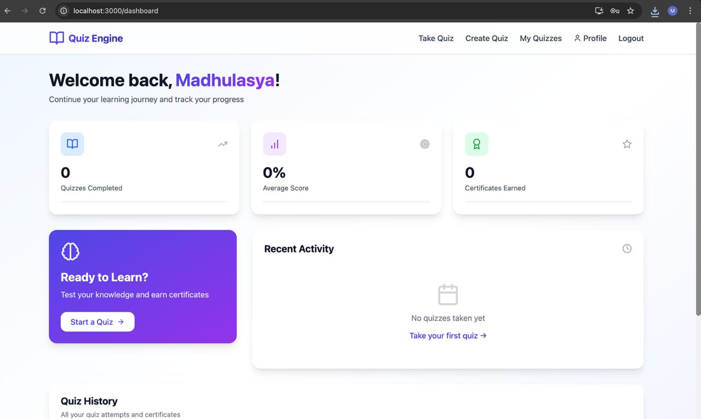
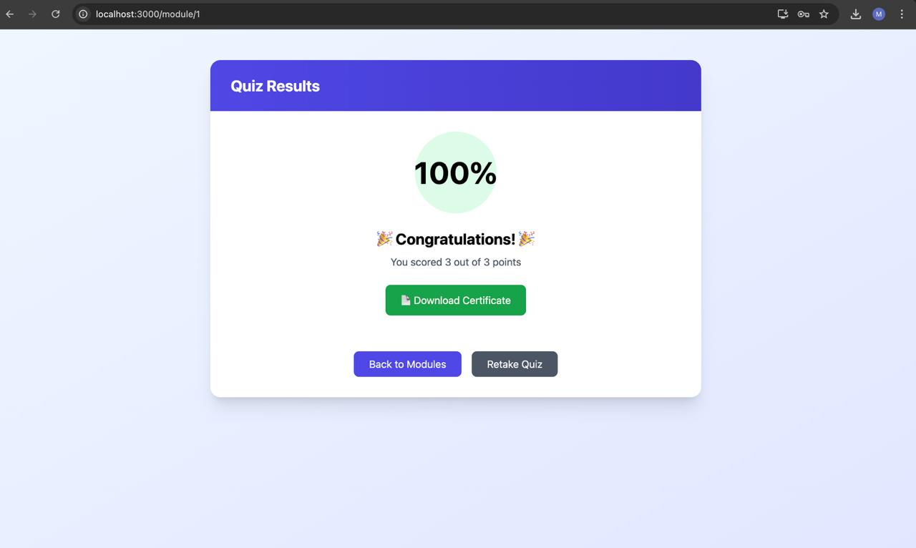
IMPLEMENTATION SCREENSHOTS
1
2
3
4
5
6
7
8(C)
9

Slide 13
ADVANTAGES & LIMITATIONS
ADVANTAGES:
Provides automated quiz evaluation, saving time and effort
Offers instant feedback to improve learning
Generates PDF certificates for skill validation
Easy to use with a simple and user-friendly interface
Stores results for performance tracking and analysis
1
2
3
4
5
LIMITATIONS:
Requires internet/server availability to function
Basic UI compared to advanced platforms
No advanced analytics or AI-based evaluation
Security can be improved for large-scale deployment
6
7
8
9

Slide 14
Thank you

