Slide 1
Deep learning based basketball video analysis for intelligent
Hongkun Jin
Mouqing Jin

Slide 2
As the great improvement of multimedia communication and artificial intelligence, The "Intelligent Arena" will be a new type of application. For many sports fans, they also want to get highlight moment when they are playing with team members. The "Intelligent Arena" will be a new type of application.
In order to get highlight video, the system has to automatically select highlight video clips in real-time living camera. The most important work is how to recognize the highlight moment and save it. To sum up, this paper has the follows four points:
1, automatically selecting the live camera that best records the match.
2, detecting the backboard and basket areas as the hotspot area.
3, recognizing and saving the shooting and scoring moment in living camera.
4, save those scoring moment into highlight video.

Slide 3
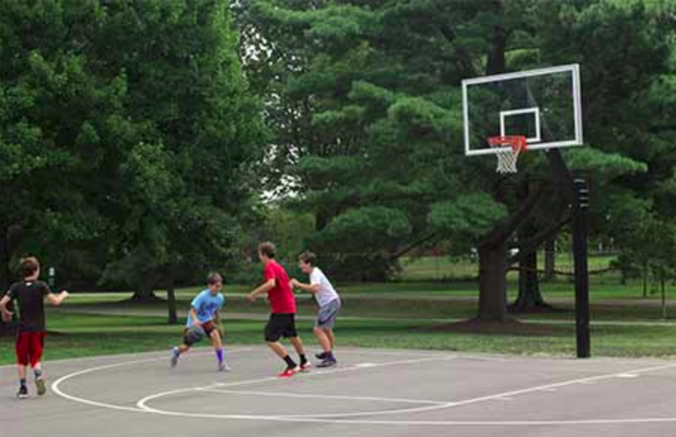

Proposal/Plan: System
Hotspot area detection
Training of hotspot
During training, we annotate the backboard, hoop, and basket as the hotspot examples. And the ACF tool in Piotr’s CV Matlab Toolbox(7) and the AdaBoost are used to train the detector for hotspot areas.
ACF detector: 7 Dollar P, Appel R, Belongie S, Perona P (2014) Fast feature pyramids for object detection. IEEE Trans. Pattern Anal Mach Intell 36(8):1532–
AdaBoost:11 Friedman J, Hastie T, Tibshirani R et al (2000) Additive logistic regression: a statistical view of boosting. Ann Stat 28(2):337–407

Slide 4
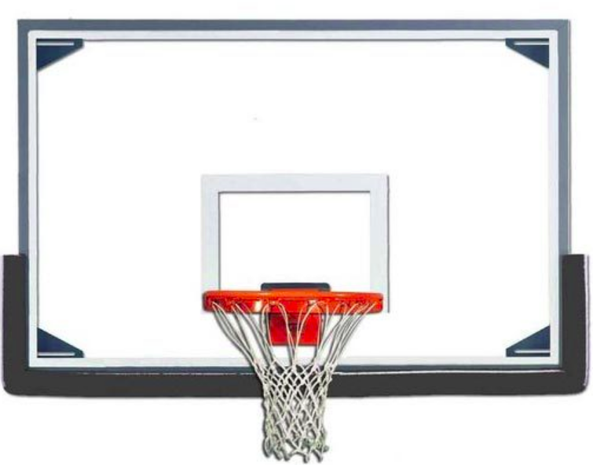
Proposal/Plan: System
Basketball energy image generation and CNN
BEI
A scoring ball pass through the basketball hoop and finish its track in the backboard area, while a non-scoring one would finish its trajectory at the edge of the backboard. So the motion track of the basketball can provide significant cues for identifying scoring from shooting.
We can directly feed the BEI into a CNN to learn an effective model for scoring detection. In our system, we adopt the AlexNet network which is constructed by four convolutional layers and two fully connected layers
Basketball track
CNN: 12. Gan C, Wang N, Yang Y, Yeung D, Hauptmann AG (2015) Devnet: A deep event network for multimedia
CNN: 36. Yan C, Xie H, Yang D, Yin J, Zhang Y, Dai Q (2017) Supervised hash coding with deep neural network for environment perception of intelligent vehicles. IEEE Trans Intell Transp Syst

Slide 5
It only can generate the highlight from detecting shooting, it limit the category of highlight video.
In the first part, users need to set several devices to select the living camera, it is inconvenient.
In their experiments, they only use 1000 clips from ten basketball players to train the scoring detection network(476 scoring clips and 571 non-scoring clips, 862 training set and 185 testing set). It is better to get more training dataset from different people and different background.

Slide 6
There are five way to select highlight video chips(Audio based methods, Motion based method, object, people detection based methods, search base method), why this paper choose that way?

