Slide 1

Summarization of User-Generated Sports Video by Using Deep Action Recognition Features
Team3-2
Hongkun Jin
Mouqing Jin

Slide 2
Introduction
Automatically generating a summary of sports video poses the challenge of detecting interesting moments, or highlights, of a game.
Traditional sports video summarization methods leverage editing conventions of broadcast sports video that facilitate the extraction of high-level semantics. However, user-generated videos are not edited, and thus traditional methods are not suitable to generate a summary.
In order to solve this problem, this work proposes a novel video summarization method that uses players’ actions as a cue to determine the highlights of the original video. A deep neural network-based approach is used to extract two types of action-related features and to classify video segments into interesting or uninteresting parts.

Slide 3
Motivation
A popular domain corresponds to sports videos taken at public events and professional/amateur matches. These types of user-generated sports videos (UGSVs) are often lengthy with several uninteresting parts, and thus many of them are stored and are never reviewed.
Generating summaries of a UGSV that only shows the interesting parts or highlights.
Traditional user-generated video summarization methods target general videos in which contents are not limited to a specific domain. This is mainly because of the difficulty in extracting semantics from an unstructured video. As opposed to extracting semantics, these methods use low-level visual features and attempt to reduce visual redundancy using clustering-based approaches.

Slide 4
Introduction
Their observation with respect to semantics extraction is that a game in most sports consists of a succession of players’ actions, and thus the actions can be one of the most important cues to determine if a certain part of video is interesting or not.
For example, a feint in boxing might not be interesting by itself, but viewers would surely enjoy it if it is followed by an uppercut that knocks out the opponent. Based on this observation, the proposed method uses players’ actions to model the highlights of a sports game.

Slide 5
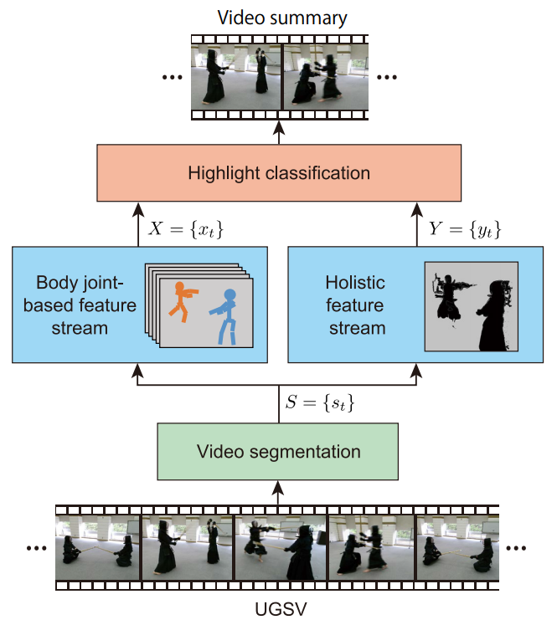
Introduction
Body joint-based features provide a precise representation of actions. The other type involves holistic features that can be obtained with deep convolutional neural networks (CNNs) designed to extract spatio-temporal features from video.
Holistic features help to capture actions in their context. Subsequently, long short-term memory (LSTM) is used to model the temporal dependencies of the extracted features for highlight classification.

Slide 6
UGSV SUMMARIZATION USING ACTION FEATURES
The idea in the present work for semantics extraction involves utilizing players’ actions, as they are the main constituents of a game.
In this work, we hypothesize that features extracted from players’ actions allow summarizing UGSV.
Their new method considers two different types of inputs, namely RGB frames of video and body joint positions, and each of them are transformed through two separate neural networks
Their method does not require recognizing the actions explicitly, thus avoiding expensive human action annotation

Slide 7
UGSV SUMMARIZATION USING ACTION FEATURES
Overview
The method ﬁrst divides the original input video into a set S = {st} of video segments
A video segment st is then fed into the two-stream network.
The body joint-based feature stream and the holistic feature stream
The features X = {xt} and Y = {yt} are then used for highlight classiﬁcation by considering the temporal dependencies among the video segments.
The highlight summaries correspond to a concatenation of the segments that are classiﬁed as interesting.

Slide 8
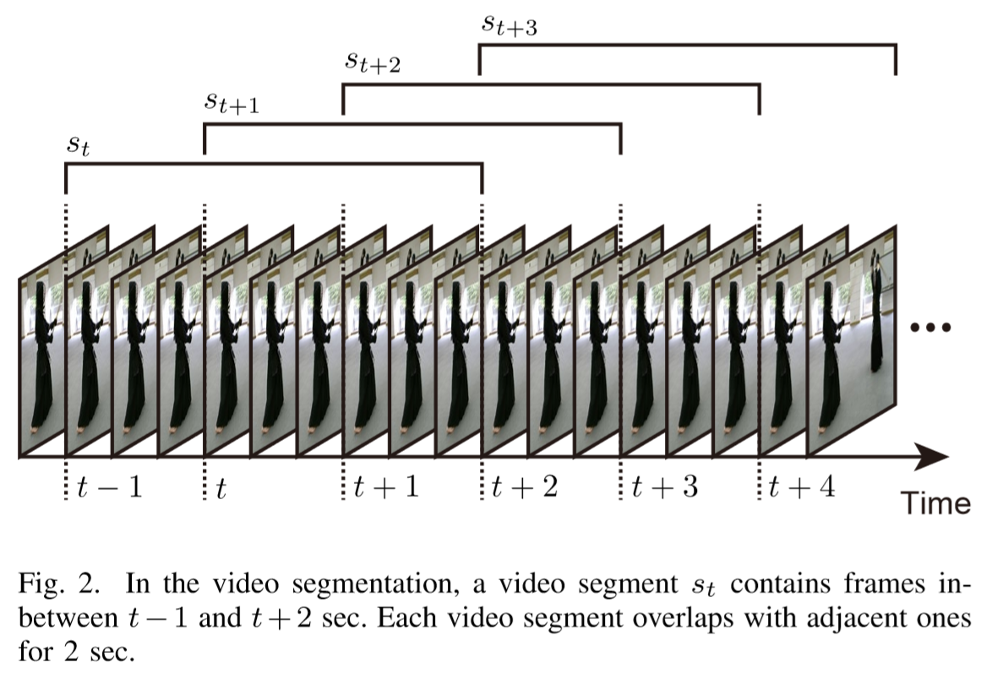
UGSV SUMMARIZATION USING ACTION FEATURES
Video segmentation
The original input video of length T seconds (sec) is uniformly segmented into multiple overlapping segments, so that subsequently a second t of video can be represented by extracting action features from a video segment st

Slide 9
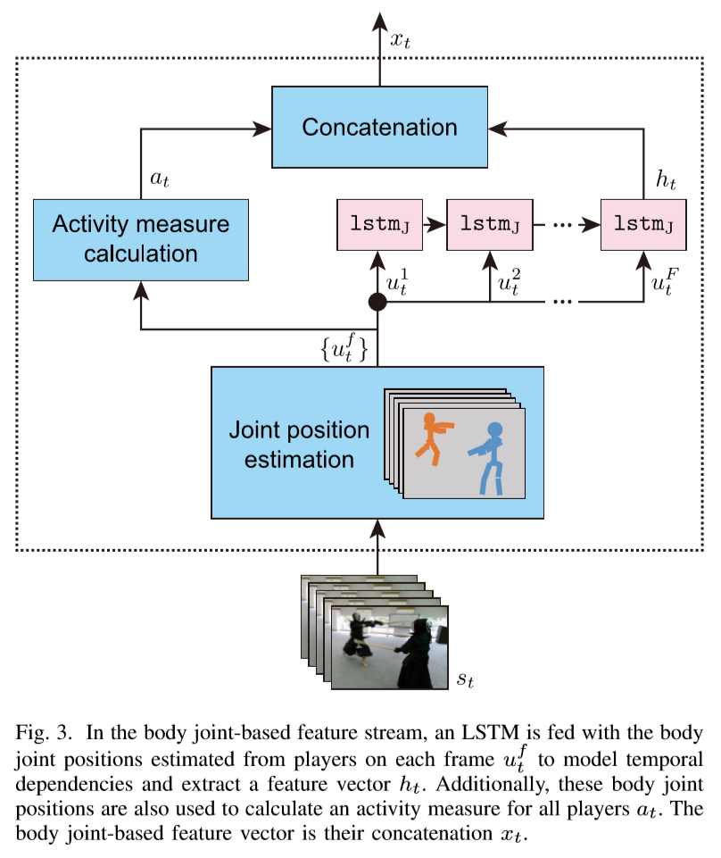
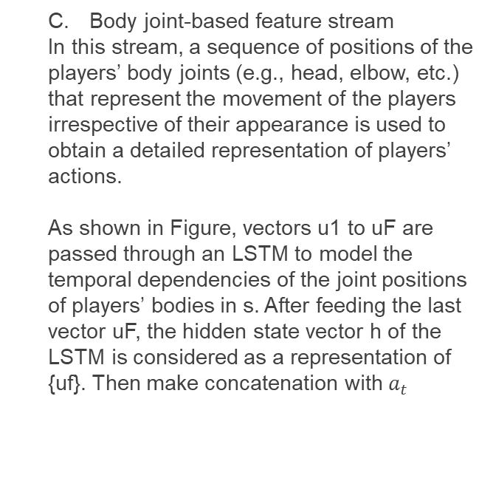
UGSV SUMMARIZATION USING ACTION FEATURES
Body joint-based feature stream
In this stream, a sequence of positions of the players’ body joints (e.g., head, elbow, etc.) that represent the movement of the players irrespective of their appearance is used to obtain a detailed representation of players’ actions.
As shown in Figure, vectors u1 to uF are passed through an LSTM to model the temporal dependencies of the joint positions of players’ bodies in s. After feeding the last vector uF, the hidden state vector h of the LSTM is considered as a representation of {uf}. Then make concatenation with $a_{t}$

Slide 10
UGSV SUMMARIZATION USING ACTION FEATURES
D. Holistic feature stream
This stream encodes a video segment s in a spatio-temporal representation.
It represents a video segment s by using a holistic feature vector y that corresponds to the output of one of the aforementioned 3D CNNs.

Slide 11
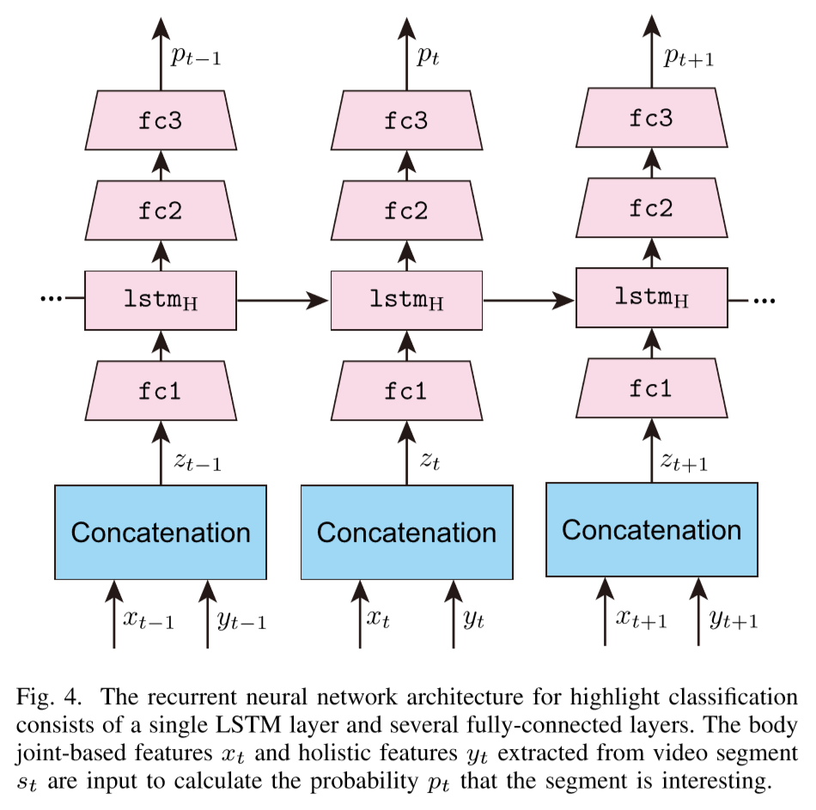

UGSV SUMMARIZATION USING ACTION FEATURES
E. Highlight classiﬁcation using LSTM
Figure 4 shows the network architecture designed to extract highlights of UGSV using the features $x_{t}$ and $y_{t}$from video segment $s_{t}.$

Slide 12
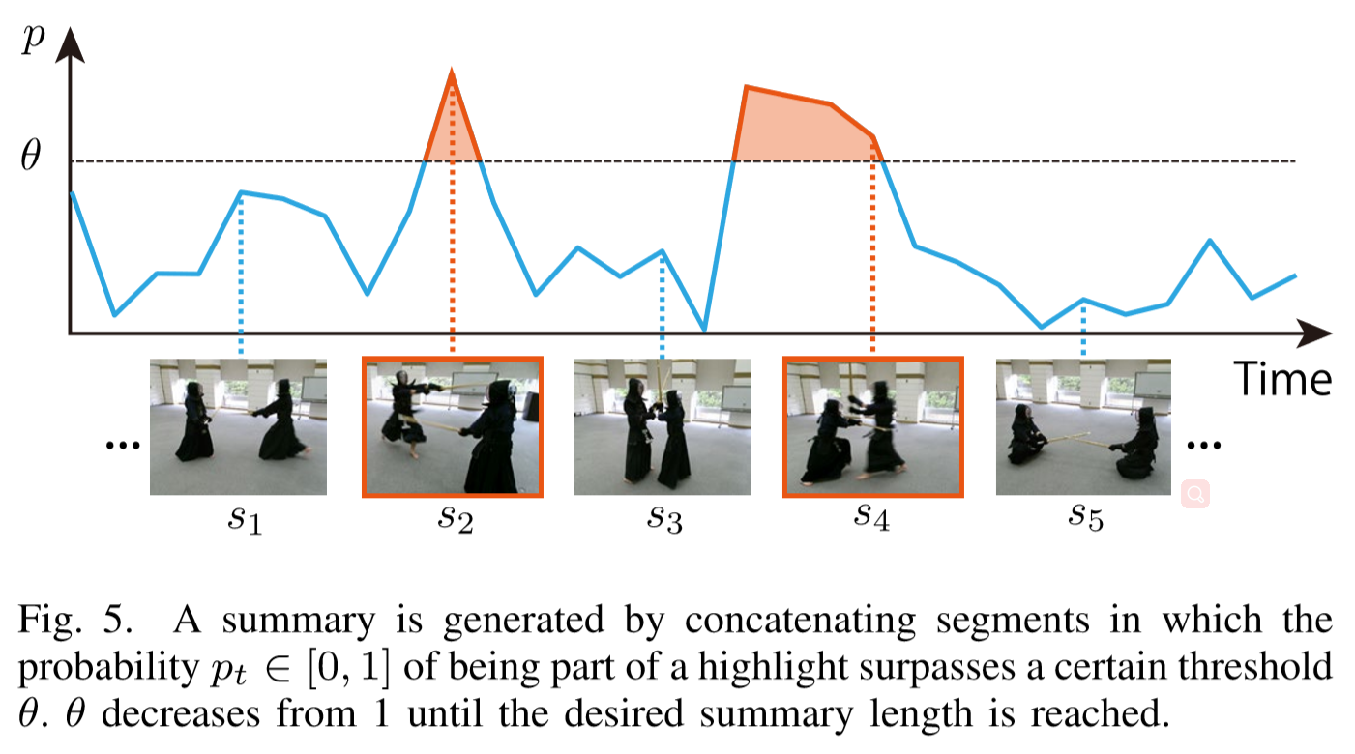
UGSV SUMMARIZATION USING ACTION FEATURES
E. Highlight classiﬁcation using LSTM
The segments in which the probability exceeds θ are concatenated to generate the output summary in the temporal order. Hence, the resulting summary may contain multiple consecutive interesting segments.

Slide 13
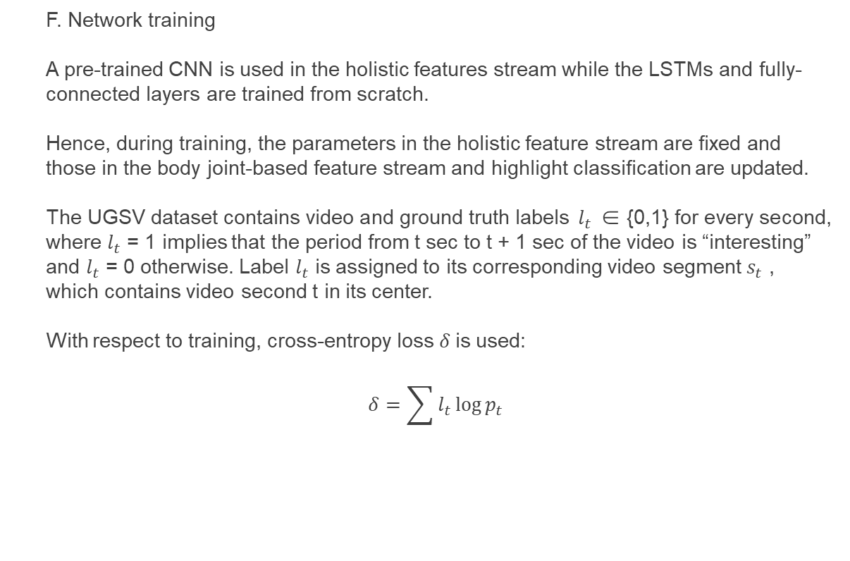
UGSV SUMMARIZATION USING ACTION FEATURES
F. Network training
A pre-trained CNN is used in the holistic features stream while the LSTMs and fully-connected layers are trained from scratch.
Hence, during training, the parameters in the holistic feature stream are ﬁxed and those in the body joint-based feature stream and highlight classiﬁcation are updated.
The UGSV dataset contains video and ground truth labels $l_{t}$ ∈ {0,1} for every second, where $l_{t}$ = 1 implies that the period from t sec to t + 1 sec of the video is “interesting” and $l_{t}$ = 0 otherwise. Label $l_{t}$ is assigned to its corresponding video segment $s_{t}$ , which contains video second t in its center.
With respect to training, cross-entropy loss$δ$ is used:
$$δ=\sum{l_{t}\log{p_{t}}}$$

Slide 14
Experiment
Experiment sport: Kendo (Japanese fencing)
Only body joint features (3D or 2D), only holistic motion features (CNN-ISA or C3D), and a combination of both features are evaluated
The completeness of the highlights of the generated summaries are examined
Users with and without experience in the sport are surveyed to study their opinions with respect to the summaries.

Slide 15
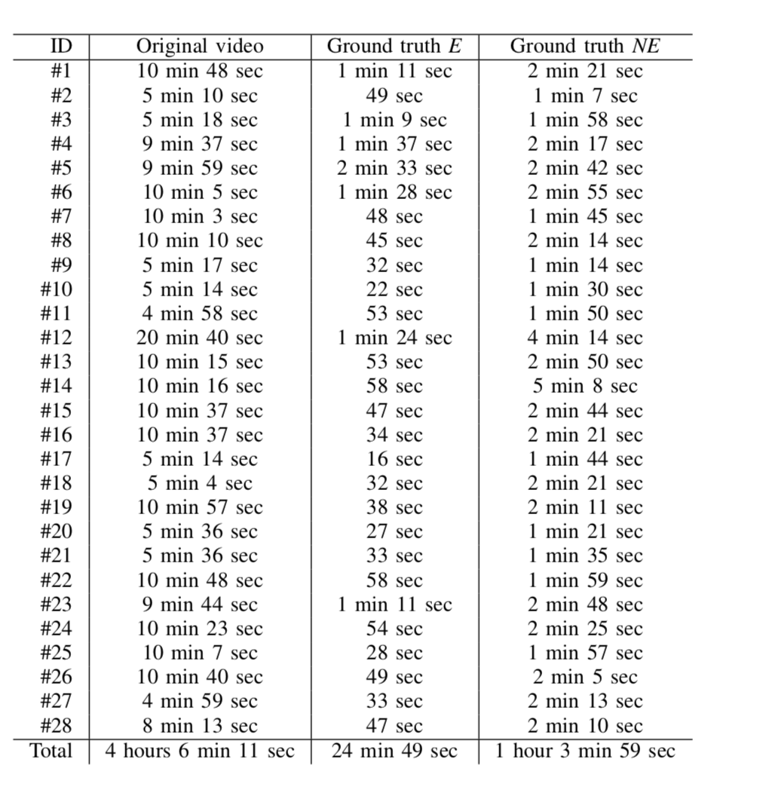
Datasets
The duration of the videos in the dataset used in the experiments
their respective ground truth highlights as annotated by users.
5 experienced people (E)
10 inexperienced people (NE)

Slide 16
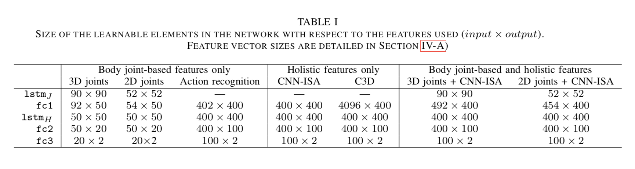
Parameters
The number of learnable parameters for each layer, which varies based on the choice of features.

Slide 17
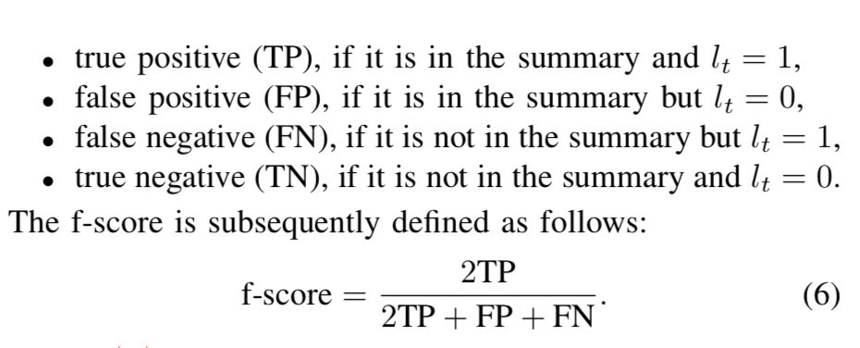
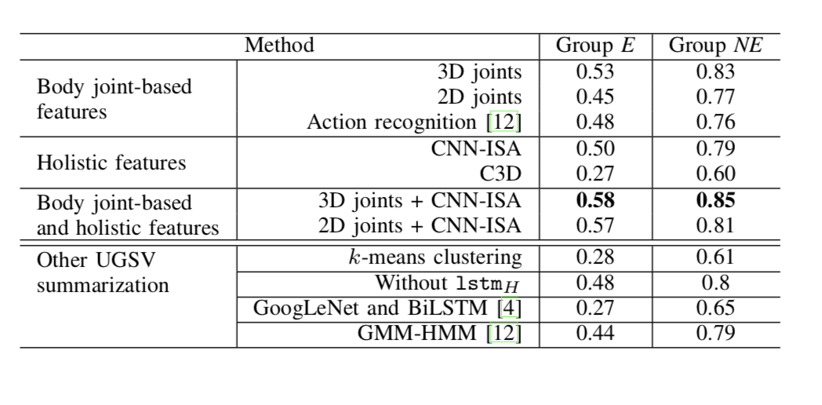
Results
Shows the f-scores for the summaries generated with
the labels of both E and NE groups

Slide 18
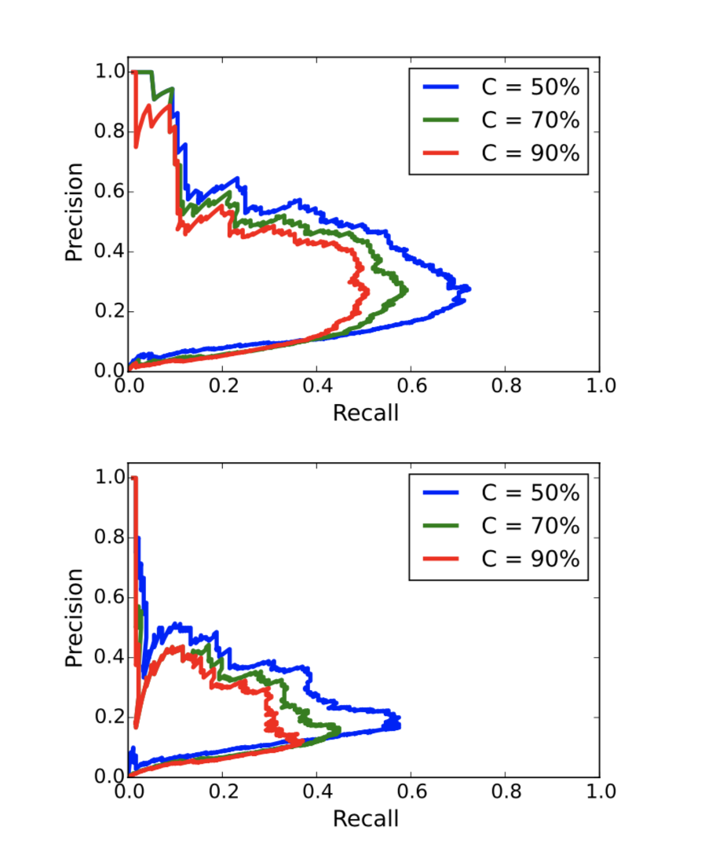
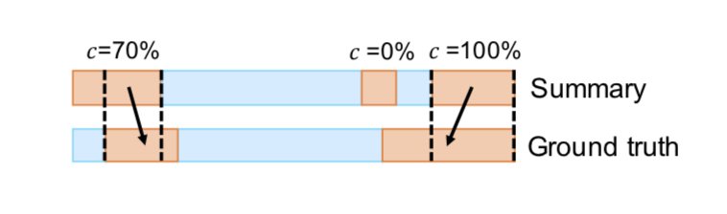
Results
Recall-precision curves for different completeness values (up: labels E, down: labels NE). The gap between the curves C = 50% and C = 70% shows that a significant number of the highlights are missing for a maximum of half the interesting segments. As θ varies, the appearing of incomplete highlights affects the association of highlights-ground truth, resulting in a jagged curve.

Slide 19
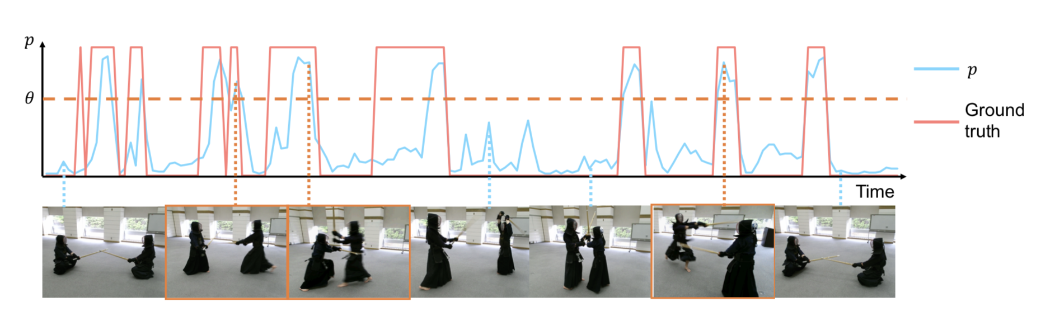
Results
Video segments with higher p are extracted prior to segments with lower p, and thus in a few cases the beginning/end segments of the highlights are missing when compared to the ground truth.

Slide 20
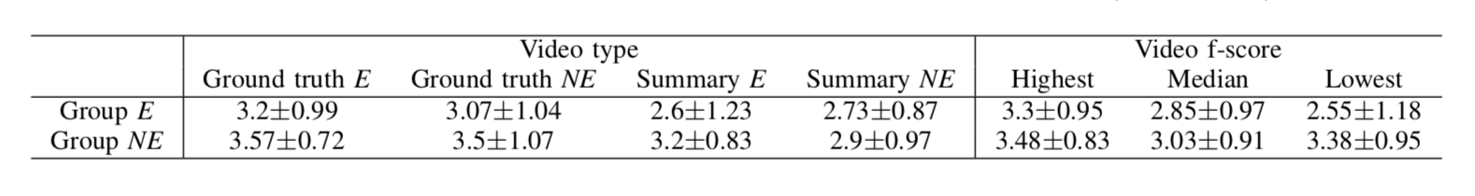
Experiment
Assign a score in a Likert scale from 1 (very few highlights are interesting) to 5 (most highlights are interesting) based on their satisfaction with the contents of each of the 12 videos.
Table shows the results of Q1 grouped by video type and video f-score.

Slide 21
Conclusion
This paper has described a novel method for automatic summarization of UGSV
The best combination among the evaluated features corresponds to a combination of 3D body joint-based features and CNN- ISA features
LSTM is useful to model the temporal dependencies of the joint positions of players’ bodies in each video segment as well as the highlights in the entire video.
In order to generate appealing summaries, players’ 3D body joint positions from depth maps offer the best performance.

Slide 22
Thank you

