Slide 1

Summarization of User-Generated Sports Video by Using Deep Action Recognition Features
Team3-2
Hongkun Jin
Mouqing Jin

Slide 2
Experiment
Experiment sport: Kendo (Japanese fencing)
Only body joint features (3D or 2D), only holistic motion features (CNN-ISA or C3D), and a combination of both features are evaluated
The completeness of the highlights of the generated summaries are examined
Experiment sport: Kendo (Japanese fencing)
Users with and without experience in the sport are surveyed to study their opinions with respect to the summaries.

Slide 3
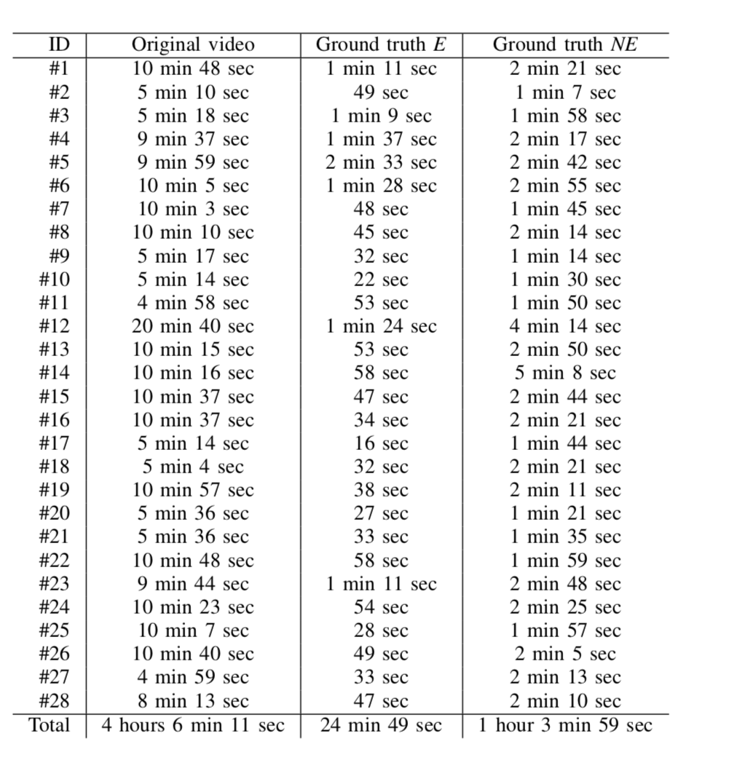
Datasets
the duration of the videos in the dataset used in the experiments
their respective ground truth highlights as annotated by users.
5 experienced people (E)
10 inexperienced people (NE)

Slide 4
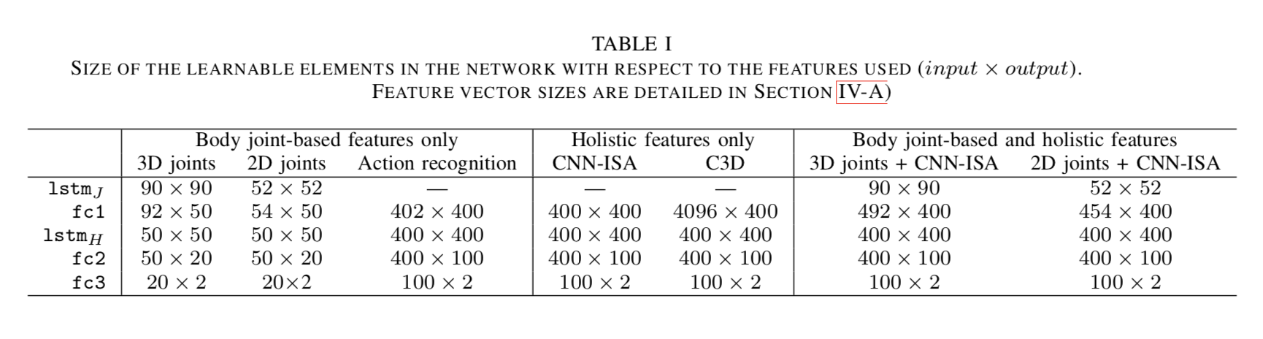
Parameters
the number of learnable parameters for each layer, which varies based on the choice of features.

Slide 5
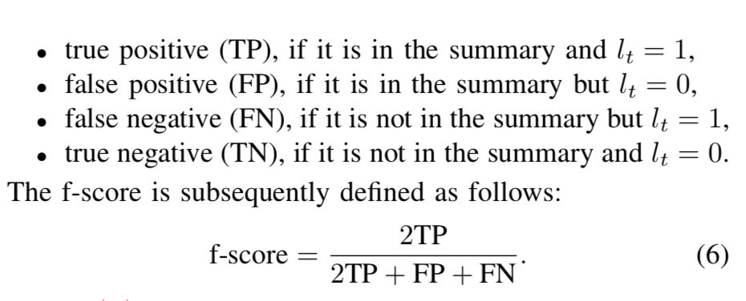
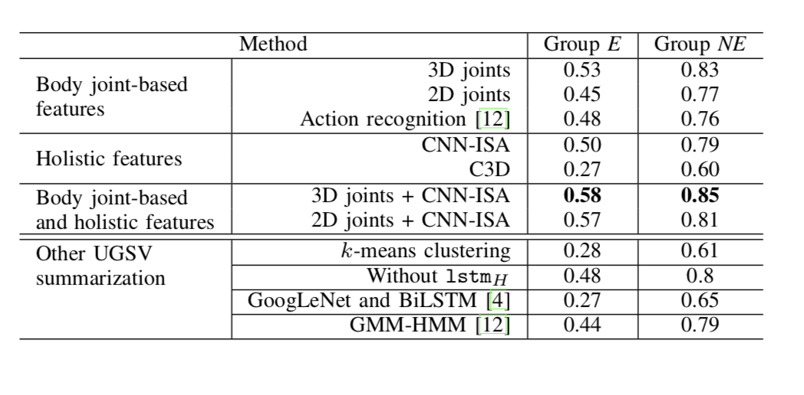
Results
Shows the f-scores for the summaries generated with
the labels of both E and NE groups

Slide 6
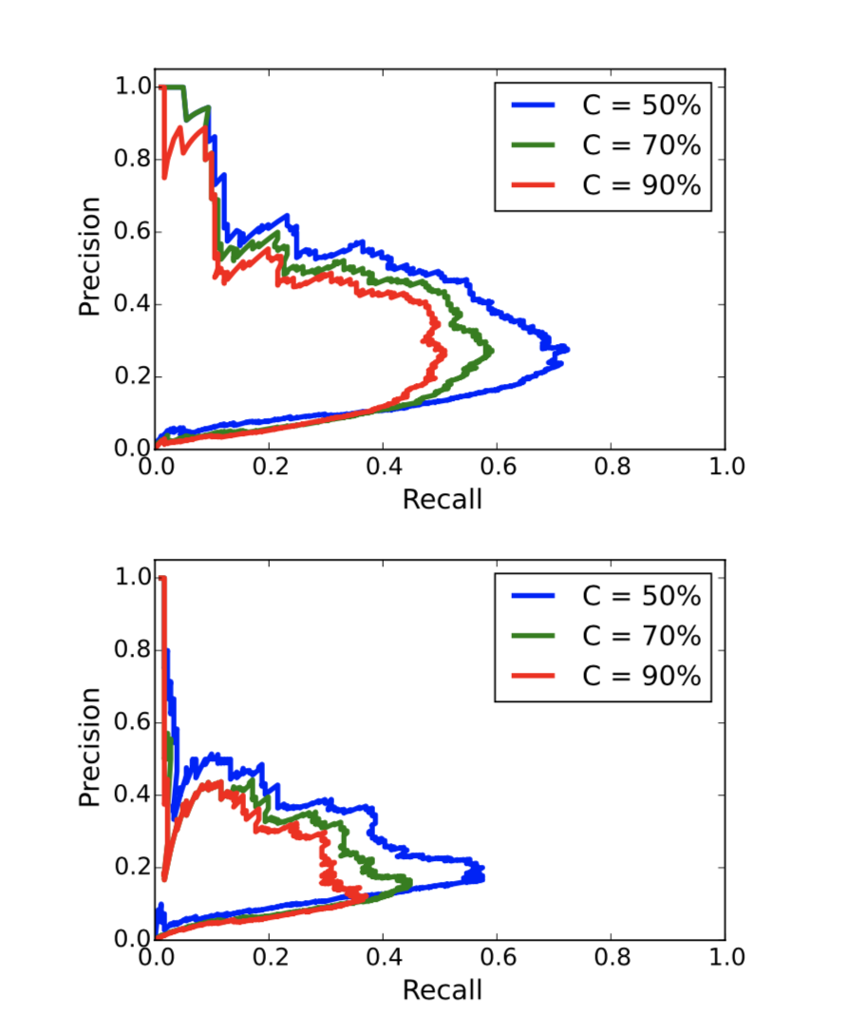
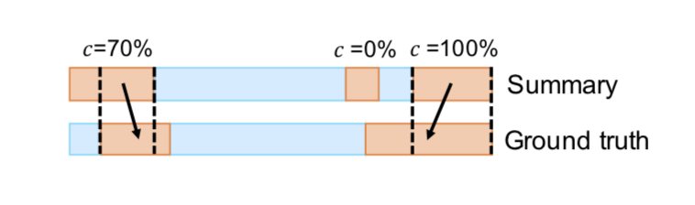
Experiment
Recall-precision curves for different completeness values (up: labels E, down: labels NE). The gap between the curves C = 50% and C = 70% shows that a significant number of the highlights are missing for a maximum of half the interesting segments. As θ varies, the appearing of incomplete highlights affects the association of highlights-ground truth, resulting in a jagged curve.

Slide 7
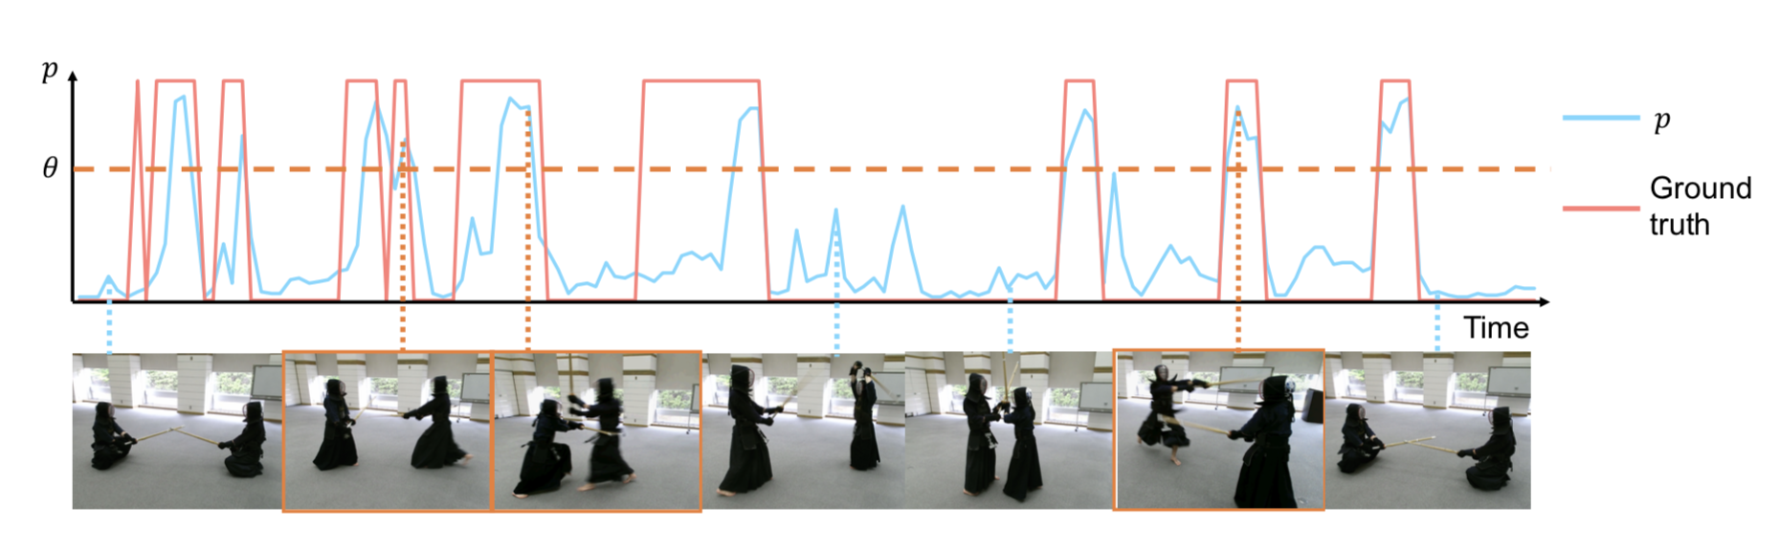
Experiment
Video segments with higher p are extracted prior to segments with lower p, and thus in a few cases the beginning/end segments of the highlights are missing when compared to the ground truth.

Slide 8
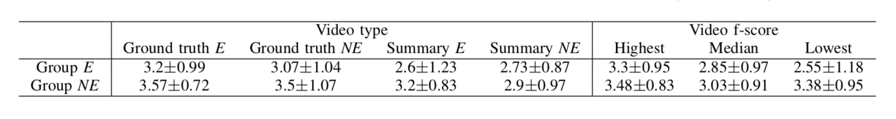
Experiment
Assign a score in a Likert scale from 1 (very few highlights are interesting) to 5 (most highlights are interesting) based on their satisfaction with the contents of each of the 12 videos.
Table shows the results of Q1 grouped by video type and video f-score.

Slide 9
only body joint features (3D or 2D), only holistic motion features (CNN-ISA or C3D), and a combination of both features are evaluated
the completeness of the highlights of the generated summaries are examined
Experiment sport: Kendo (Japanese fencing)
The total length of the videos is 246 min with a framerate of approximately 20 fps
users with and without experience in the sport are surveyed to study their opinions with respect to the summaries.

Slide 10
Conclusion
This paper has described a novel method for automatic summarization of UGSV
The best combination among the evaluated features corresponds to a combination of 3D body joint-based features and CNN- ISA features
LSTM is useful to model the temporal dependencies of the joint positions of players’ bodies in each video segment as well as the highlights in the entire video.
In order to generate appealing summaries, players’ 3D body joint positions from depth maps offer the best performance.

