Slide 1
CS5542 Big Data Analytics and Applications Tutorial 9 Tensorflow – Image Classification-CNN

Slide 2
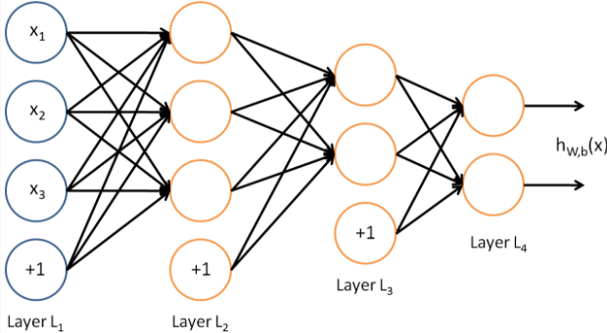
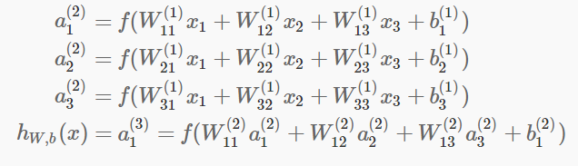
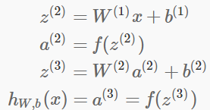
Multi Layer Perceptron
Feed forward

Slide 3
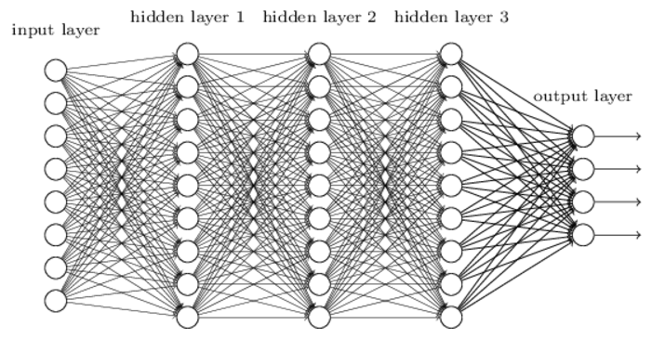
Convolutional Networks
Fully connected layers are not good enough -computationally expensive, not making use of spatial structure
Convolutional neural networks use three basic ideas: local receptive fields, shared weights, and pooling

Slide 4
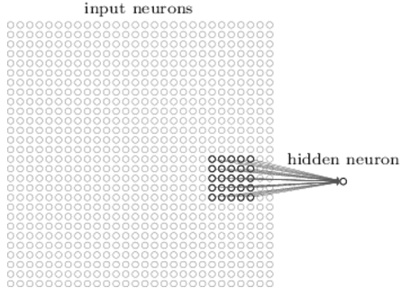
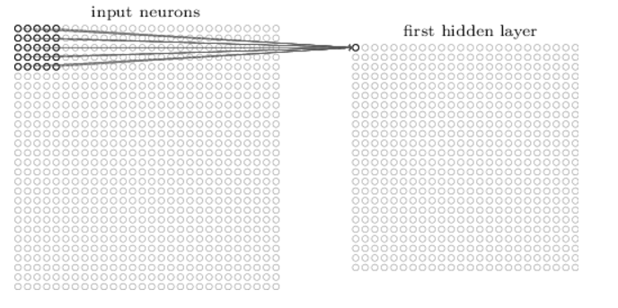
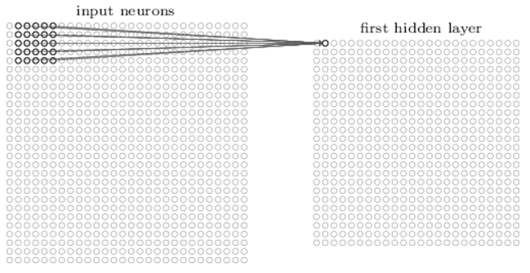
Local receptive Fields
Notes:
The picture shows a stride length of 1. Sometimes a different stride length is used.

Slide 5
Shared weights and biases
Same weights and bias for each of the 24x24 hidden neurons
all the neurons in the first hidden layer detect exactly the same feature just at different locations in the input image
Informally, the feature detected by a hidden neuron can be said as the kind of input pattern that will cause the neuron to activate: it might be an edge in the image, for instance, or maybe some other type of shape
This makes convolutional networks – translation invariance of images
the map from the input layer to the hidden layer a feature map
The shared weights and bias are often said to define a kernel or filter
Greatly reduces number of parameters involved

Slide 6
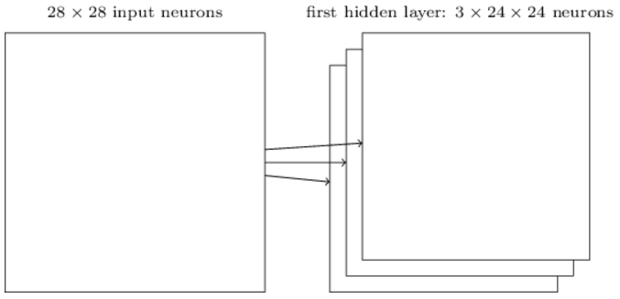

Convolution
convolutional layer consists of several different feature maps
We use 32 feature maps for MNIST

Slide 7
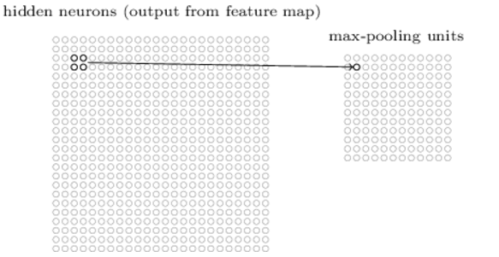
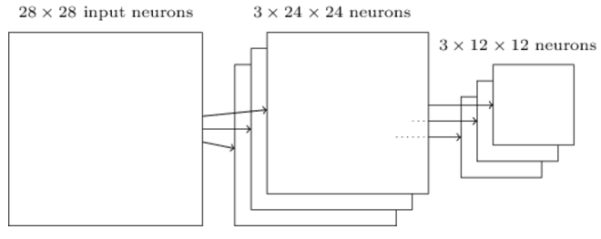
Pooling Layers
Pooling layers are usually used immediately after convolutional layers
pooling layers simplify the information in the output from the convolutional layer
a pooling layer takes each feature map output from the convolutional layer and prepares a condensed feature map
apply max-pooling to each feature map separately

Slide 8
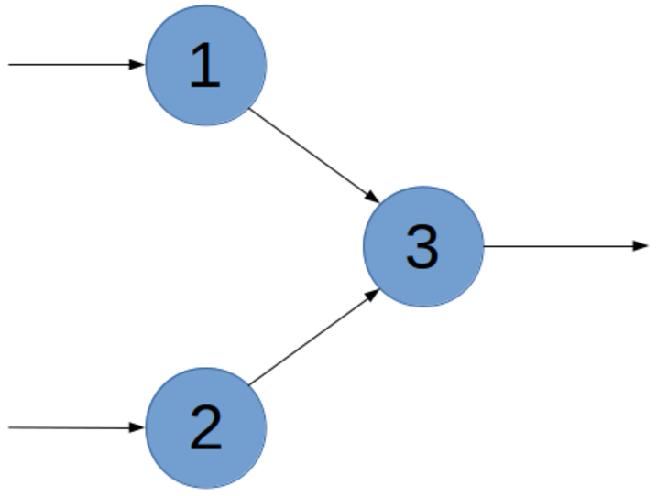
Dropout
dropout is a form of regularization to avoid overfitting
dropout as a form of ensemble learning
At each training step in a mini-batch, the dropout procedure creates a different network (by randomly removing some units), which is trained using backpropagation as usual
The effect of this is that neurons are prevented from co-adapting too much which makes overfitting less likely
At test case the whole network is used (all units) but with scaled down weights. Mathematically this approximates ensemble averaging (using the geometric mean as average)
There is also something called dropconnect but this is the same principle for connections between nodes. In general, the effect of dropconnect is less consequent and less strong as compared to dropout.

Slide 9
Workflow
Learn about the MNIST dataset
Read, load, parse dataset
Build CNN Model
Train the model
Evaluate the model

Slide 10
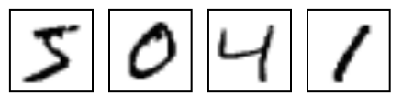
MNIST
MNIST is a simple computer vision dataset. It consists of images of handwritten digits like these:
It also includes labels for each image, telling us which digit it is. For example, the labels for the above images are 5, 0, 4, and 1
http://yann.lecun.com/exdb/mnist/

Slide 11

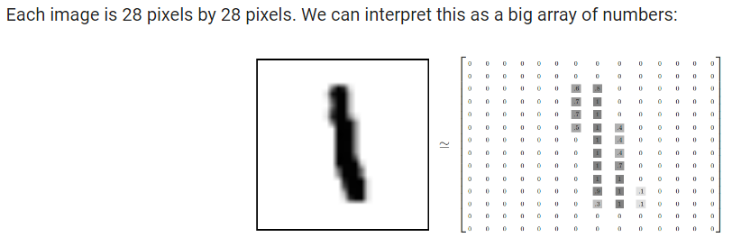
Download and Read Data
55,000 data points of training data (mnist.train), mnist.train.labels, mnist.train.images
10,000 points of test data (mnist.test)
5,000 points of validation data (mnist.validation)

Slide 12
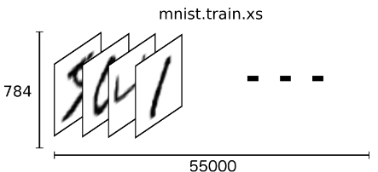
MNIST
mnist.train.images is a tensor (an n-dimensional array) with a shape of [55000, 784]
The first dimension is an index into the list of images and the second dimension is the index for each pixel in each image

Slide 13
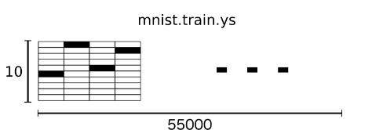
One hot vector
labels as "one-hot vectors“
0 in most dimensions, and 1 in a single dimension
For example, 3 would be [0,0,0,1,0,0,0,0,0,0].
mnist.train.labels is a [55000, 10] array of floats

Slide 14
Weight Initialization
Initialize weights with a small amount of noise for symmetry breaking, and to prevent 0 gradients
Since we're using ReLU neurons, it is also good practice to initialize them with a slightly positive initial bias to avoid "dead neurons"

Slide 15
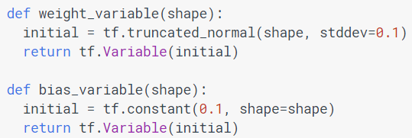
Weight Initialization

Slide 16
Convolution and Pooling
Our convolutions uses a stride of one and are zero padded so that the output is the same size as the input
Our pooling is plain old max pooling over 2x2 blocks

Slide 17
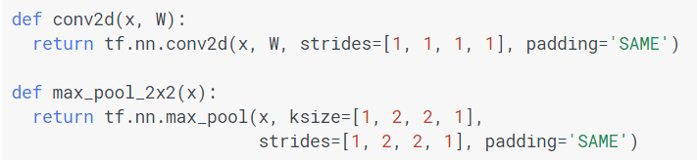
Convolution and Pooling

Slide 18

First Convolution Layer
convolution, followed by max pooling
compute 32 features for each 5x5 patch
weight tensor will have a shape of [5, 5, 1, 32]
The first two dimensions are the patch size, the next is the number of input channels, and the last is the number of output channels
a bias vector with a component for each output channel

Slide 19

First Convolution Layer
we first reshape x to a 4d tensor
second and third dimensions corresponding to image width and height
final dimension corresponding to the number of color channels
Convolve and max pool

Slide 20
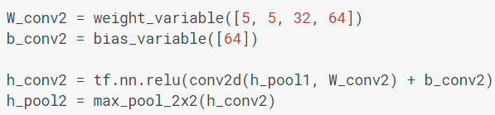
Second Convolution Layer
second layer will have 64 features for each 5x5 patch

Slide 21
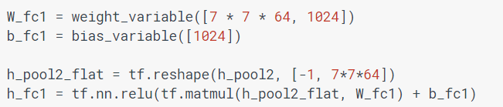
Densely Connected Layer
Now that the image size has been reduced to 7x7, we add a fully-connected layer with 1024 neurons to allow processing on the entire image

Slide 22

Dropout Layer
To reduce overfitting, we will apply dropout before the readout layer
We create a placeholder for the probability that a neuron's output is kept during dropout
This allows us to turn dropout on during training, and turn it off during testing

Slide 23
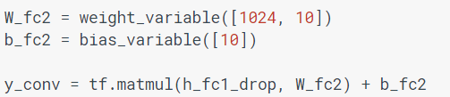
Readout Layer
Finally, we add a layer, for softmax regression

Slide 24
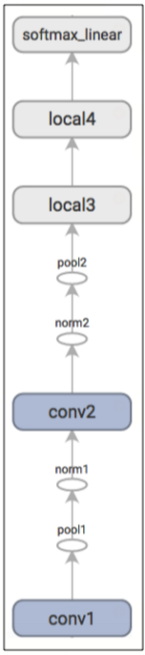
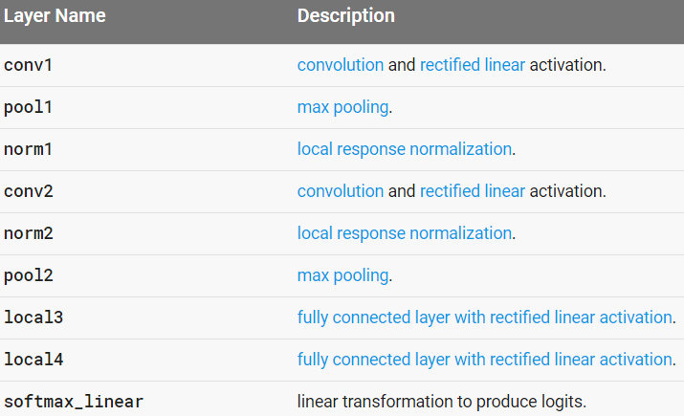
Sample CNN Model

Slide 25
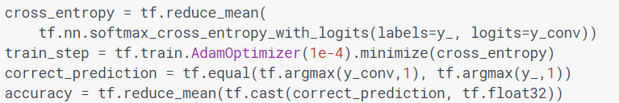
Loss/Cost fn and accuracy

Slide 26
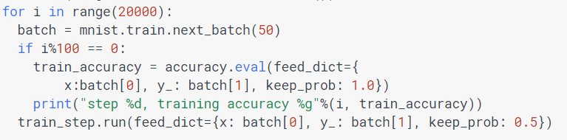
Train
Train for 20000 iterations. But for class will do only 500 iterations

Slide 27
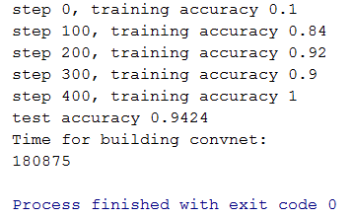
Test

Slide 28
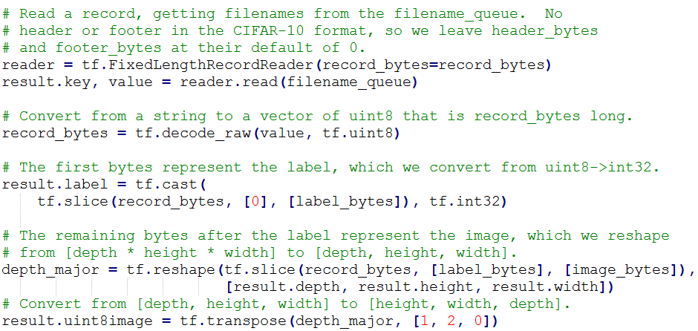
Reading Binary Files

Slide 29
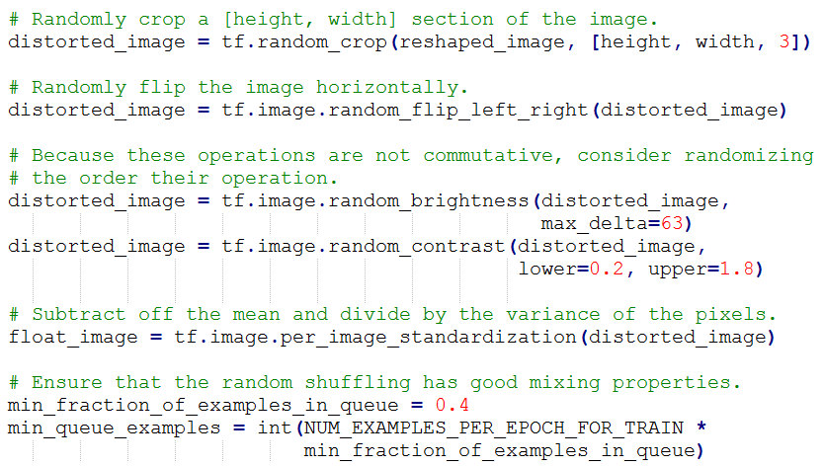
Varying Image Data

Slide 30
Reading Image Files
Refer:
https://github.com/tensorflow/tensorflow/blob/master/tensorflow/examples/image_retraining/retrain.py

Slide 31
Thank You !!!

