Slide 1
CS5542 Big Data Analytics and Applications Tutorial 10 – Deep Learning-IV
March 22nd 2018
UMKC

Slide 2
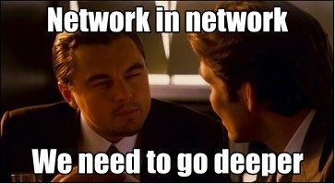
Basics
●
What is ILSVRC14?
- ImageNet Large-Scale Visual Recognition Challenge 2014
●
What is ImageNet?
WordNet hierarchy, concept = "synonym set" or "synset".
More than 100,000 synsets in WordNet, on average 1000 images to illustrate each synset
●
What are Google Inception and GoogLeNet?
-

Slide 3
Overview of the GoogleNet
●
A deep convolutional neural network architecture
●
Classification and detection for ILSVRC14
●
Improved utilization of the computing resources inside the network
while increasing size, both depth and width
●
12x fewer parameters than the winning architecture of Krizhevsky
●
Significantly more accurate than state of the art
●
22 layers deep when counting only layers with parameters
●
The overall number of layers (independent building blocks) used for the construction of the network is about 100

Slide 4
What is the Problem?
Aim:
–
To improve the performance of classification and detection
●
Restrictions:
–
Usage of CNN
Able to train with smaller dataset
Limited computational power and memory usage
–
–

Slide 5
How to improve classification and detection rates?
●
Straightforward approach;
Jut increase the size of network in both direction !
BUT!!!

Slide 6
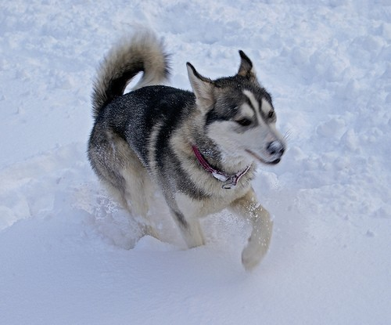
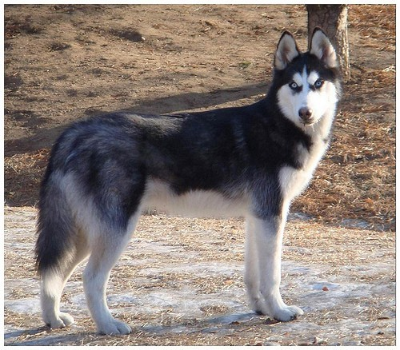
Straightforward approach, challenge 1
Larger number of parameters → Requires bigger data;
Otherwise overfit! High quality training sets can be tricky and expensive...
(a) Siberian husky
(b) Eskimo dog

Slide 7
Straightforward approach, challenge 2
Dramatically increased use of computational resources! A simple example:
●
●
–
If two convolutional layers are chained, any uniform increase in the number of their filters results in a quadratic increase of computation

Slide 8
What is their approach?
●
Moving from fully connected to sparsely connected architectures, even inside the convolutions

Slide 9
Handicap of the sparse approach
●
Todays computing infrastructures are very inefficient when it comes to numerical calculation on non-uniform sparse data structures
●
The gap is widened even further by the use of steadily improving, highly tuned, numerical libraries that allow for extremely fast dense matrix multiplication, exploiting the minute details of the underlying CPU or GPU hardware
●
Also, non-uniform sparse models require more sophisticated engineering and computing infrastructure
●
Even people go back to fully connected approach!

Slide 10
Their Solution
●
An architecture that makes use of the extra sparsity, even at filter level, as suggested by the theory, but exploits our current hardware by utilizing computations on dense matrices
●
Clustering sparse matrices into relatively dense submatrices tends to give state of the art practical performance for sparse matrix multiplication

Slide 11
Their motivation
●
Multi-scale processing namely synergy of deep architectures and classical computer vision, like the R- CNN algorithm by Girshick
●
If the probability distribution of the data-set is representable by a large, very sparse deep neural network, then the optimal network topology can be constructed layer by layer by analyzing the correlation statistics of the activations of the last layer and clustering neurons with highly correlated outputs
●
Hebbian principle: neurons that fire together, wire together

Slide 12
Hebbian Principle
Input

Slide 13
Cluster according activation statistics
Layer 1
Input

Slide 14
Cluster according correlation statistics
Layer 2
Layer 1
Input

Slide 15
Cluster according correlation statistics
Layer 3
Layer 2
Layer 1
Input

Slide 16

In images, correlations tend to be local

Slide 17
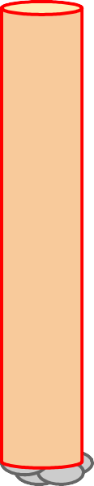
Cover very local clusters by 1x1 convolutions
number of filters
1x1

Slide 18

Less spread out correlations
number of filters
1x1

Slide 19
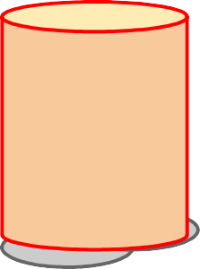
Cover more spread out clusters by 3x3 convolutions
number of filters
1x1
3x3

Slide 20
Cover more spread out clusters by 5x5 convolutions
number of filters
1x1
3x3

Slide 21
Cover more spread out clusters by 5x5 convolutions
number of filters
1x1
5x5
3x3

Slide 22
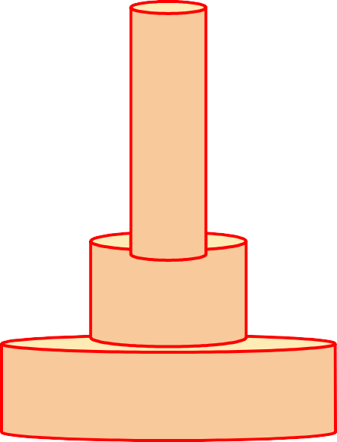
A heterogeneous set of convolutions
number of filters
1x1
3x3
5x5

Slide 23
Schematic view (naive version)
number of filters
1x1
Filter concatenation
3x3
1x1 convolutions
3x3 convolutions
5x5 convolutions
5x5
Previous layer

Slide 24
Naive idea
Filter concatenation
1x1 convolutions
3x3 convolutions
5x5 convolutions
Previous layer

Slide 25
Naive idea (does not work!)
Filter concatenation
1x1 convolutions
3x3 convolutions
5x5 convolutions
3x3 max pooling
Previous layer

Slide 26
Inception module
Filter concatenation
3x3 convolutions
5x5 convolutions
1x1 convolutions
1x1 convolutions
1x1 convolutions
1x1 convolutions
3x3 max pooling
Previous layer

Slide 27
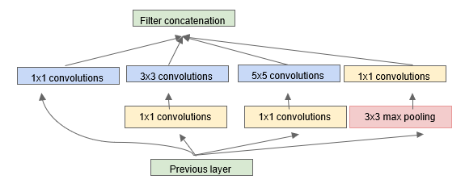
Inception module
1×1 convolutions are used to compute reductions before the expensive 3×3 and 5×5 convolutions.
Besides being used as reductions, they also include the use of rectified linear activation which makes them dual-purpose

Slide 28
How these 1x1 convolutions work?
●
Receptive field
Not dimensionality reduction in space, but can dimensionality reduction in channel
ReLU functionality
●
●

Slide 29
Solution Details
●
Optimal local sparse structure in a convolutional vision network can be approximated and covered by readily available dense components
●
Find the optimal local construction and repeat it spatially

Slide 30
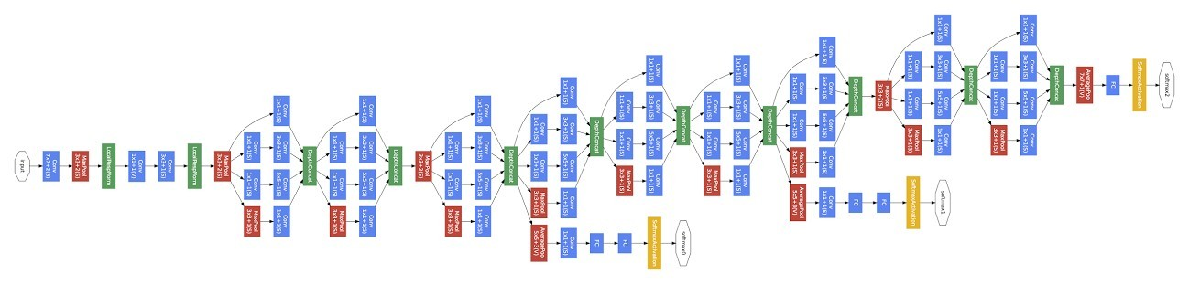
GoogLeNet
Convolution Pooling Softmax Other

Slide 31
Inception
832
1024
832
512
512
512
256
480
480
Width of inception modules ranges from 256 filters (in early modules) to 1024 in top inception modules.
Can remove fully connected layers on top completely
Computional cost is increased by less than 2X compared to Krizhevsky’s network. (<1.5Bn operations/evaluation)
Number of parameters is reduced to 5 million

Slide 32
Auxiliary classifiers
●
Encourage discrimination in the lower stages in the classifier
Increase the gradient signal that gets propagated back Provide additional regularization
●
●

Slide 33
Auxiliary classifiers
An average pooling layer with 5x5 filter size and stride 3, resulting in an 4x4x512 output or the (4a), and 4x4x528 for the (4d) stage.
A 1x1 convolution with 128 filters for dimension reduction and rectified linear activation.
A fully connected layer with 1024 units and rectified linear activation.
A dropout layer with 70% ratio of dropped outputs.
A linear layer with softmax loss as the classifier (predicting the same 1000 classes as the main classifier, but removed at inference time)

Slide 34
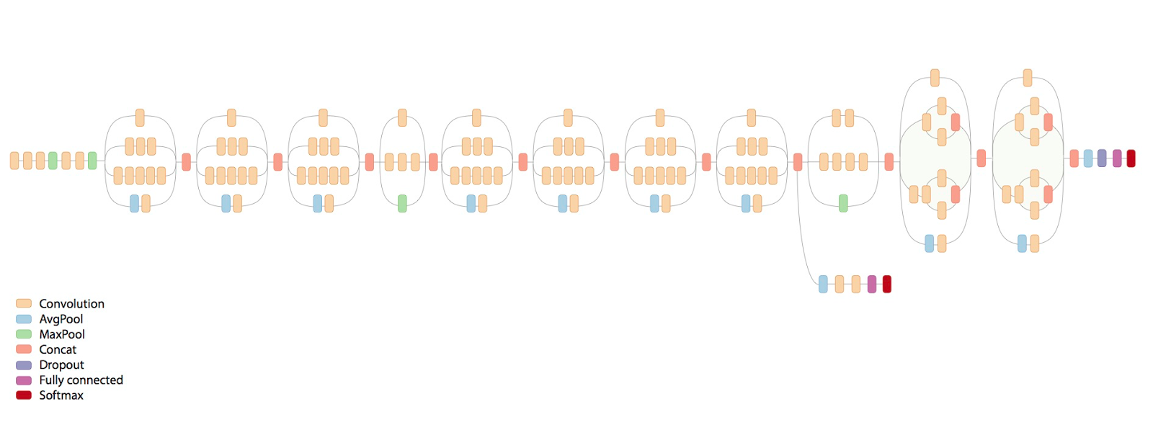
Inception V4

Slide 35
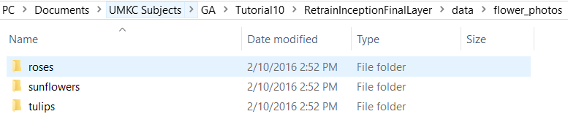
Our Dataset

Slide 36
Retrain
Script loads the pre-trained Inception v3 model, removes the old final layer, and trains a new one on the flower photos you've downloaded.
ImageNet was not trained on any of these flower species, originally.

Slide 37
Retrain
However, the kinds of information that make it possible for ImageNet to differentiate among 1,000 classes are also useful for distinguishing other objects.
By using this pre-trained network, we are using that information as input to the final classification layer that distinguishes our flower classes.

Slide 38
Bottlenecks
The first phase analyzes all the images on disk and calculates the bottleneck values for each of them. What's a bottleneck?
For this codelab, you are training only the last layer; the previous layers retain their already-trained state.
A 'Bottleneck,' then, is an informal term we often use for the layer just before the final output layer that actually does the classification.

Slide 39
Bottlenecks
Every image is reused multiple times during training.
Calculating the layers behind the bottleneck for each image takes a significant amount of time.
By caching the outputs of the lower layers on disk, they don't have to be repeatedly recalculated.

Slide 40
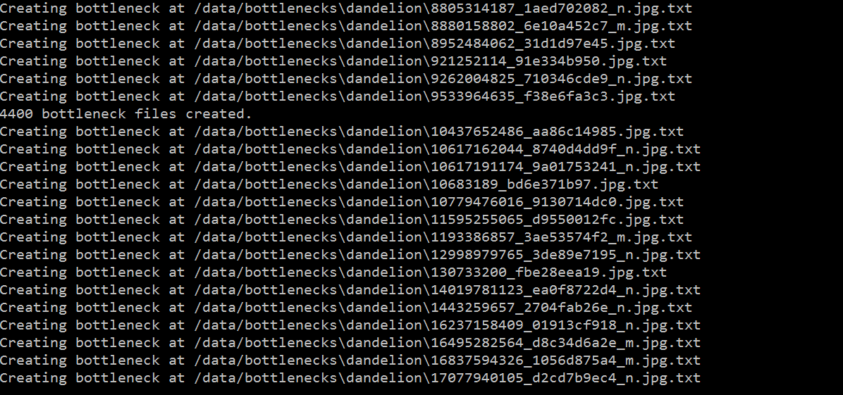
Bottlenecks

Slide 41
Training
The training accuracy shows the percentage of the images used in the current training batch that were labeled with the correct class.
Validation accuracy: The validation accuracy is the precision (percentage of correctly-labelled images) on a randomly-selected group of images from a different set.
Cross entropy is a loss function that gives a glimpse into how well the learning process is progressing. (Lower numbers are better here.)

Slide 42

Dataset

Slide 43
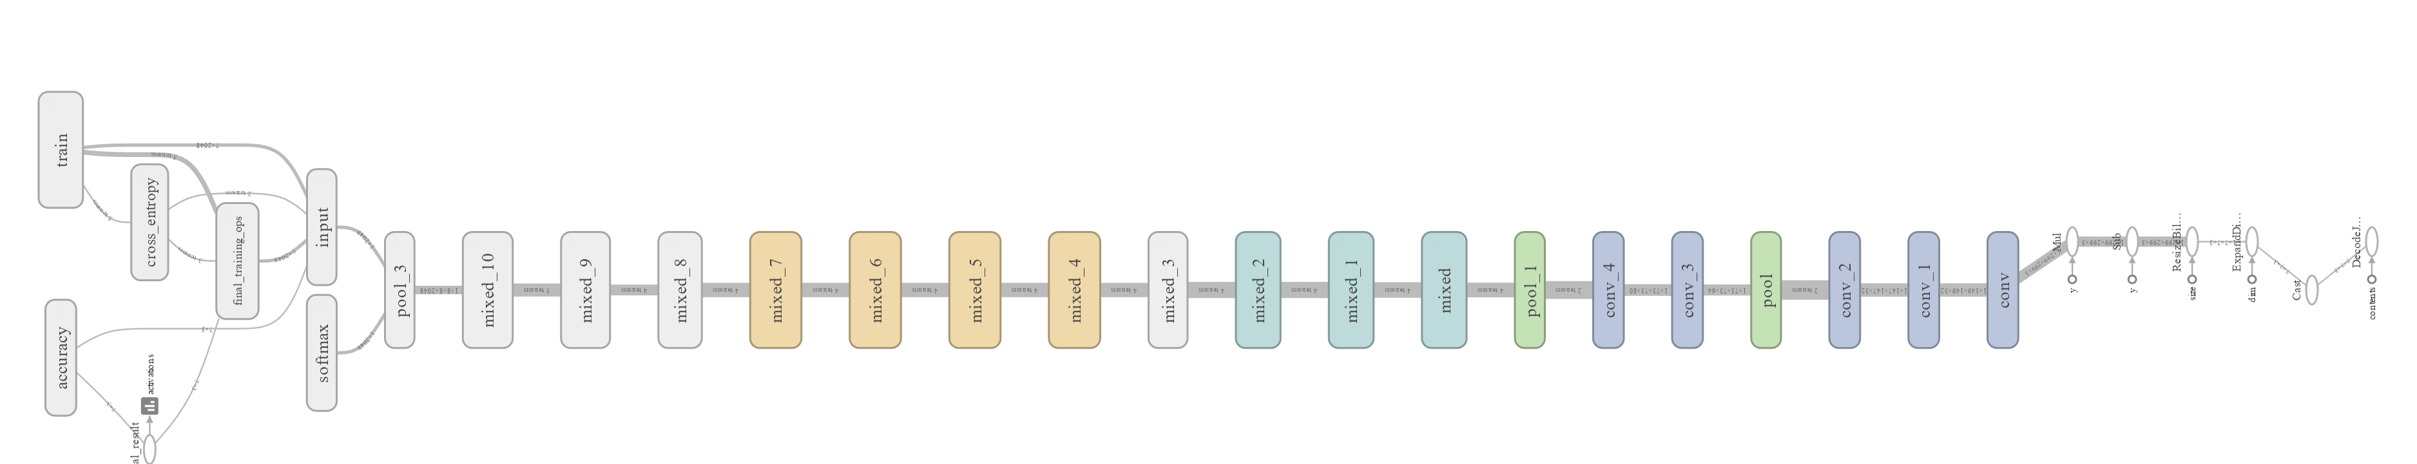
Graph

Slide 44
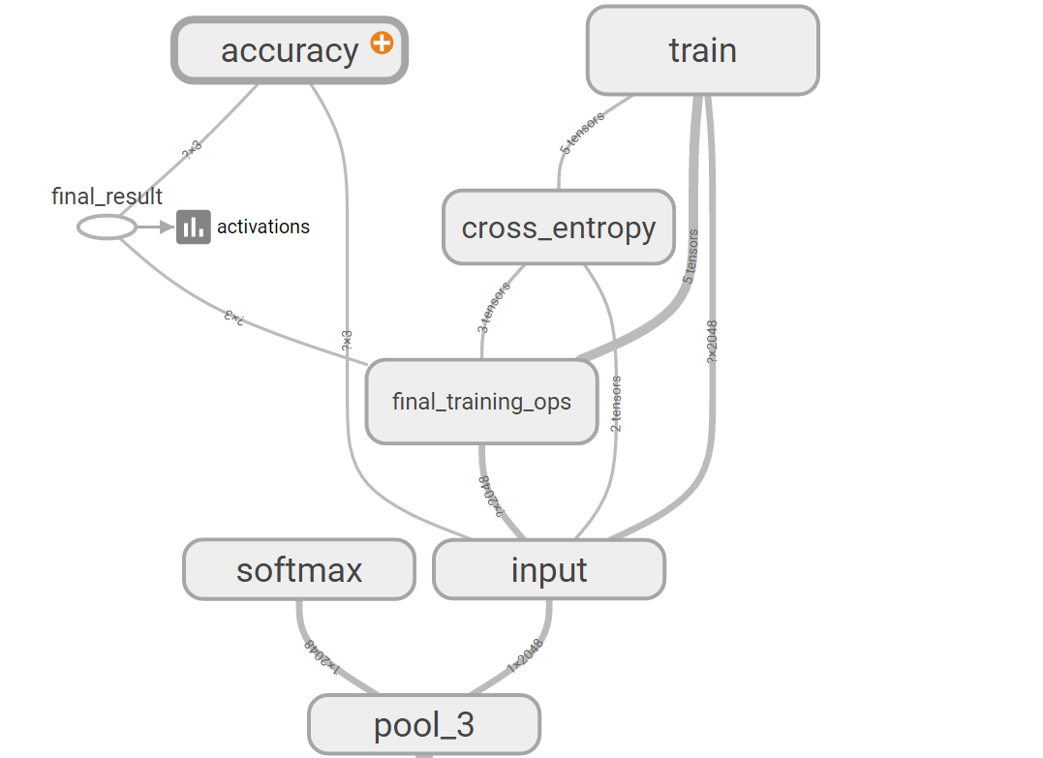
Graph

Slide 45
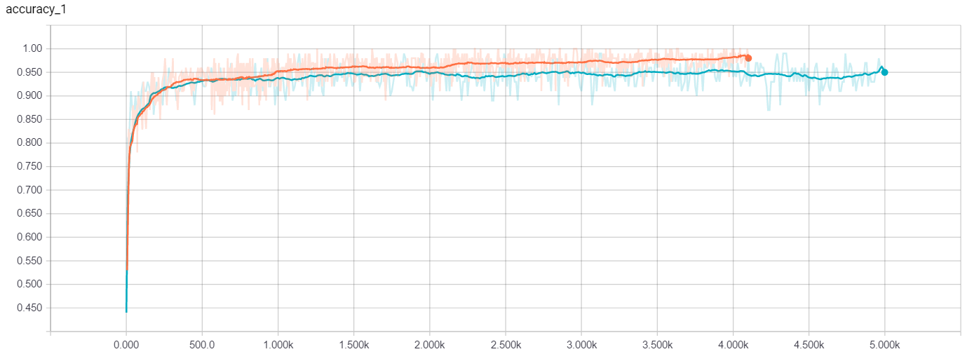
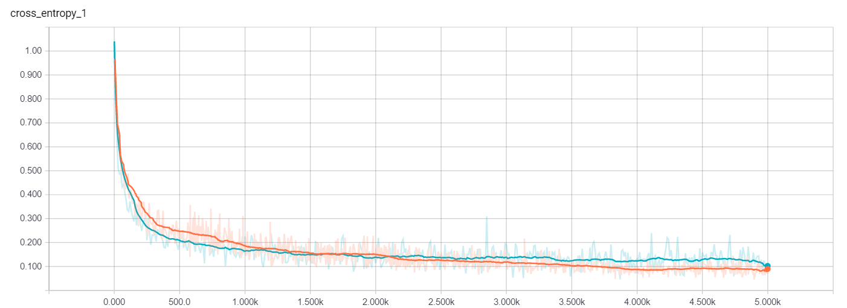
Accuracy and Cross_entropy

Slide 46
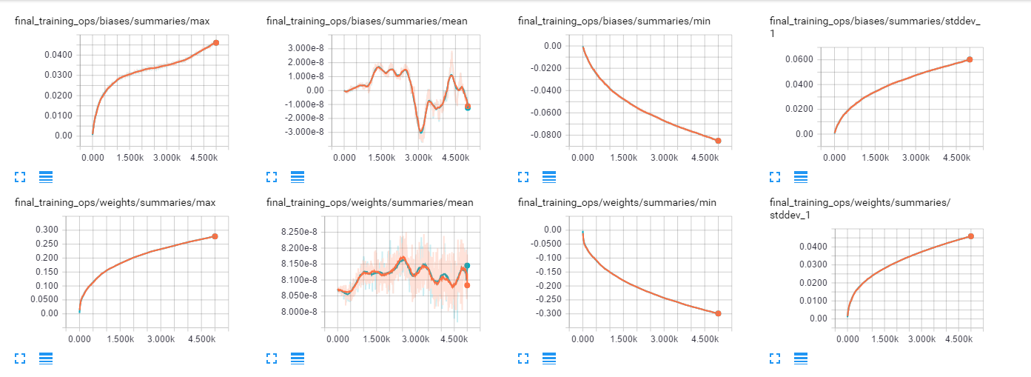
Training Parameters

Slide 47
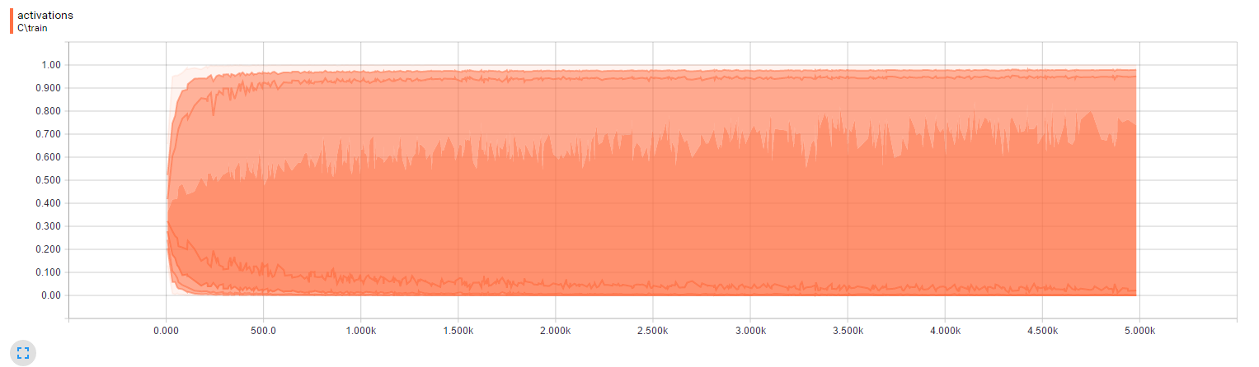
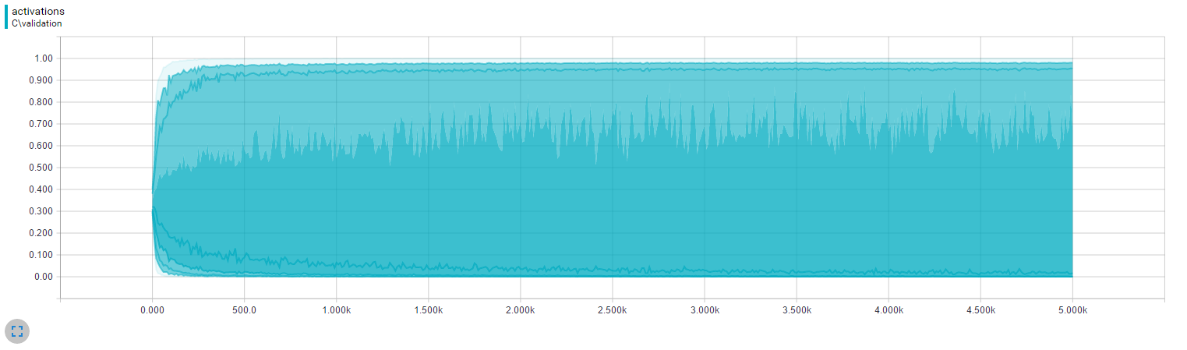
Activations

Slide 48
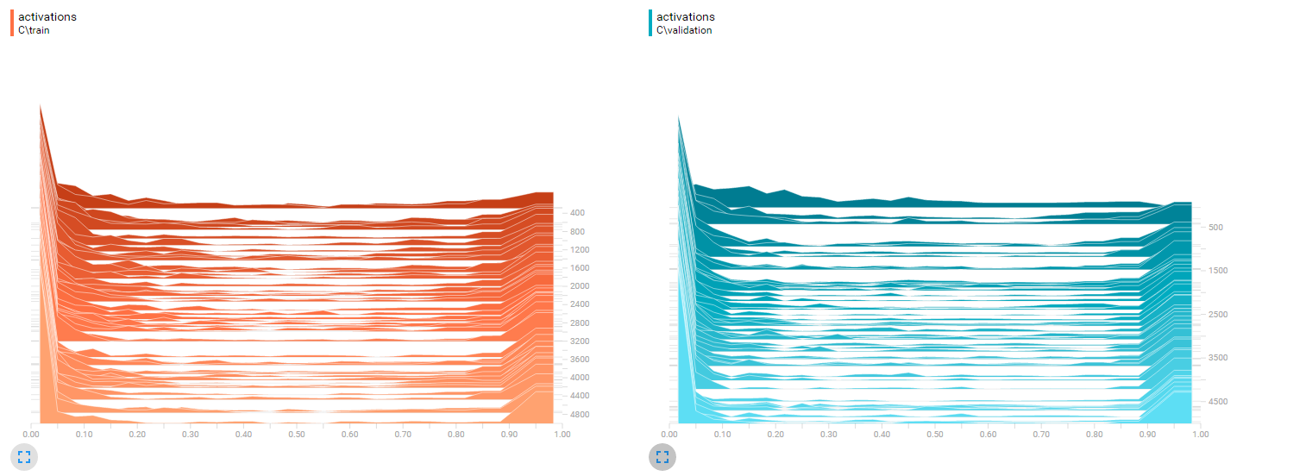
Activations

Slide 49
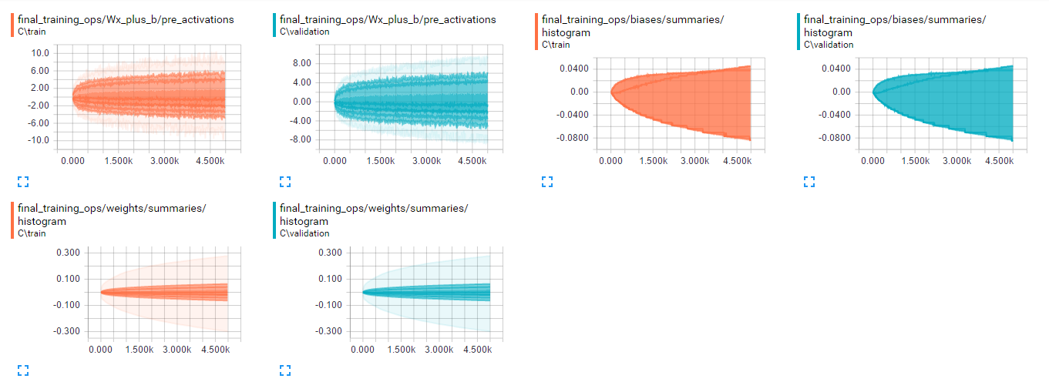
Final Training Ops

Slide 50
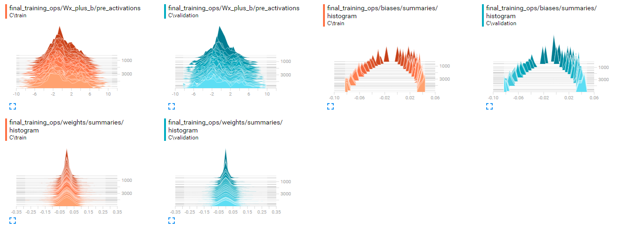
Final Training Ops

Slide 51
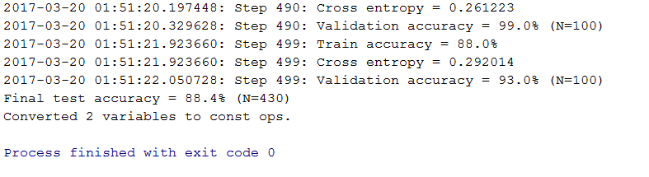
Test Accuracy

Slide 52

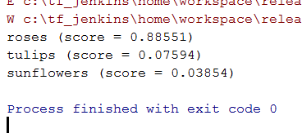
Sample Inference

Slide 53

Sample Inference

Slide 54
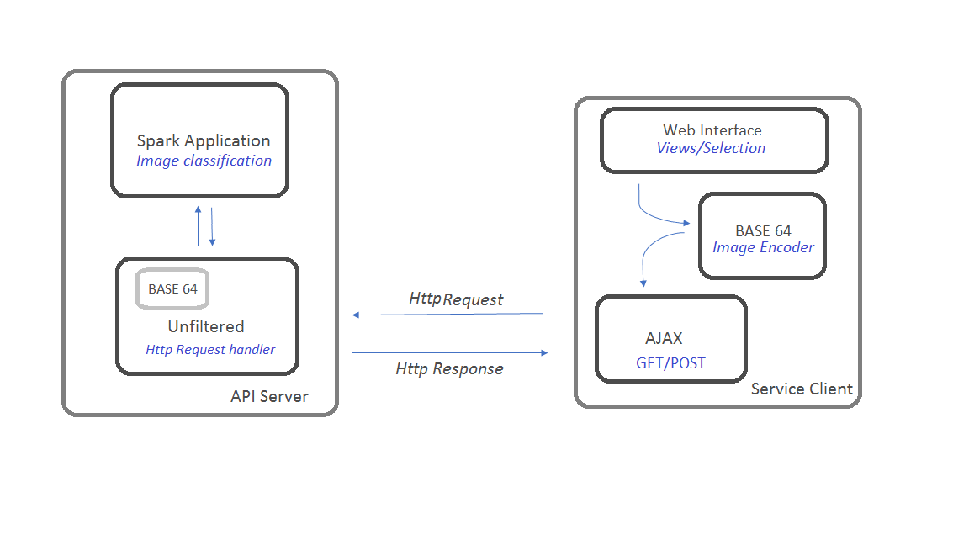
Architecture
Tensorflow
FLASK

Slide 55
Flask
Flask is a microframework for Python. Precisely a web-development microframework.
Flask has built-in development server and debugger
RESTful support integrated
Extensively documented

Slide 56
Flask
Sample code
from flask import Flask
app = Flask(__name__)
@app.route("/")
def hello():
return "Hello World!"
if __name__ == "__main__":
app.run()
Easy to setup
$ pip install Flask
$ python hello.py
* Running on http://localhost:5000/

Slide 57
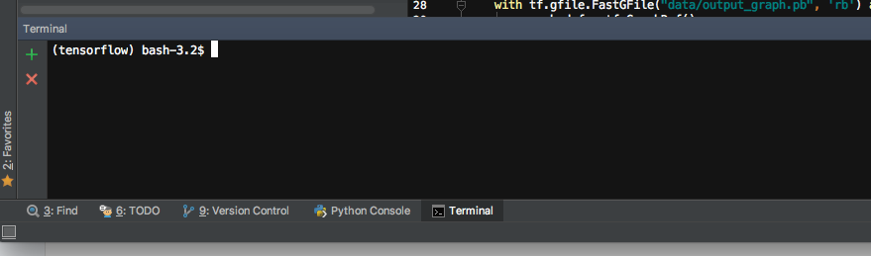
Demo application – local Build/Run
Open PyCharm terminal
$pip install Flask Flask_Cors
$export FLASK_APP=label_image.py
$python –m flask run
Open browser and navigate to the URL displayed

Slide 58
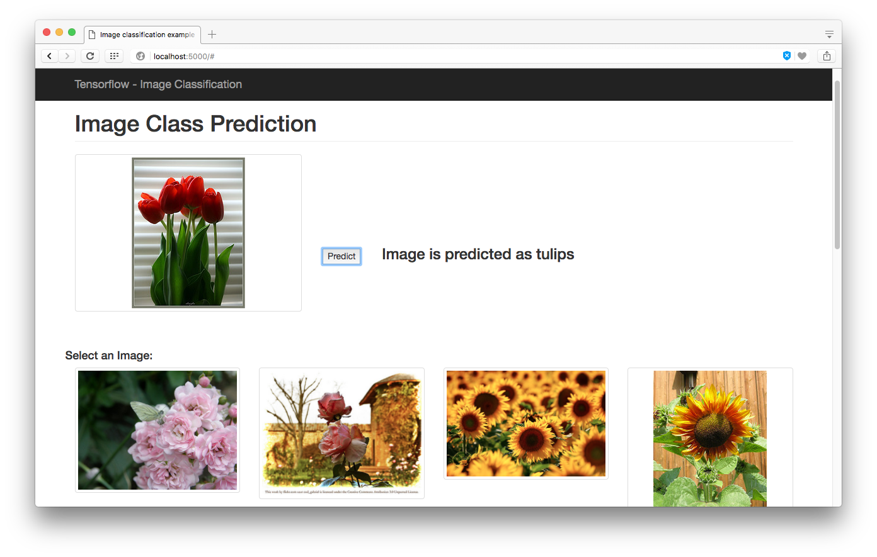
Demo Application

Slide 59
Reference
https://www.tensorflow.org/tutorials/image_retraining
http://flask.pocoo.org

