Slide 1

CS5542 Big Data Analytics and Applications Tutorial 4 Image Classification

Slide 2

User
Project Workflow
Question Answering
(Google Conversion API)
Interactive Virtual Reality
(Google Cardboard SDK)
Annotation Presentation
Image or Video Data
External API (Clarifai API)
Machine Learning (Spark)
Deep Learning
(Tensor Flow)
Annotations
Annotation Processing

Slide 3
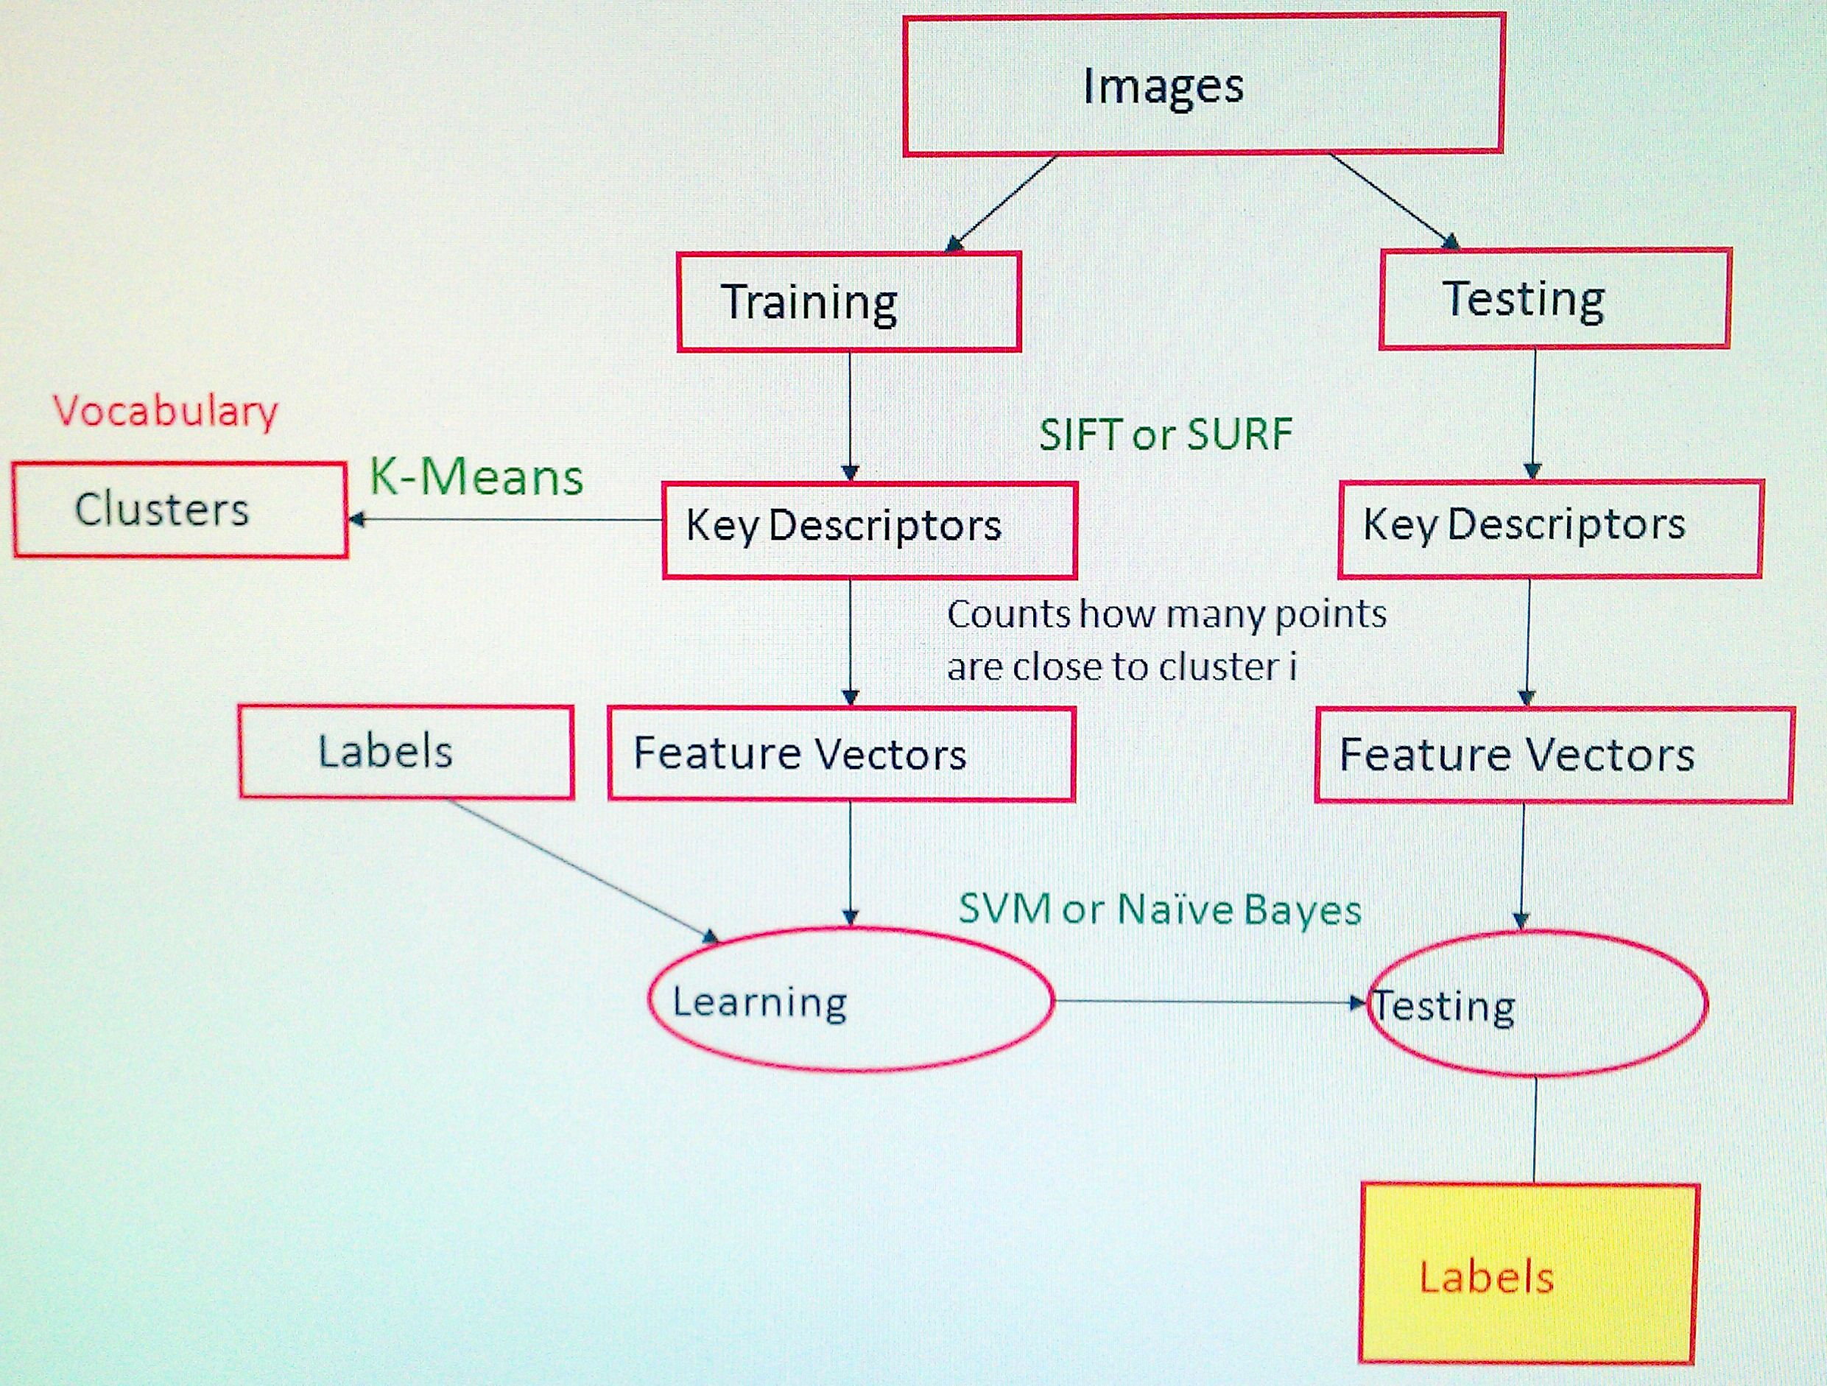
Image Classification
Notes:
SIFT – Scale Invariant Feature Transform
SURF – Speeded up robust features

Slide 4
Training and Testing

Slide 5
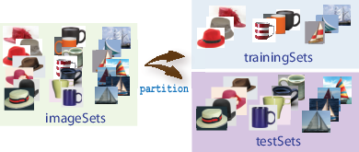
Image Classification with Bag of Visual Words
Step 1: Set Up Image Category Sets

Slide 6

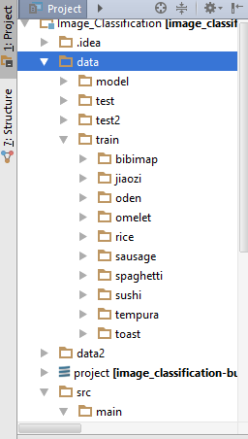
Image Categories

Slide 7
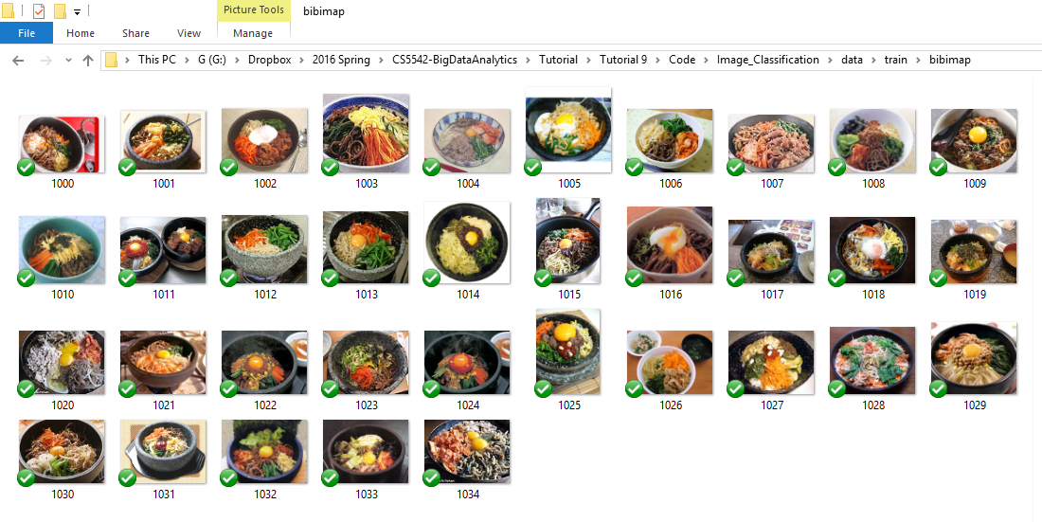
Training Data (Static UEC Food Dataset)

Slide 8
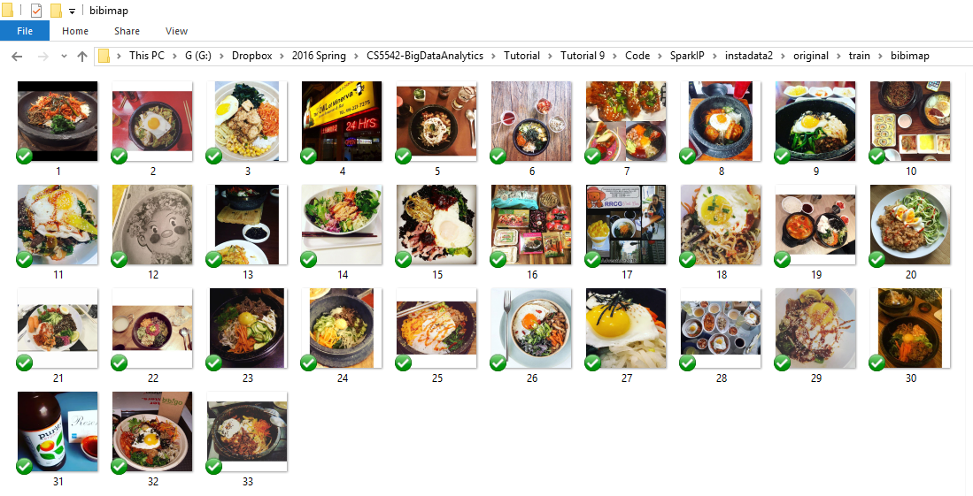
Testing Data (Instagram)

Slide 9
Key Descriptor Extraction
Feature Extraction

Slide 10
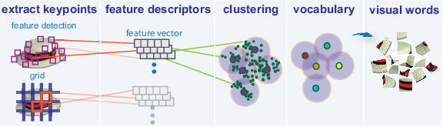
Image Classification with Bag of Visual Words
Step 2: Create Bag of Features

Slide 11
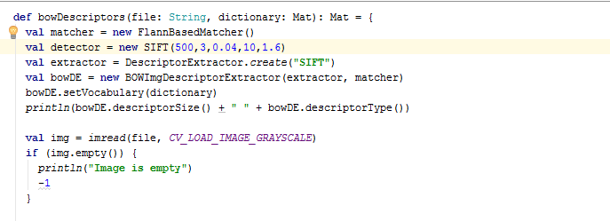
SIFT using opencv
ImageUtils.scala

Slide 12
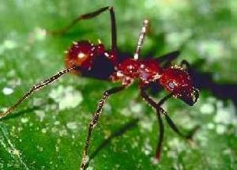
Sample SIFT Features
0.009884679, 0.0, 0.0, 0.0049423394, 0.009884679, 0.0032948928, 0.0049423394, 0.0, 0.0016474464, 0.0, 0.0, 0.0, 0.0, 0.0016474464, 0.0032948928, 0.0032948928, 0.0049423394, 0.0, 0.008237232, 0.0032948928, 0.0049423394, 0.0, 0.009884679, 0.0, 0.0, 0.0, 0.0, 0.0, 0.0032948928, 0.0, 0.0016474464, 0.0, 0.0016474464, 0.0032948928, 0.0016474464, 0.0, 0.0065897857, 0.0049423394, 0.0016474464, 0.0, 0.0, 0.0016474464, 0.0016474464, 0.0, 0.0, 0.0016474464, 0.0016474464, 0.0016474464, 0.0, 0.0065897857, 0.0, 0.0, 0.0, 0.0049423394,
300 x 215

Slide 13
Clustering and Creation of BOW

Slide 14
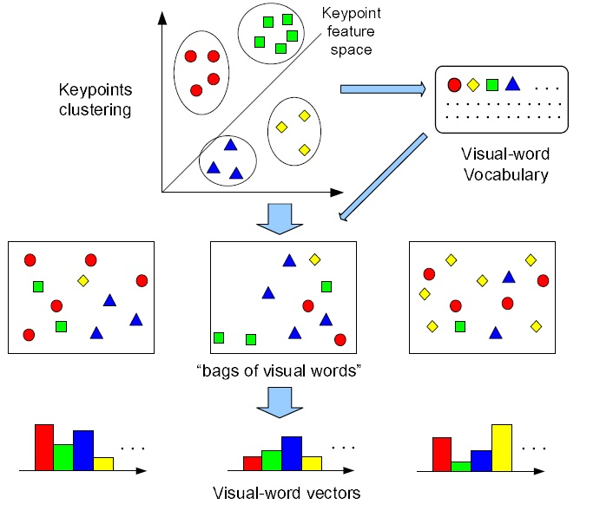
Bag of Visual Words from Extracted Patch-based Visual Features
Vector Quantization (VQ)
Clusters the keypoint descriptors in their feature space into a large number of clusters using the K-means clustering algorithm
Each cluster represents a visual word representing a specific local pattern shared by the keypoints in that cluster.
Visual word vocabulary describing different local patterns in images.
The number of clusters determines the size of the vocabulary, which can vary from hundreds to over tens of thousands
Mapping the keypoints to visual words, we can represent each image as a "bag of visual words".

Slide 15
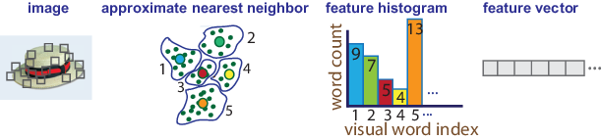
Image Classification with Bag of Visual Words
Step 3: Train an Image Classifier With Bag of Visual Words
3-1) Use the bagOfFeatures encode method to encode each image from the training set.
Detects and extracts features from the image
Uses the approximate nearest neighbor algorithm to construct a feature histogram for each image.
Increments histogram bins based on the proximity of the descriptor to a particular cluster center.
The histogram length: the number of visual words that the bagOfFeatures object constructed.

Slide 16
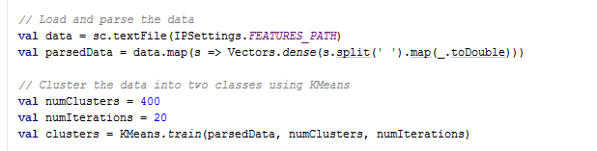
Bag of Words
Bag of Words in our approach is created using kMeans Clustering Algorithm

Slide 17
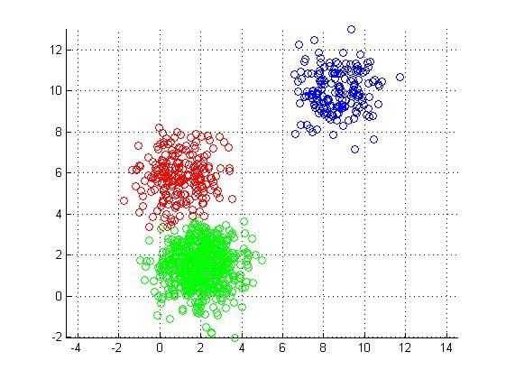
KMeans
The SIFT Key Vectors are plotted on a plane for clusters to be found.

Slide 18
Feature Vector

Slide 19
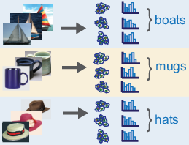
Image Classification with Bag of Visual Words
Step 3: Train an Image Classifier With Bag of Visual Words
3-2) Repeat step 1 for each image in the training set to create the training data.

Slide 20
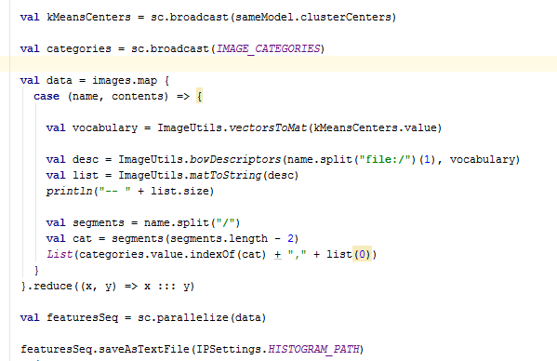
Histogram Creation for Images based on BOW
The histogram acts as the Feature Vector for the image

Slide 21
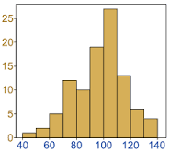
Feature Vector
Histogram for each image based on KMeans Clustering
Histogram size : (400, 1)
Histogram : [ 0.0, 0.0, 0.0, 0.0061919503, 0.0, 0.0, 0.0, 0.009287925, 0.0, 0.0, 0.0, 0.0, 0.0061919503, 0.0061919503, 0.0, 0.0, 0.0, 0.0030959751, 0.0, 0.0030959751, 0.0061919503, 0.0, 0.0, 0.0030959751, 0.0030959751, 0.0030959751, 0.0061919503, 0.0, 0.0030959751, 0.0061919503, 0.0, 0.0030959751, 0.0, 0.0030959751, 0.0, 0.0061919503, 0.0, 0.0061919503, 0.0030959751, 0.0, 0.0, 0.0061919503, 0.0, 0.0030959751, 0.0, 0.0030959751, 0.0030959751, 0.012383901, 0.0, 0.0, 0.0, 0.0, 0.0, 0.0 … ]

Slide 22
Classification

Slide 23
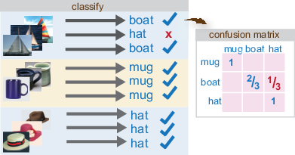
Image Classification with Bag of Visual Words
Step 3: Train an Image Classifier With Bag of Visual Words
3-3) Evaluate the quality of the classifier.
The output confusion matrix represents the analysis of the prediction.

Slide 24
Classification Algorithm
Different Classification Algorithms can be used
Naïve Bayes
Decision Tree
Random Forest
Support Vector Machine (SVM)
Current Implementation we have Random Forest Based Classification of Images

Slide 25
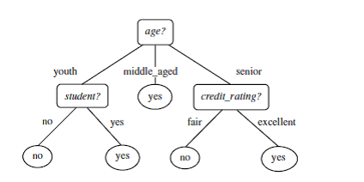
Decision Tree

Slide 26
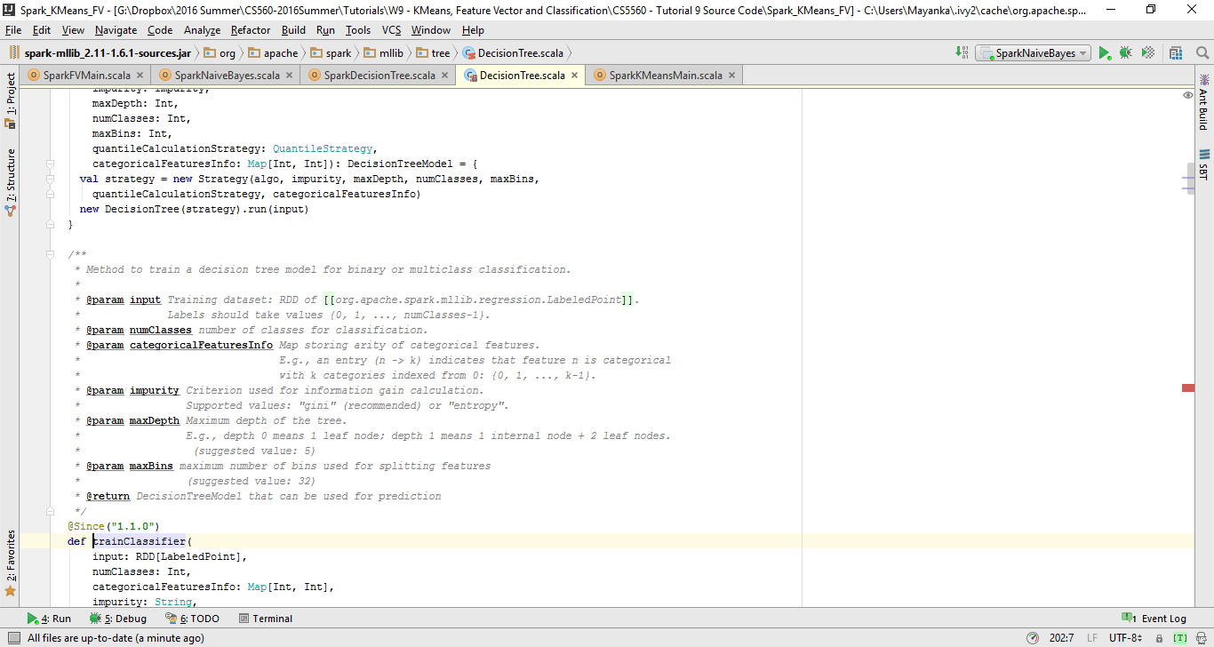
Decision Tree
val numClasses = 5 val categoricalFeaturesInfo = Map[Int, Int]() val impurity = "gini" val maxDepth = 5 val maxBins = 32 val model = DecisionTree.trainClassifier(trainingData,numClasses, categoricalFeaturesInfo, impurity, maxDepth, maxBins)

Slide 27
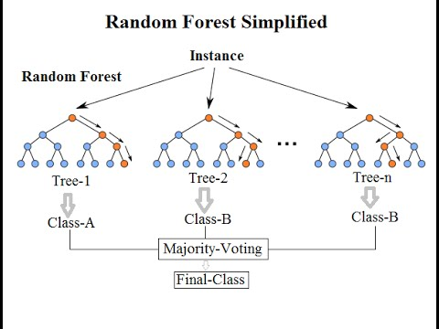

Slide 28
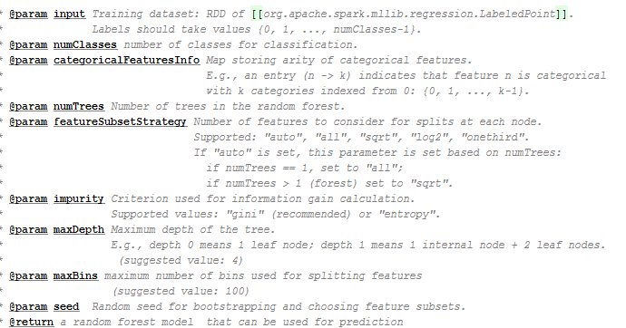
Random Forest
val numClasses = 5 val categoricalFeaturesInfo = Map[Int, Int]() val impurity = "gini" val maxDepth = 5 val maxBins = 32 val featureSubsetStrategy = "auto" val numTrees = 5 val model = RandomForest.trainClassifier(trainingData, numClasses,
categoricalFeaturesInfo, numTrees, featureSubsetStrategy, impurity,
maxDepth, maxBins)

Slide 29
Image Classification with Bag of Visual Words
Step 4: Classify an Image or Image Set
Use a predict method on a new image to determine its category.

Slide 30
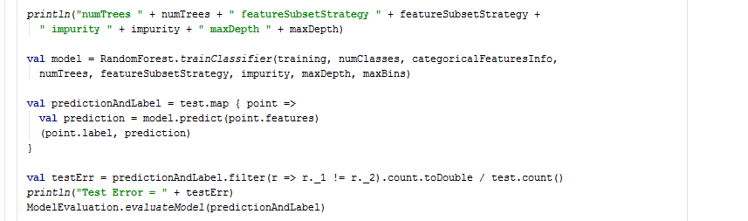
Training the Classifier Based on Random Forest

Slide 31
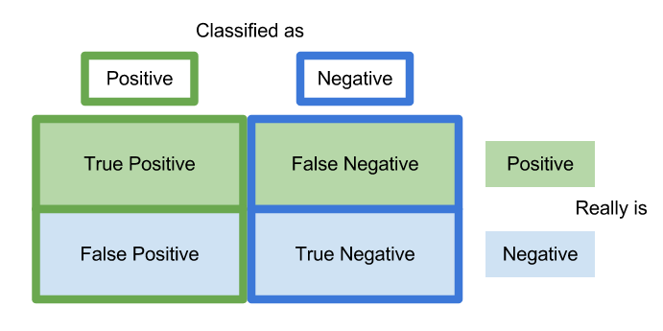
Confusion Matrix

Slide 32
Confusion Matrix
val metrics = new MulticlassMetrics(y) println("Accuracy:" + metrics.accuracy) println( metrics.confusionMatrix)

Slide 33
Confusion Matrix
Image Categories => {"rice", "tempura", "toast", "bibimap", "sushi", "spaghetti", "sausage", "oden", "omelet", "jiaozi“}
Factors Affecting the Confusion Matrix:
Domain based Feature Selection
RGB
Color Histogram
SIFT / SURF
Edge Detection
Ambiguity between Categories
Different Sources of Data for Training and Testing
Social Media Data has a lot of diverse as well noisy data
Size of Data
Choice of Classification Algorithm
Preprocessing data in terms of size, noise data reduction etc.
 | I | II | III | IV | V | VI | VII | VIII | IX | X
I | 0 | 2 | 0 | 0 | 0 | 0 | 3 | 0 | 0 | 0
II | 0 | 2 | 0 | 0 | 1 | 1 | 0 | 1 | 0 | 0
III | 0 | 0 | 2 | 1 | 0 | 0 | 1 | 0 | 1 | 0
IV | 0 | 0 | 0 | 3 | 0 | 0 | 1 | 0 | 1 | 0
V | 0 | 0 | 1 | 1 | 1 | 0 | 0 | 0 | 2 | 0
VI | 0 | 0 | 1 | 1 | 0 | 0 | 1 | 0 | 2 | 0
VII | 0 | 1 | 1 | 0 | 2 | 0 | 0 | 0 | 1 | 0
VIII | 3 | 1 | 0 | 0 | 0 | 0 | 0 | 0 | 1 | 0
IX | 0 | 0 | 1 | 1 | 1 | 1 | 0 | 0 | 0 | 1
X | 0 | 1 | 0 | 1 | 0 | 0 | 1 | 0 | 2 | 0

