Slide 1
CS5542 Big Data Analytics and Applications Tutorial 5– API capability for Apache Spark Programs
15th February 2018
UMKC

Slide 2
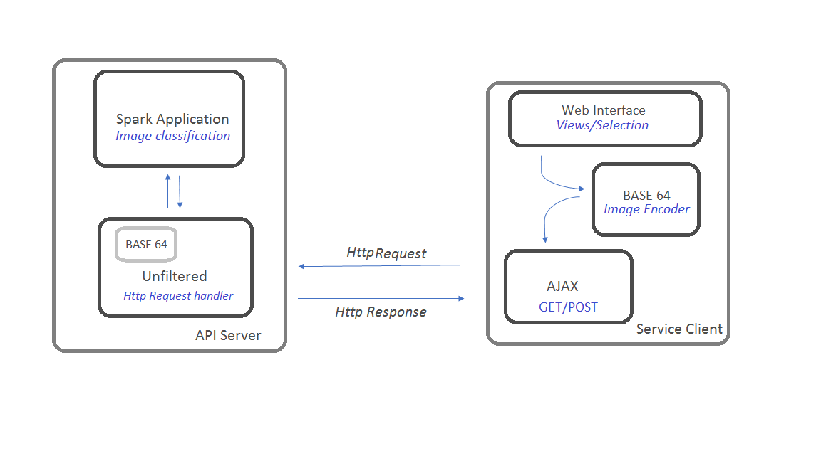
Architecture
AKKA HTTP

Slide 3
Apache Spark Http API
Unfiltered: Simple light weight, but not matured framework, growing fast.
Play 2.0: Not exactly lightweight. But has mvc architecture support and very well documented.
Scalatra: A web framework in the spirit of ruby’s Sinatra-Framework.
Lift: Secure webframework and supports modular approach (lift apps can make use of pre-build modules).

Slide 4
Akka HTTP
The Akka HTTP Core Server API provides a Flow- or Function-level interface that allows an application to respond to incoming HTTP requests by simply mapping requests to responses.
akka-http-cors
CORS (Cross Origin Resource Sharing) is a mechanism to enable cross origin requests.
This is a Scala implementation for the server-side targeting the Akka Http library. Main features:
Works without any additional configuration. Sensible defaults are provided.
Respects the full standard defined by the W3C, even the border cases.
Cross-origin resource sharing (CORS) is a mechanism that allows restricted resources (e.g. fonts) on a web page to be requested from another domain outside the domain from which the first resource was serve

Slide 5
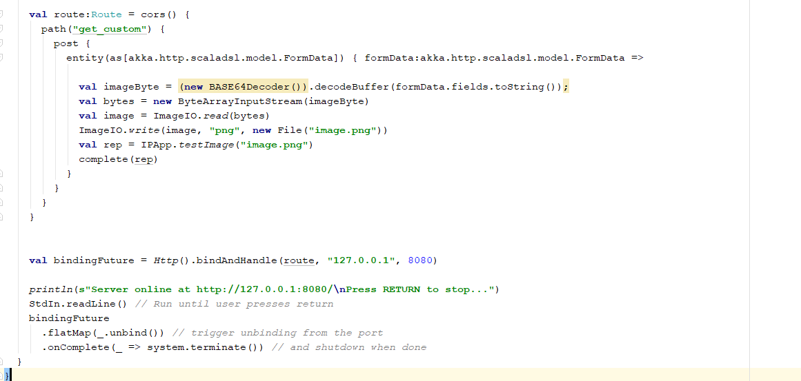
Code Snippet

Slide 6
Changes to the Spark program
Modify the driver program with main method to custom named function; which eventually be used in GET or POST request.
Donot instantiate new SparkContext(), Use SparkContext.getOrCreate(SparkConf sparkConf) instead.

Slide 7
Install node js, npm:
Windows:
Step 1: Install nodejs and npm
Download the windows installer (.msi file) from the Node.js web site (https://nodejs.org/en/download/).
Run the installer.
Select npm package manager to install
Restart your computer!

Slide 8
Step 2: Verify npm installation:
Open command prompt, Powershell or a similar command line tool and type:
npm -v
Step 3: Install superstatic
npm install -g superstatic
Linux (Ubuntu):
Step 1: Install nodejs and npm
sudo apt-get install nodejs
sudo apt-get install npm
sudo ln -s /usr/bin/nodejs /usr/bin/node
Step 2: Verify node and npm installation:
$ npm -v
Step 3: Install superstatic
sudo npm install -g superstatic

Slide 9
Mac OS:
Step 1: Install package manager (‘Homebrew’)
ruby -e "$(curl -fsSL https://raw.githubusercontent.com/Homebrew/install/master/install)"
brew install node
Step 2: Verify node and npm installation:
$node -v
$npm -v
Step 3: Install superstatic
npm install -g superstatic

Slide 10
Executing the programs:
Open IntelliJ and import Image_Classification project
Run SimpleServer.scala Program
Open terminal/Command prompt
Change directory to UI ex (~/Documents/ImageClassification/UI)
Copy paste the below command and enter
superstatic -p 8081
Open http://localhost:8081 in your browser

Slide 11
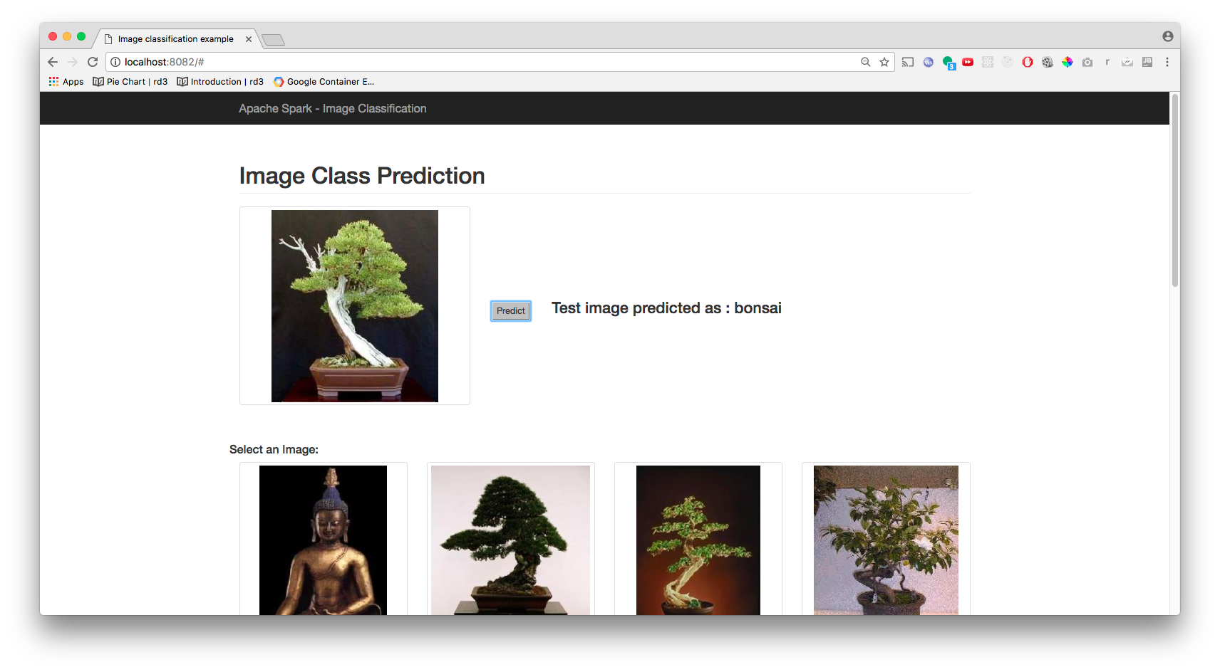
Image Classification – Client interface

Slide 12
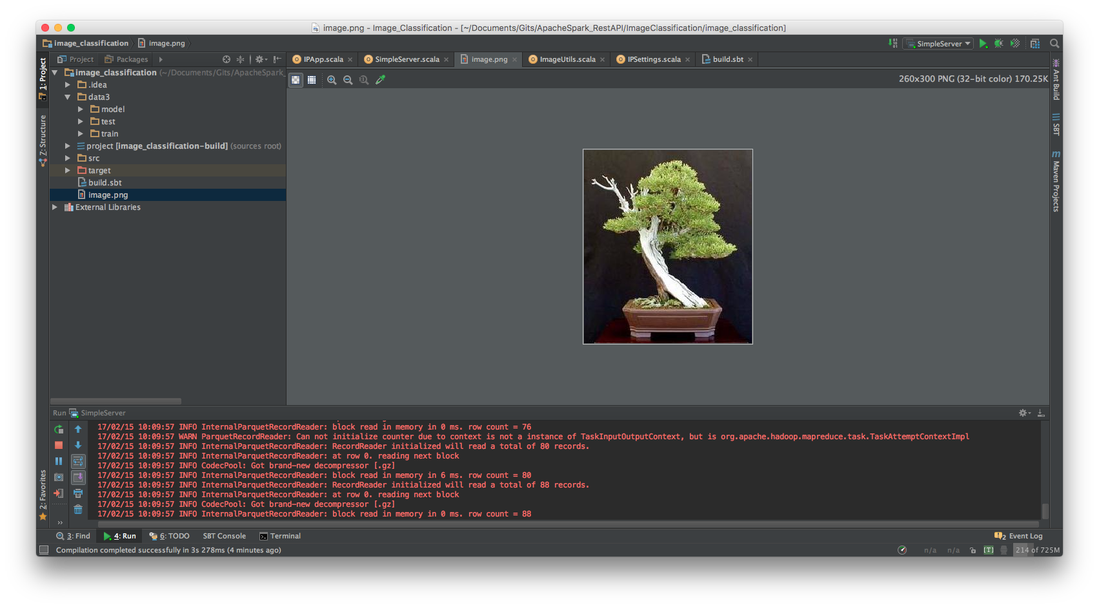
Image Classification - Server side

Slide 13
Reference:
Unfiltered - https://github.com/unfiltered/unfiltered
Blog - http://unfiltered.databinder.net/Within+the+Parameters.html
Example - http://nicholas.ren/2014/12/21/build-rest-api-in-scala.html
Alternatives:
Simplified Http - https://github.com/scalaj/scalaj-http

