Slide 1
Business / data analytics project
Pfizer Personalized Medicine: Clinical Trial Analytics
From clinical trial data to actionable treatment insights
Md Kaifi Ur Rahman
September 2026
Tools: Microsoft Excel, Looker Studio
Open Interactive Looker Studio Dashboard
View GitHub Project Repository

Slide 2
Outcomes split evenly overall; improvement rates ranged from 31% to 39% by drug
Summary of 1,000 patient records. All findings are observed associations within this dataset.
1,000
34.70%
~5.40
patient records
overall observed treatment success rate
average treatment efficacy score (1 to 10)
Finding | Evidence
Outcomes were spread evenly | 34.7% Improved, 34.2% No Change, 31.1% Deteriorated
Drugs led on different measures | Drug C: highest improvement rate (38.52%). Drug D: highest average efficacy (5.56)
Mutation status was associated with a difference | Improvement rate 37.37% (positive) vs 32.33% (negative)
Side effects and PFS varied by drug | Side-effect counts 35 to 62 per drug and type; average PFS 11.26 to 11.95 months
Basis: 22 PivotTable analyses, 3 scatter analyses, 15 Excel visualizations and an interactive Looker Studio dashboard.
Pfizer Personalized Medicine | Clinical Trial Analytics
2

Slide 3
Objective: relate patient, treatment and genetic factors to trial outcomes
Pfizer wants to know how these characteristics are associated with the outcomes below.
Outcomes examined
Questions the project answers
Treatment outcome
1
How do outcomes and success rate differ across drugs, doses and trial phases?
Drug efficacy
2
How do age group, gender and ethnicity relate to observed success?
Side effects
Survival rate
3
Is mutation status associated with efficacy, improvement or PFS?
Progression-free survival (PFS)
4
How are side effects distributed across drugs and treatment duration?
Treatment success
5
How do survival rate and PFS compare across drugs, and with each other?
Approach: clinical trial data > analytics > outcome insights > decision support
Pfizer Personalized Medicine | Clinical Trial Analytics
3

Slide 4
1,000 patient records, each described across five groups of variables
One row per patient.
Data structure
Numerical measures
Group | Fields
Demographics | Age, Gender, Ethnicity, Medical History
Treatment | Drug, Trial Phase, Dose, Duration of Treatment, Start/End Date
Genetics | Gene Name, Mutation Status, Expression Level, Biomarker Level, Genomic Profile
Side effects | Side Effects, Adverse Events
Clinical outcomes | Treatment Outcome, Efficacy Score, Survival Rate, Progression-Free Survival
Measure | Range
Efficacy Score | 1 to 10
Survival Rate | 6 to 24 months
Progression-Free Survival | 3 to 20 months
Dose | 50 to 200 mg
Treatment Duration | 30 to 180 days
Age | 18 to 85 years
Pfizer Personalized Medicine | Clinical Trial Analytics
4

Slide 5
Missing values were limited to four fields; records were validated before analysis
Cleaning covered missing values, IDs, dates, ranges, categories and analytical helper fields.
Before: missing values
Cleaning workflow
After: validation results
Field | Missing
Genomic_Profile | 48.7%
Medical_History | 18.2%
Side_Effects | 16.7%
Adverse_Events | 8.1%
1
Identify missing values
Check | Result
Total records | 1,000
Unique Patient IDs | 1,000
Duplicate IDs | 0
Age | 18 to 85
Duration (days) | 30 to 180
Efficacy score | 1 to 10
Survival (months) | 6 to 24
PFS (months) | 3 to 20
2
Standardize "None" to "Not Reported"
3
Validate duplicate patient IDs
4
Validate dates
5
Validate numerical ranges
All other fields were complete.
6
Check categorical consistency
7
Create analytical helper fields
Pfizer Personalized Medicine | Clinical Trial Analytics
5

Slide 6
Eight steps took the data from raw records to an interactive dashboard
Steps 4 to 6 produced the analytical evidence: 22 PivotTables, 3 scatter analyses and 15 Excel charts.
# | Step | What was done | Output
1 | Data cleaning | Missing values handled; "None" standardized to "Not Reported" | Clean_Data sheet
2 | Quality validation | Duplicates, dates, numerical ranges, categorical consistency | Data_Quality sheet
3 | Feature preparation | Success indicator; numeric helper fields for dose, side effects, outcome | Helper columns
4 | PivotTable analysis | Outcomes by drug, dose, demographics, genetics, side effects, survival | 22 PivotTable analyses
5 | Relationship analysis | Dose, treatment duration, side effects, survival vs PFS | 3 scatter analyses
6 | Visualization | Charts built from the PivotTables and clean data | 15 Excel visualizations
7 | Interactive dashboard | KPIs and views for non-technical users | Looker Studio dashboard
8 | Business interpretation | Findings framed as observed associations, not causal claims | This presentation
Pfizer Personalized Medicine | Clinical Trial Analytics
6

Slide 7
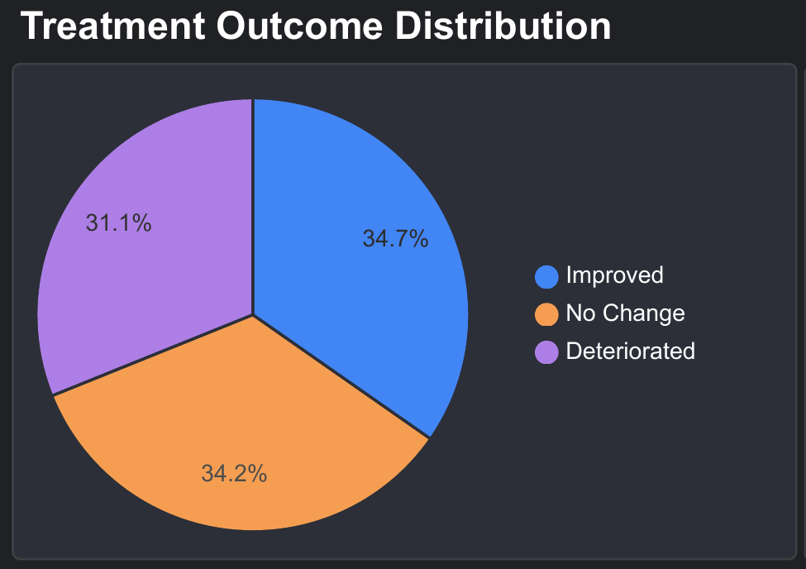
Outcomes split roughly into thirds; Drug C had the highest observed improvement rate
IMPROVEMENT RATE BY DRUG
Drug | Patients | Improved | Improvement rate
Drug A | 244 | 76 | 31.15%
Drug B | 235 | 80 | 34.04%
Drug C | 270 | 104 | 38.52%
Drug D | 251 | 87 | 34.66%
Drug C had the highest observed improvement rate in this dataset; Drug A the lowest.
The spread between drugs (about 7 points) is an observed pattern only; no significance testing was performed.
Treatment outcome distribution across all 1,000 patients: 34.7% Improved, 34.2% No Change, 31.1% Deteriorated.
Source: Looker Studio dashboard (screenshot)
7

Slide 8
Average efficacy scores differed only modestly across drugs (5.27 to 5.56)
Average efficacy score: Drug D 5.56, Drug A 5.51, Drug C 5.27, Drug B 5.27. Drug D is highest here, while Drug C had the highest improvement rate, so the two measures do not rank drugs identically.
Patients were spread across all four trial phases in every drug group (Drug C largest at 270 patients, Drug B smallest at 235).
Note: some Excel value axes are truncated (do not start at zero), which visually exaggerates differences. Use the values in the text.
Source: Pfizer_Project.xlsx (charts as built in Excel)
8

Slide 9
Observed success varied by age group, gender and trial phase
Age group: highest for 18-30 (38.07%), lowest for 31-50 (32.17%).
Gender: Female 38.59%, Male 33.71%, Other 32.14%.
Trial phase: the chart plots Improved patients per phase (79, 105, 78, 85). As a share of each phase: 30.7%, 42.3%, 30.6%, 35.4% (calculated from workbook counts).
By ethnicity (PivotTable): improvement rate ranged from 32.46% (Other) to 37.98% (African American).
Note: some Excel value axes are truncated (do not start at zero), which visually exaggerates differences. Use the values in the text.
Source: Pfizer_Project.xlsx (charts as built in Excel)
9

Slide 10
Mutation-positive patients had a higher observed improvement rate but a lower average efficacy score
MUTATION STATUS
37.37%
improvement rate, mutation-positive
32.33%
improvement rate, mutation-negative
Average PFS: Positive 11.69 vs Negative 11.51 months. Average efficacy: Positive 5.24 vs Negative 5.54. Associations only. Excel value axes are truncated, which visually exaggerates differences.
GENE-LEVEL VIEW: EXPRESSION VS SURVIVAL
Gene | BRCA1 | BRCA2 | EGFR | HER2 | TP53
Avg expression level | 2.95 | 3.04 | 3.00 | 3.01 | 2.90
Avg survival (months) | 14.46 | 15.19 | 14.98 | 15.23 | 14.97
Expression levels and survival were similar across the five genes.
Source: Pfizer_Project.xlsx (charts as built in Excel)
10

Slide 11
Side effects were spread across categories, with counts differing by drug
Overall: Nausea 213, Dizziness 209, Headache 206, Fatigue 205, Not Reported 167. Counts per drug and side effect ranged from 35 to 62 patients.
IMPROVEMENT RATE BY DOSE
Note: side effects were numerically encoded only as a helper for the scatter chart. The codes are not a clinical scale.
50 mg | 100 mg | 150 mg | 200 mg
34.69% | 33.97% | 31.80% | 38.19%
Highest at 200 mg, lowest at 150 mg; no steady rise with dose.
Source: Pfizer_Project.xlsx (charts as built in Excel)
11

Slide 12
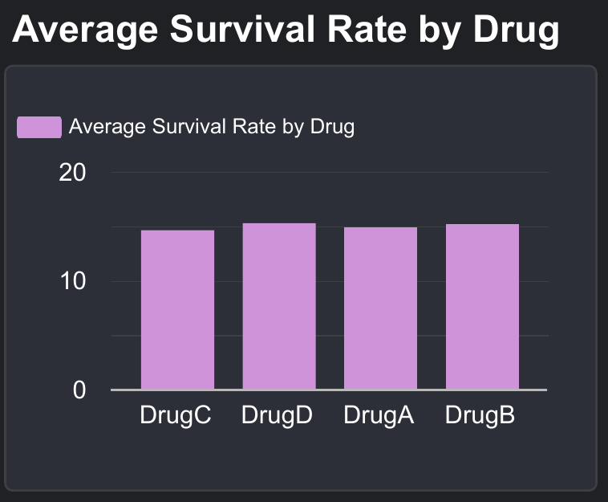
Survival rate and PFS were analysed separately; averages differed little by drug
This chart plots average PFS by drug: A 11.95, B 11.57, C 11.60, D 11.26 months.
Dashboard view of average survival rate by drug: A 14.85, B 15.16, C 14.61, D 15.25 months.
Each point is a patient: survival rate (6 to 24 months, x) against PFS (3 to 20 months, y). No clear linear pattern is visible (correlation about 0.02, calculated from Clean_Data).
Survival rate and PFS are different measures and are not interchangeable. Charts are shown as built in the workbook; the PFS line chart axis is truncated, which exaggerates differences.
Source: Pfizer_Project.xlsx (charts as built in Excel) and Looker Studio dashboard
12

Slide 13
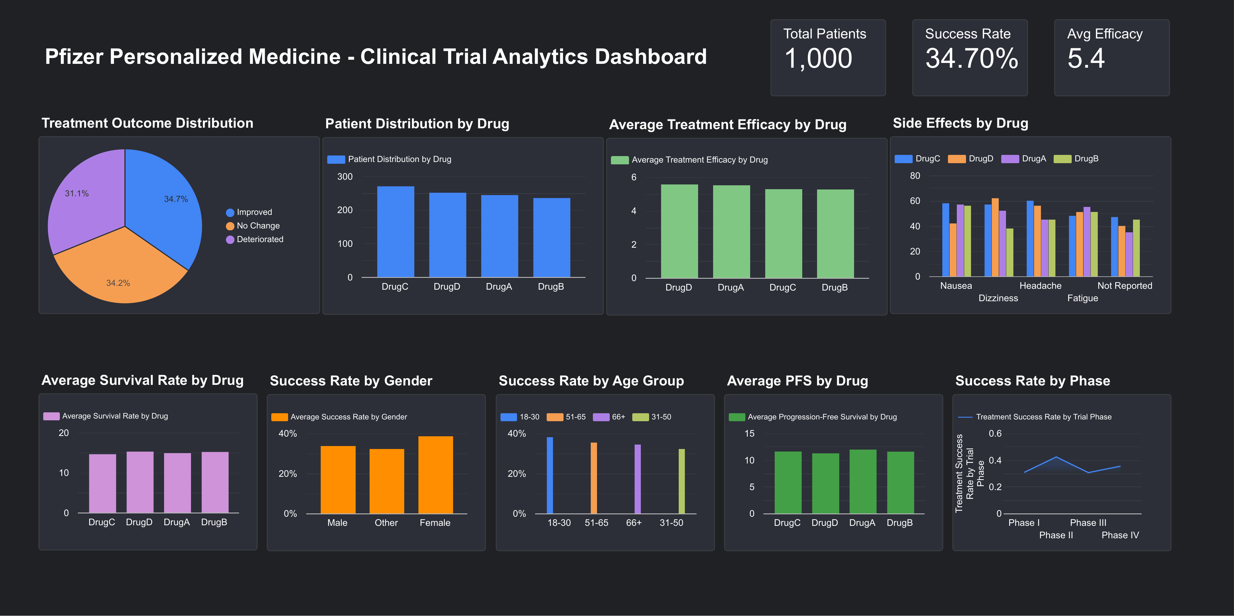
Interactive dashboard: the same analysis in a form managers can filter and explore
WHAT IT COVERS
KPIs: 1,000 patients, 34.70% success rate, 5.4 avg efficacy
Treatment outcome distribution
Patient distribution and efficacy by drug
Side effects by drug
Survival and PFS by drug
Success rate by gender, age group and trial phase
Open Interactive Looker Studio Dashboard
View GitHub Project Repository
Source: Looker Studio dashboard (screenshot)
13

Slide 14
The analysis supports monitoring and comparison, not clinical conclusions
Where the analysis can support decisions, and what limits it.
Decision-support uses
Limitations
Use | Shown in
Trial performance monitoring | KPIs, Looker Studio dashboard
Drug comparison | Outcomes, efficacy, survival, PFS by drug
Segment patterns | Age, gender, ethnicity, mutation status
Side-effect monitoring | Side effects by drug
Genetic exploration | Mutation status, gene expression
Stakeholder communication | Interactive dashboard
Observational data: associations only, no causal interpretation
Genomic Profile missing for 48.7% of records; Medical History for 18.2%
No significance testing or multivariate modelling
Side-effect and outcome codes are visualization helpers, not clinical scales
Portfolio project on a single dataset; not a basis for clinical decisions
Pfizer Personalized Medicine | Clinical Trial Analytics
14

Slide 15
Conclusion: the workflow runs end to end; statistical validation is the next step
From raw clinical data > structured analysis > decision-ready insights.
Conclusion
Next steps
The project demonstrates an end-to-end analytics workflow from raw clinical-trial data through data quality, exploratory analysis, visualization and interactive reporting.
1
Deeper statistical testing
2
Multivariate analysis
3
More rigorous modelling of treatment outcomes
4
Validation on additional datasets
5
Integration with larger clinical and genomic datasets
6
Advanced predictive analytics where appropriate
Open Interactive Looker Studio Dashboard
View GitHub Project Repository
Pfizer Personalized Medicine | Clinical Trial Analytics
15

Slide 16
Appendix A1: relationship analyses (scatter plots)
Success indicator (0/1) against dose administered (50 to 200 mg).
Treatment duration against numerically encoded side effects (helper codes, not a clinical scale).
Encoded side effects against encoded treatment outcome (helper codes only).
Source: Pfizer_Project.xlsx (charts as built in Excel)
16

Slide 17
Appendix A2: patient composition
Gender breakdown of patients: Female 311, Male 353, Other 336.
Patients by age group: 18-30 197, 31-50 286, 51-65 229, 66+ 288.
Source: Pfizer_Project.xlsx (charts as built in Excel)
17

Slide 18
Appendix A3: KPI definitions used in the dashboard
Metric | Definition | Value
Total Patients | Count of unique Patient IDs | 1,000
Overall Treatment Success Rate | Share of patients with outcome "Improved" (Success Indicator) | 34.70% (347 patients)
Average Treatment Efficacy Score | Mean Efficacy Score (scale 1 to 10) | 5.40
Survival Rate | Survival in months (observed 6 to 24); mean across patients | 14.96 months
Progression-Free Survival (PFS) | Months without progression (observed 3 to 20); mean across patients | 11.59 months
Pfizer Personalized Medicine | Clinical Trial Analytics
18

