Slide 1

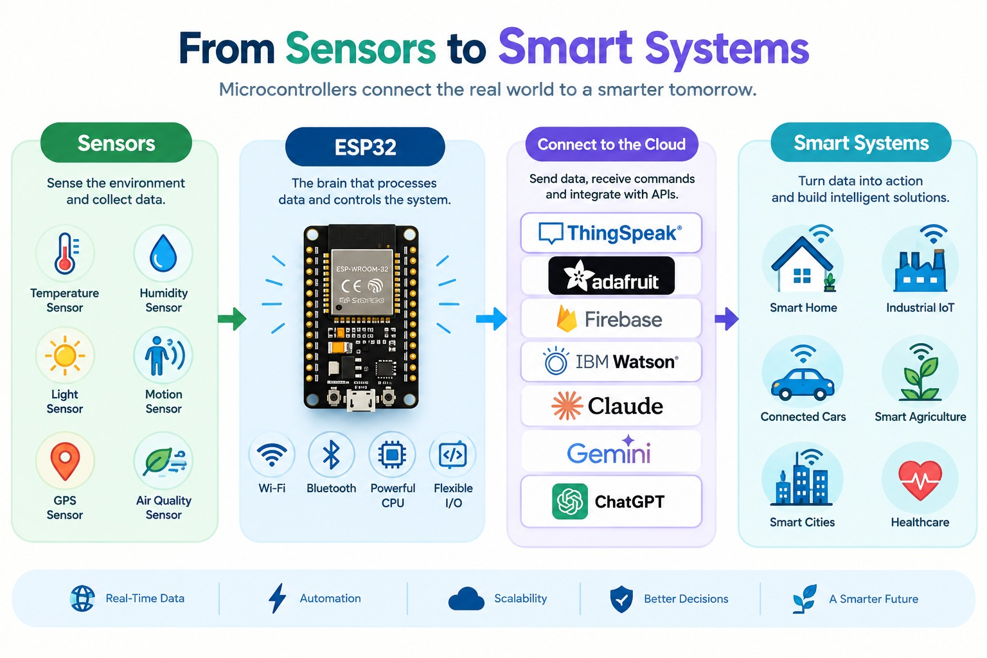
From Sensors to
Smart Systems
An Introduction
to ESP32 and IoT

Slide 2
PART 1 · INTRODUCTION · THE RECURRING CHALLENGE
How could a small chip detect an ambulance
and change a traffic signal?
DECIDE
ACT
Sound · microphone
Change the signal
Light · LDR
Enough evidence to act?
WAIT
Button · simulation
Keep watching
What could fool a sound-only detector?
What evidence would you trust before acting?
A loud sound is a clue, not an identity, the system must decide before it acts.

Slide 3
PART 1 · INTRODUCTION · YOUR LEARNING JOURNEY
One story for every project : sense, decide, act, communicate.
01
02
03
04
Sense
Decide
Act
Communicate
Read an input: button, LDR, microphone
Apply a rule: a threshold or condition
Drive an output: LED, buzzer, servo
Share a useful status: display, Wi-Fi
TRAFFIC SIGNAL MODEL
Button (simulated ambulance) → Rule → LED pattern changes → Status shared
SMART ALARM
Potentiometer threshold → Rule → Buzzer sounds → Reading shown on a display

Slide 4
PART 1 · INTRODUCTION · HOW CAN A SMALL DEVICE DO SO MUCH?
Microcontrollers: Built for One Task, Computers for Many
MICROCONTROLLER · ESP32
GENERAL-PURPOSE COMPUTER
The dedicated lab assistant
The whole student workspace
JOB
JOB
Runs one focused program, all the time
Runs many applications for a person
TALKS TO
TALKS TO
Sensors and actuators, through its pins
Screens, keyboards, networks, storage
LIVES
LIVES
Inside a doorbell, a washer, a traffic controller
On a desk, in a data centre, in your bag
Both compute. They differ in role, integration and resources.

Slide 5
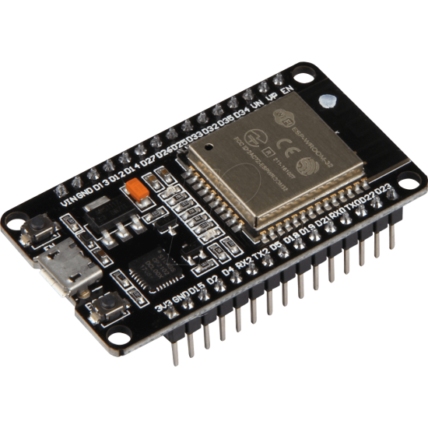
PART 2 · ESP32 · INSTRUCTIONS, MEMORY, I/O, PROTOCOLS, RADIOS
The ESP32 is the brain: processor, memory,
pins, ADC and radios in one module.
ESP32 MODULE · FUNCTIONAL VIEW
CPU
1–2 cores*
RAM
working data
FLASH
program store
GPIO
digital I/O
ADC
analog input
RADIO
Wi-Fi · BT
Pins also carry UART · I2C · SPI; radios add Wi-Fi and Bluetooth*
GPIO header pins — count and numbering vary by board

Slide 6
PART 2 · ESP32 · INSTRUCTIONS · RISC AND CISC
The CPU repeats a tiny cycle
fetch an instruction, decode it and execute it.
FETCH
DECODE
EXECUTE
Get the next instruction
Work out what it means
Do it: read, compare, write
RISC · SMALL SPECIALISED STEPS
CISC · COMPLEX COMBINED STEPS
LOAD R1, GPIO ; Read GPIO register
OR R1, R1, #0x20 ; Set bit 5
STORE GPIO, R1 ; Write it back
BSET GPIO, 5 ; Set GPIO bit 5
ESP32 variants use Xtensa or RISC-V cores. This is a way of thinking, not a speed ranking.

Slide 7
PART 2 · ESP32 · TYPES OF MEMORY
If power goes off, which memory keeps its contents?
power on
power off
later
FLASH · NOTEBOOK
Program code
kept
RAM · WORKTABLE
Live variables
lost
NVS · LOCKER
Saved settings (in flash)
kept
PREDICT · SHOW OF HANDS
A counter in RAM or an alarm threshold saved to NVS, which survives?
NVS lives in flash, it survives resets but has limited write cycles and saves deliberately.

Slide 8
PART 3 · INPUT DEVICES · PUSH BUTTON AND PULL-UP RESISTORS
What does a pin read when nothing is connected?
FLOATING · NO RESISTOR
PULL-UP
PULL-DOWN
?
3.3 V
3.3 V
R
GPIO
GPIO
GPIO
idle: HIGH
pressed: LOW
R
idle: LOW
pressed: HIGH
Reads: unpredictable
Noise decides the level.
GND
GND
A pull resistor keeps the pin at a steady default level when nothing is happening. But when you press the button, that action takes control and changes the pin’s state.

Slide 9
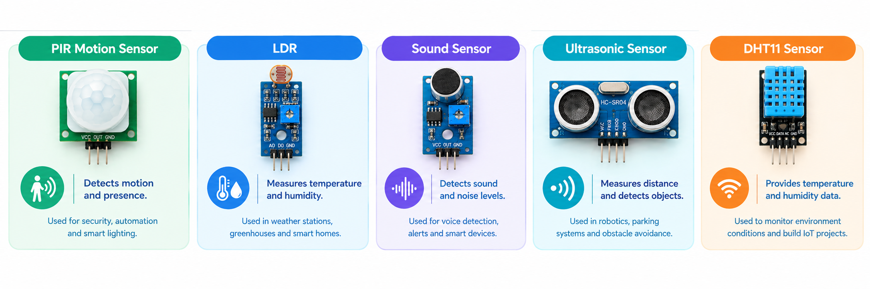
PART 3 · INPUT DEVICES · LDR, MICROPHONE, ULTRASONIC, DHT
Sensors: Each Measures a Unique Quantity in Its Own Electrical Form

Slide 10
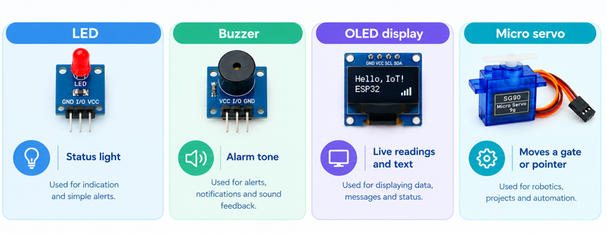
PART 4 · OUTPUT DEVICES · LED, BUZZER, OLED, SERVO
Outputs turn a decision into something
people can see, hear or feel.

Slide 11
PART 5 · ARDUINO STRUCTURE · void setup() AND void loop()
setup() prepares the stage once & loop() repeats the performance.
blink.ino
setup() · RUNS ONCE
void setup() {
pinMode(LED_PIN, OUTPUT); // once
}
void loop() {
digitalWrite(LED_PIN, HIGH); // on
delay(500);
digitalWrite(LED_PIN, LOW); // off
delay(500);
}
Prepare the stage: pin modes, serial, sensors
loop() · REPEATS FOREVER
The performance: read → decide → act, again and again
↺ returns to the top of loop()
PREDICT
What does the LED do?
What changes with delay(100)?
LED_PIN is defined for your verified board and external LED circuit

Slide 12
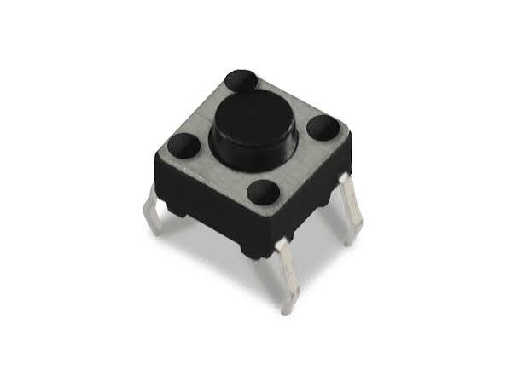
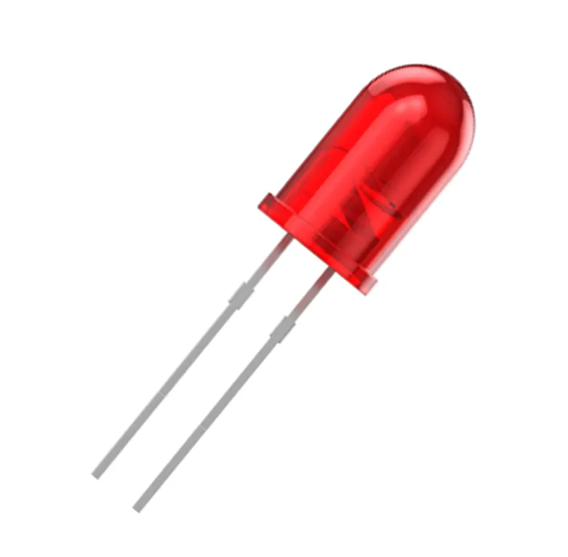
PART 6 · GPIO · ENABLING A PIN, READING AND WRITING
Digital input reads a button & digital output drives an LED.
HIGH / LOW in
ESP32
HIGH / LOW out
read → decide → drive
Digital input — pressed or released
Digital output — on or off
ENABLE · READ · WRITE
OUTPUT CIRCUIT · CONCEPT, NOT A WIRING MAP
pinMode(BUTTON_PIN, INPUT_PULLUP);
pinMode(LED_PIN, OUTPUT);
bool on = digitalRead(BUTTON_PIN) == LOW;
digitalWrite(LED_PIN, on ? HIGH : LOW);
GPIO pin
Resistor
LED (+ → −)
GND
Before power: check LED polarity, the resistor, 3.3 V logic levels and a shared ground.

Slide 13
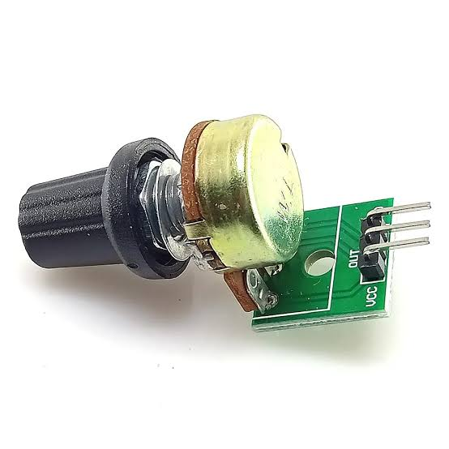
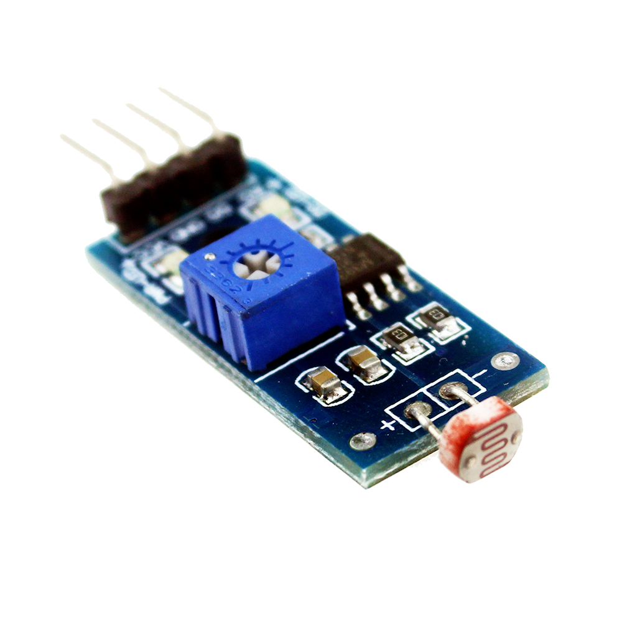
PART 6 · ANALOG PIN · READING VALUES WITH THE ADC
The ADC turns a changing voltage into a number.
PLACEHOLDER
voltage
ADC READING · EXAMPLE
Potentiometer
2048
analogRead() → 0…4095 (12-bit)
low voltage → small number
high voltage → large number
PLACEHOLDER
v = analogRead(POT_PIN);
LDR module
time
Readings are steps and can be noisy. AnalogReadMilliVolts() returns calibrated millivolts.

Slide 14
PART 7 · COMMUNICATION PROTOCOLS
Wired Protocols: Choose the One Your Device Speaks
UART · THE DIRECT SHUTTLE
I2C · THE ADDRESSED BUS
SPI · THE EXPRESS LANE
TX
SDA
RX
SCL
WIRES · 2 (TX, RX)
USE · text to your laptop
KIT · Serial Monitor**
WIRES · 2 (SDA, SCL), shared
USE · many addressed devices
KIT · OLED / LCD adapter
WIRES · 4 (SCK, MOSI, MISO, CS)
USE · fast displays, SD cards
KIT · SPI display, if supplied
WIRELESS
Wi-Fi: link to a web page or cloud service. Bluetooth: pair with nearby devices.
Radio support varies by ESP32 variant.

Slide 15
PART 8 · COMPILATION PROCESS
Your text becomes machine instructions
before the ESP32 can run it.
01 SOURCE
02 COMPILE
03 BINARY
04 UPLOAD
05 EXECUTE
Your sketch: readable text
Toolchain translates + links
Machine code for the ESP32 cores
Sent over USB into flash
Board resets and runs it
IF THE BUILD FAILS
IF THE UPLOAD FAILS
Read the first error line; fix the source or the board selection.
Check the cable (data, not charge-only), the port and the board selection.

Slide 16
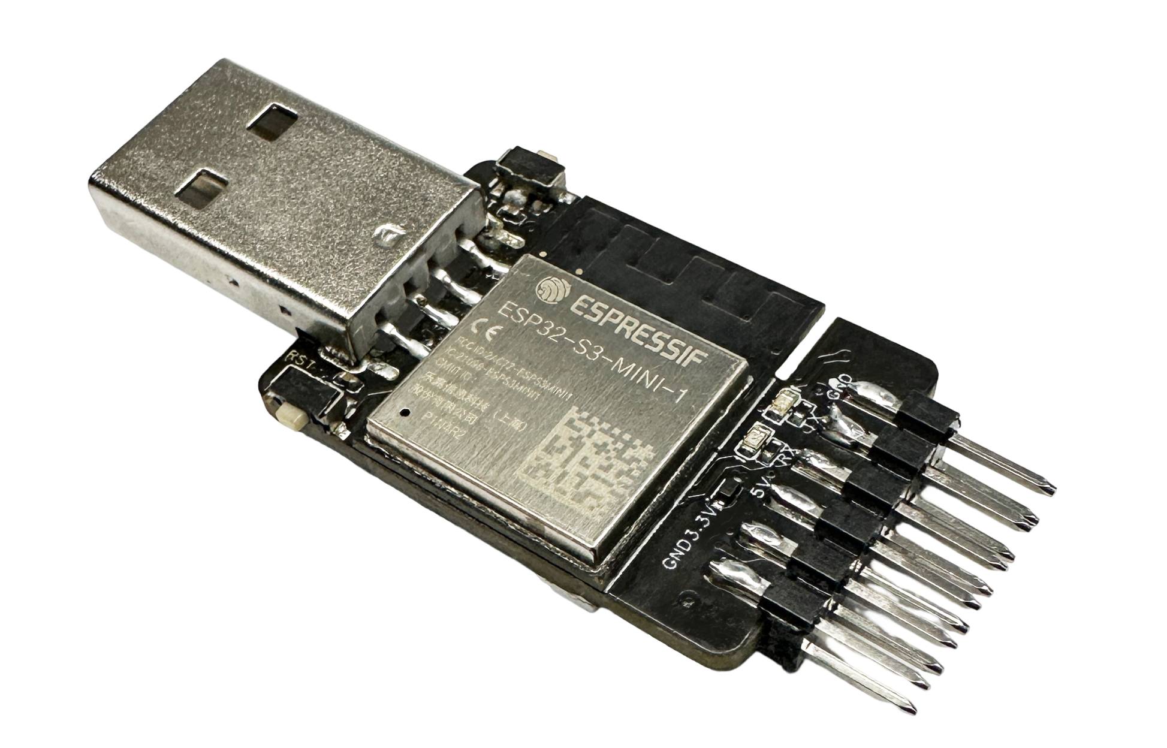
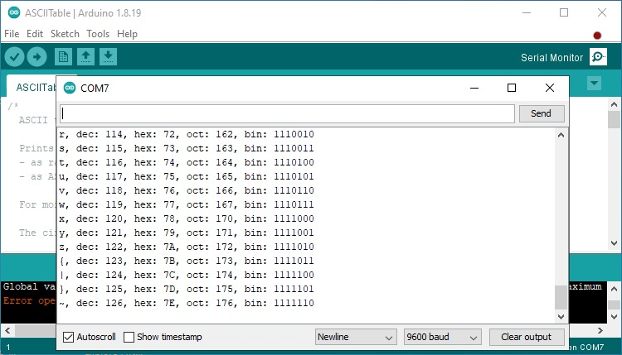
PART 9 · DEBUGGING · SERIAL MONITOR AND ALTERNATIVES
Investigate the physical system before you blame the code.
ASK IN ORDER
SPOT THE BUG · 60 SECONDS
01
Is the board powered? (LED, USB, supply)
pinMode(LED_PIN, INPUT);
digitalWrite(LED_PIN, HIGH);
02
Are the connections correct? (pins, polarity, ground)
Wiring verified. Upload succeeded.
The LED never lights. Which word is wrong?
03
Is the expected code running? (right board, port, upload)
SERIAL MONITOR · AND ALTERNATIVES
04
What does the Serial Monitor report? (baud rate matches)
Serial.begin(115200);
Serial.println(reading);
Disconnect power before rewiring. Serial output shows what the code sees, not whether wiring is safe.

Slide 17
PART 10 · IOT BASICS AND INTRODUCTION
A connected device is only useful
if someone can act on what it shares.
SENSOR
ESP32
WI-FI
WEB / CLOUD
USER
Observe the world
Decide locally
Carry the message
Show status, keep history
Take action
LOCAL OUTPUT
Smart alarm: The buzzer sounds locally, the dashboard adds context.
Traffic model: Report the simulated event and never treat noise as authority.
Buzzer or LED still responds if Wi-Fi drops

Slide 18
PART 11 · IOT ON THE ESP32 · SETTING UP A WEB SERVER
The ESP32 can serve a web page
that shows its own sensor reading.
webserver.ino · arduino-esp32
1 · JOIN THE NETWORK
#include <WiFi.h>
#include <WebServer.h>
WebServer server(80);
void setup() {
WiFi.begin(SSID, PASSWORD);
while (WiFi.status() != WL_CONNECTED)
delay(500);
server.on("/", []() {
server.send(200, "text/plain",
String(analogRead(POT_PIN)));
});
server.begin();
}
void loop() { server.handleClient(); }
WiFi.begin() joins the classroom Wi-Fi — or WiFi.softAP() makes the ESP32 its own hotspot.
2 · LISTEN ON PORT 80
WebServer waits for requests and the Serial Monitor prints the board's IP address.
3 · RESPOND
A laptop browser opens http://<board-ip>/ — the board replies with its live reading.

Slide 19
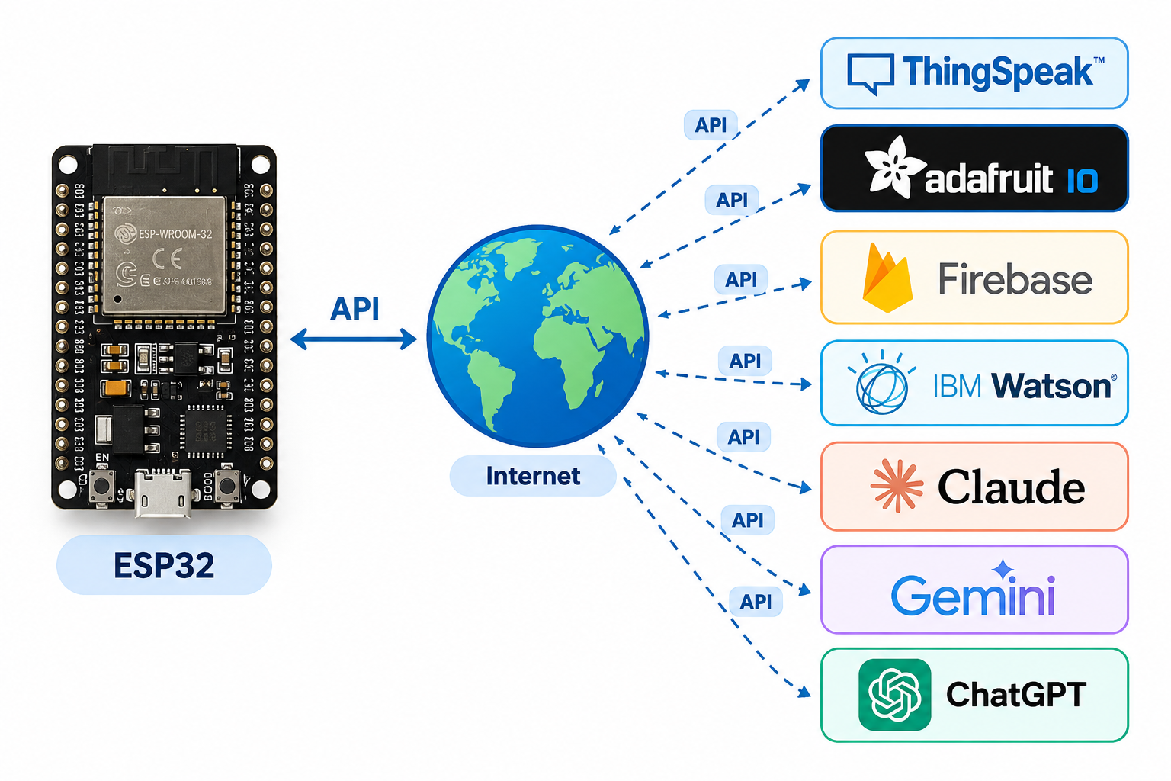
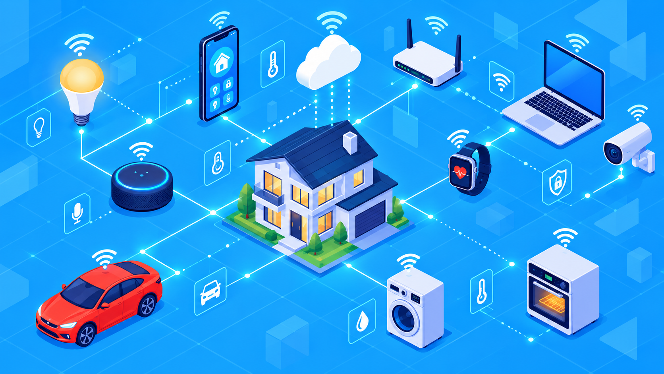
The ESP32 can be connect to any APIs.

