Slide 1
Aircraft Analysis
Presentation by Claire Njeri

Slide 2
Overview
This project analyzes aviation accident data to identify aircraft types and conditions associated with the lowest accident risk.
Using statistical and visual data analysis, the study provides insights to guide the aviation division in enhancing air safety and optimizing resource allocation.

Slide 3
Business Understanding
The goal is to advise the head of the new aviation division on aircraft with the lowest accident potential.
Through exploratory data analysis of aviation incident records, the project identifies safety trends by aircraft make, model, engine type, weather, and flight phase, supporting data-driven decisions for fleet acquisition and pilot training.

Slide 4
Data Understanding
Dataset: Aviation accident data with 90,348 records and 31 variables.
Checked data shape, types, and completeness.
Identified missing values (notably in Latitude, Longitude, and Aircraft.Category).
Removed duplicates (1,390 found and dropped).
Analyzed continuous (e.g., injuries, engines) and categorical (e.g., make, damage, weather) variables

Slide 5
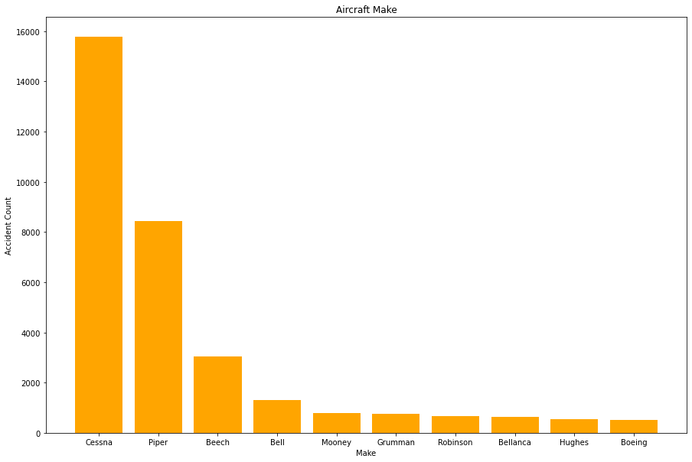
Data Analysis
Cessna, Piper, Beech, and Bell had the most accidents.

Slide 6
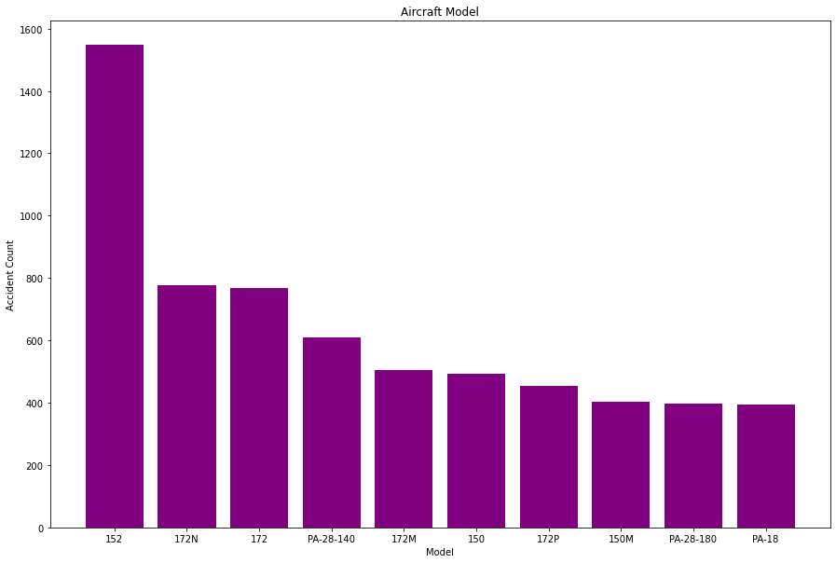
Aircraft Model
Models such as Cessna 152, 150M, PA-28-180, and PA-18 were among the top involved in accidents.

Slide 7
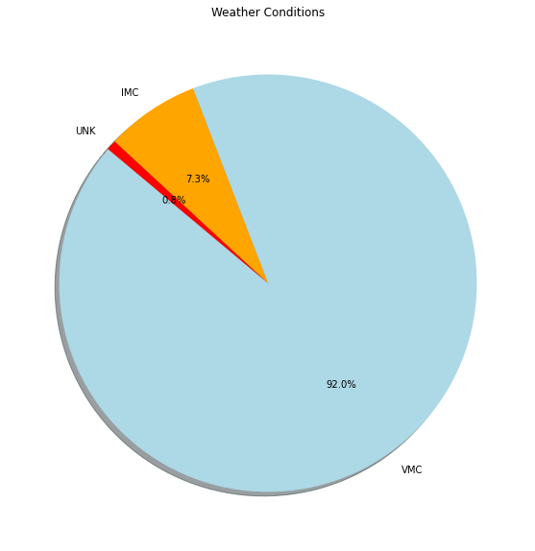
Weather Conditions
92% of accidents occurred under VMC (good visibility) conditions.

Slide 8
Recommendations
Aircraft Selection: Consider safer makes such as Boeing, Hughes, Bellanca, Robinson, Grumman, and Mooney for acquisition.
Model Choice: Prefer models with lower accident rates such as: 150M, PA-28-180, PA-18.
Pilot Training: Reinforce training for critical phases (landing, takeoff, maneuvering).
Weather Vigilance: Maintain safety protocols even in VMC conditions, as most accidents occur in seemingly “safe” weather.

Slide 9
Next Steps
Perform predictive modeling to identify risk factors statistically.
Integrate data from maintenance logs and pilot experience for deeper insights.
Develop dashboards for ongoing safety monitoring and reporting.

Slide 10
Thank you
For further enquiries, on the analysis reach me out through:
Claire Njeri Nduhiu
GitHub

