Slide 1
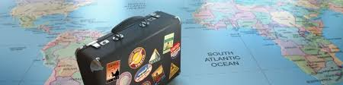
TRAVELTIDE’S REWARD PROGRAM
HOW TO ASSIGN PERKS SO THEY ARE MOST EFFECTIVE?

Slide 2

OBJECTIVES
Selecting the relevant scope of data that our company has gathered
on customers behaviour.
Analysis of said data to facilitate the creation of customer segmentation.
Assigning the specific perks i.e. rewards based on the above mentioned
segmentation to specific customers so they are encouraged
to join rewards program.

Slide 3
RESULT
For the purpose of our analysis we considered the customers who accessed our website since 04.01.2023 no less than seven times.
The number of our customers that met the above criteria was 5998.
Based on that selected cohort we have created segmentation that consists of 6 distinct groups.
We then assigned perks to specific customers based on their segments as well as several other individual characteristics (family status, age etc.)

Slide 4
METHOD
For the purpose of creating the segmentation we used RFM analysis..
The RFM analysis considers three characteristics:
Recency - how recent was the latest activity?
Frequency - how frequent were our products purchased?
Monetary - what was the total revenue?
Each customer was given a score for each of the above characteristics - the higher the score, the better.
Based on these scores they were then grouped into segments.
Perks were then assigned to specific customers based on their segments as well as other individual characteristics (family status, age etc.)

Slide 5
SEGMENTATION
Potencial travelers - customers that visited our website but haven't completed any booking.
New travelers - customers that made a booking recently, but overall don't have much of history with TRAVELTIDE.
Lost travelers - customers who haven't made any booking in some time.
Regular travelers - users that have a history of booking with us until today.
Loyal travelers - customers who enjoy our services, the more of them we have, the better.
Top travelers - customers who not only use our services regularly and frequently but also generate a lot of revenue.

Slide 6
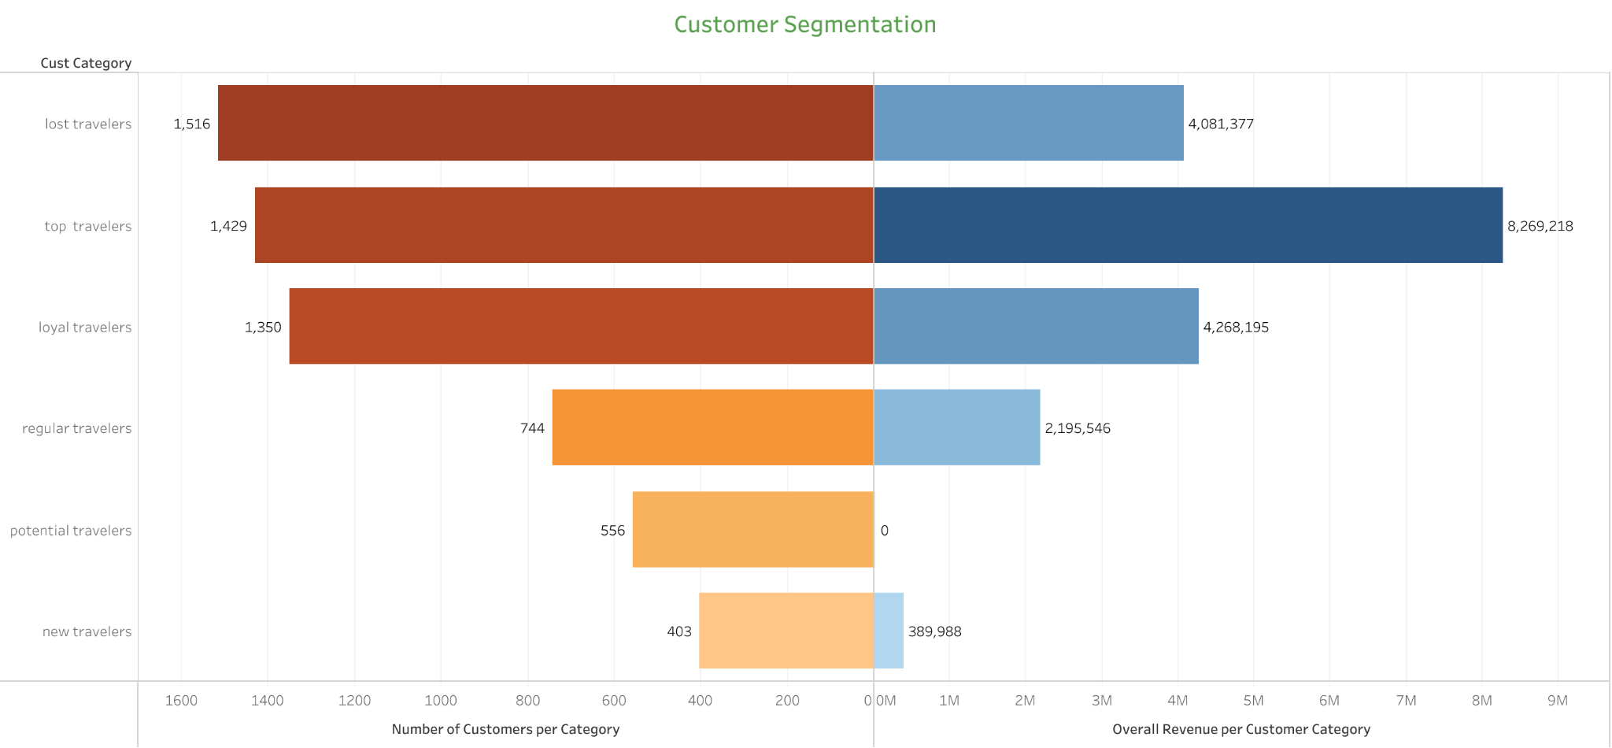
SEGMENTATION IN NUMBERS

Slide 7
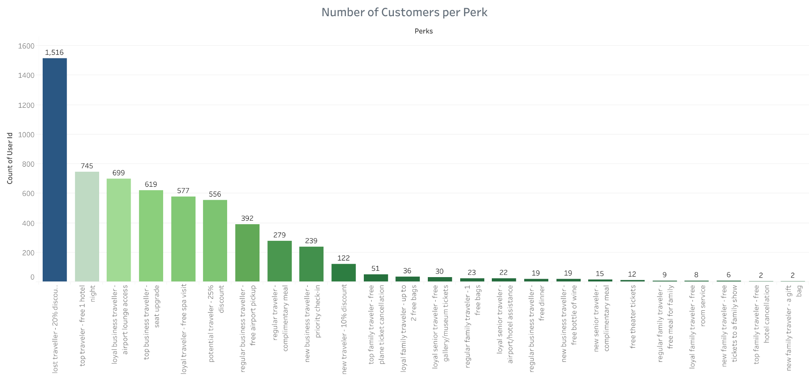
PERKS
Notes:
Based on the segmentation as well as other factors like age, family status, length of the stay etc, we assigned a specific perk to each customer.

Slide 8
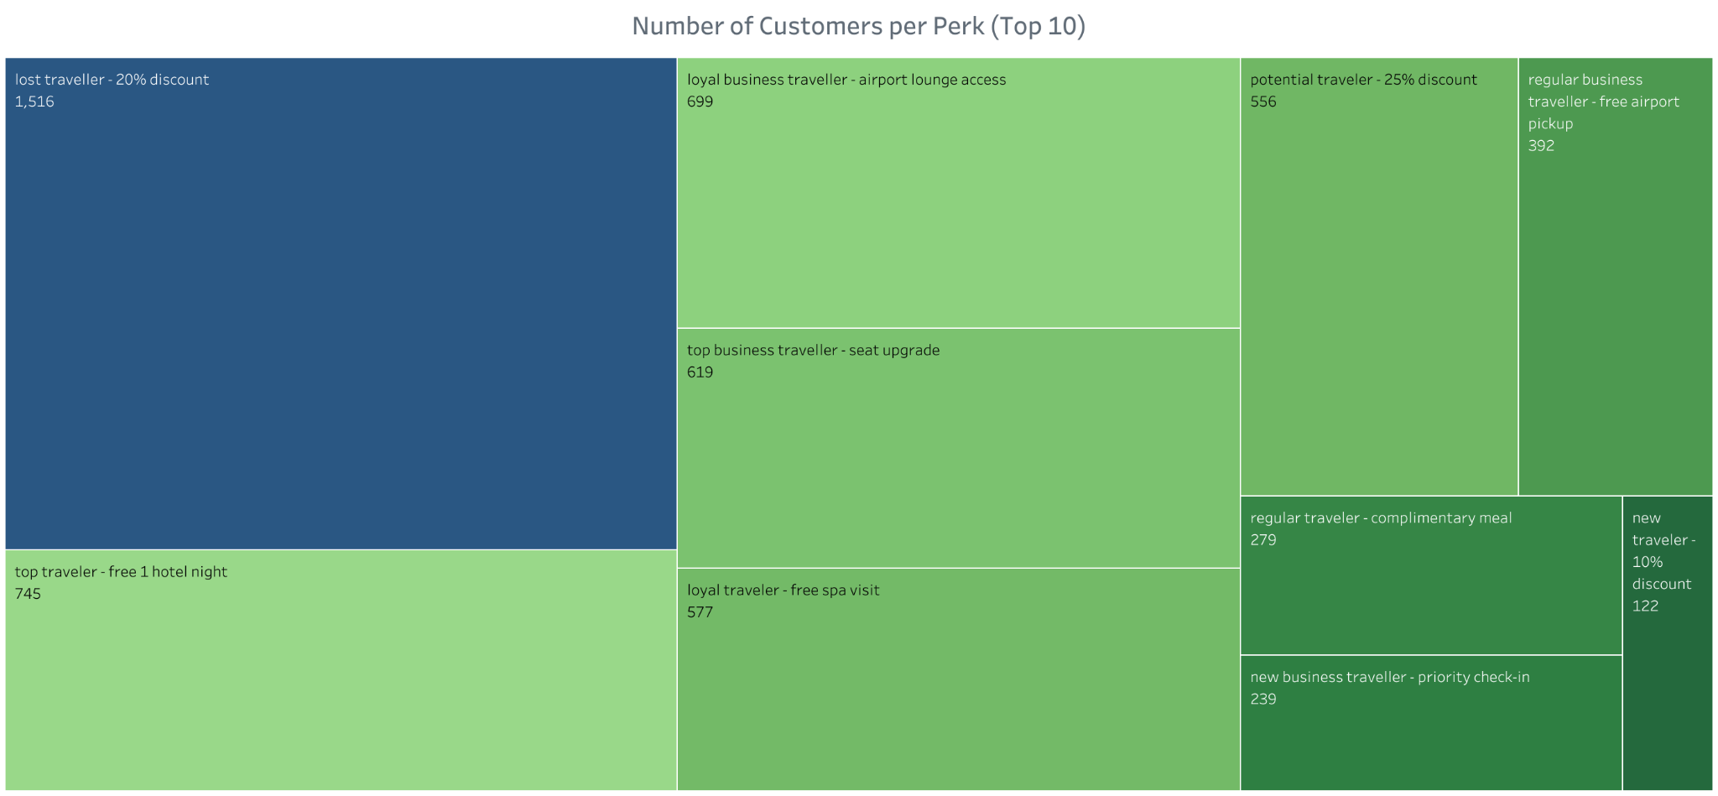
Notes:
These are the perks that were assigned to more than a 100 customers. All together they represent more than 90 percent of our population.

Slide 9
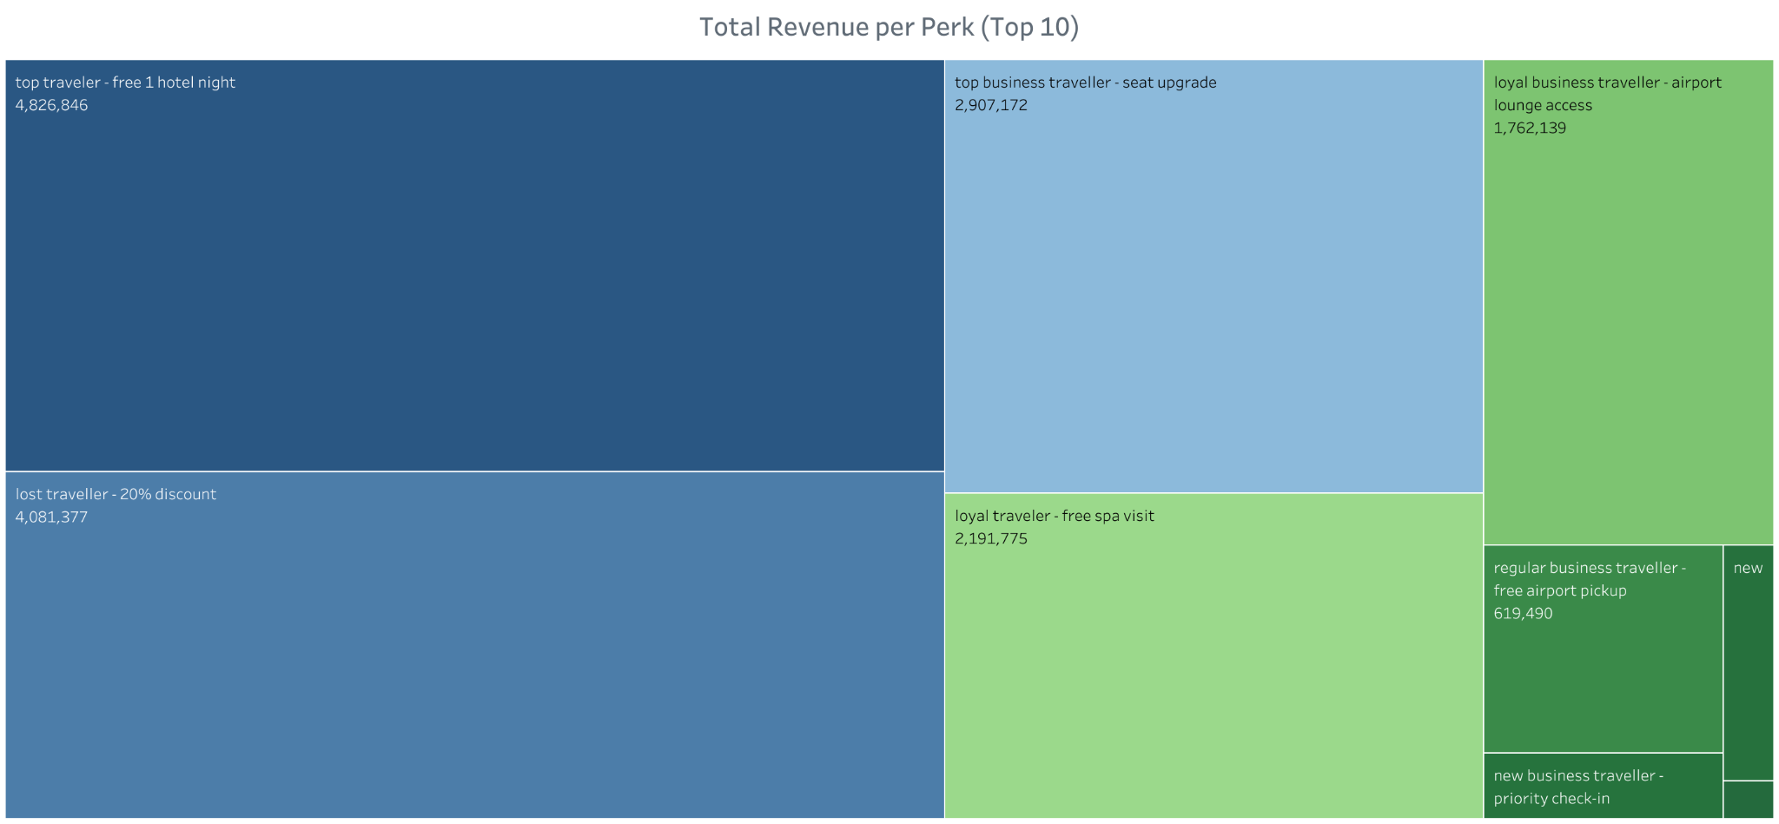
Notes:
Bottom right corner is new senior traveller - complimentary meal and above it new traveller - 10% discount
Combined revenue of the customers with above perks is over 90 percent of total revenue

Slide 10
RECOMMENDATIONS
It has to be stressed that our proposition need to be tested to see if perks are effective in achieving our goal. Once the test is concluded the collected data needs to be reviewed and fixes implemented.
For future data collection purposes we recommend asking customers as they complete their bookings about purpose of the trip (business, leisure etc.) or who are they travelling with (family, friends). That would enable us to conduct more in depth analysis of customers behaviour and hopefully lead to more effective marketing campaigns.
We have also discovered several issues in collected data and we will be forwarding those to data engineering team for them to be fixed.

Slide 11
Please reach out to me in case of any questions.
Thank you for your time.

