Slide 1
Summer School on First-Principles Computational Materials Research
Advance Level
July 7, 2009, NCTS (South), National Cheng Kung University
Hands-on session II
Molecular Dynamics Simulations
  CO
  H₂O
  O₂
  CO₂
張俊明 東華大學物理系
Chun-Ming Chang
Department of Physics, National Dong Hwa University
Revised by Fuyen Fan for Phys 8129@NTU, 2017/11/13

Slide 2
The most important parameters in MDS with VASP
SMASS → what kind of MD you want
POTIM → time step
TEBEG → initial temperature
TEEND → final temperature
NSW → how long of MD runs
IBRION → MD or others

Slide 3
Structure relaxation
POSCAR
CO:
1.00000000000
8.0000000000000 0.0000000000000 0.0000000000000
0.0000000000000 8.0000000000000 0.0000000000000
0.0000000000000 0.0000000000000 8.0000000000000
1 1
Selective dynamics
cartesian
0.000000000000 0.000000000000 0.000000000000 F F F
1.150000000000 0.000000000000 0.000000000000 T F F

Slide 4
INCAR
System = CO
PREC = Low
IALGO = 48
IBRION = 2
NSW = 61
EDIFFG = -1.0E-3
force criterion
r₀ ~ 1.14 Å

Slide 5
Vibrational frequency
POSCAR
(copy the CONTCAR from the relaxation run)
CO:
1.00000000000000
8.0000000000000000 0.0000000000000000 0.0000000000000000
0.0000000000000000 8.0000000000000000 0.0000000000000000
0.0000000000000000 0.0000000000000000 8.0000000000000000
1 1
Selective dynamics
Direct
0.0000000000000000 0.0000000000000000 0.0000000000000000 T F F
0.1427758793470213 0.0000000000000000 0.0000000000000000 T F F
0.00000000E+00 0.00000000E+00 0.00000000E+00
0.00000000E+00 0.00000000E+00 0.00000000E+00

Slide 6
INCAR
grep THz OUTCAR
System = CO
PREC = Low
IALGO = 48
IBRION = 5
NSW = 61
POTIM = 0.01
NFREE = 2
What values do you get?
How about change the PRECision?
ν = 64.172247 THz
= 2140.555677 cm⁻¹

Slide 7
NEV MD
POSCAR
(copy the CONTCAR from the relaxation run)
CO:
1.00000000000000
8.0000000000000000 0.0000000000000000 0.0000000000000000
0.0000000000000000 8.0000000000000000 0.0000000000000000
0.0000000000000000 0.0000000000000000 8.0000000000000000
1 1
Selective dynamics
Direct
0.0000000000000000 0.0000000000000000 0.0000000000000000 T T T
0.1427709066334016 0.0000000000000000 0.0000000000000000 T T T
0.00000000E+00 0.00000000E+00 0.00000000E+00 → del
0.00000000E+00 0.00000000E+00 0.00000000E+00 → del

Slide 8
INCAR
System = CO
PREC = Low
IALGO = 48
IBRION = 0
SMASS = -3
POTIM = 1
TEBEG = 300
NSW = 200
LCHARG = FALSE
LWAVE = FALSE
NEV MD

Slide 9
Procedure
bsub < job.vasp.sh
grep F= OSZICAR > E-NEV.dat
dis.x < XDATCAR
xmgrace fort.71
  Fourier transform the data to get the vibrational spectrum
run vasp
get data about energies
transform data format for plot
plot out the data

Slide 10
E-NEV.dat
.
.
10 T= 265. E= -.14541174E+02 F= -.14606678E+02 E0= -.14610543E+02 EK= 0.68478E-01 SP= -.11E-01 SK= 0.80E-02
temperature
Time step
Total energy
Potential energy
Kinetic energy
potential and kinetic energy of thermostat

Slide 11
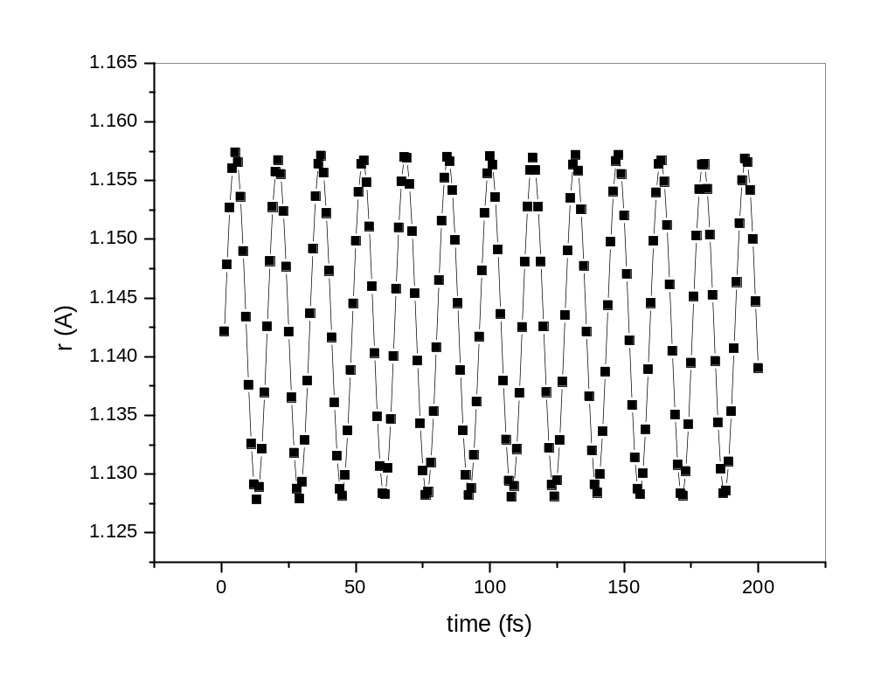

Slide 12
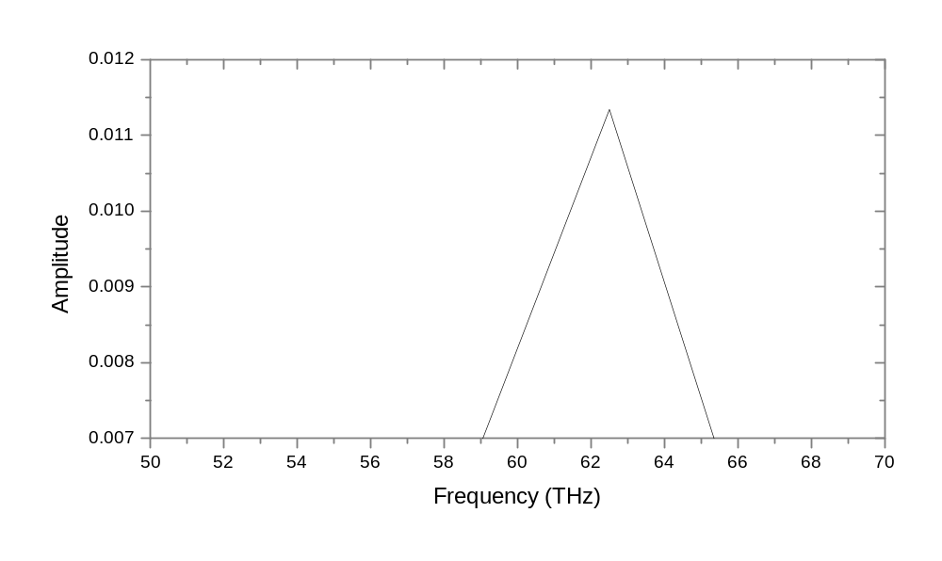

Slide 13
INCAR
System = CO
PREC = Low
IALGO = 48
IBRION = 0
SMASS = -1
POTIM = 1
TEBEG = 300
TEEND = 900
NSW = 200
LCHARG = FALSE
LWAVE = FALSE
NTV MD with constrained T method
This allow you to perform simulated annealing

Slide 14
Procedure
bsub < job.vasp.sh
grep F= OSZICAR > E-NEV.dat
dis.x < XDATCAR
xmgrace fort.71
  Fourier transform the data to get the vibrational spectrum
run vasp
get data about energies
transform data format for plot
plot out the data

Slide 15
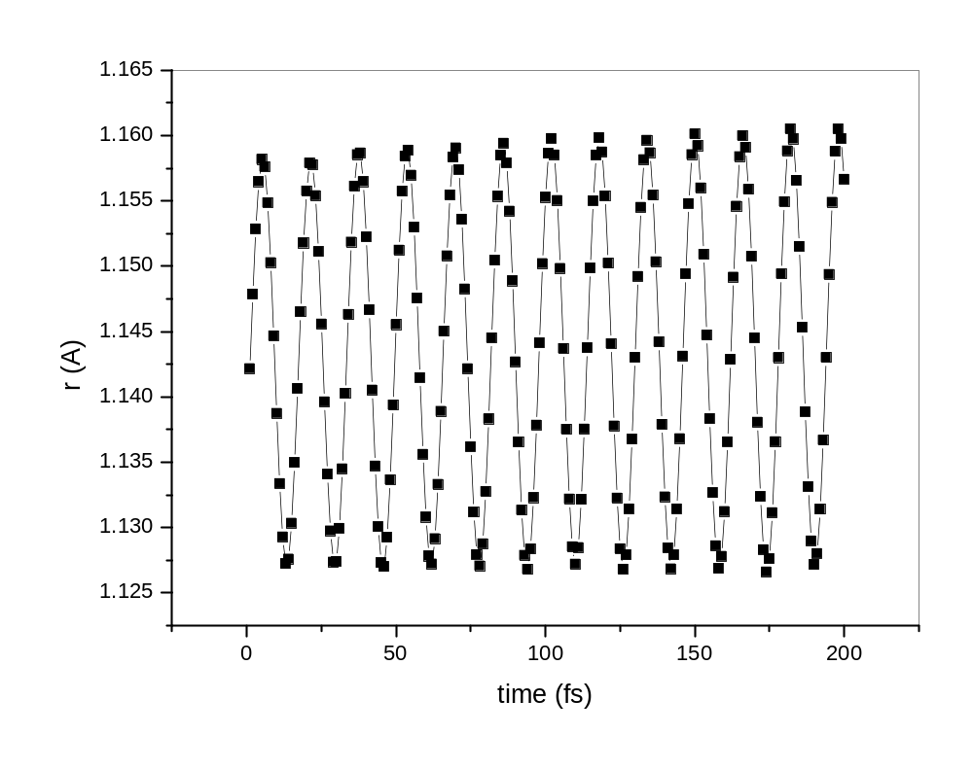

Slide 16
Structure relaxation
Bond length, bond angle
Water molecule
POSCAR
H2O
1.00000000000000000
8.000000000000000 .000000000000000 .000000000000000
.000000000000000 8.000000000000000 .000000000000000
.000000000000000 .000000000000000 8.000000000000000
2 1
Selective dynamics
CART
5.100000000 4.000000000 4.000000000 T T T
4.000000000 5.100000000 4.000000000 T T T
4.000000000 4.000000000 4.000000000 F F F

Slide 17
INCAR
System = H2O
PREC = Low
IALGO = 48
IBRION = 2
NSW = 150
NELM = 40
EDIFFG = -1.0E-3
force criterion

Slide 18
Procedure
cat POT.H POT.O > POTCAR
bsub < job.vasp.sh
r0.x < CONTCAR
→ 0.970605016 104.387146
create POTCAR for H₂O
run vasp
calculate O-H bond length and H-O-H bond angle
O-H bond length (Å)
H-O-H bond angle (º)
Expt: 0.96 Å 104.54º

Slide 19
CONTCAR
H2O
1.00000000000000
8.0000000000000000 0.0000000000000000 0.0000000000000000
0.0000000000000000 8.0000000000000000 0.0000000000000000
0.0000000000000000 0.0000000000000000 8.0000000000000000
2 1
Selective dynamics
Direct
0.1203706572562901 -0.0151925322097680 0.0000000000000000 T T T
-0.0151925322097680 0.1203706572562901 0.0000000000000000 T T T
0.0000000000000000 0.0000000000000000 0.0000000000000000 F F F
0.00000000E+00 0.00000000E+00 0.00000000E+00
0.00000000E+00 0.00000000E+00 0.00000000E+00
0.00000000E+00 0.00000000E+00 0.00000000E+00

Slide 20
Constant temperature MD
vibrational frequencies
Water molecule
bsub < job.vasp.sh
dis.x < XDATCAR
xmgrace fort.71
xdat2vasp.pl
vmd
p4v
  Fourier transform the VAF to get vibrational frequency spectrum
transform data format for plot
transform data format for movie
plot out VAF

Slide 21
INCAR
System = H2O
PREC = Low
IALGO = 48
IBRION = 0
NSW = 200
POTIM = 1
TEBEG = 300
SMASS = 0
LCHARG = .FALSE.
LWAVE = .FALSE.
initial temperature (K)
Nosé dynamics
do not write out the charge and wavefunction files

Slide 22
CONTCAR→POSCAR
H2O
1.00000000000000
8.0000000000000000 0.0000000000000000 0.0000000000000000
0.0000000000000000 8.0000000000000000 0.0000000000000000
0.0000000000000000 0.0000000000000000 8.0000000000000000
2 1
Selective dynamics
Direct
0.1203706572562901 -0.0151925322097680 0.0000000000000000 T T T
-0.0151925322097680 0.1203706572562901 0.0000000000000000 T T T
0.0000000000000000 0.0000000000000000 0.0000000000000000 T T T
→ del
0.00000000E+00 0.00000000E+00 0.00000000E+00 → del
0.00000000E+00 0.00000000E+00 0.00000000E+00 → del
0.00000000E+00 0.00000000E+00 0.00000000E+00 → del

Slide 23
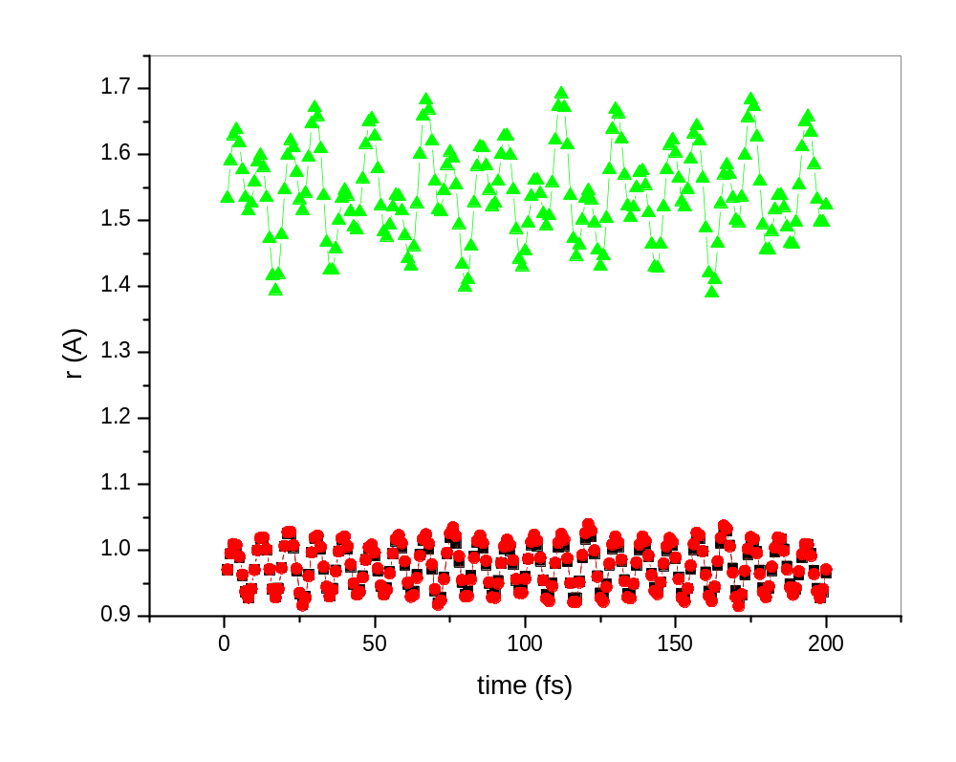

Slide 24
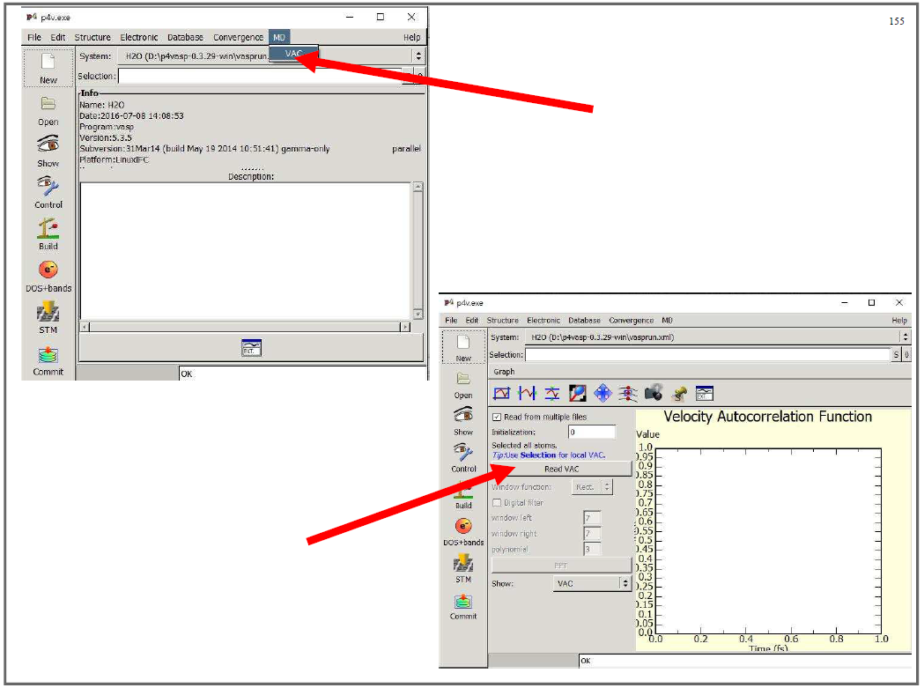

Slide 25
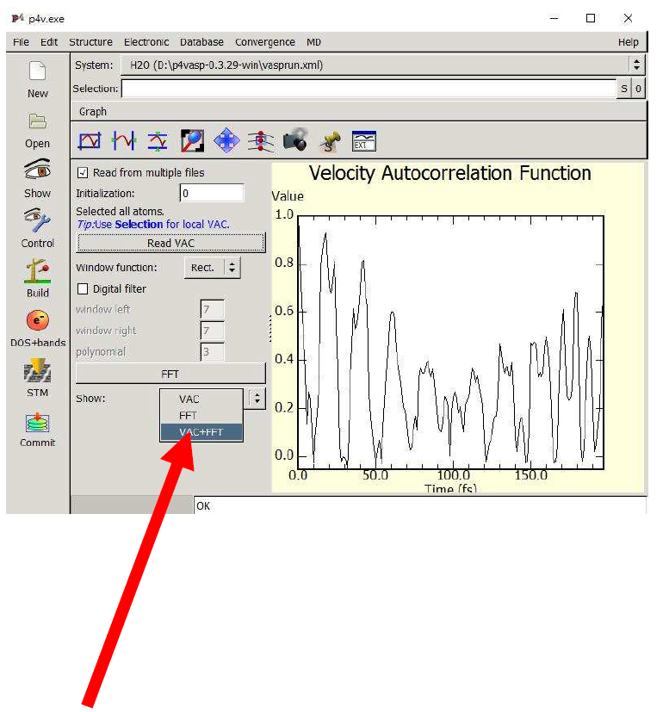
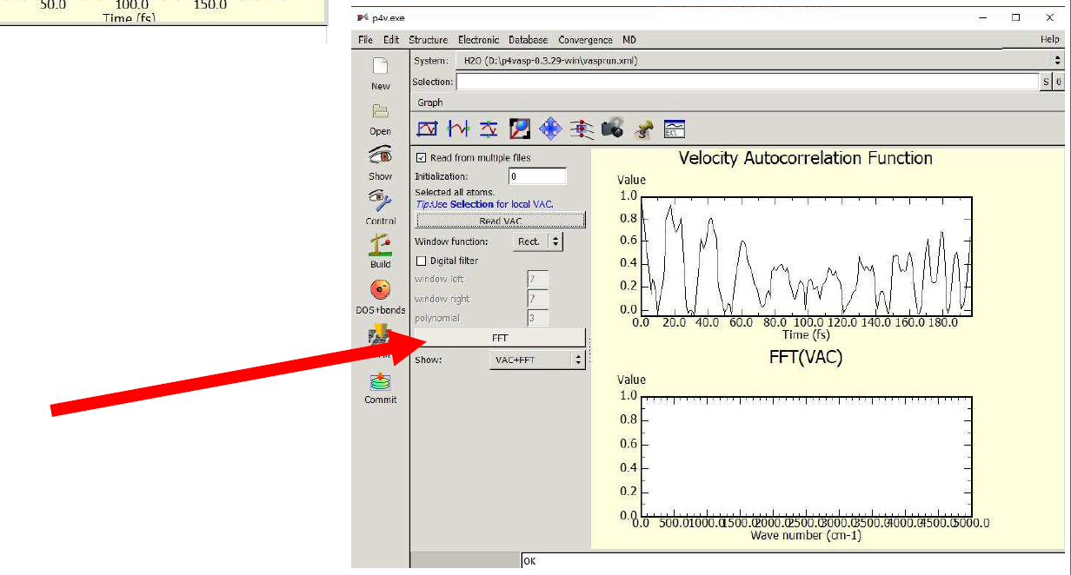

Slide 26
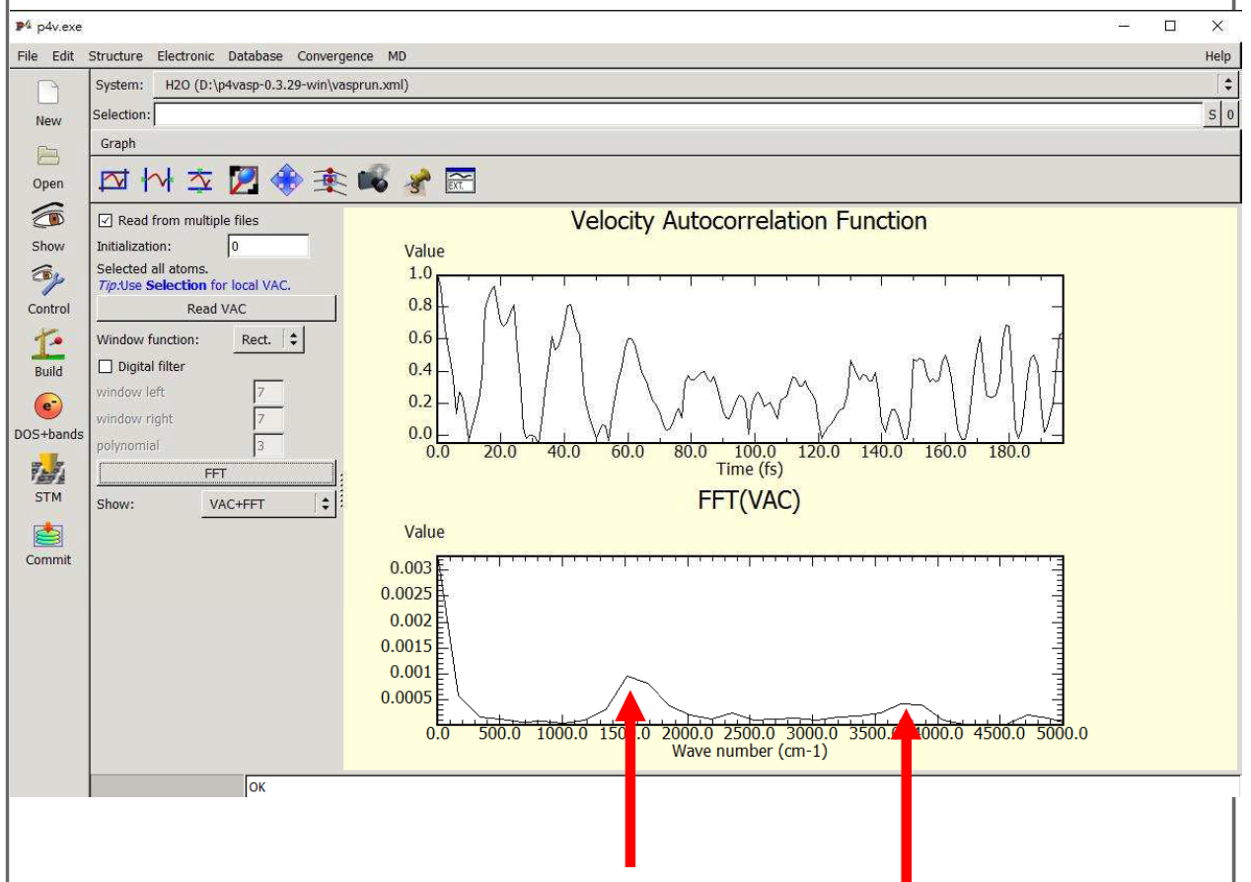

Slide 27
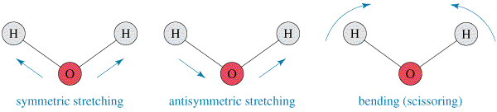
Vibrational normal modes of water molecule
109.55 THz
112.68 THz
47.85 THz

Slide 28
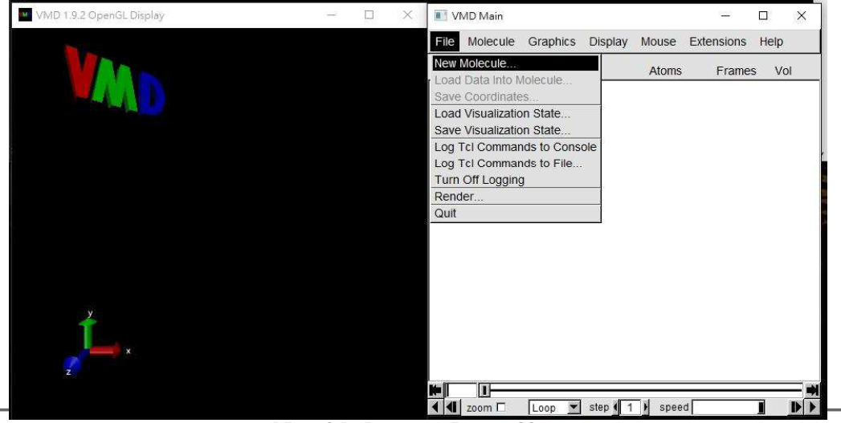

Slide 29
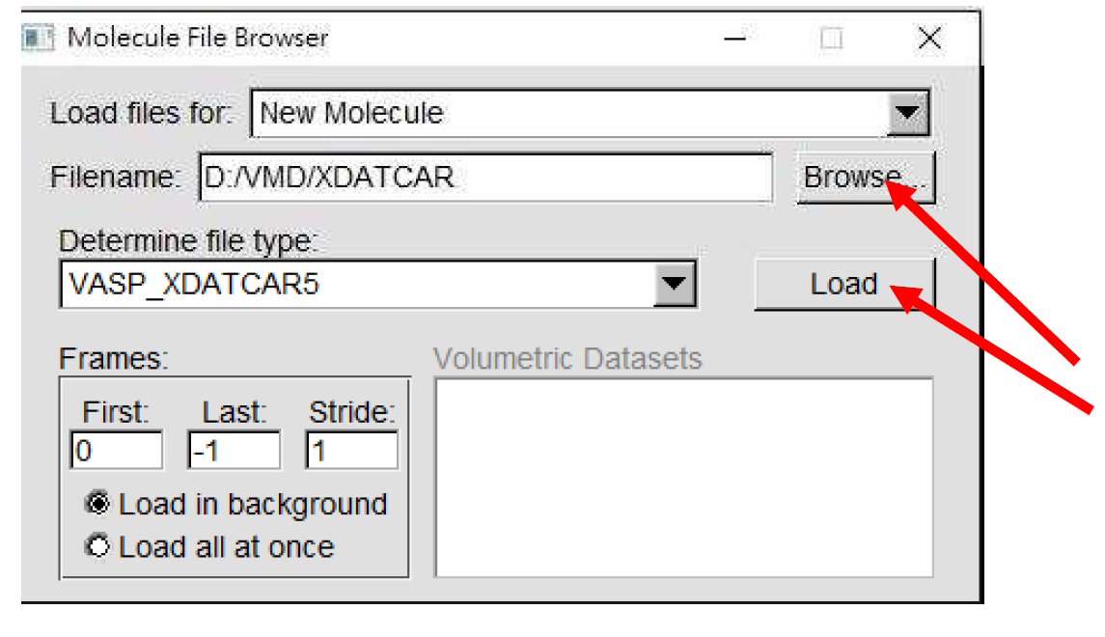
movie.xyz

Slide 30
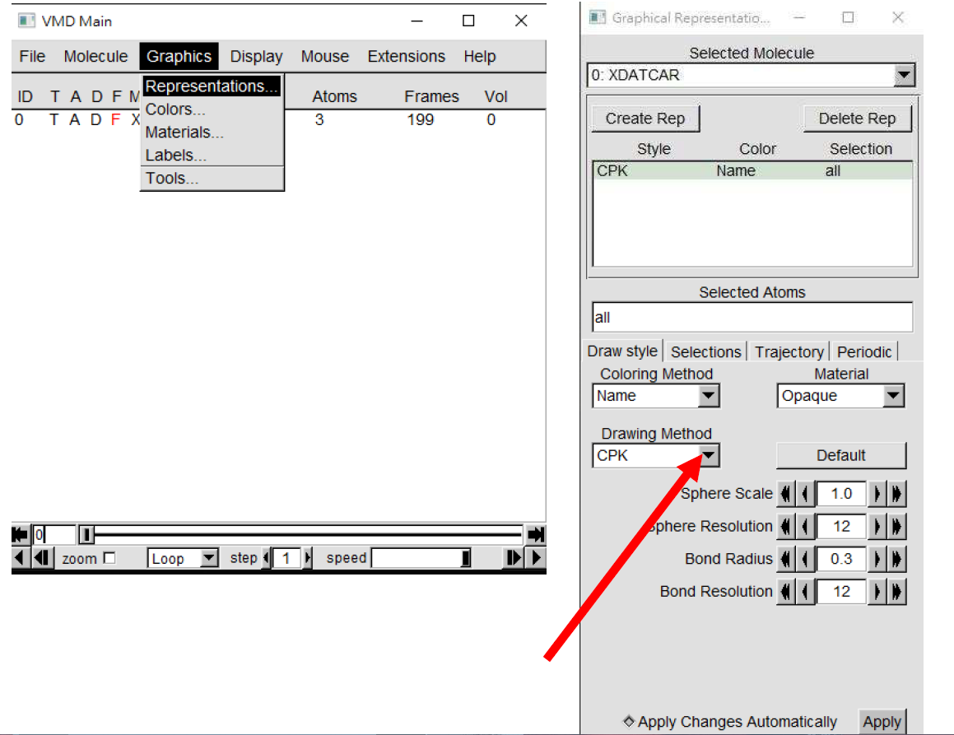

Slide 31
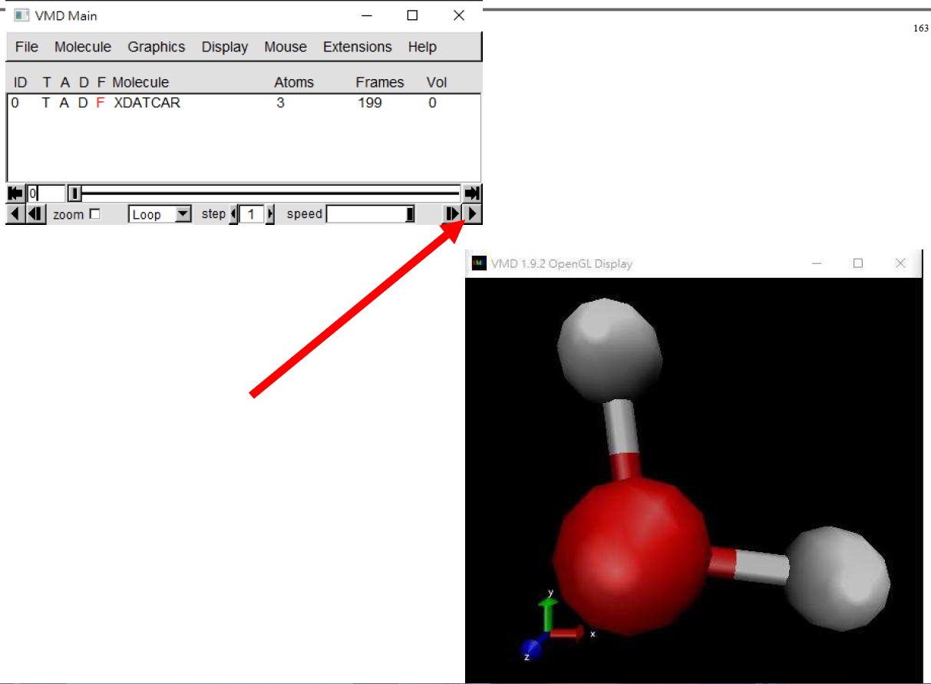

Slide 32
Practice
  O₂
  CO₂
  Copy files: /home/s11gyg00/cp.sh

