Slide 1
Chapter IX. Magnetism:
Magnetic Properties of Solids from First-Principles
Hands-on Excises
In this “computer experiment” class, we will work on the following excises:
(1) Electronic structure and magnetism in half-metallic ferromagnet CrO₂
(a) Perform a self-consistent spin-polarized scalar-relativistic electronic
structure calculation
(b) Plot the spin-polarized band structure and density of states.
Understand the half-metallicity.
(c) Find out the total and site-decomposed spin magnetic moments.
Verify the quantization of the spin magnetic moment.
Copy files: /home/s11gyg00/cp.sh

Slide 2
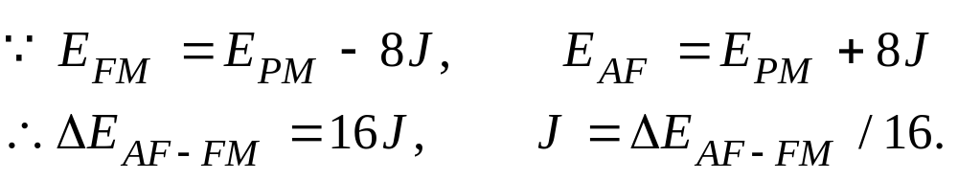
(2) Effective magnetic coupling (exchange interaction) J in bcc Fe:
(a) Perform two self-consistent total energy calculations for the
ferromagnetic and antiferromagnetic states of Fe in the simple cubic
structure (2 atoms per unit cell), respectively.
(b) Use the calculated total energy difference between the two magnetic
configurations to estimate the effective nearest neighbot interaction
parameter J.
Notes:

Slide 3
(3) Magneto-crystalline anisotropy energy of FePt:
(a) Perform a self-consistent spin-polarized scalar-relativistic electronic
structure calculation and then freeze the charge (CHGCAR).
Examine the magnetic moments and density of states.
(b) Now add spin-orbit coupling and make spin moment pointing the
[001] direction and note the spin and orbital magnetic moments as
well as the total energy.
(c) Now make spin moment pointing the [100] direction and note the
spin and orbital magnetic moments as well as the total energy.
(d) Now by comparing the total energies for the [001] and [100]
magnetizations, you should see that the [001] magnetization has a
lower energy, i.e., is the easy axis.

Slide 4
(4) Magneto-crystalline anisotropy energy of free-standing Fe monolayer:
(a) Perform a self-consistent spin-polarized scalar-relativistic electronic
structure calculation and then freeze the charge (CHGCAR).
Examine the magnetic moments and density of states.
(b) Now add spin-orbit coupling and make spin moment pointing the
[001] direction and note the spin and orbital magnetic moments as
well as the total energy.
(c) Now make spin moment pointing the [100] direction and note the
spin and orbital magnetic moments as well as the total energy.
(d) Now by comparing the total energies for the [001] and [100]
magnetizations, you should see that the [001] magnetization has a
lower energy, i.e., is the easy axis.

Slide 5
(5) Ru monolayer on Ag (001) surface becomes ferromagnetic:
Perform a self-consistent spin-polarized scalar-relativistic electronic
structure calculation and then freeze the charge (CHGCAR).
Examine the magnetic moments and density of states.

