Slide 1

“Chance Quality” Model for Football Shots (TASK -2)
Predicting Goal Probability of a Shot
Aritra Majumdar
16.06.2024

Slide 2
INTRODUCTION
Objective: The aim is to measure the quality of a chance by calculating the probability of a shot resulting in a goal from Metrica sports data.
Methodology:
· Modeling Aim: Shot Outcome ~ Set of features/variables
· Data Sources: Read and process event and tracking data (for both Home and Away teams) from Metrica Sports Match-2.
· Coordinate Conversion: Convert coordinates to OPTA format.
· Data Integration: Merge event and tracking data to create a unified dataset.
· Data Engineering: Process the merged data, considering Metrica data provides coordinates for both sides of the pitch.
· Shot and Goal Counting: Count the number of shots and goals.
· Player Count in Triangle: Determine the number of players (home and away) present in the triangle formed by the shooting location and the two goal posts using tracking data.
· Interference Calculation: Calculate the degree of interference exerted on the shot-taker by counting the number of defenders within 2 meters of the shooting location (assumed distance).
· Distance Calculations: Compute shot distances to both goal posts and to the goal.
· Shot Angle Calculation: Calculate the angle of the shot.
· Zone Assignment: Assign zones on the pitch based on the shooting location.
· Categorical Mapping: Apply fixed mappings to categorical columns (e.g., Body Part, Interference_on_Shooter, and zone).
· Body Part Assignment: As the Metrica data does not explicitly mention the body part, assign shots taken by the "Head" as 1 and the rest as "Other" (assigned 2).

Slide 3
Essential notes
Pre-Processing Steps:
All the pre-processing steps for Task – 2 are detailed in the "Task -2 - Metrica data Processing" file.
Prediction Aspects:
To facilitate prediction, models from Task – 1 could be saved and loaded for use on the Metrica data. Machine learning models are saved in a .SAV file using JOBLIB or PICKLE, and the ANN model is saved in a .h5 file. These files would need to be submitted along with the task.
As a result, saved the pre-processed file as “Shot_data_metrica.xlsx” and loaded it for prediction.
Differences Between Task – 1 and Task – 2:
Feature Consistency: Both tasks use the same features.
Body Part Mapping:
Task – 1: fixed_bodypart_mapping = {'Head': 1, 'Left': 2, 'Right': 3, 'Other': 4}
Task – 2: As the Metrica data does not explicitly mention the body part, I extracted “Head” goals from the “Subtype” column and encoded them as 1, with the rest of the goals encoded as “Other” (2). Thus, fixed_bodypart_mapping = {'Head': 1, 'Other': 2}
Special Functions to Note:
process: Converts coordinate pairs to location lists and adds new columns to the DataFrame.
is_point_in_triangle: Checks if a point is inside or on the edge of a triangle using barycentric coordinates.
count_players_in_triangle: Counts the number of home and away players within the triangle defined by the shooting location and the goal posts.
calculate_interference_on_shooter: Calculates the degree of interference on the shot-taker from defenders by checking the number of defenders within 2 meters of the shooting location.

Slide 4
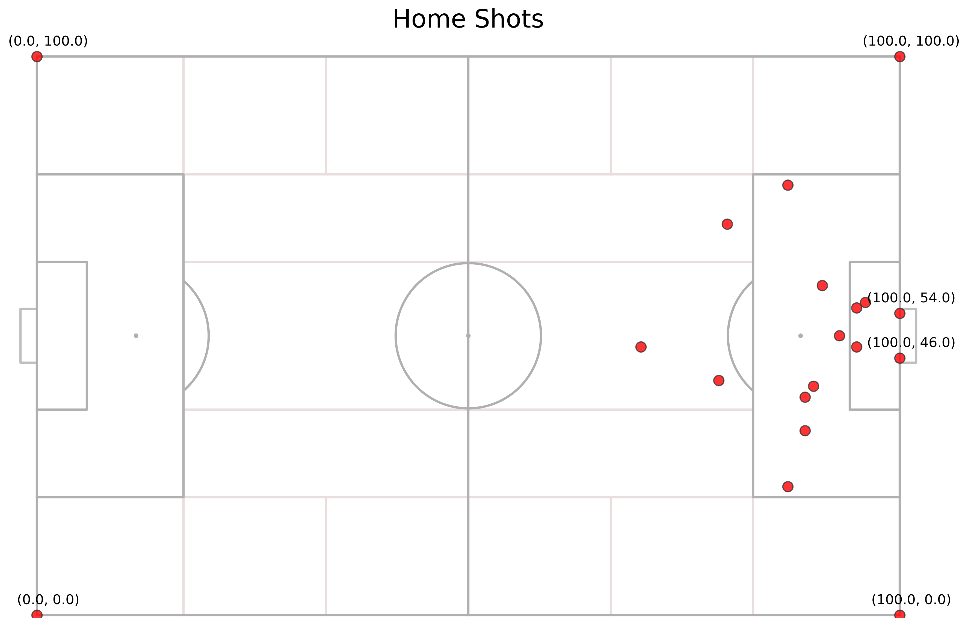
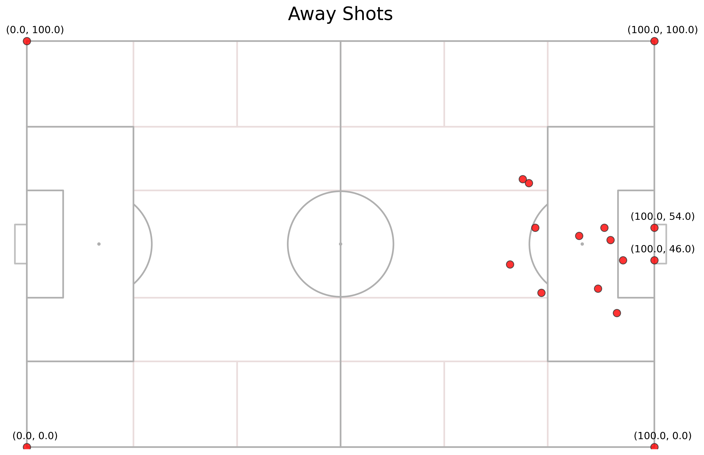
Test case
Home Team Data Points: 1044
Away Team Data Points: 891
Total Shots in the Match: 24
Home Team Shots: 13 (Open play: 12, Set Piece: 1)
Away Team Shots: 11 (Open play: 9, Set Piece: 2)
Goals Scored:
Home Team Goals: 3 (Open play: 3, Set Piece: 0)
Away Team Goals: 2 (Open play: 1, Set Piece: 1)
In the accompanying figure, both Home and Away team shots are plotted. The objective is to predict the probability of scoring for each shot using advanced machine learning models.
Models Used:
XGBoost without sampling
ANN cost-sensitive
In the following two slides, I present the open-play goals for both Home and Away teams, along with the positions of opponents and teammates. Due to scope constraints, not all 24 shots are shown.

Slide 5
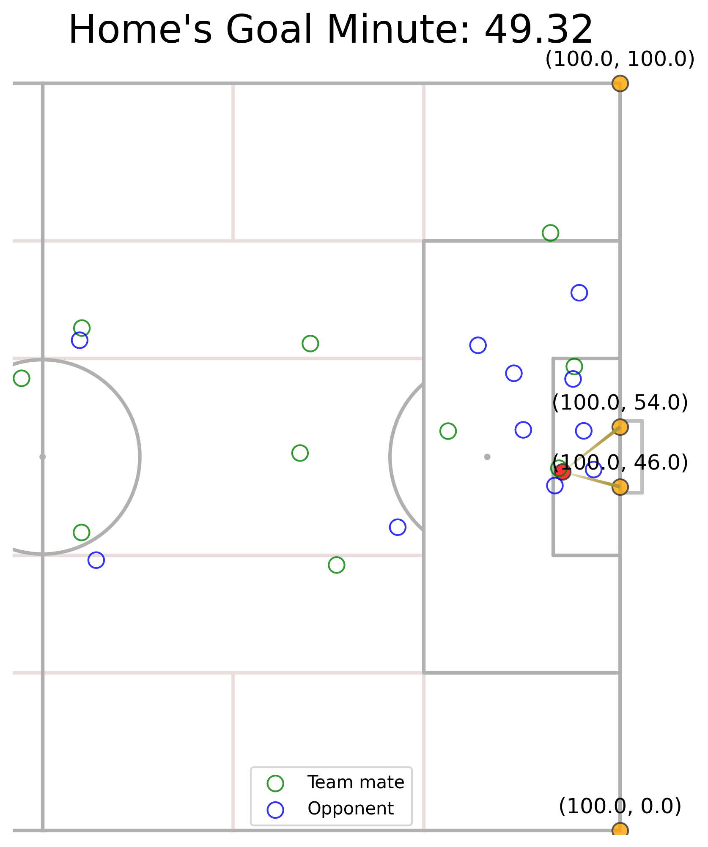
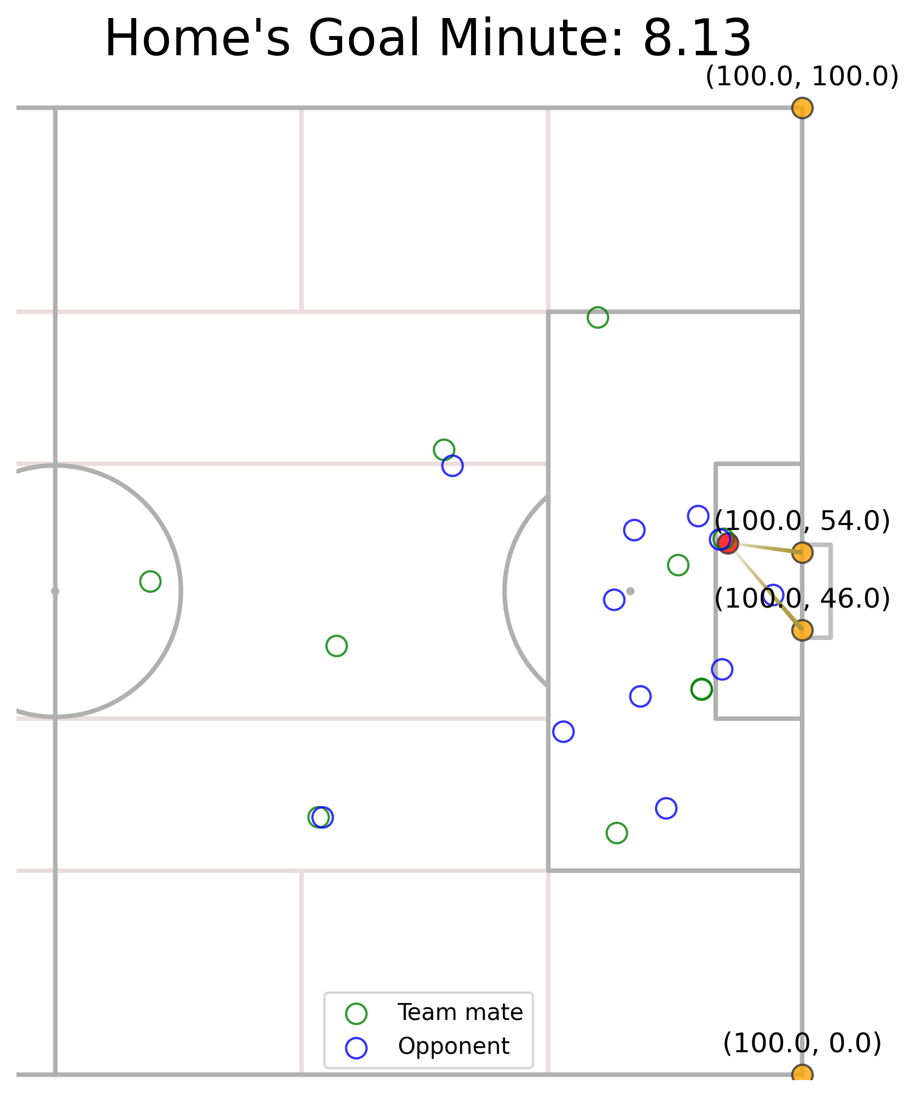
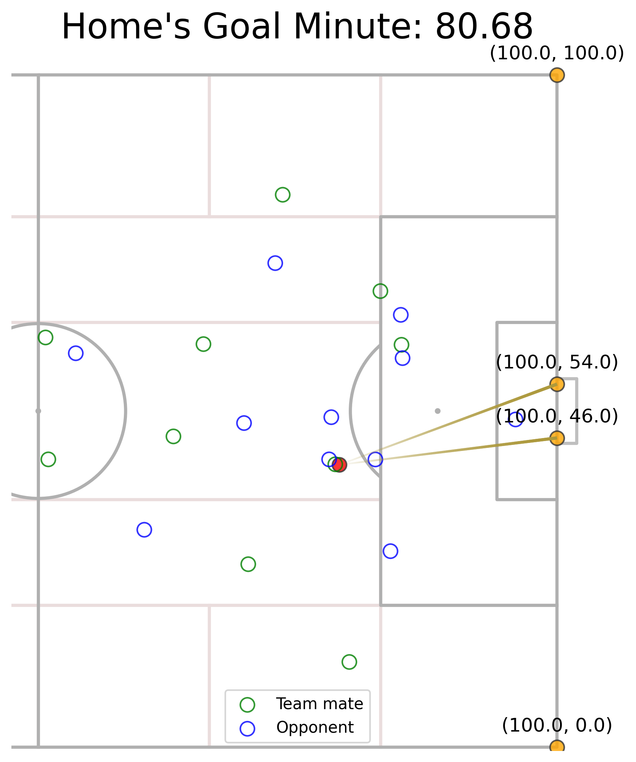
Situations of Three OPEN PLAY HOME GOALS

Slide 6
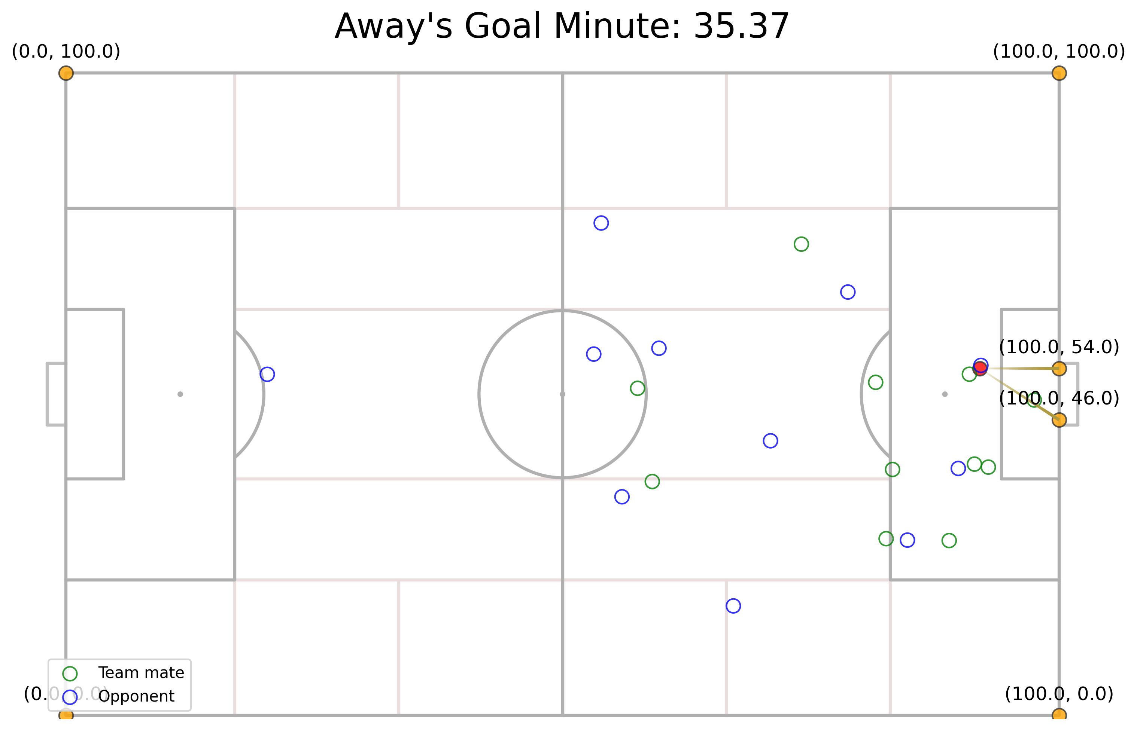
Situations of One OPEN PLAY AWAY GOAL

Slide 7
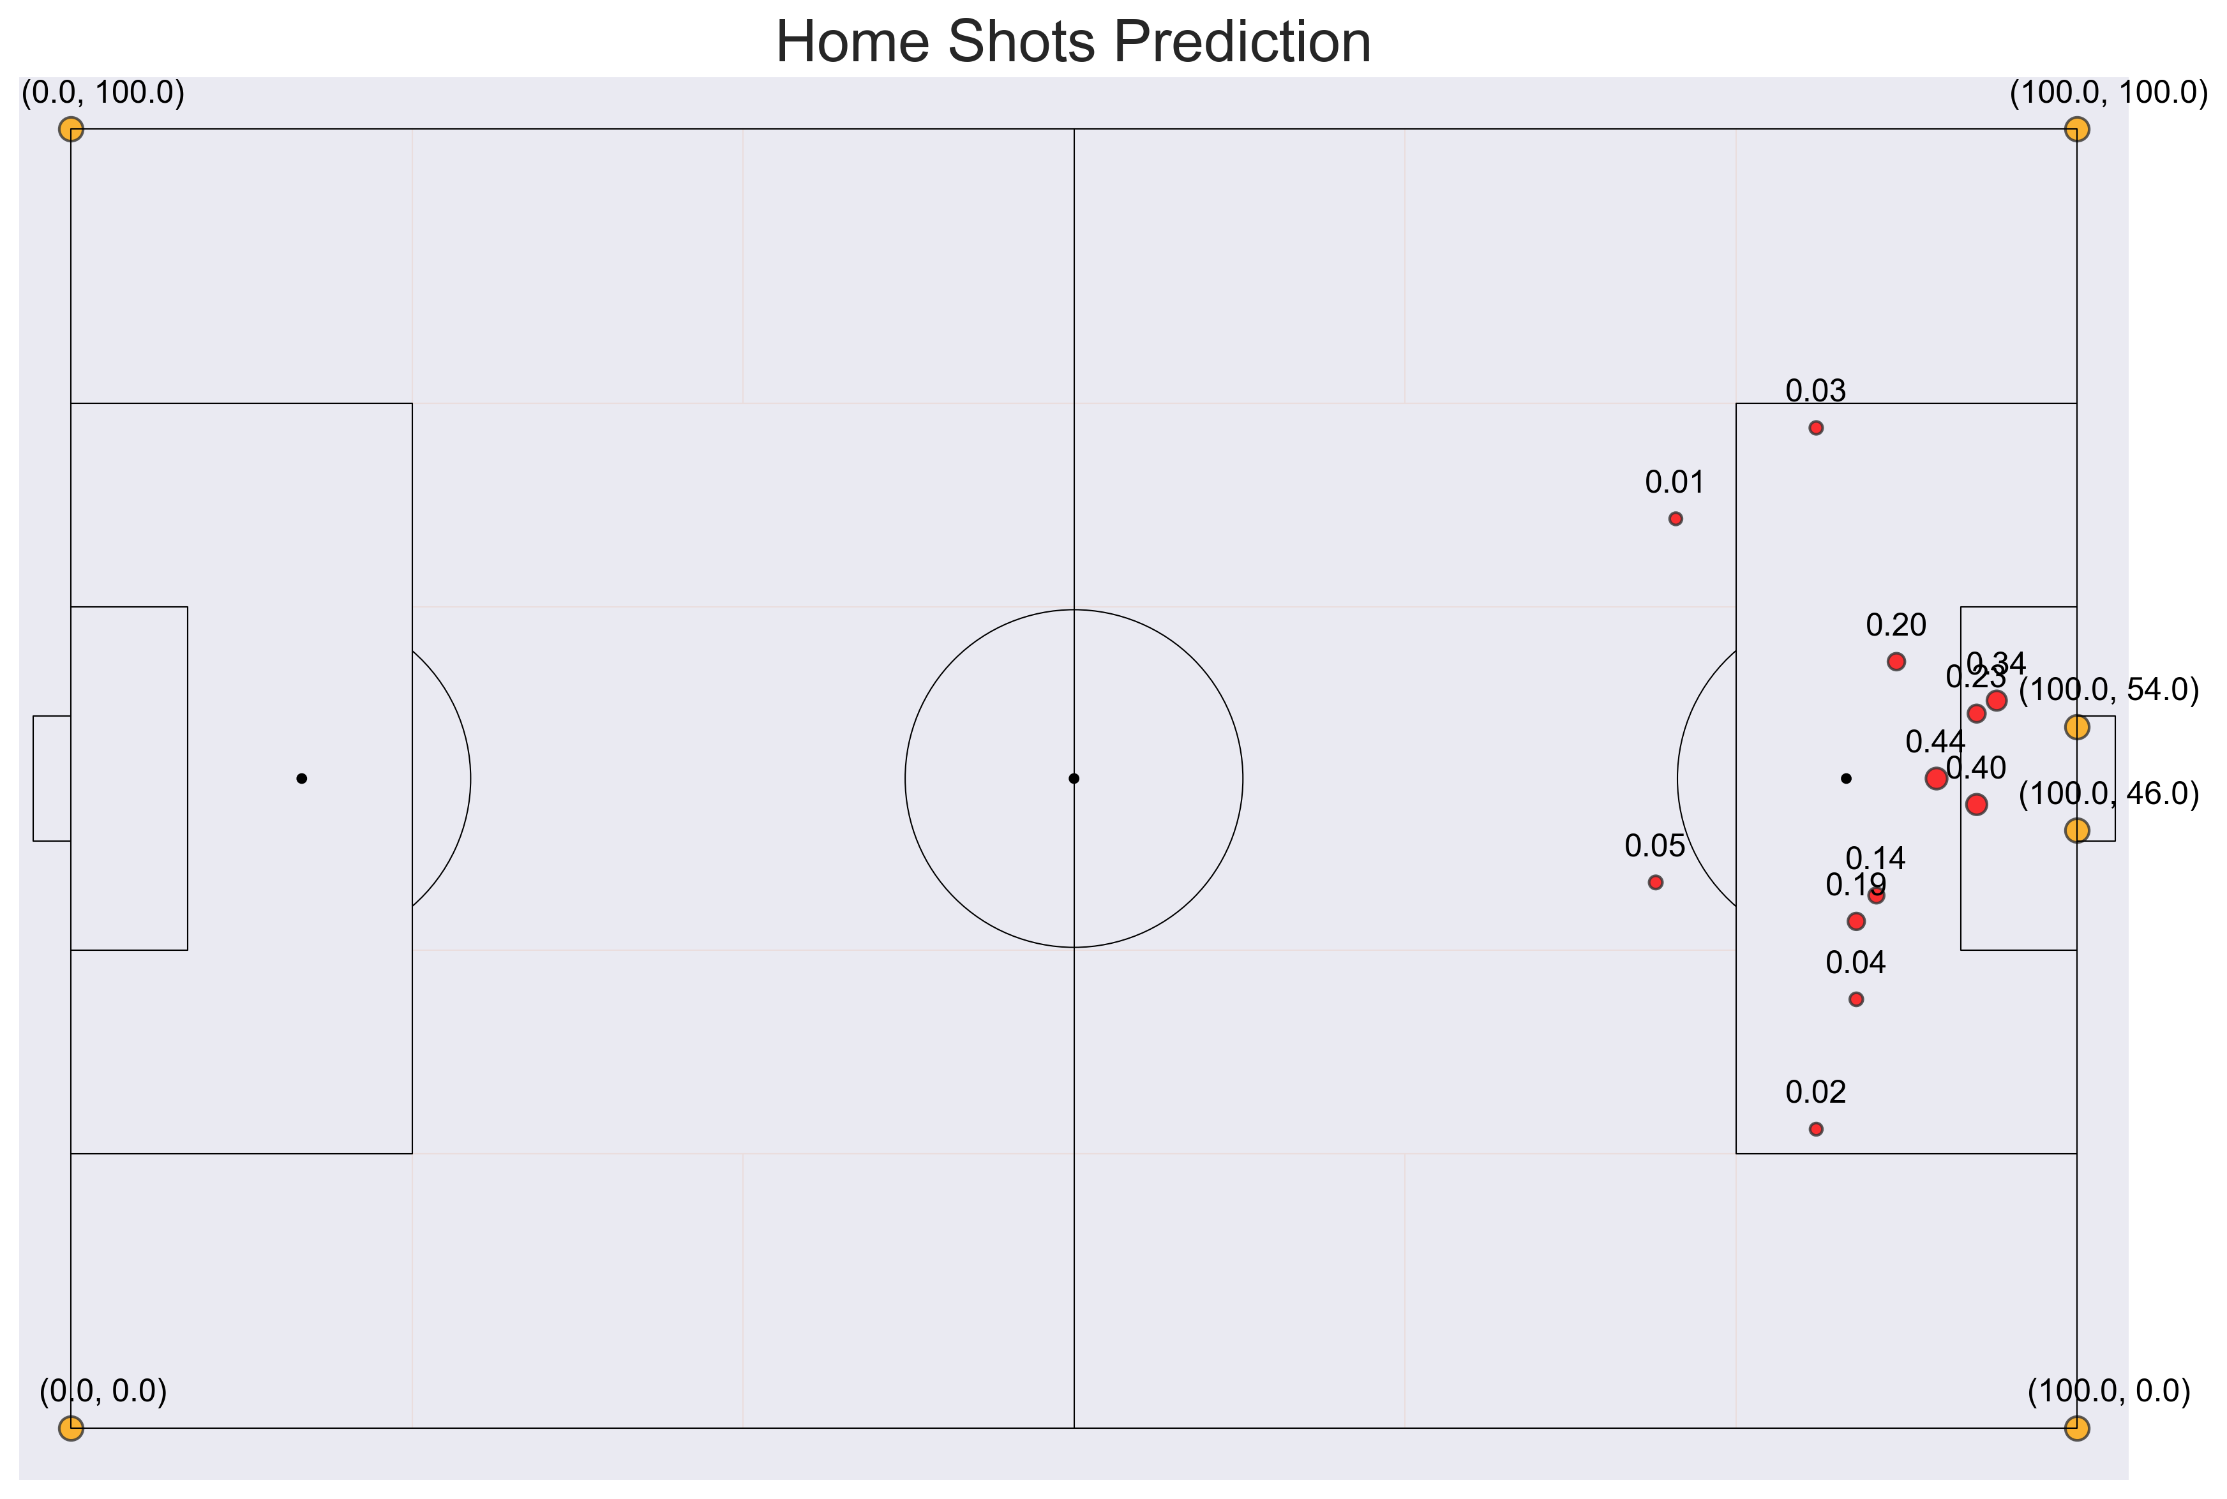
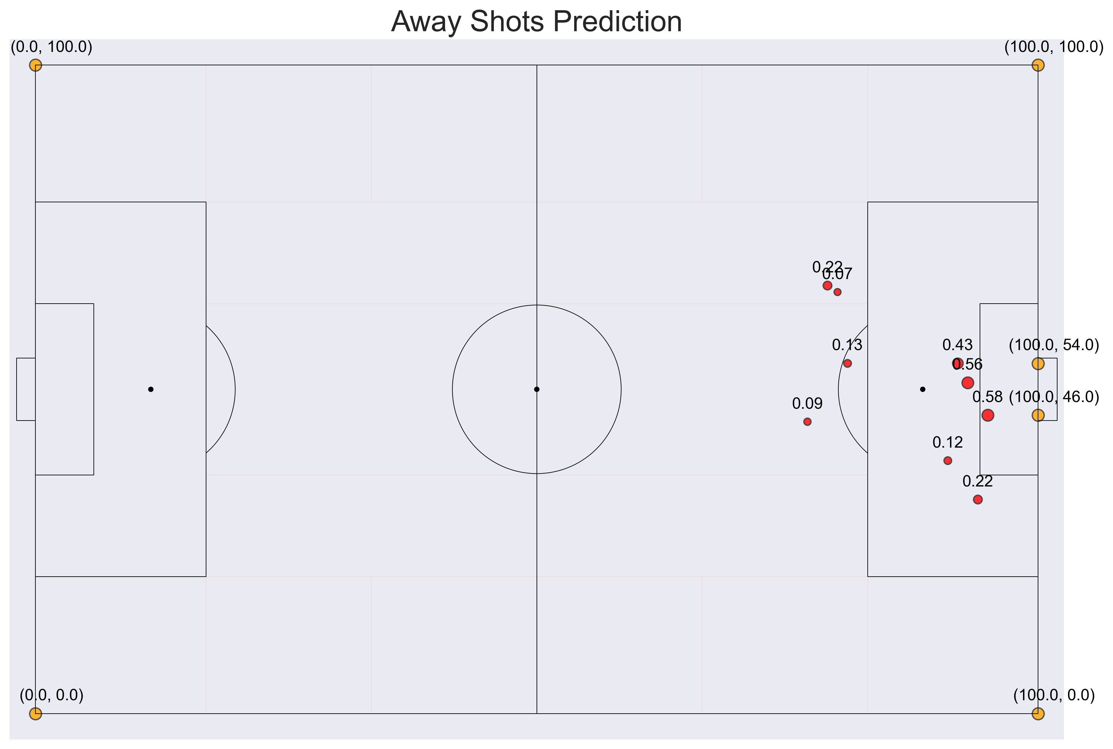
open play shots prediction (XGBoost without sampling)
Home Team (xG predicted: 2.10)
Away Team (xG predicted: 2.41)
Please refer to the “Task 2 - xG - (XGBoost) + metrica.ipynb” file for in-detail results

Slide 8
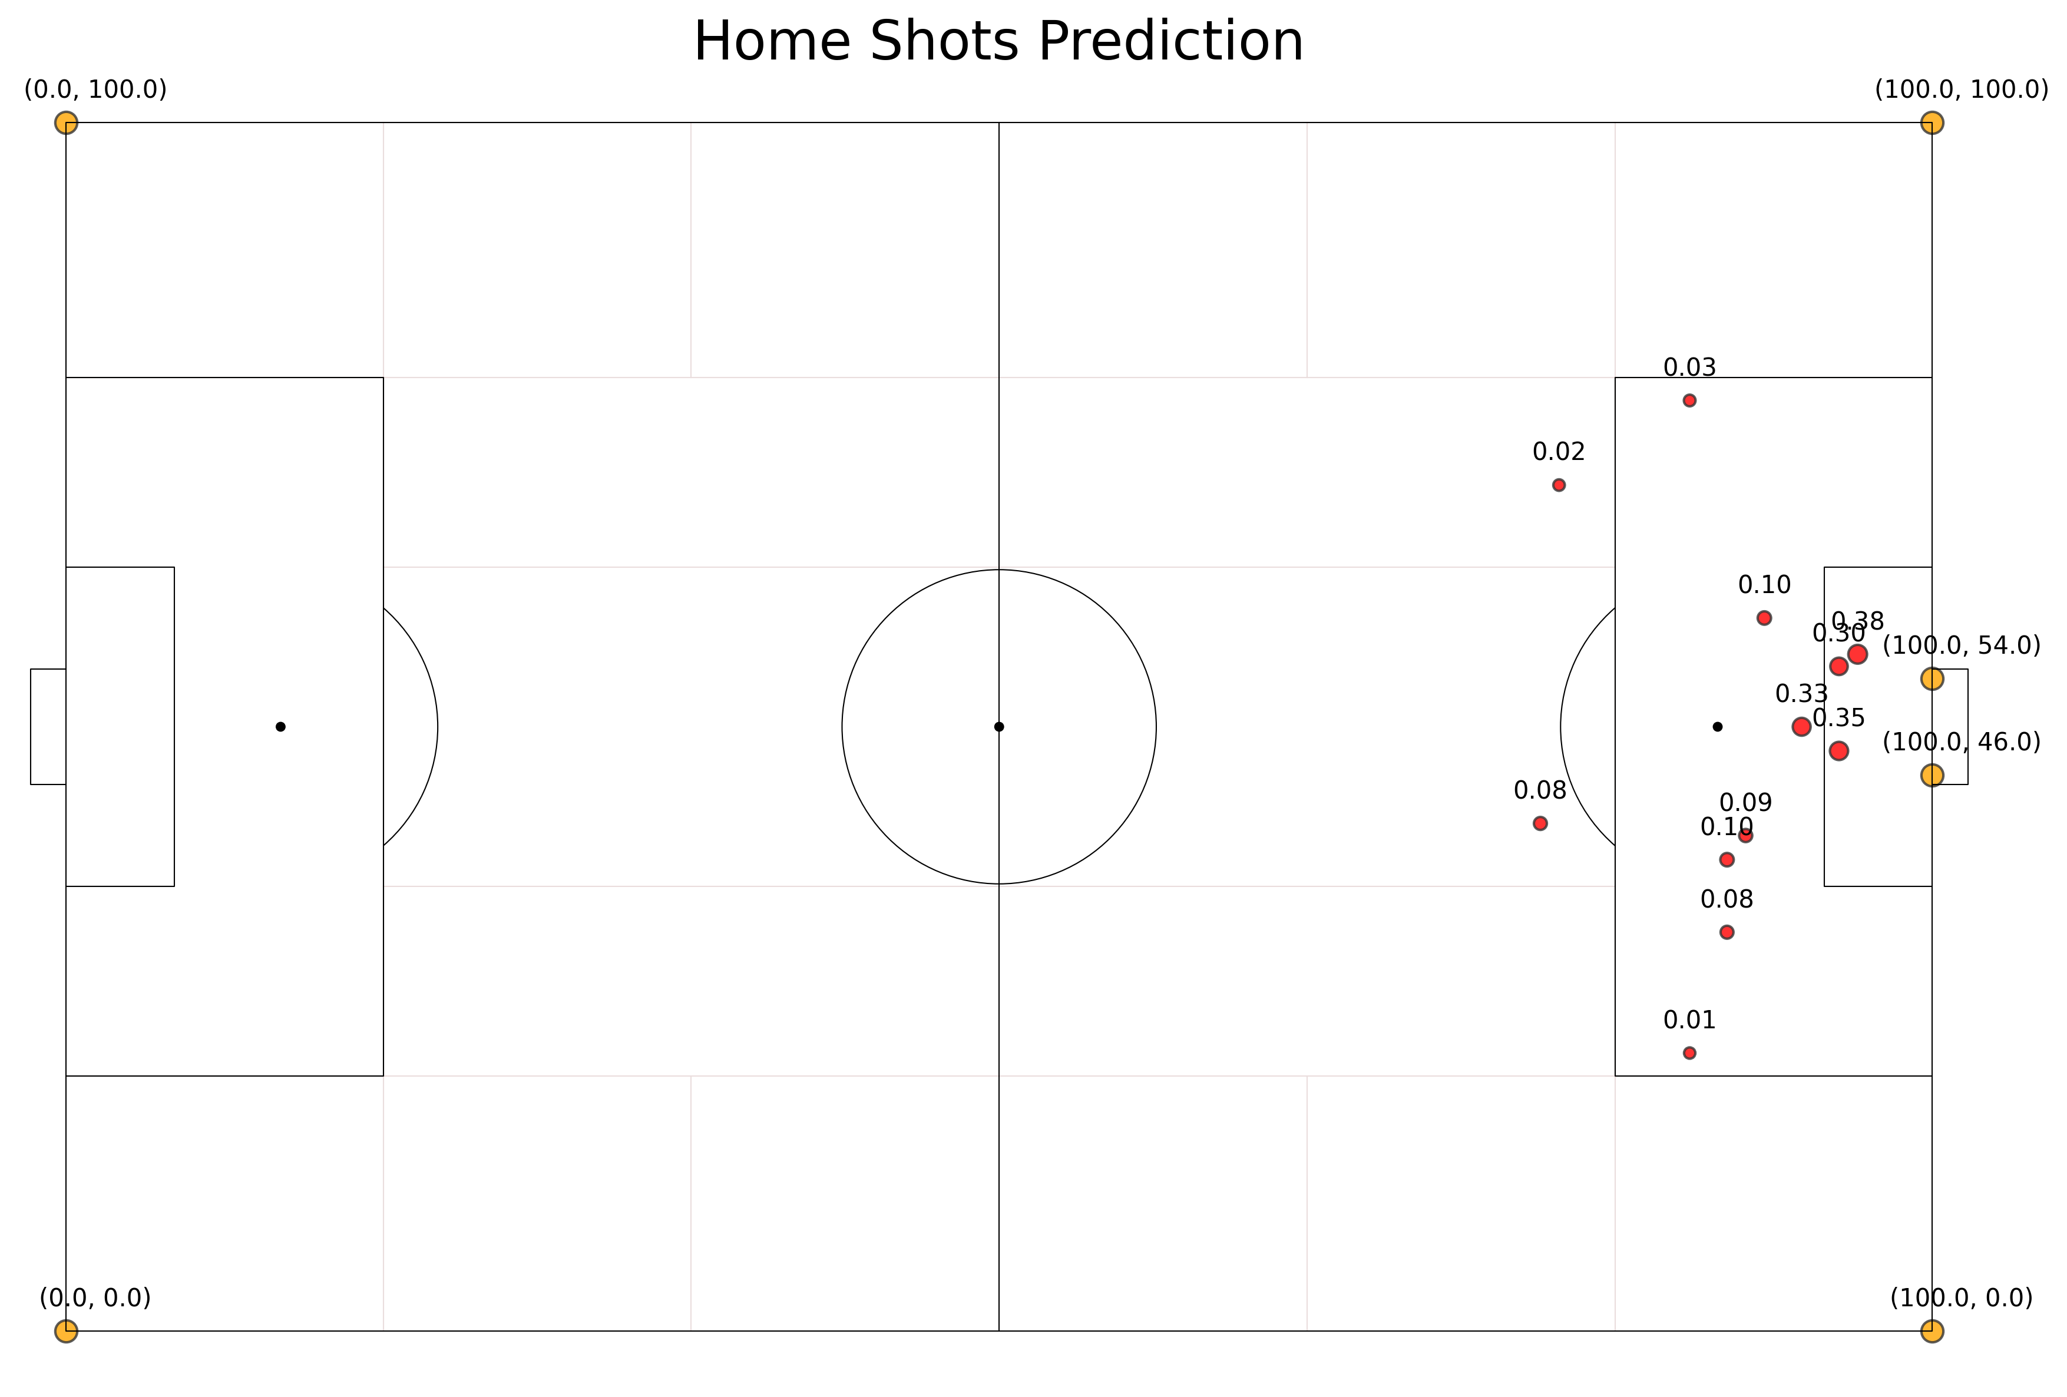
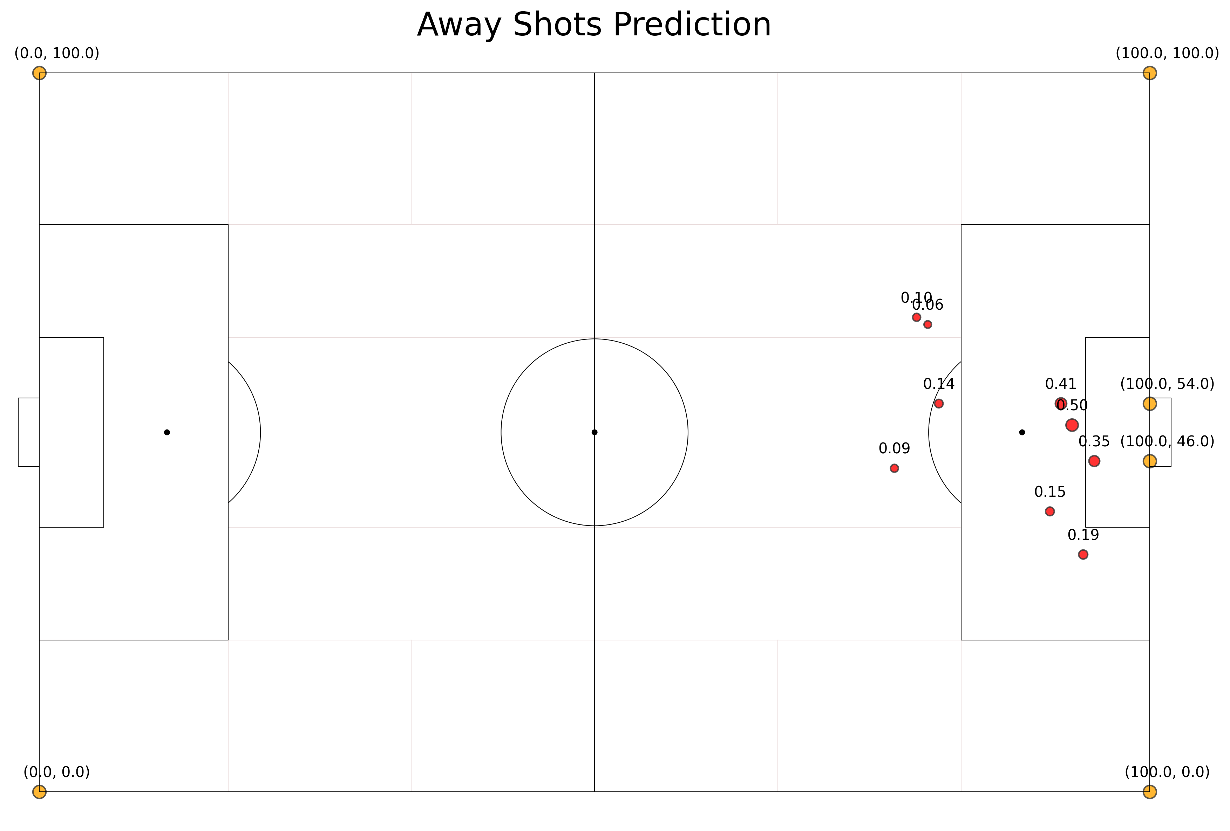
open play shots prediction (ANN COST-SENSITIVE)
Home Team (xG predicted: 1.87)
Away Team (xG predicted: 1.98)
Please refer to the “Task 2 - xG - (ANN) + metrica.ipynb” file for in-detail results

Slide 9
Essential Notes
xG Set Play (xGSP)
xG Set Play quantifies the expected goals from set-piece situations, including corners, free kicks, and penalties. This metric contrasts with xG Open Play and evaluates a team's proficiency in converting dead-ball situations into scoring opportunities. The xG Set Play metric is essential for understanding a team's effectiveness in breaking down organized defenses through set-pieces. The following xG metrics fall under xG Set Play:
xG Corners
xG Corners specifically measures the expected goals from corner kicks. This metric evaluates the quality of corner deliveries and the finishing prowess of the receiving players, providing insights into a team's strategy and efficiency in converting corners into goals.
xG Free Kick
xG Free Kick calculates the expected goals from direct free kicks. It assesses a player or team's ability to score from set-piece opportunities outside the penalty area, taking into account factors such as distance from the goal and angle of the shot.
xG Penalty
xG Penalty measures the expected goals from penalty kicks. It evaluates the probability of a penalty being converted into a goal, with each penalty typically worth 0.79 xG.
We have very less amount of Set-piece shots to train a model and predict. That is why the three set-piece shots (1 penalty, and 2 Freekicks) are assigned to 0.79 (for the penalty) and 0.10 (for the Free-kicks) accordingly.

Slide 10
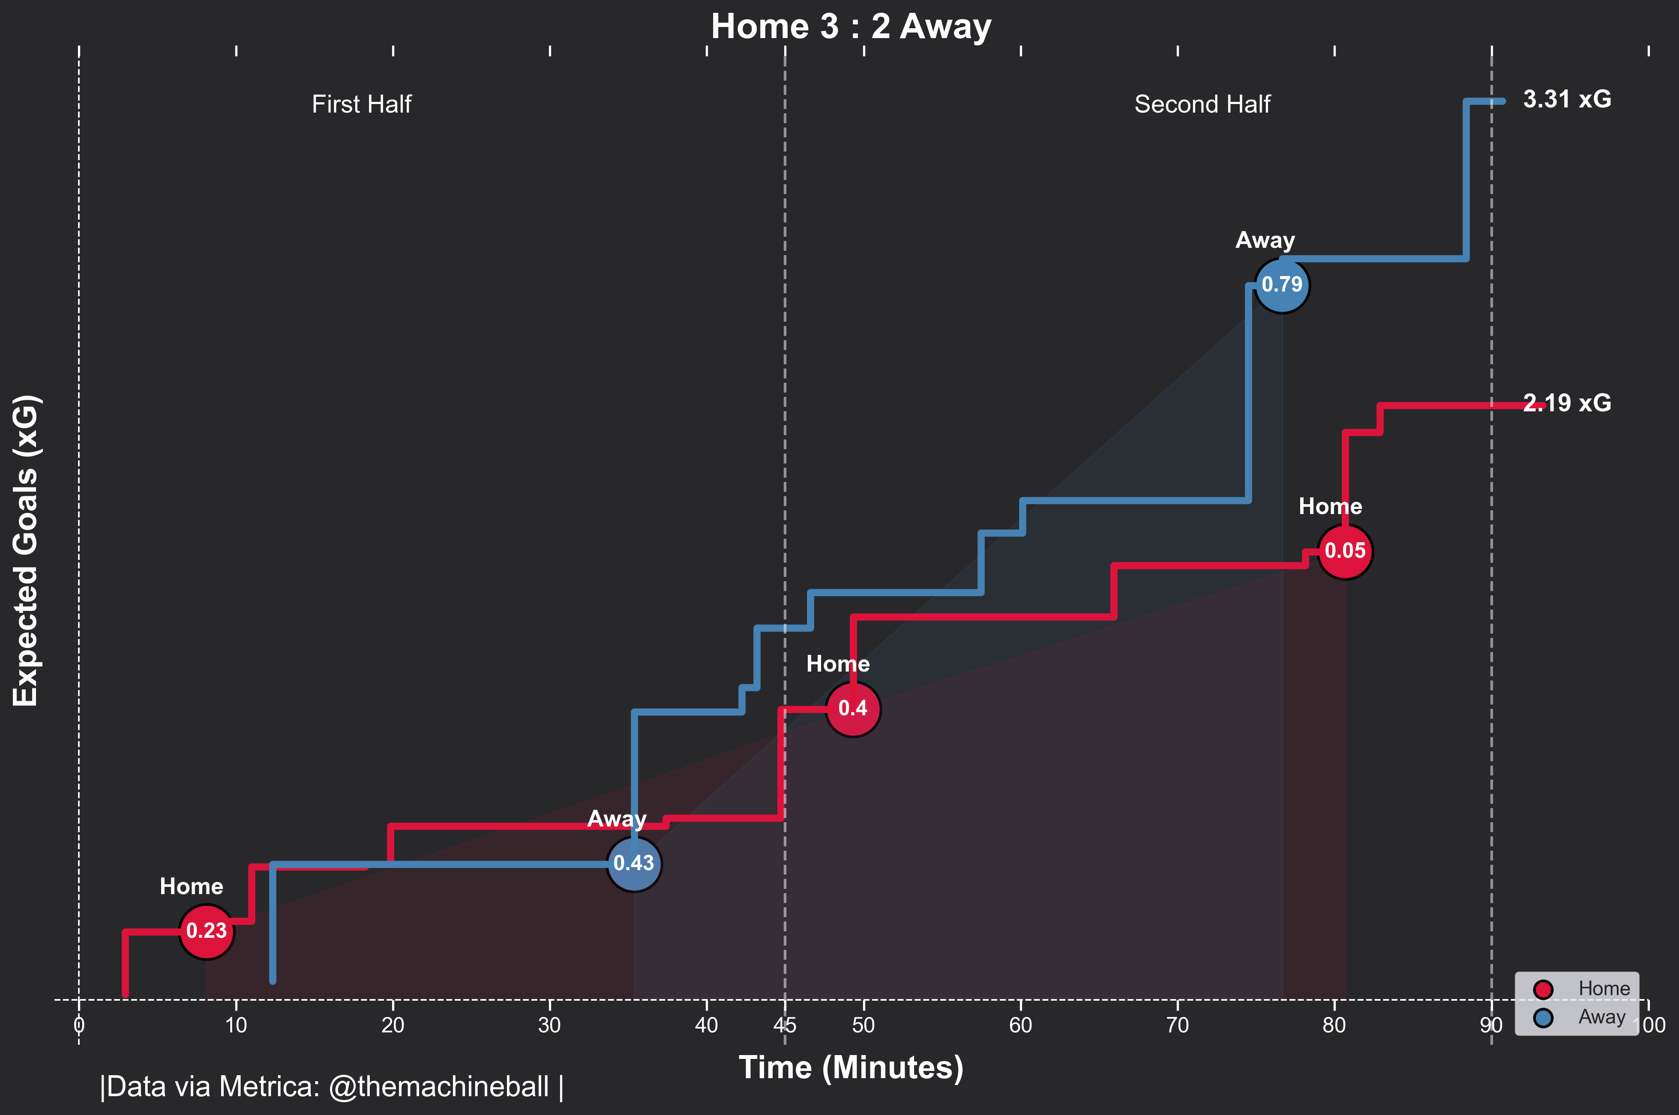
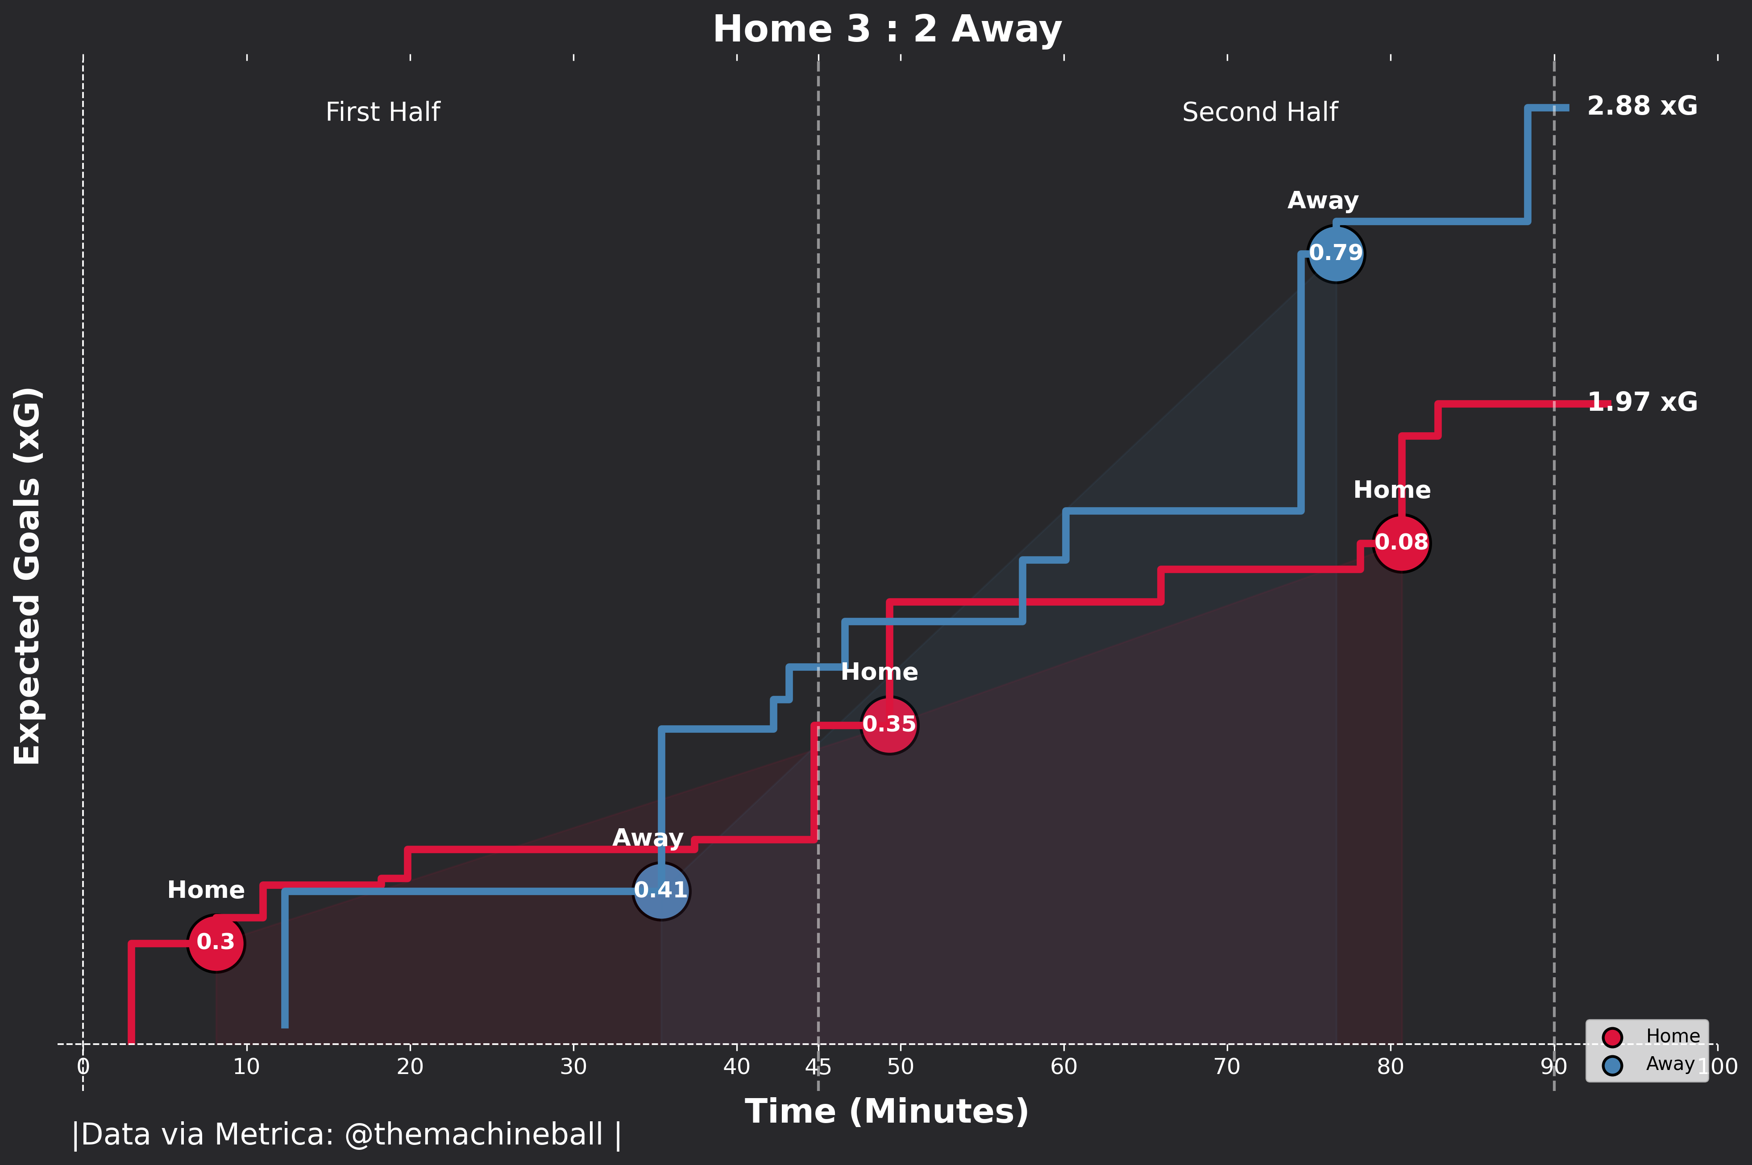
Final results
XGBOOST
ANN
According to Expected Goal Model, Away team has higher xG than the Home team.

