Slide 1
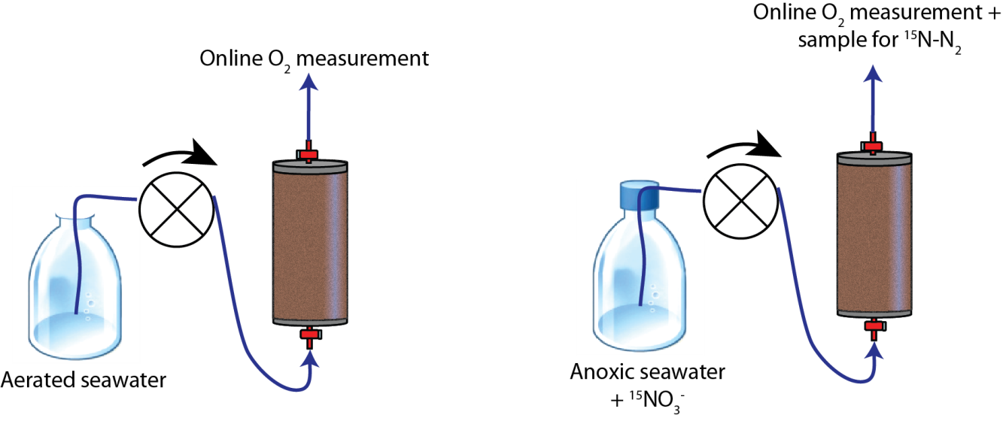
Volumetric Reaction Rates

Slide 2
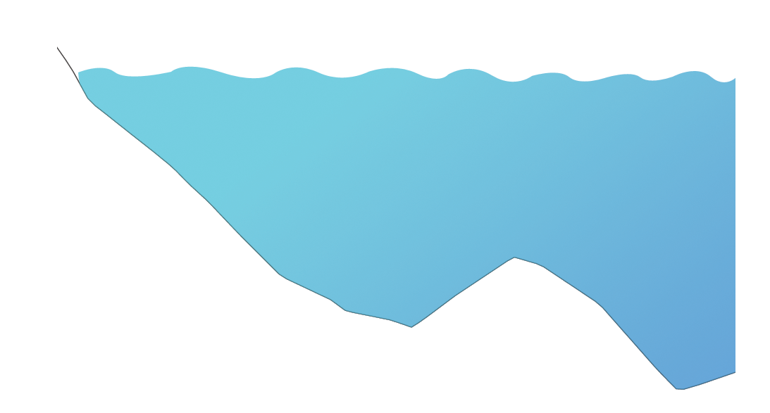
Biogeochemical Rates
HWL
Ridge
LWL

Slide 3
Skin Circulation
HWL
Ridge
LWL

Slide 4
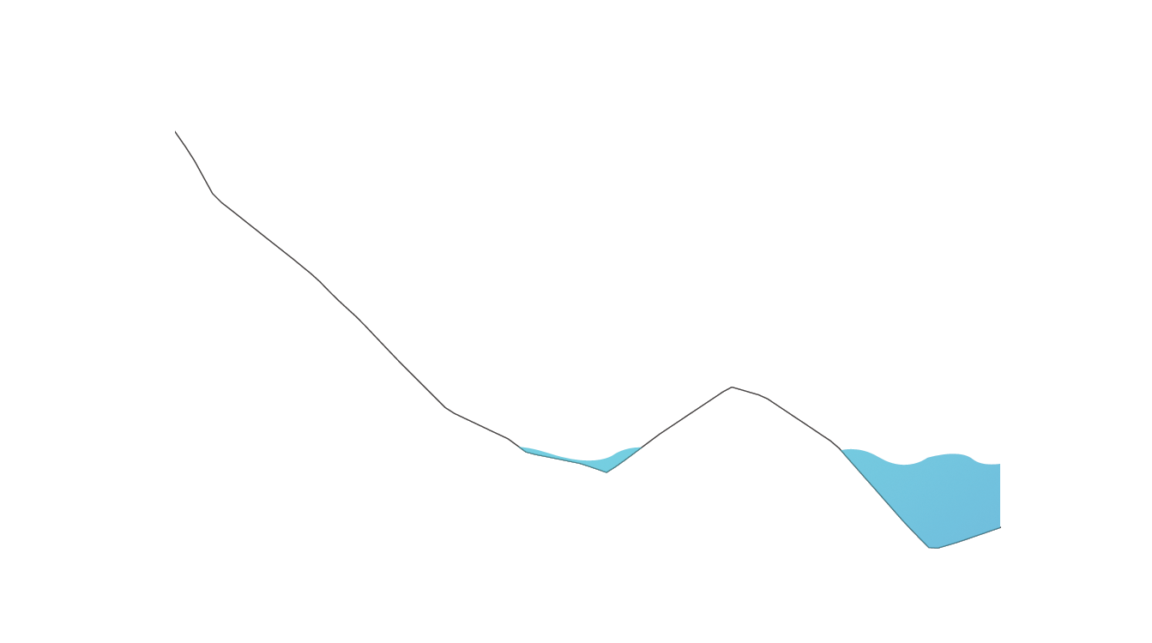
Body Circulation: Low Tide
HWL
HWL
NN
Ridge
LWL
LWL

