Slide 1
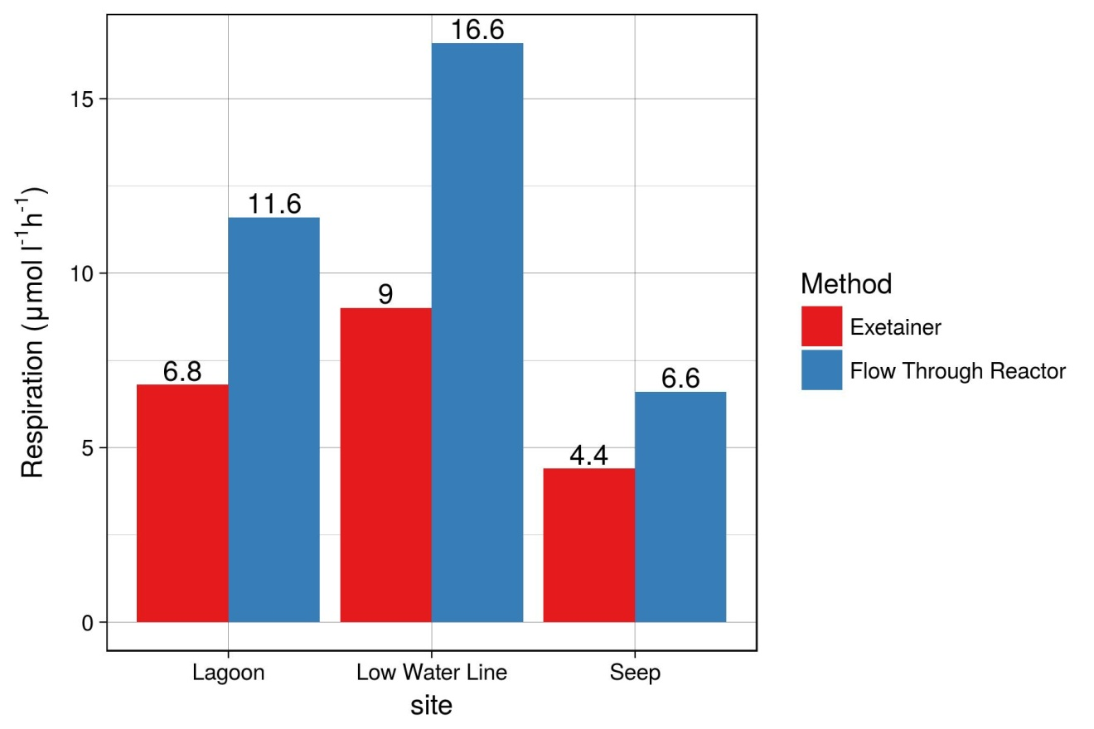
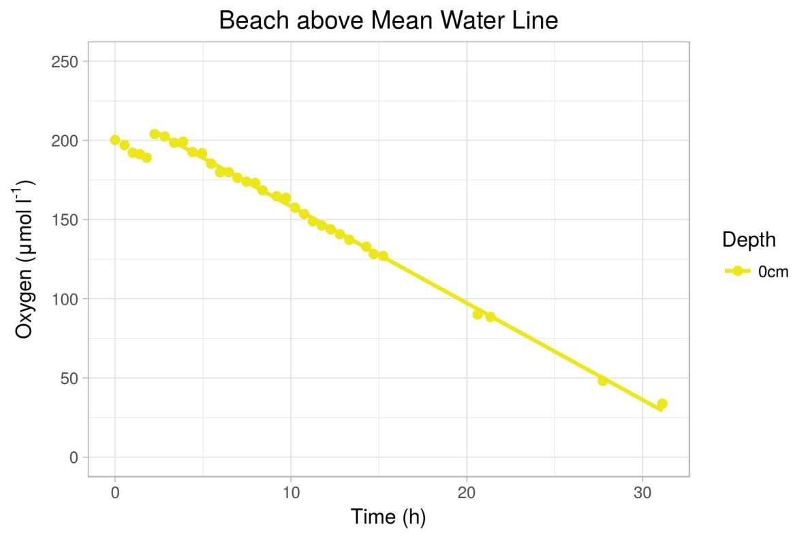
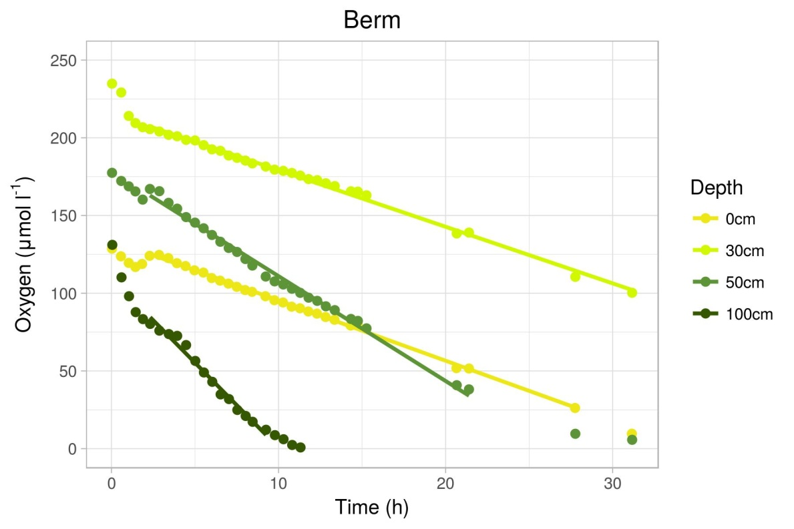
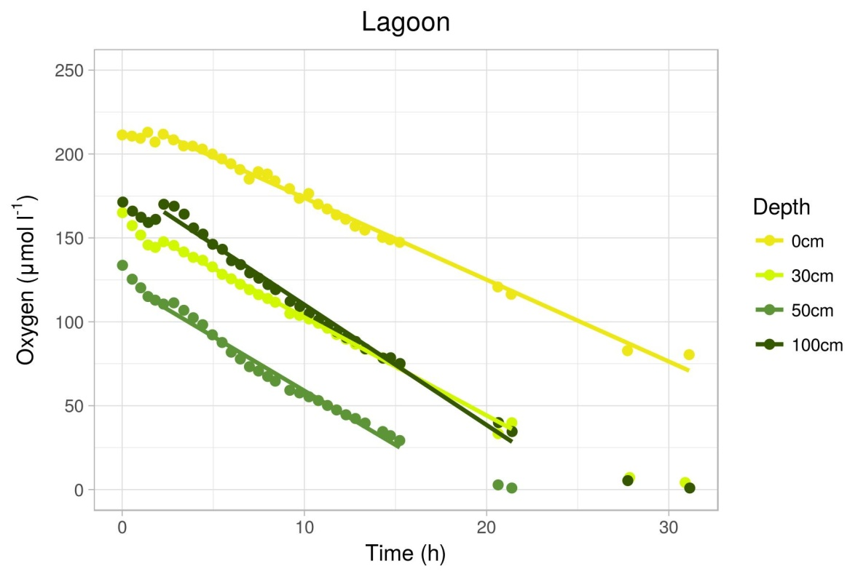
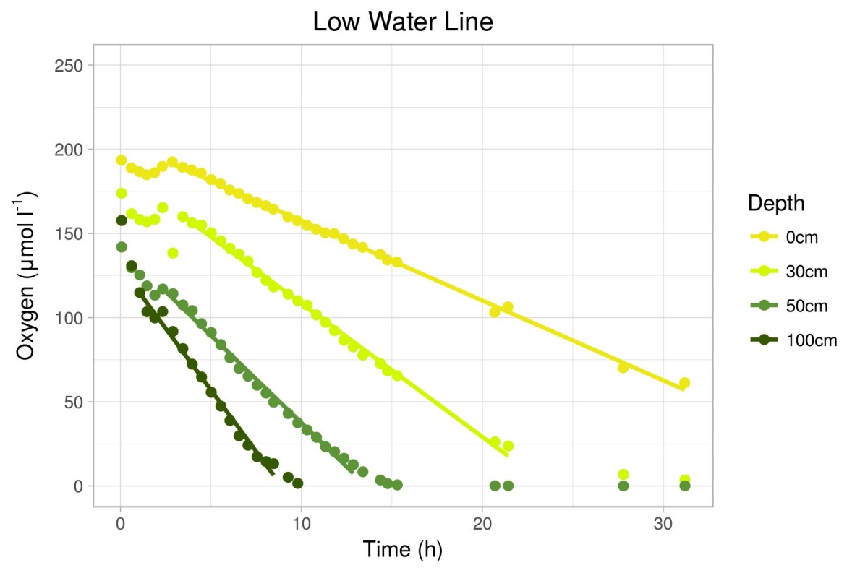
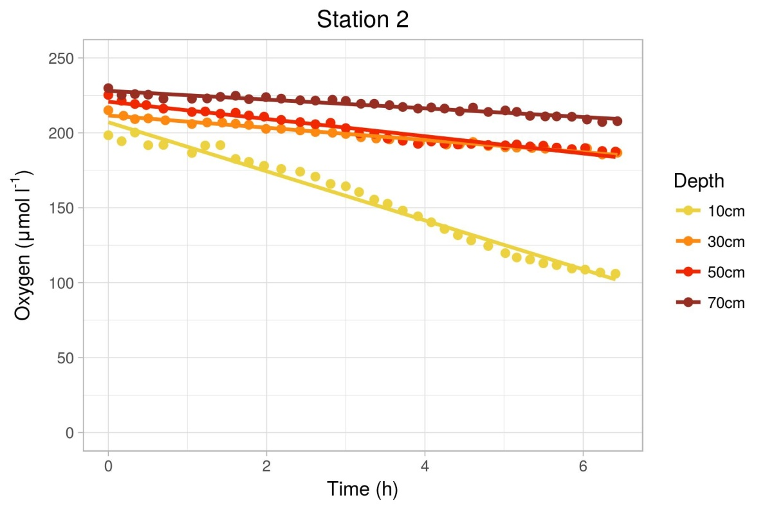
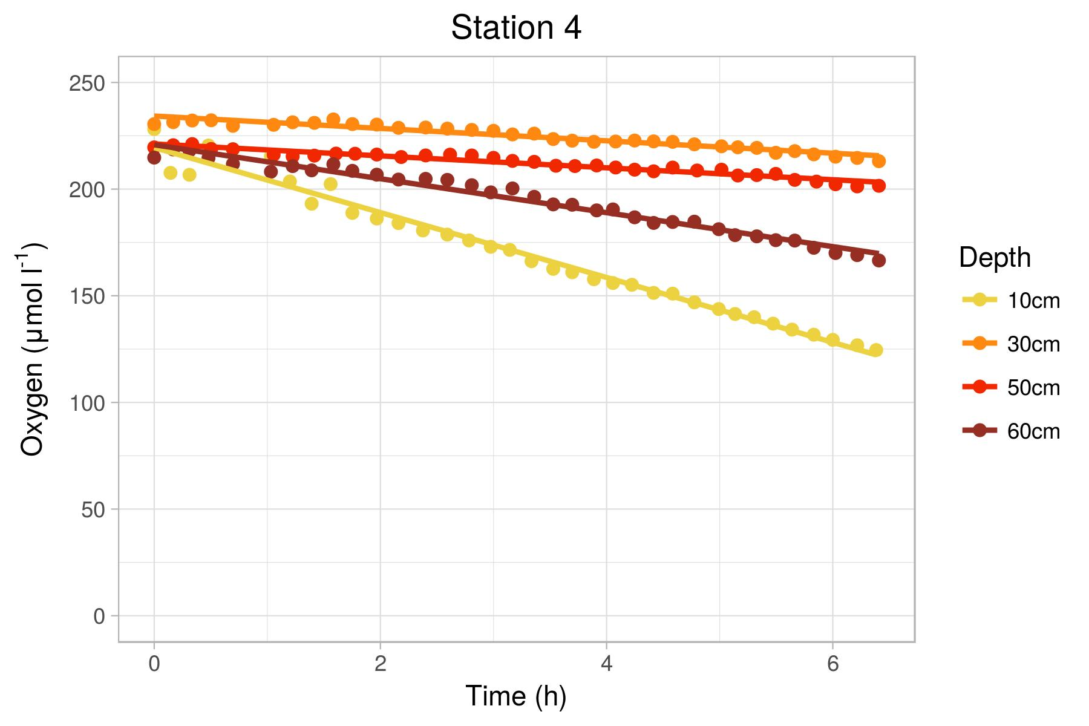
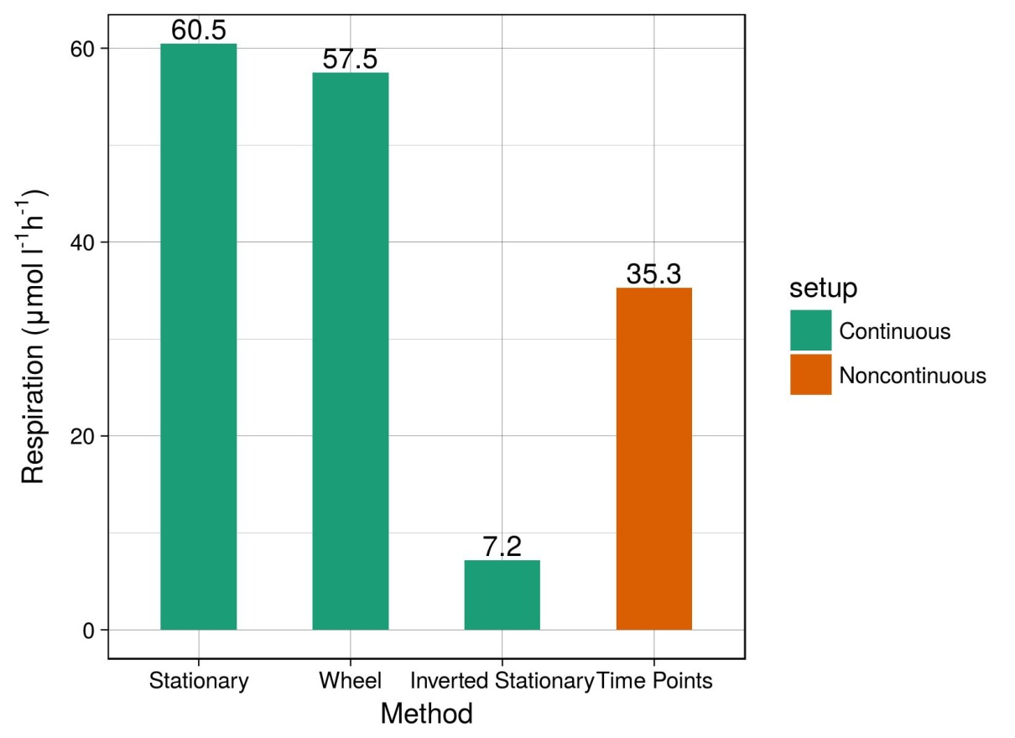
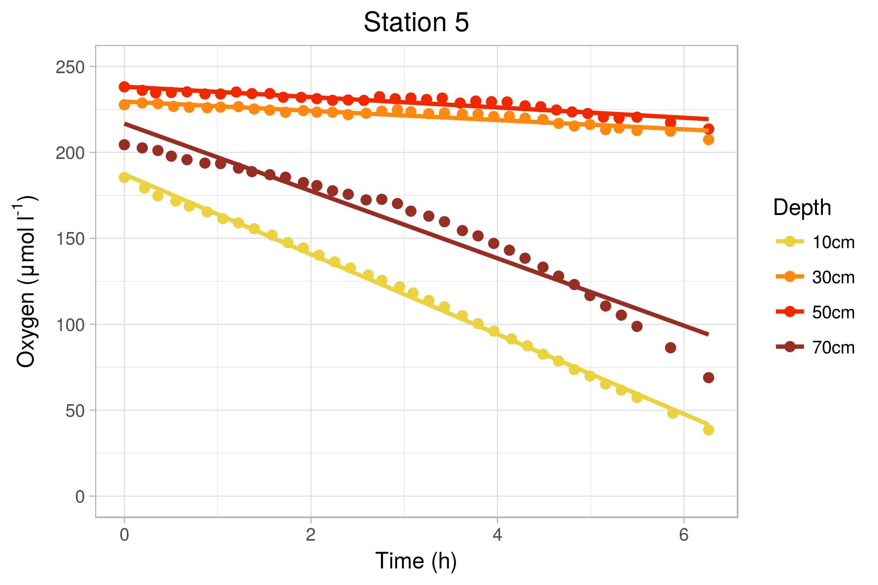
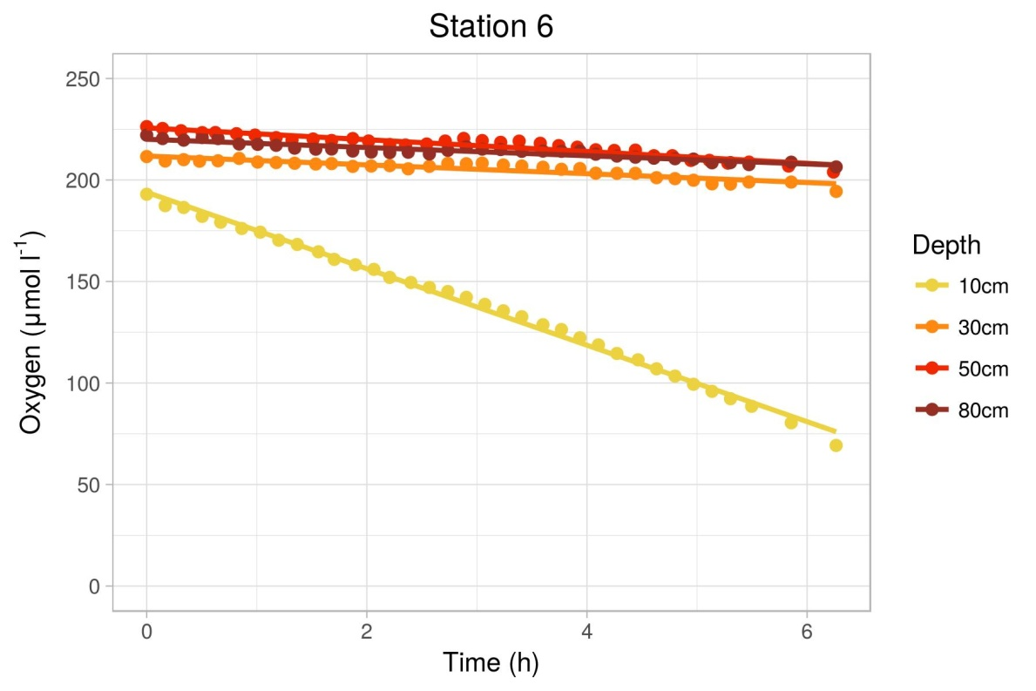
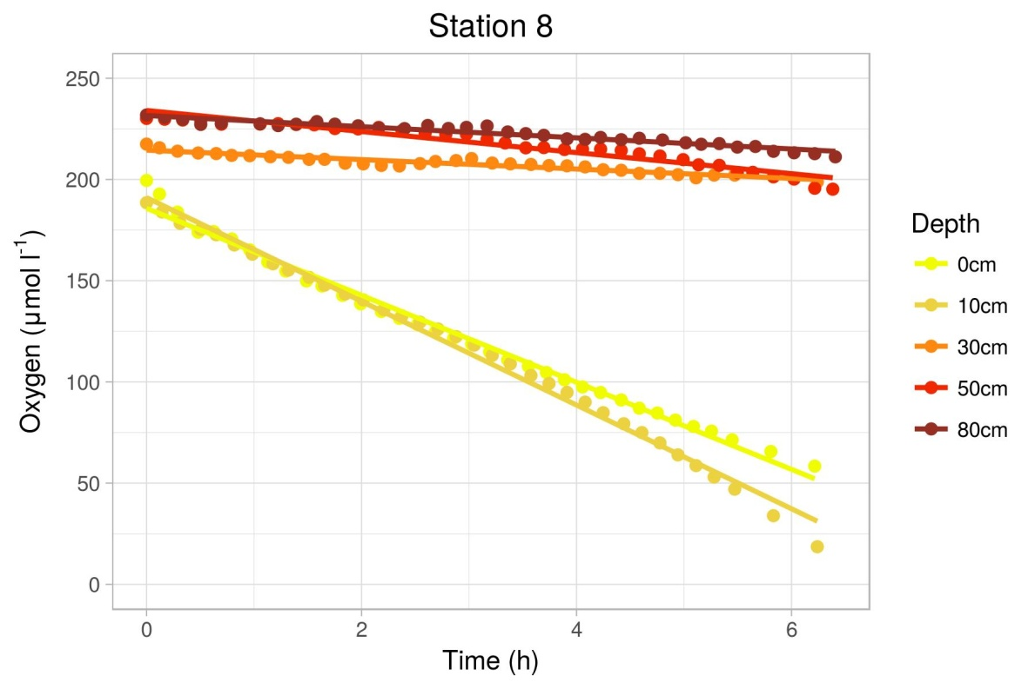
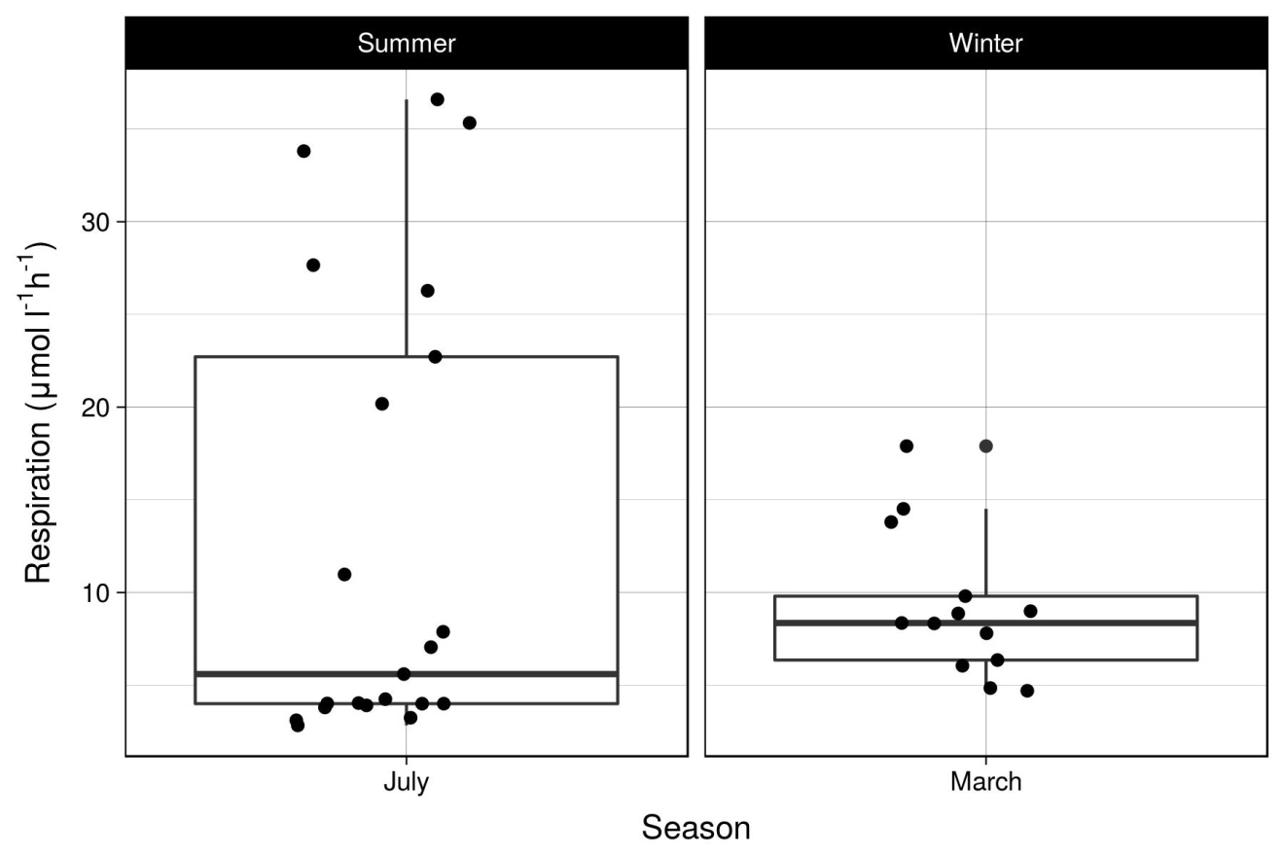
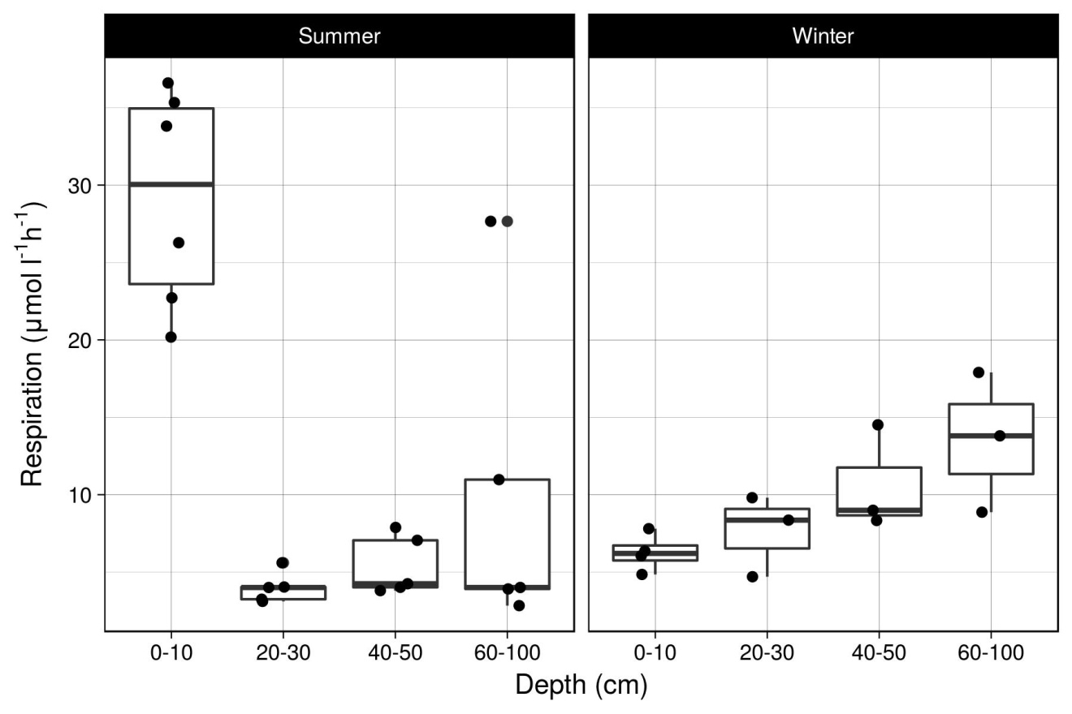
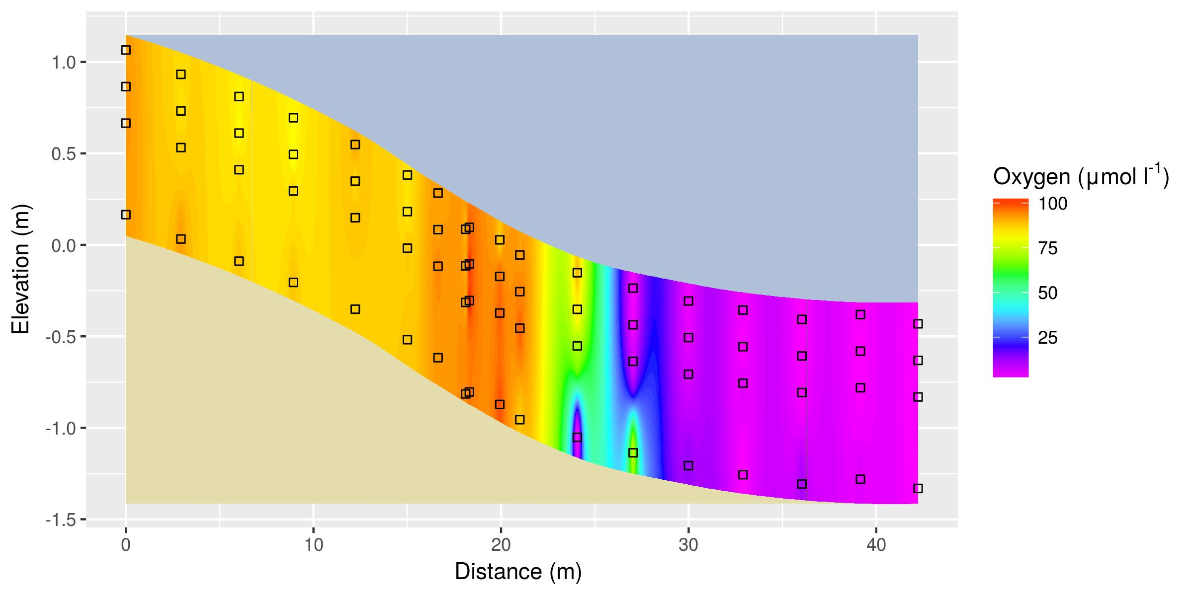
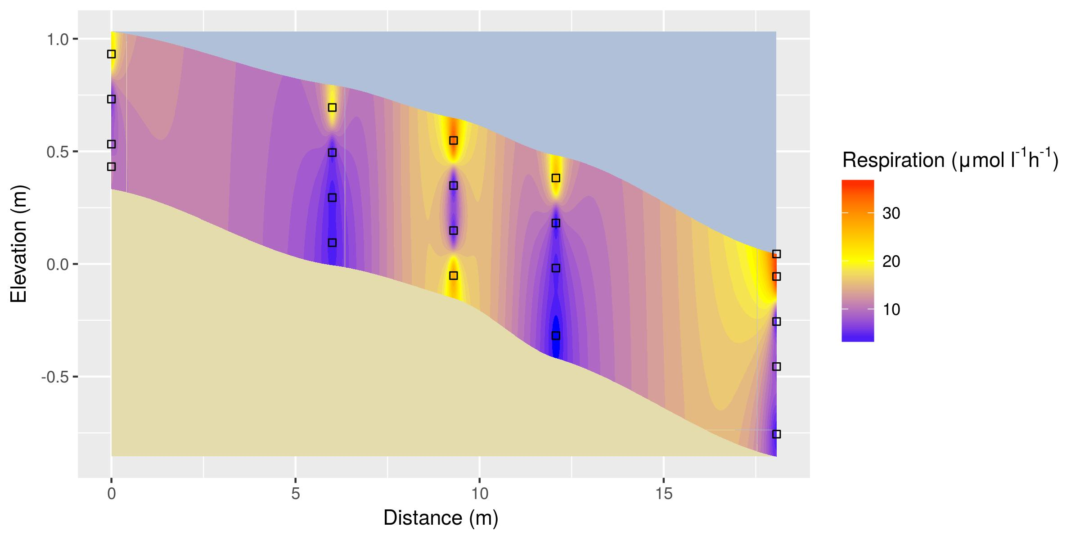
Development of an in situ measurement protocol for volumetric oxygen consumption rates in permeable sediments Kai Blumberg, Soeren Ahmerkamp, Marcel Kuypers Max Planck Institute for Marine Microbiology
Department of Biogeochemistry
INTRODUCTION
Sandy sediments cover up to 70% of continental shelf areas. Characterized by high permeability, sands allow for increased seawater advection, transporting solutes and particles from the water column into the sediment. Sand microbial communities serve as natural bio-catalytic filters, using seawater adverted oxygen to remineralization organic matter sourced from ground water discharge. Quantification of remineralization rates requires accurate measurements of volumetric respiration rates. Sediment incubated flow-through reactors allow for quantification of such rates by reducing complex transport processes into a measurable one-dimentional concentration gradient. It is, however, unknown how representative such measurements are, as they do not consider in situ heterogenity or intrinsic sediment characteristics. Thus a novel in situ measurement protocol for volumetric oxygen consumption rates was developed. The objectives of this work were to:
OBJECTIVES
Compare the results of the novel optode-spot exotainer methods with flow-through reactors
Measure volumetric oxygen consumption rates during the winter and summer seasons
Model oxygen profiles and consumption rates along a sandy beach transect
METHODS
Figure 1: Pore water circulation …
Method Comparison
Rate measurements derived from flow through reactors (blue) and the novel in situ exetainer optode spot time point reactions (red). Rates derived from the new method appear to be ~60% of those from the previous method (Objective 1).
RESULTS
Volumetric oxygen consumption rates:
Winter (above) and Summer (below) rates were quantified using the non-continuous manually mixed optode spot exotainer method (Objective 2).
Exetainer optode spot method
Comparisons of rates obtained via continuous vs.. non-contiguous, mixed vs. unmixed measurement setups. Non mixed continuous setups involved measuring oxygen values directly in the sediment (stationary) or in the porewater filled headspace (Inverted stationary), The continuous mixed setup involved attaching the optode to a spinning wheel to simulate advection (Wheel). The non-contiguous mixed setup involved manual inversion preceding measurements (time points).
Figure 3A: Winter oxygen respiration rates
Figure 2A: Exotainer v.s. flow-through reactor method comparison
Figure 2B: Continuous vs. non-continuous exetainer optode method comparison
Figure 3B: Summer oxygen respiration rates
Results
Fig. 4A: Seasonal Oxygen consumption rates
Fig. 4B: Seasonal Oxygen consumption rates
Fig. 5: Interpolated winter oxygen profile along sandy beach transect Spiekaroog Germany (North Sea).
OUTLOOK
Method comparison:
The novel exetainer optode spot method yields ~60% of the rate obtained via the flow through reactor method.
Manually mixed exotainer time points method yields ~60% of the rate obtained via a continuously mixed wheel setup.
Respiration rates:
Mean winter rate higher than summer, with less variation.
General trend toward higher rates at deeper depths, however, the highest rates at at surface depths in the summer.
Fig. 6: Interpolated summer oxygen consumption rates along sandy beach transect Spiekaroog Germany (North Sea).
REFERENCES
…

