Slide 1
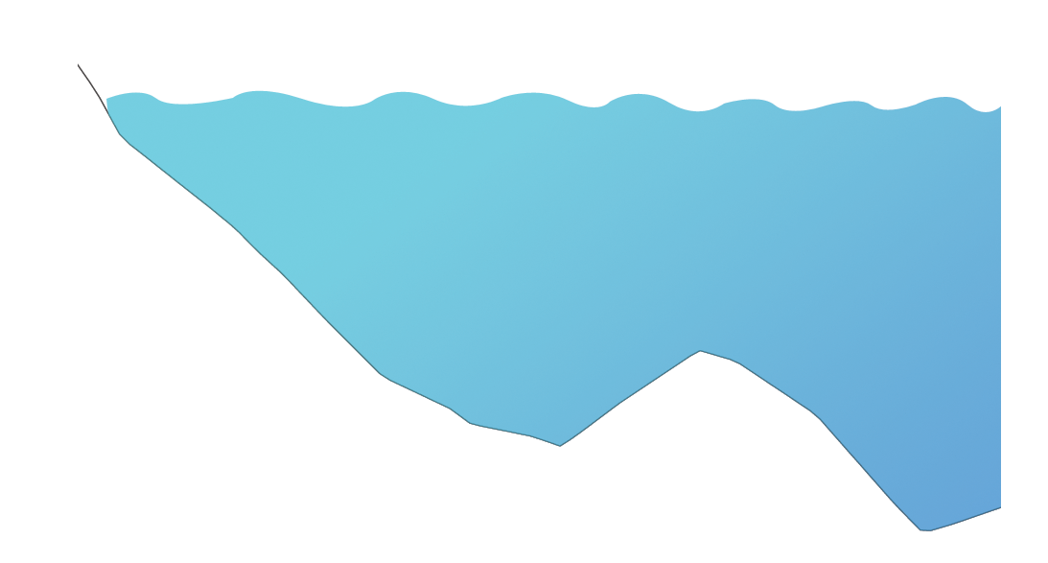
Biogeochemical Rates
HWL
Ridge
LWL

Slide 2
Skin Circulation
HWL
Ridge
LWL

Slide 3
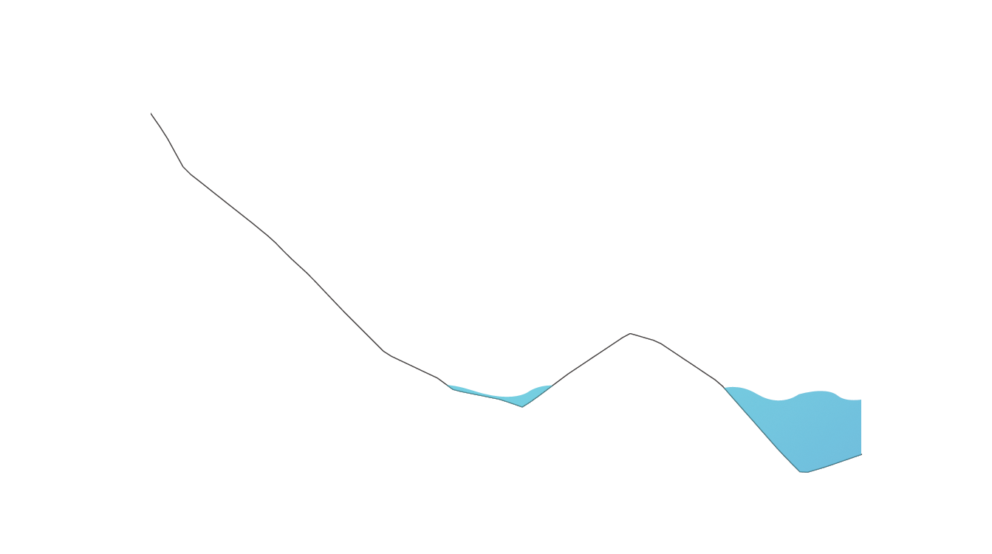
Body Circulation: Low Tide
HWL
HWL
NN
Ridge
LWL
LWL

