Slide 1
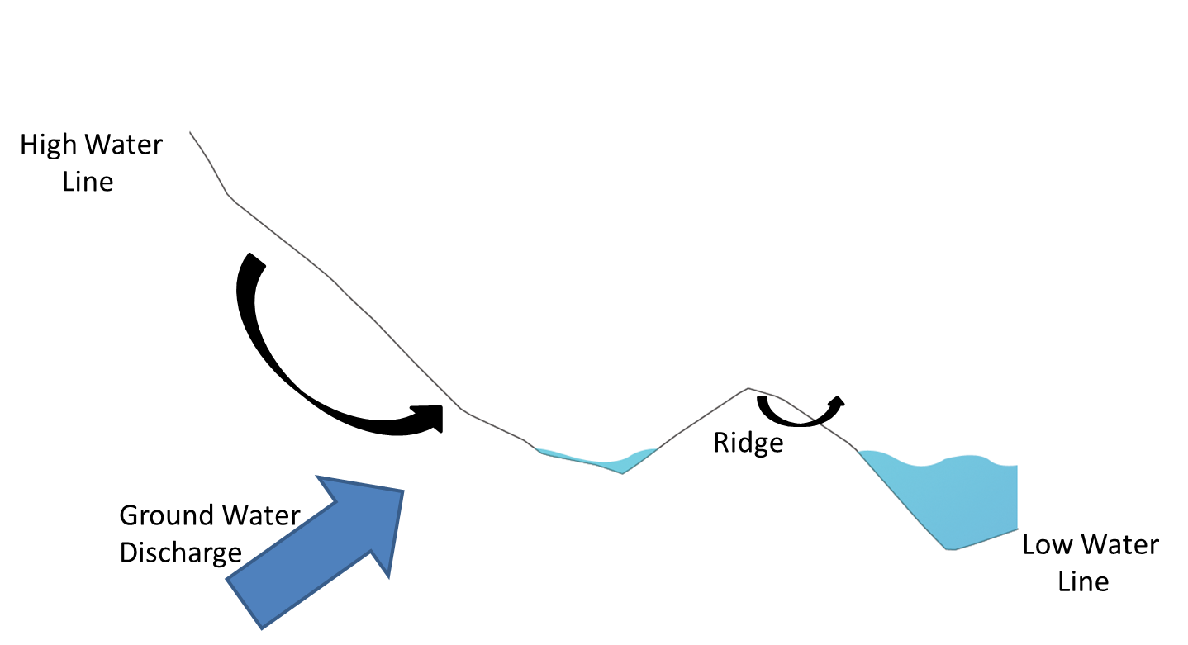
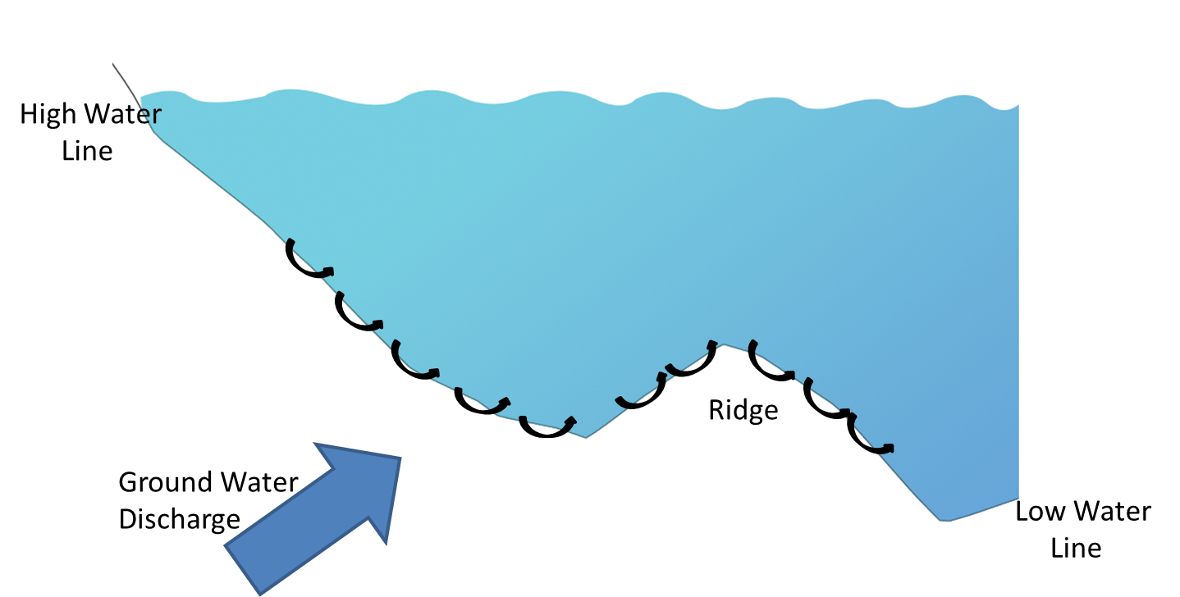
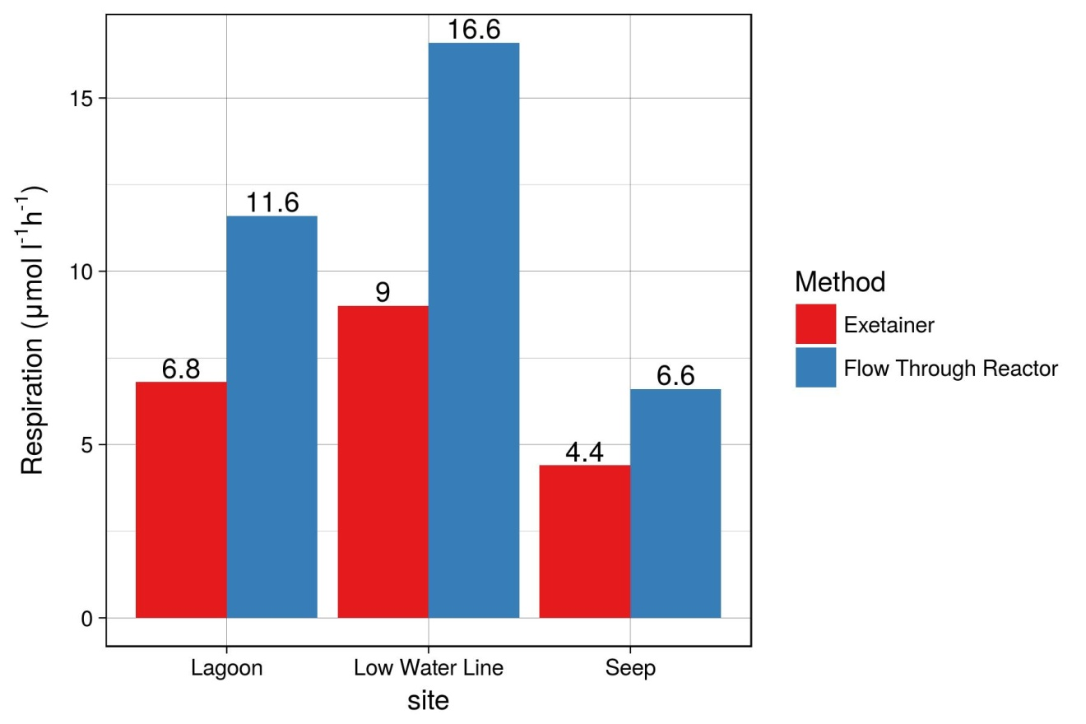
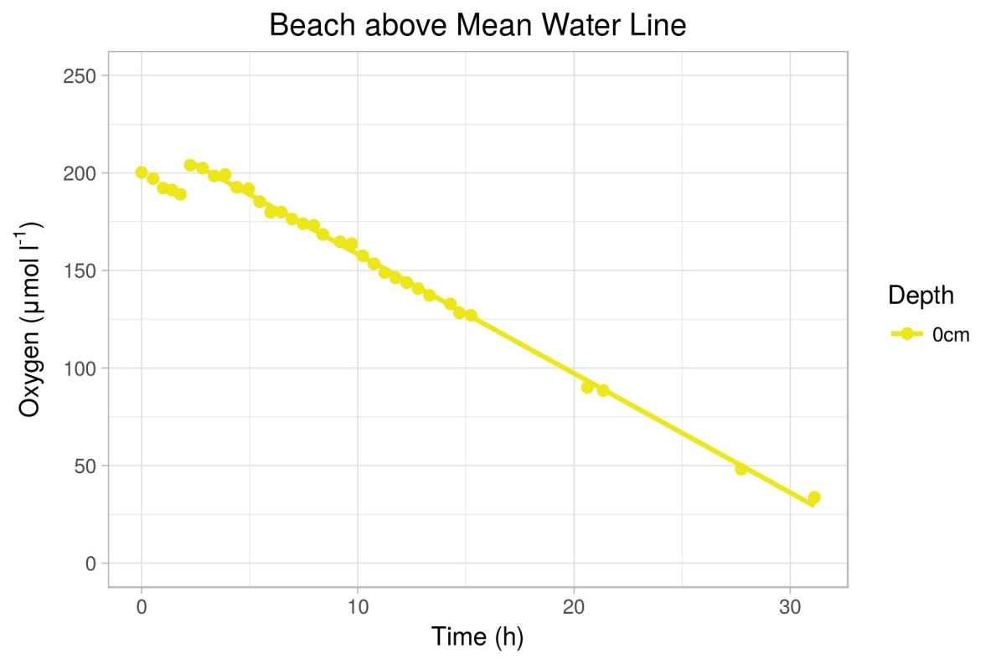
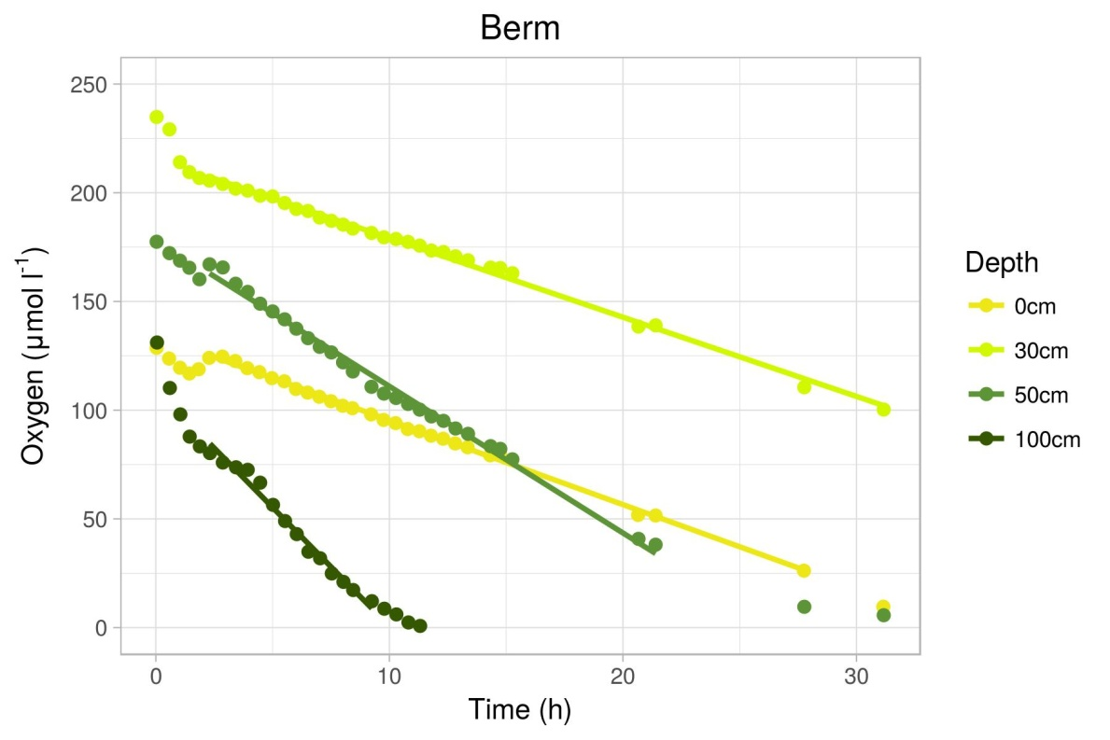
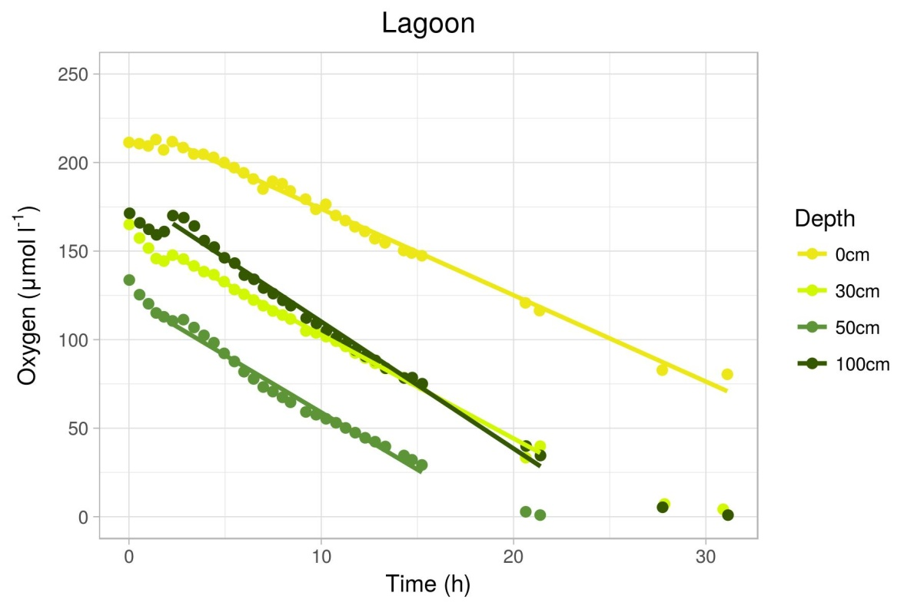
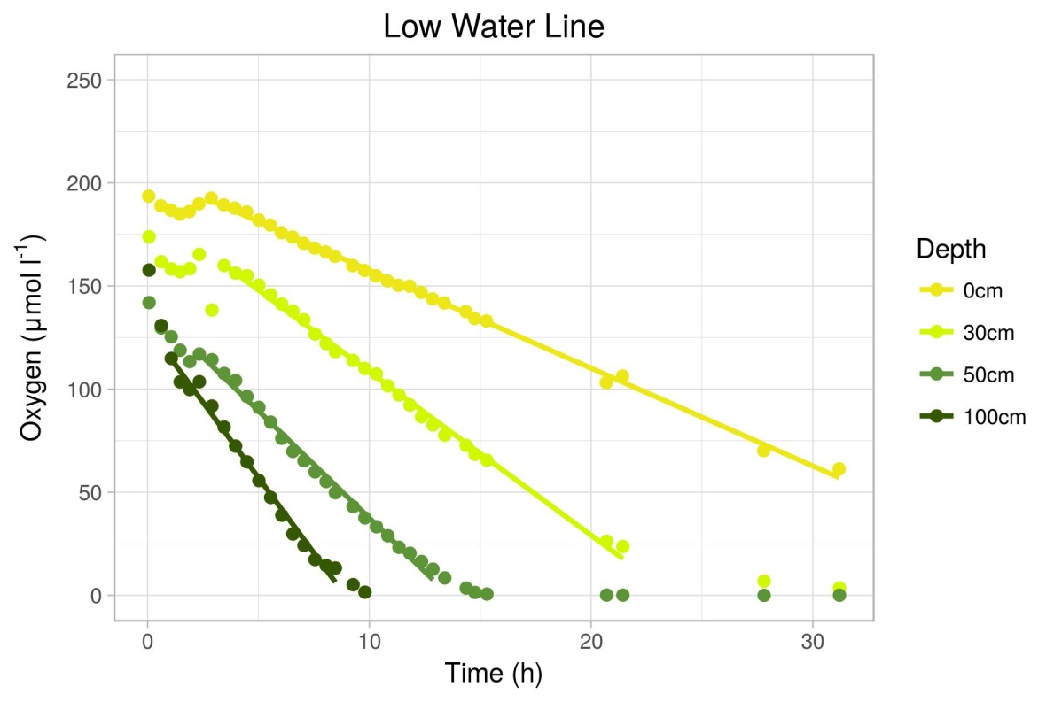
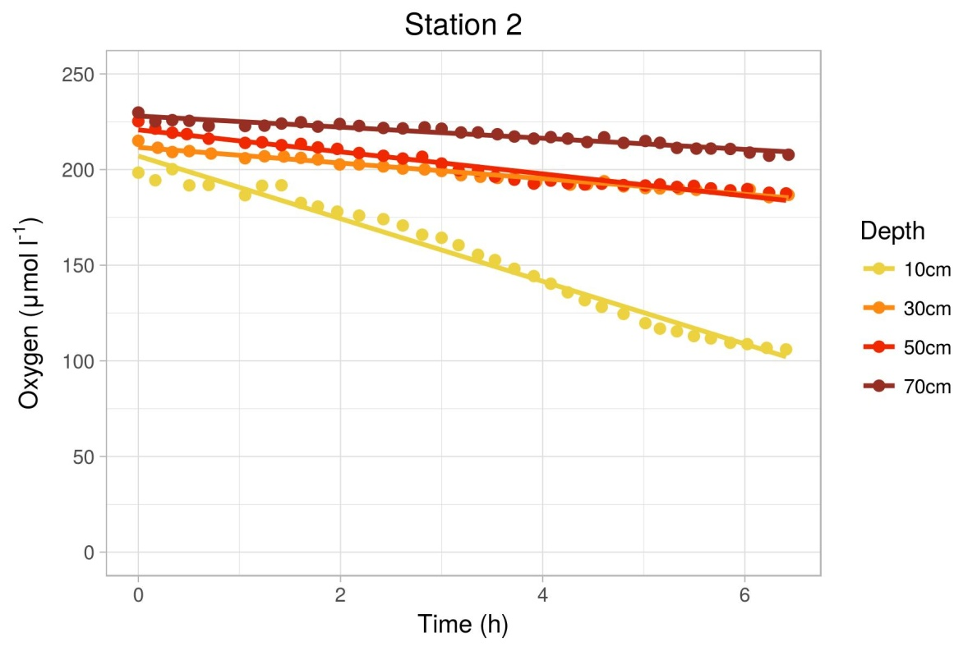
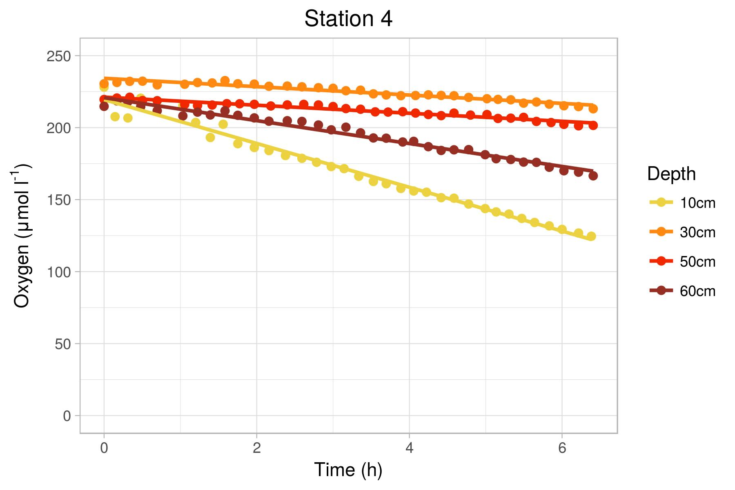
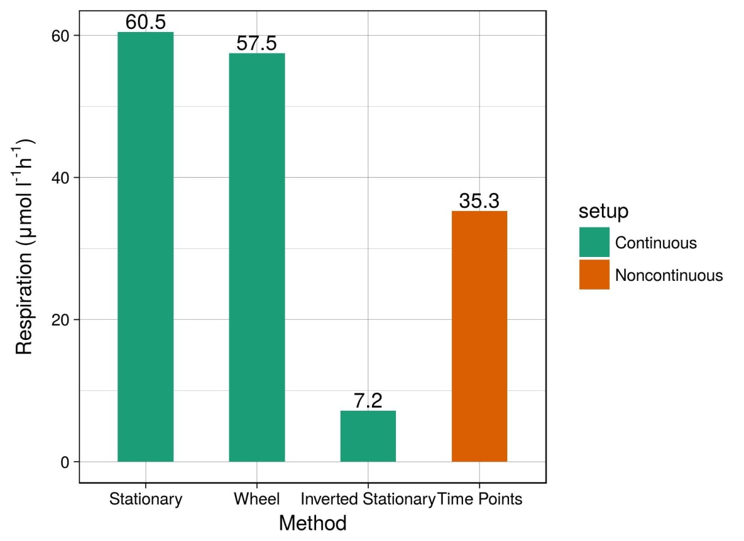
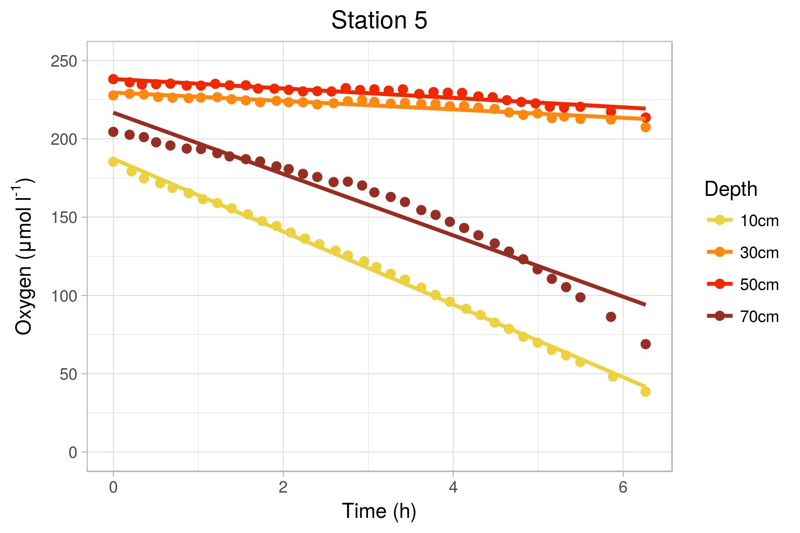
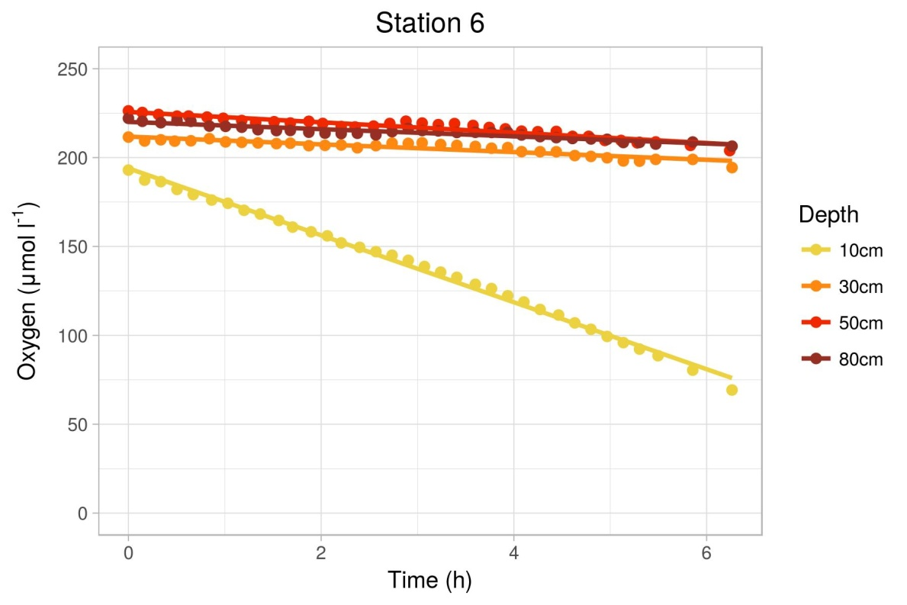
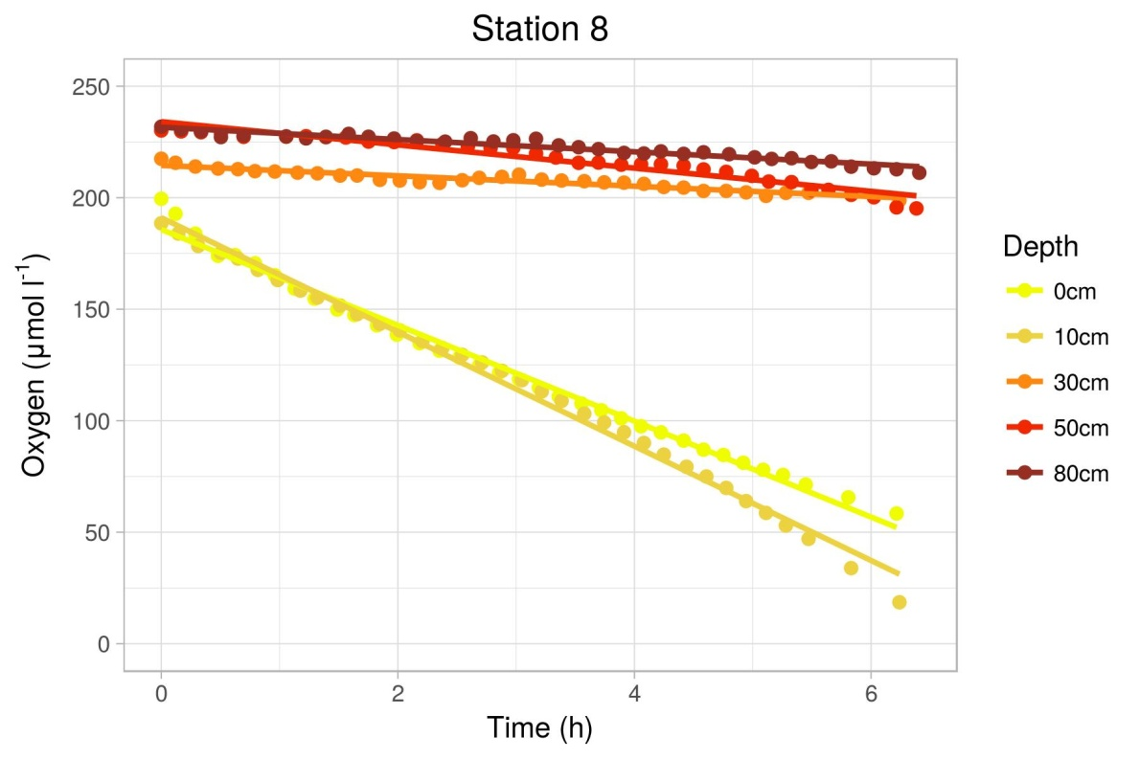
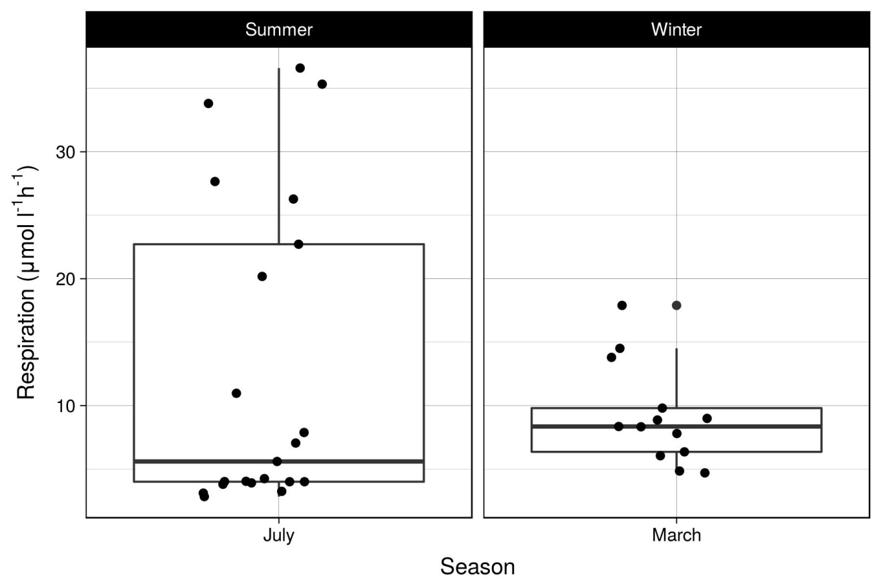
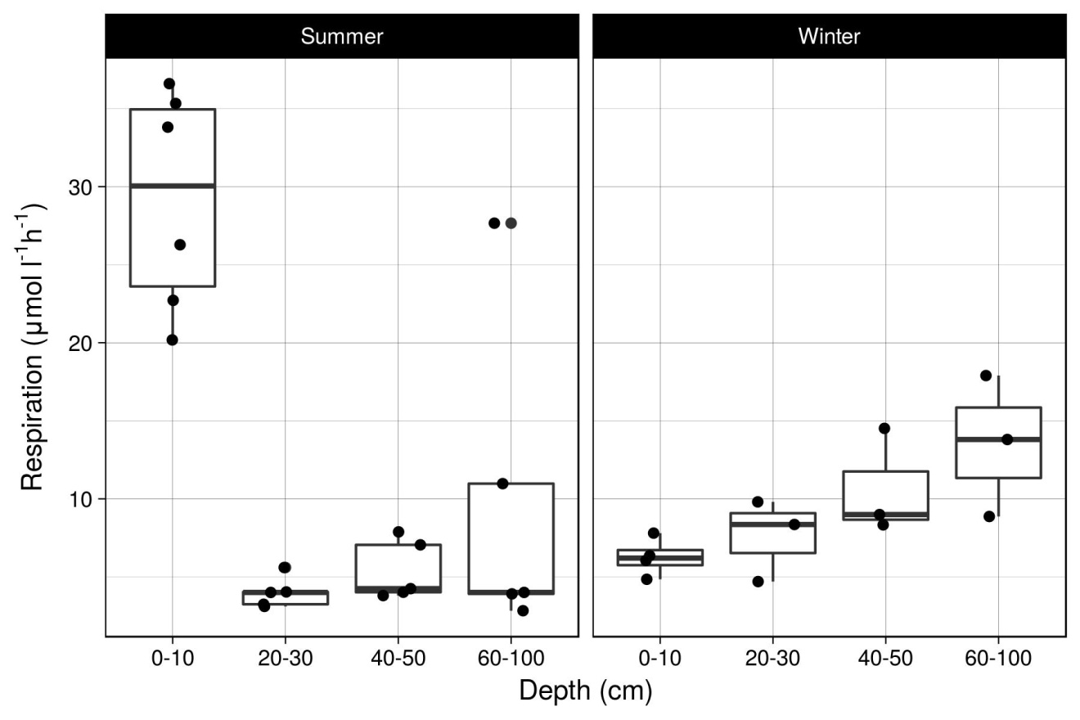
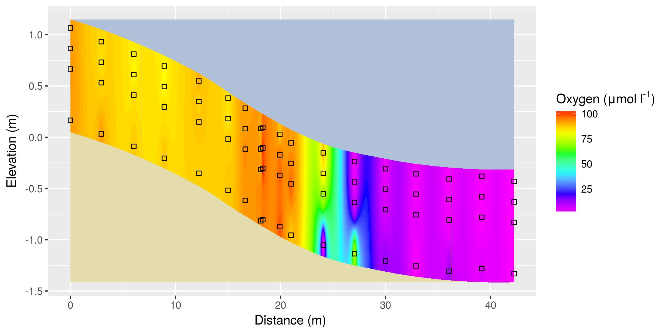
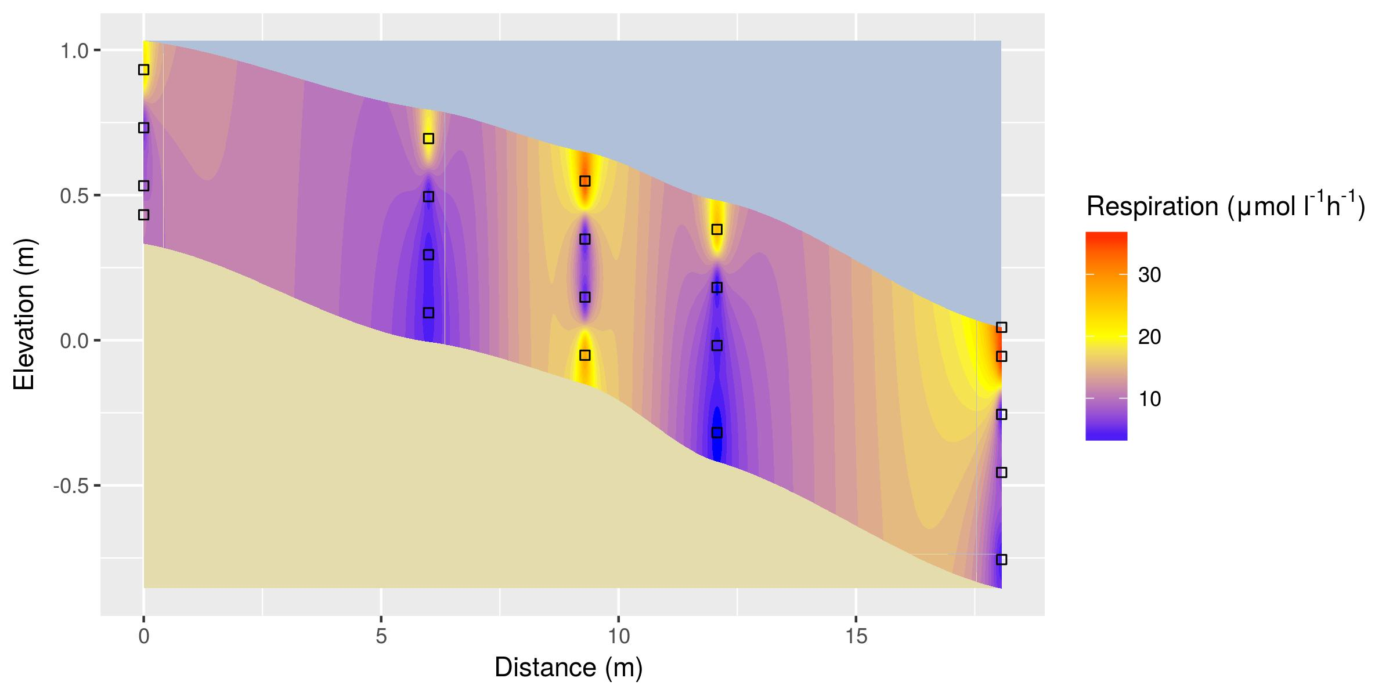
Development of an in situ measurement protocol for volumetric oxygen consumption rates in permeable sediments Kai Blumberg, Soeren Ahmerkamp, Hannah Marchant, Marcel Kuypers Max Planck Institute for Marine Microbiology
Department of Biogeochemistry
INTRODUCTION
Sandy sediments cover up to 70% of continental shelf areas. Characterized by high permeability, sands allow for increased seawater advection, transporting solutes and particles from the water column into the sediment. Sand microbial communities serve as natural bio-catalytic filters, making use of oxygen transported via seawater advection to remineralization organic matter sourced from ground water discharge. Quantification of remineralization rates requires accurate measurements of volumetric respiration rates. Sediment incubated flow-through reactors allow for quantification of such rates by reducing complex transport processes into a measurable one-dimensional concentration gradient. It is, however, unknown how representative such measurements are, as they do not consider in situ heterogeneity or intrinsic sediment characteristics. Thus a novel in situ measurement protocol for volumetric oxygen consumption rates was developed. The objectives of this work were to:
OBJECTIVES
Compare the results of the novel optode-spot exetainer methods with flow-through reactors
Measure volumetric oxygen consumption rates during the winter and summer seasons
Model oxygen profiles and consumption rates along a sandy beach transect
Figure 1A: Low tide body circulation
METHODS
RESULTS
Figure 1B: High tide skin circulation
METHOD COMPARISON
Figure 2A: shows rate measurements derived from flow through reactors (blue) and the novel in situ exetainer optode spot time point reactions (red). Rates derived from the new method appear to be ~60% of those from the previous method (Objective 1).
OXYGEN CONSUMPTION RATES
Winter (Figure 3A) and Summer (Figure 3B) rates were quantified (Objective 2) using the non-continuous manually mixed optode spot exetainer time points method
EXETAINER OPTODE METHOD
Figure 2B: shows a comparison of rates obtained via continuous vs. non-continuous, mixed vs. unmixed measurement setups. Non mixed continuous setups involved either positioning the optode measurement spot over the sediment phase (stationary) or over the porewater filled headspace (Inverted stationary), The continuously mixed setup involved attaching the optode to a spinning wheel to simulate advection (Wheel). The non- continuous mixed setup involved manual inversion preceding measurements (time points).
Figure 3A: Winter oxygen respiration rates
Figure 2A: Exotainer v.s. flow-through reactor method comparison
Figure 2B: Continuous vs. non-continuous exetainer optode method comparison
RESULTS
Figure 3B: Summer oxygen respiration rates
Fig. 4A: Seasonal Oxygen consumption rates
Fig. 4B: Seasonal Oxygen consumption rates
Fig. 5: Interpolated winter oxygen profile along a sandy beach transect Spiekaroog Germany (North Sea).
OUTLOOK
Method comparison:
The novel exetainer optode spot method yields ~60% of the rate obtained via the flow through reactor method.
Manually mixed exotainer time points method yields ~60% of the rate obtained via a continuously mixed wheel setup.
Respiration rates:
Mean winter rate higher than summer, with less variation.
General trend toward higher rates at deeper depths, however, the highest rates at surface depths in the summer.
REFERENCES
Ahmerkamp, S., Winter, C., Krämer, K., Beer, D. de, Janssen, F., Friedrich, J., Kuypers, M.M.M., and Holtappels, M. (2017). Regulation of benthic oxygen fluxes in permeable sediments of the coastal ocean: Regulation of benthic oxygen fluxes. Limnology and Oceanography.
Sawyer, A.H., Michael, H.A., and Schroth, A.W. (2016). From soil to sea: the role of groundwater in coastal critical zone processes: From soil to sea. Wiley Interdisciplinary Reviews: Water 3, 706–726.
Fig. 6: Interpolated summer oxygen consumption rates along a sandy beach transect Spiekaroog Germany (North Sea).

