Slide 1
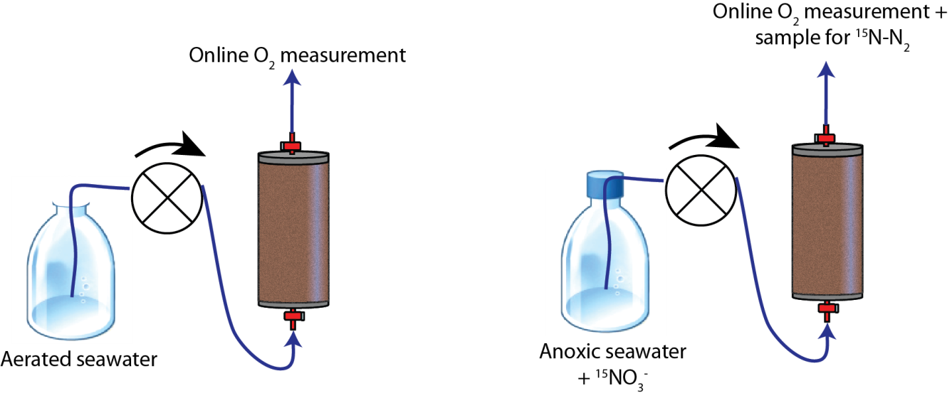
Volumetric Reaction Rates

Slide 2
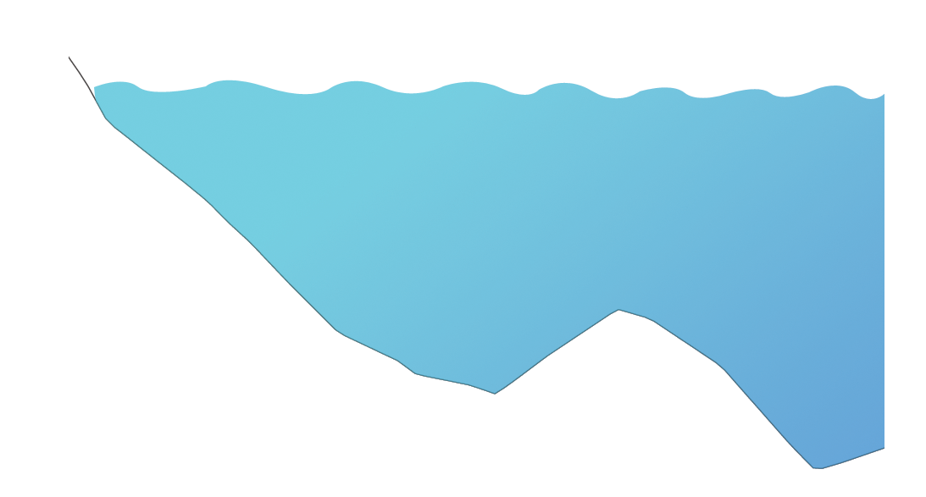
Biogeochemical Rates
HWL
Ridge
LWL

Slide 3
Skin Circulation
High Water
Line
Ridge
Ground Water
Discharge
Low Water
Line

Slide 4
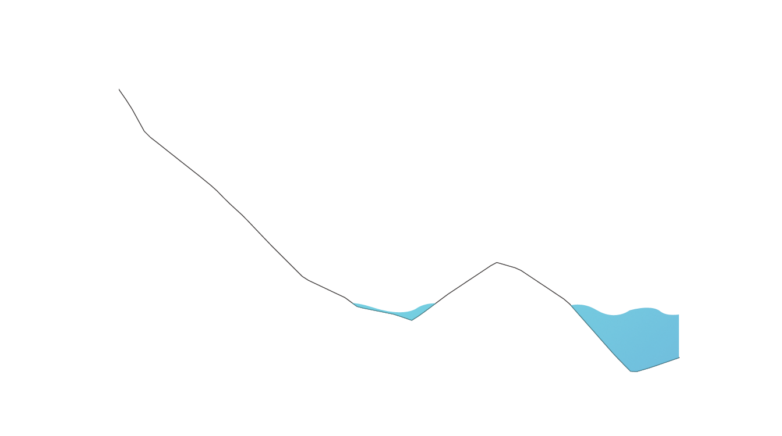
Body Circulation: Low Tide
HWL
High Water
Line
NN
Ridge
Ground Water
Discharge
LWL
Low Water
Line

Slide 5
Skin Circulation: High Tide
High Water
Line
Ridge
Ground Water
Discharge
Low Water
Line

Slide 6
Body Circulation: Low Tide
HWL
High Water
Line
NN
Ridge
Ground Water
Discharge
LWL
Low Water
Line

