Slide 1
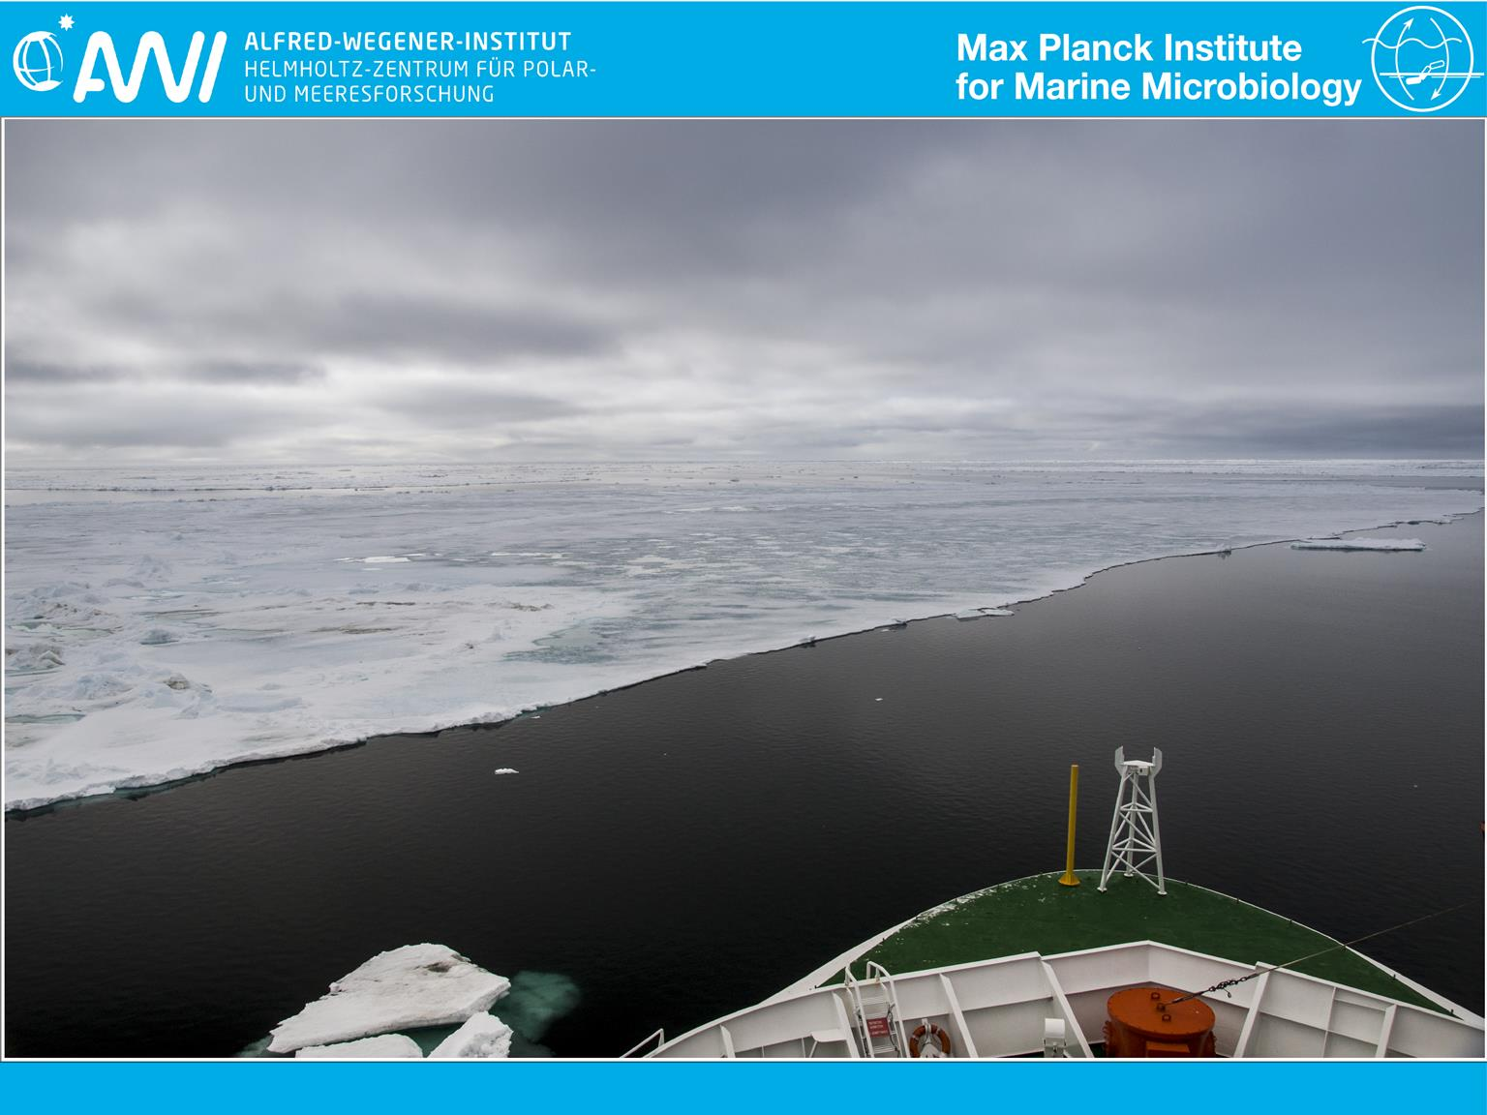
Interconnecting Arctic observatory data through machine-actionable knowledge representation: are ontologies fit for purpose?
Kai Blumberg
Supervisor: Dr. Pier Luigi Buttigieg
Group leader: Prof. Dr. Antje Boetius
Image courtesy of Fadeev et al, 2016: Towards an integrated microbial observatory in the Arctic Ocean 10013/epic.49869. d001
Notes:
1

Slide 2
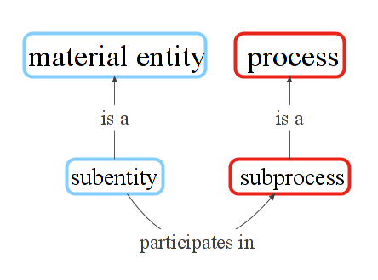
Ontology
Representation of knowledge
knowledge network
machine and human readable
hierarchically structured
connects entities via relations
digital semantic infrastructure
supports data queries
Notes:
2

Slide 3
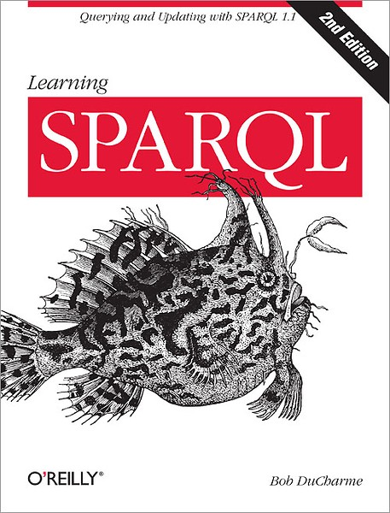
Ontology
Representation of knowledge
knowledge network
machine and human readable
hierarchically structured
connects entities via relations
digital semantic infrastructure
supports data queries
Notes:
3

Slide 4
Outline:
Ontology contributions
PCO examples
Interlinking AWI datasets
Inorganic nutrient & physical oceanography
Competency questions
"Can we find the author of an ontology term and if so give me their contact information?"
"What environments are affected by processes causally downstream of sea ice melting?"
Outlook
Notes:
4

Slide 5
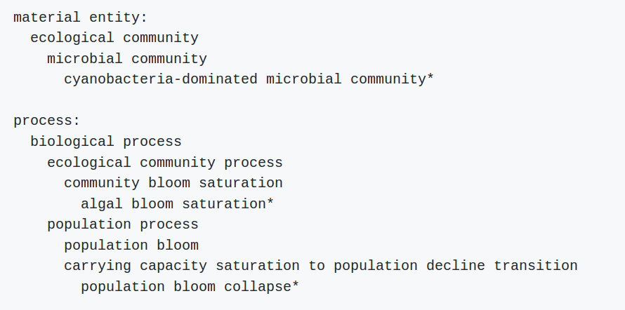
Example PCO contributions
Notes:
5

Slide 6
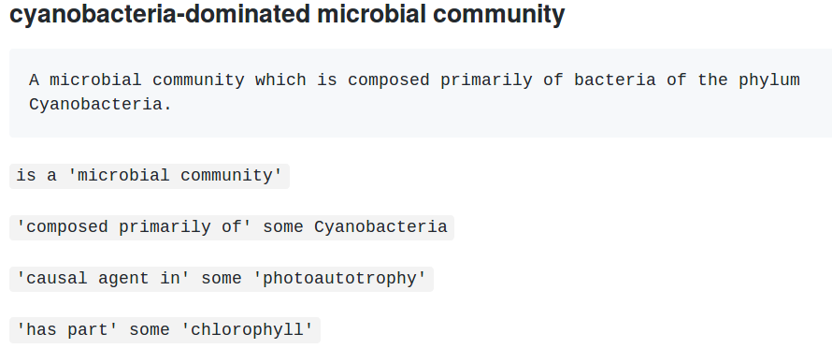
Example PCO contributions
Notes:
6

Slide 7
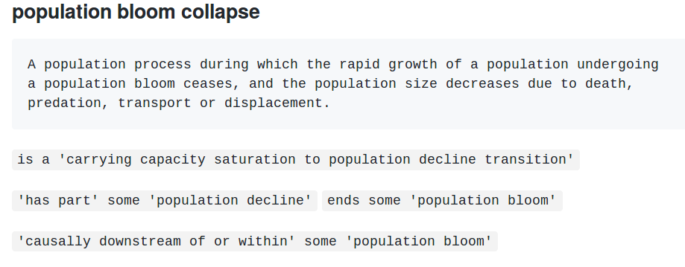
Example PCO contributions
Notes:
7

Slide 8
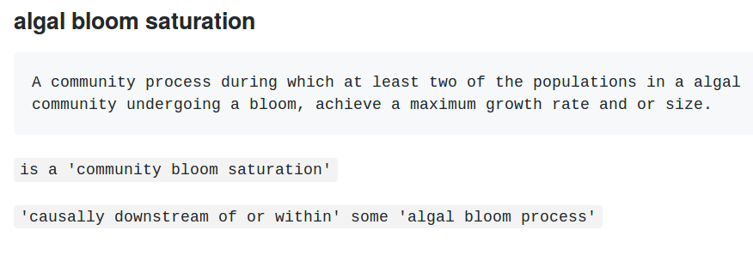
Example PCO contributions
Notes:
8

Slide 9
Interlinking AWI FRAM datasets
Diatom Phenology in the Southern Ocean: Mean Patterns, Trends and the Role of Climate Oscillations, satellite data
Bacterial sequence information
Biogeography and Photosynthetic Biomass of Arctic Marine Pico-Eukaroytes during Summer of the Record Sea Ice Minimum 2012
Biogenic particle flux
Inorganic nutrients
Physical oceanography and currents
Snow height on sea ice
Influence of snow depth and surface flooding on light transmission through Antarctic pack ice, supplementary data
Notes:
9

Slide 10
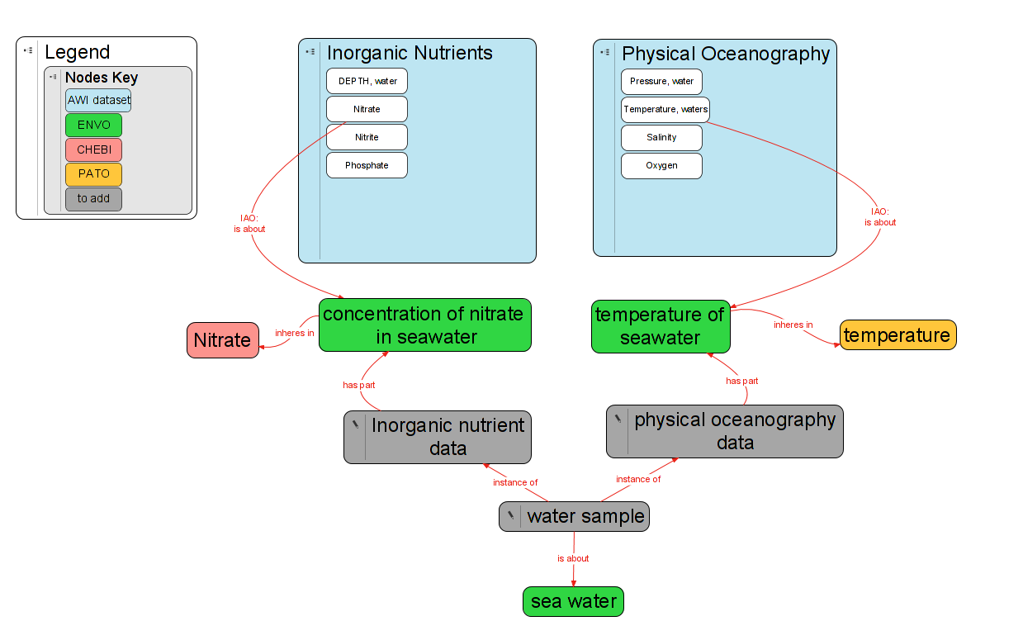
Interlinking AWI datasets
Notes:
10

Slide 11
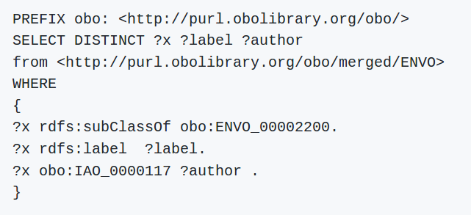
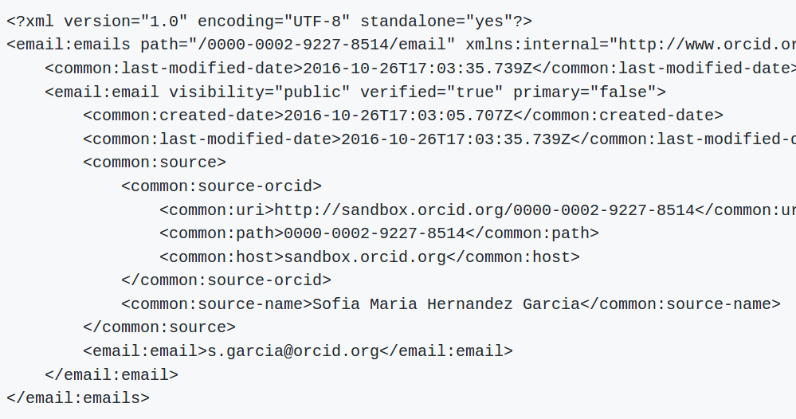
Competency questions
"Can we find the author of an ontology term and if so give me their contact information?"
1 submit sparql query:
3 send
2
4 grep email from:
Notes:
11

Slide 12
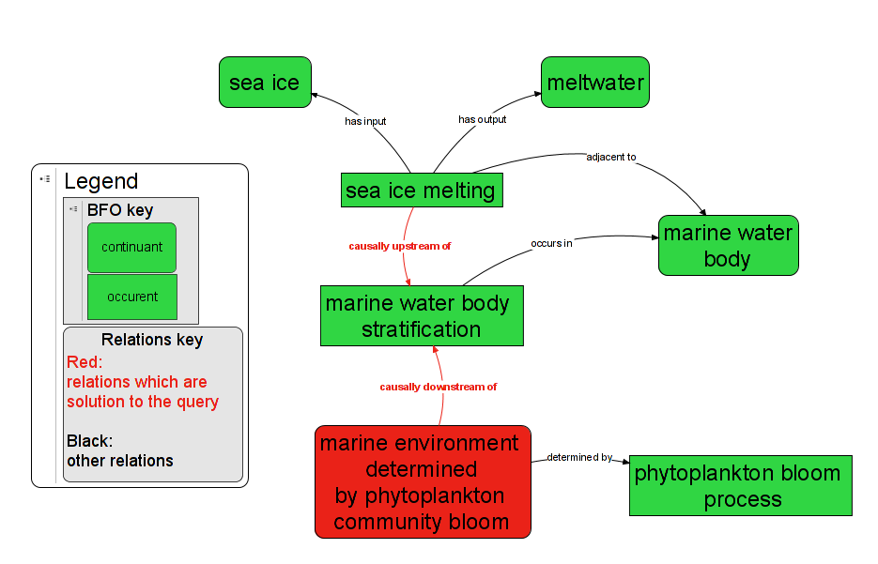
Competency questions
"What environments are affected by processes causally downstream of sea ice melting?"
Notes:
12

Slide 13
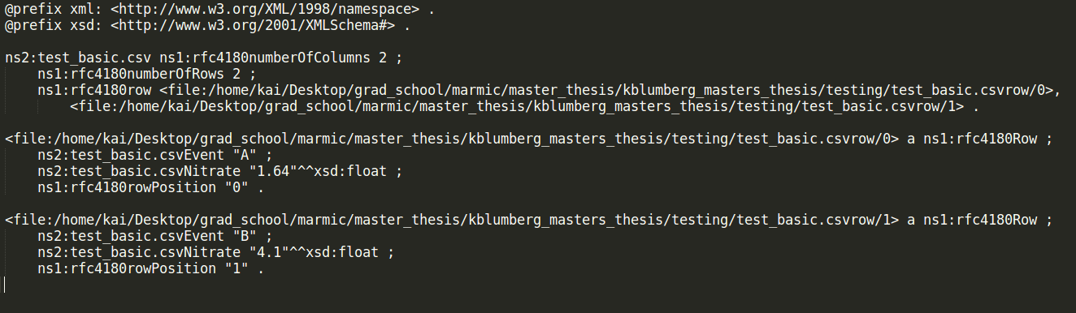
Outlook & next steps
Create local datastore of AWI FRAM data in query-able format
Use ontology terms to link datasets
Perform advanced queries:
“What seawater nitrate data do we have collected within a phytoplankton bloom?”
Demonstrate value in exposing AWI data to the internet in machine readable and searchable manor
Notes:
13

