Slide 1






Interconnecting Marine Biogeochemical and Omics Datasets Through Machine-Actionable Knowledge Representation:
Are Ontology-Enriched Cyberinfrastructure Systems Fit For Purpose?

Slide 2

Outline
Introduction:
Motivation FAIR Data
Ontology
Projects:
Planet Microbe Data Integration
Taxonomy of EBI ENA Biome Classes
Development of OMEGA-C Tool
Ontology-Mobilized Environmental & Genomic Annotation & Comparison Tool

Slide 3

Wilderness of Data
1
11
11
01010111
110011001
11
ARX_343_R.FASTA
10
log.txt
01
Test.csv
TGACGTTACGGTGATCGATTCGCC
Cruise_1_01.01.14.xlsx
10100001010100100010010010100100101010101100010100101001001001001001001
010
110
010
1
10
10
S1_01.NetCDF
010
10
110
Testfile_X.CSV
110011
010010110101001011

Slide 4
Taming the Wilderness
1
11
11
01010111
110011001
Sea_ice_plankton.FASTA
10
11
genome_log.txt
01
irradiance.csv
TGACGTTACGGTGATCGATTCGCC
Inorganic_nutrients.xlsx
10100001010100100010010010100100101010101100010100101001001001001001001
010
110
010
1
10
10
010
10
110
Chlorophyll_a.CSV
Satelite_chlorophyll.NetCDF
110011
010010110101001011

Slide 5
FAIR
To BE INTEROPERABLE:
I1. (meta)data use a formal, accessible, shared, and broadly applicable language for knowledge representation.
I2. (meta)data use vocabularies that follow FAIR principles.
I3. (meta)data include qualified references to other (meta)data.
Wilkinson et al. 2016 Scientific Data

Slide 6
Ontologies
Stronger semantics
A rough illustration of the semantic gradient
Taxonomies
Data models
Controlled
vocabularies
Thesauri
Glossaries
Weaker semantics
Modified from McCreary D (2006)
Patterns of Semantic Integration. CC 2.5

Slide 7

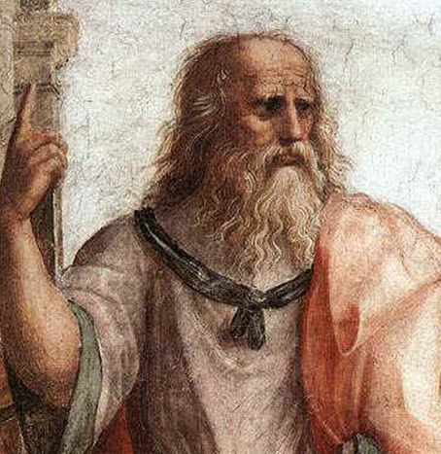





Ontology
~ def. A machine- and human-readable, logical representation of expert knowledge about real-world entities
thing
association
associated thing
7
Notes:
Introduce what an ontology is
There is a well established way to help machines get a naive understanding of the real world by showing it what things are based on its associations to other things. Web of association encode filed ontology, branch of metaphysical classification of things in the world and how they relate to one another, practical to way explain what we mean when we ID things to machines. Knowledge map, basically a knowledge map, good ones conducive to machines navigating by simulating what humans know about data.

Slide 8
Ontology
~ def. A machine- and human-readable, logical representation of expert knowledge about real-world entities
Knowledge Graph
8
Notes:
Introduce what an ontology is
There is a well established way to help machines get a naive understanding of the real world by showing it what things are based on its associations to other things. Web of association encode filed ontology, branch of metaphysical classification of things in the world and how they relate to one another, practical to way explain what we mean when we ID things to machines. Knowledge map, basically a knowledge map, good ones conducive to machines navigating by simulating what humans know about data.

Slide 9

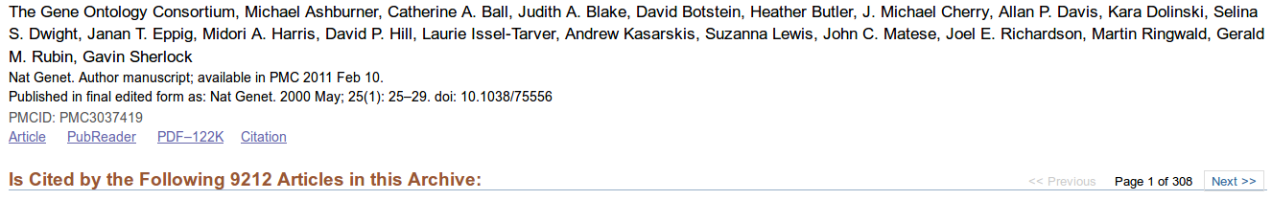
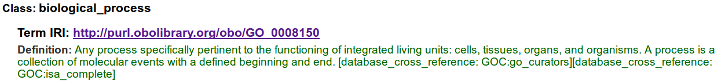
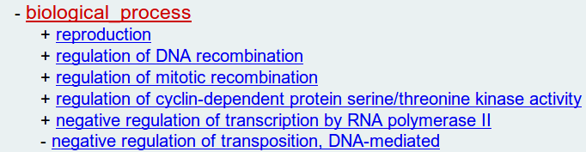
…
Notes:
9

Slide 10

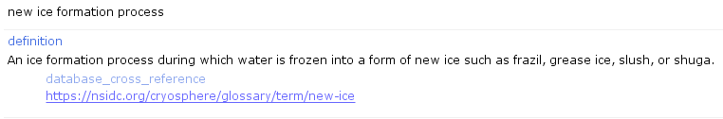
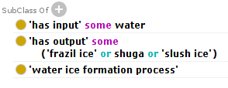
Notes:
10
Knowledge graphs aren’t just picture, engineered with controlled axioms, controlled by another ontology RO -> bring in AI angle, there are AI agents reasoners which check graphs, RO thoroughly checked by logicians,
Take opportunity to show the guts of these to engineer this knowledge have a view diagram (simple first), then simple diagram, then zoom out diagram more complexities, -> semantic science research seeing if our captures of human knowledge withstand AI checks, run test see if
After 3 versions repeat the envo/go /data slide, take a step back we talked about the first two , now we’ll talk about the 3rd part the data that’s been linked.

Slide 11







Planet Microbe Data Integration
Integrate key marine biogeochemical & omics datasets within common cyberinfrastructure
MMETSP
Aim to demonstrate example best practices for community specific cyberinfrastructure

Slide 12
Planet Microbe Data Integration
Making use of & extending OBO Foundry Ontologies to harmonize metadata
MMETSP
ENVO: concentration of nitrate in seawater
TARA: Nitrate µmol/l
HOT_CTD: NITRATE (umol/kg)
BATS: NO31 (Nitrate+Nitrite-1) (umol/kg)
UO: micromole per kilogram

Slide 13
concentration of nitrate in seawater
Definition:
The concentration of oxygen when measured in water.
Axiom:
'concentration of' and
('inheres in' some
(nitrate and
('part of' some 'sea water')))
PATO: Phenotype and Trait Ontology
http://purl.obolibrary.org/obo/PATO_0000033
CHEBI: Chemical Entities of Biological Interest http://purl.obolibrary.org/obo/CHEBI_17632
ENVO: Environment Ontology
http://purl.obolibrary.org/obo/ENVO_00002149
Purl: Permanent Uniform Resource Locator

Slide 14


Taxonomy of EBI ENA Biome Classes
European Bioinformatics Institute
Kmer Frequencies
PFAM
(Known Gene) Frequencies
GC Content
…
Sample | Label | Method 1 | Method 2 | Method 3
1 | A | m1_c1 | m2_c1 | m3_c1
2 | A | m1_c1 | m2_c2 | m3_c1
3 | A | m1_c2 | m2_c3 | m3_c1
4 | B | m1_c3 | m2_c4 | m3_c2
5 | B | m1_c4 | m2_c4 | m3_c2
6 | C | m1_c2 | m2_c1 | m3_c3
7 | C | m1_c5 | m2_c5 | m3_c3
ENVO term
e.g. marine benthic biome
Unknown Putative Gene Frequencies
…

Slide 15
Example Hierarchal Clustering
Sample | Label | Method 1 | Method 2 | Method 3
1 | A | m1_c1 | m2_c1 | m3_c1
2 | A | m1_c1 | m2_c2 | m3_c1
3 | A | m1_c2 | m2_c3 | m3_c1
4 | B | m1_c3 | m2_c4 | m3_c2
5 | B | m1_c4 | m2_c4 | m3_c2
6 | C | m1_c2 | m2_c1 | m3_c3
7 | C | m1_c5 | m2_c5 | m3_c3
Method 1:
K means
K = # of labels
Method 3:
Samples:
1 2 3 6 4 5 7
0
100
Labels:
A A A C B B C
Samples:
1 2 6 3 7 4 5
Labels:
A A C A C B B
Method 2:
Ontology Term Hierarchy:
A
Discovered A subclass
B
C
Putative Taxonomy of Ecosystems:
Samples:
1 6 2 3 4 5 7
Putative novel uncharacterized environment
Labels:
A C A C B B C
15

Slide 16
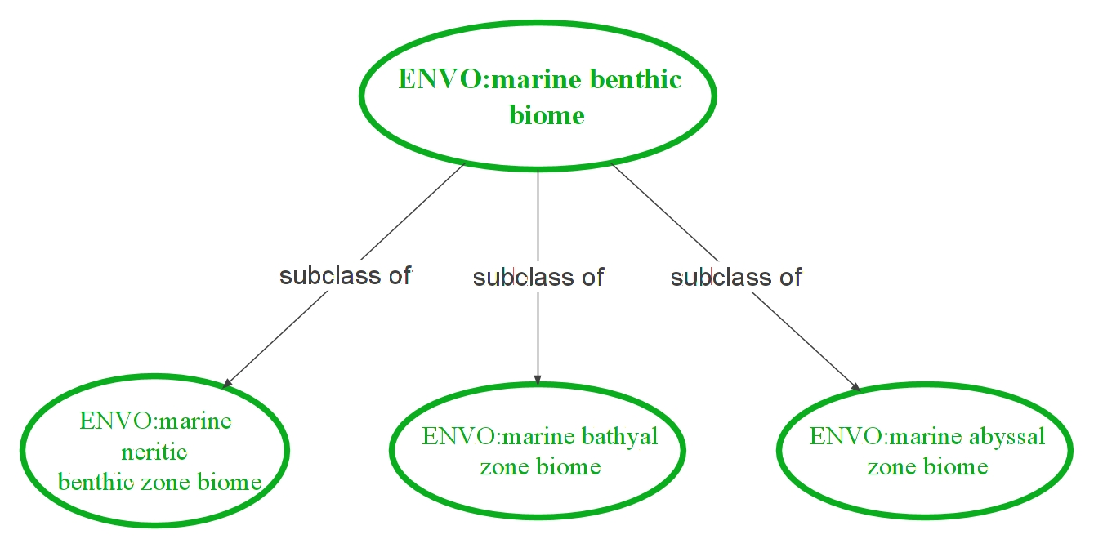
OMEGA-C Tool
Ontology-Mobilized Environmental & Genomic Annotation & Comparison Tool
Ask questions:
“What molecular functions differentiate various types of marine benthic biomes
ENVO
Search knowledge graph for omics data ‘about’ terms from an ENVO hierarchy
Data
Data
Data
Find and prepare omics data from knowledge graph such as Planet Microbe
GO
ORF prediction
ORF annotation
Conversion to GO terms
Creation of GO term frequency matrix
Select GO term hierarchies as features for machine learning analysis
Maximize signal to noise ratio which GO terms maximally differentiate ENVO groups
Report back GO term hierarchies hypothesized to be real differentiable signal

Slide 17

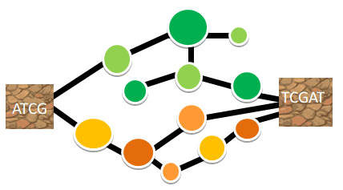
“What biological processes differentiate various types of marine benthic biomes?”
?
Notes:
17
*note this applies only for marine benthic biomes for which we have examples present in the dataholdings

Slide 18
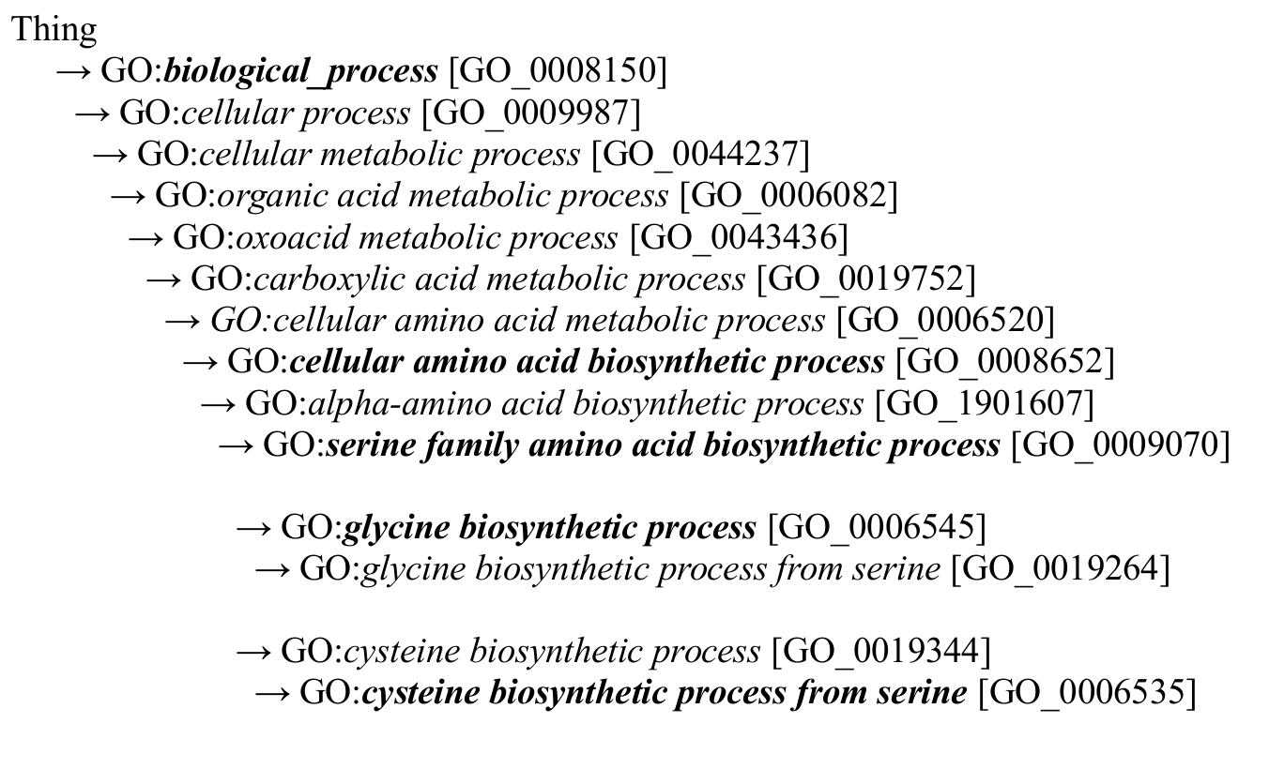
GO:biological_process Hierarchy

Slide 19
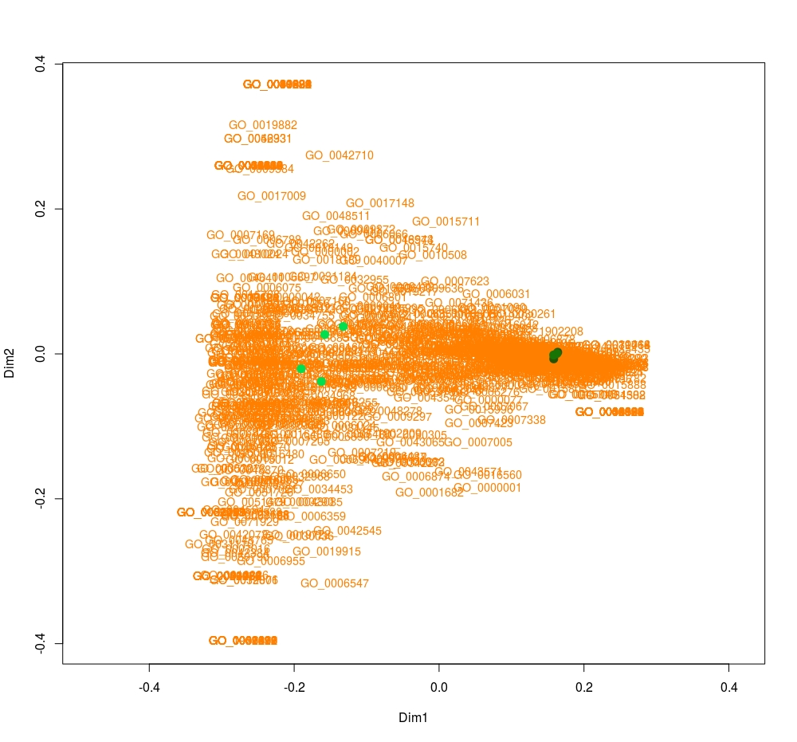
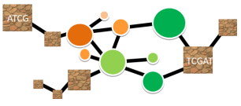
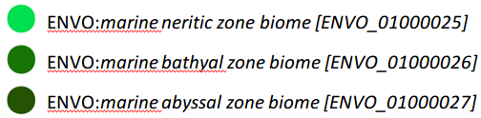
Example: “What biological processes differentiate various types of marine benthic biomes?”
?
ENVO:marine neritic zone biome
GO:respiratory electron transport chain [GO_0022904]
GO:intracellular protein transport [GO_0006886]
GO:response to arsenic-containing substance [GO_0046685]
Notes:
19

Slide 20
Example: “What biological processes differentiate various types of marine benthic biomes?”
?
ENVO: marine abyssal zone biome and ENVO: marine bathyal zone biome
GO:tyrosine biosynthetic process [GO_0006571]
GO:2’-deoxyribonucleotide metabolic process [GO_0009394]
GO:organic phosphonate metabolic process [GO_0019634]
Notes:
20

Slide 21
“What cellular amino acid biosynthetic processes differentiate marine benthic biomes?”
?
Notes:
21
*note this applies only for marine benthic biomes for which we have examples present in the dataholdings

Slide 22
GO:biological_process Hierarchy

Slide 23
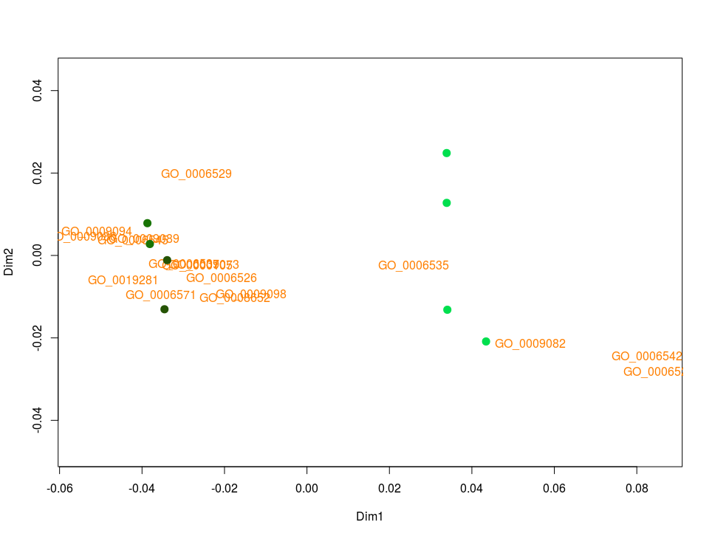
“What cellular amino acid biosynthetic processes differentiate marine benthic biomes?”
?
ENVO:marine neritic zone biome
GO:cysteine biosynthetic process from serine [GO_0006535]
GO:branched-chain amino acid biosynthetic process [GO_0009082]
GO:leucine biosynthetic process [GO_0009098]
Notes:
23

Slide 24
“What cellular amino acid biosynthetic processes differentiate marine benthic biomes?”
?
ENVO: marine abyssal zone biome and ENVO: marine bathyal zone biome
GO:lysine biosynthetic process via diaminopimelate [GO_0009089]
GO:glutamate biosynthetic process [GO_0006537]
GO:glycine biosynthetic process [GO_0006545]
24
Notes:
24

Slide 25
“What serine family amino acid biosynthetic processes differentiate marine benthic biomes?”
?
Notes:
25
*note this applies only for marine benthic biomes for which we have examples present in the dataholdings

Slide 26
GO:biological_process Hierarchy

Slide 27

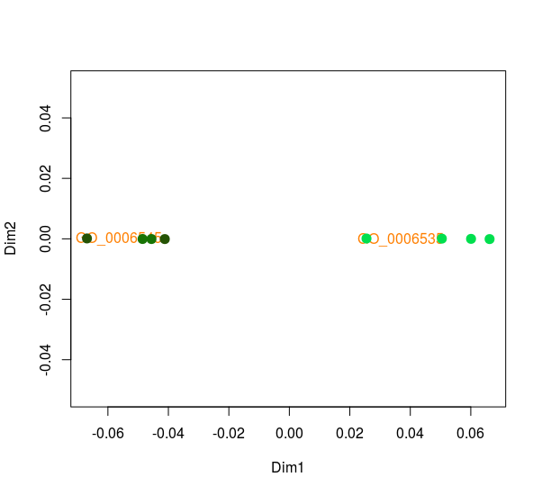
“What serine family amino acid biosynthetic processes differentiate marine benthic biomes?”
?
ENVO:marine neritic zone biome
GO:cysteine biosynthetic process from serine [GO_0006535]
ENVO: marine abyssal zone biome and ENVO: marine bathyal zone biome
GO:glycine biosynthetic processes [GO_0006545]
Notes:
27

Slide 28

Acknowledgments
Hurwitz Lab
Dr. Bonnie Hurwitz (University of Arizona)
Ken Youens-Clark (University of Arizona)
Dr. Alise Ponsero (University of Arizona)
Potential Committee Members
Dr. Pier Luigi Buttigieg (Alfred Wegener Institute)
Dr. Scott Saleska (University of Arizona)
Dr. Clayton Morrison (University of Arizona)
Dr. Jana U’Ren (University of Arizona)
Additional Collaborators
Dr. Ramona Walls (CYVERSE, University of Arizona)
Some slides partially adapted from the presentation: Ontological support for the EBVs, courtesy of Pier Luigi Buttigieg https://creativecommons.org/licenses/by/2.0/legalcode

Slide 29

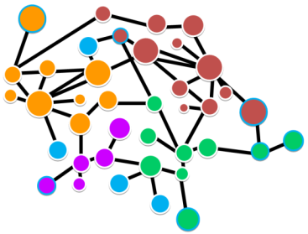



Questions?

Slide 30
Title
A

