Slide 1
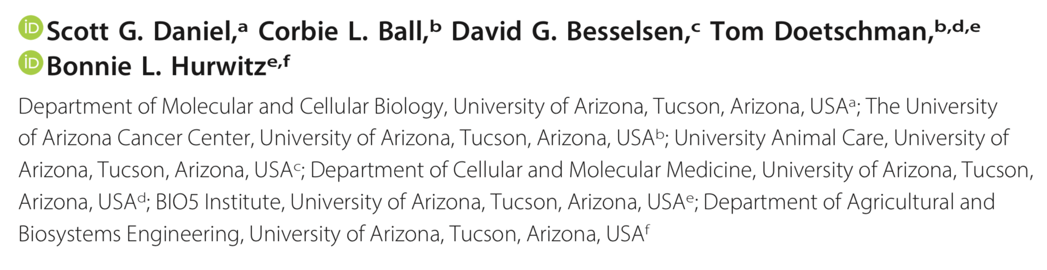

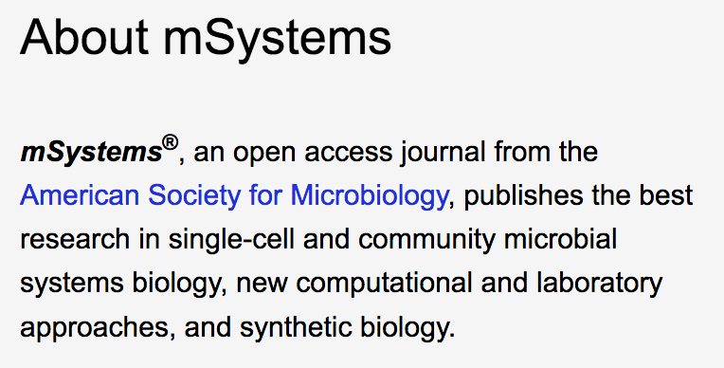
Functional Changes in the Gut Microbiome Contribute to Transforming Growth Factor 􏰀-Deficient Colon Cancer

Slide 2
Motivation
To learn more about Colorectal cancer (CRC) one of the most treatable cancer types yet is still responsible for a death rate of over 50,000 per year in the United States.
To examine functional shifts in the gut microbiome in CRC using integrated ‘omics’ approaches to untangle the role of host genotype, inflammation, and microbial ecology

Slide 3
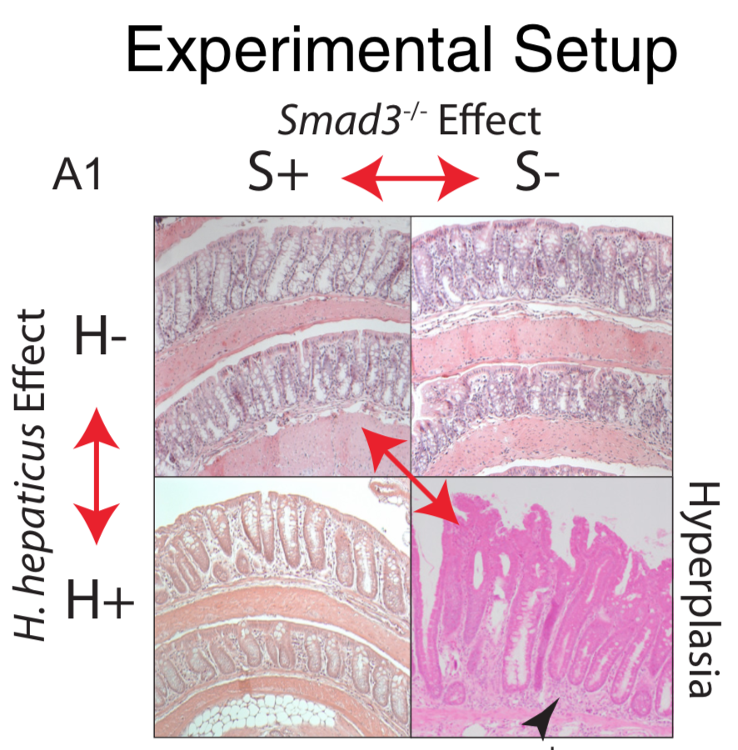
Methods
Obtained mice with/without a Smad3- knockout mutation
Infected mice with Helicobacter hepticus
Employed quantitative real time polymerase chain reaction (qRT-PCR)
Collected and sequenced DNA and RNA from the mice populations
Employed bioinformatic pipelines

Slide 4
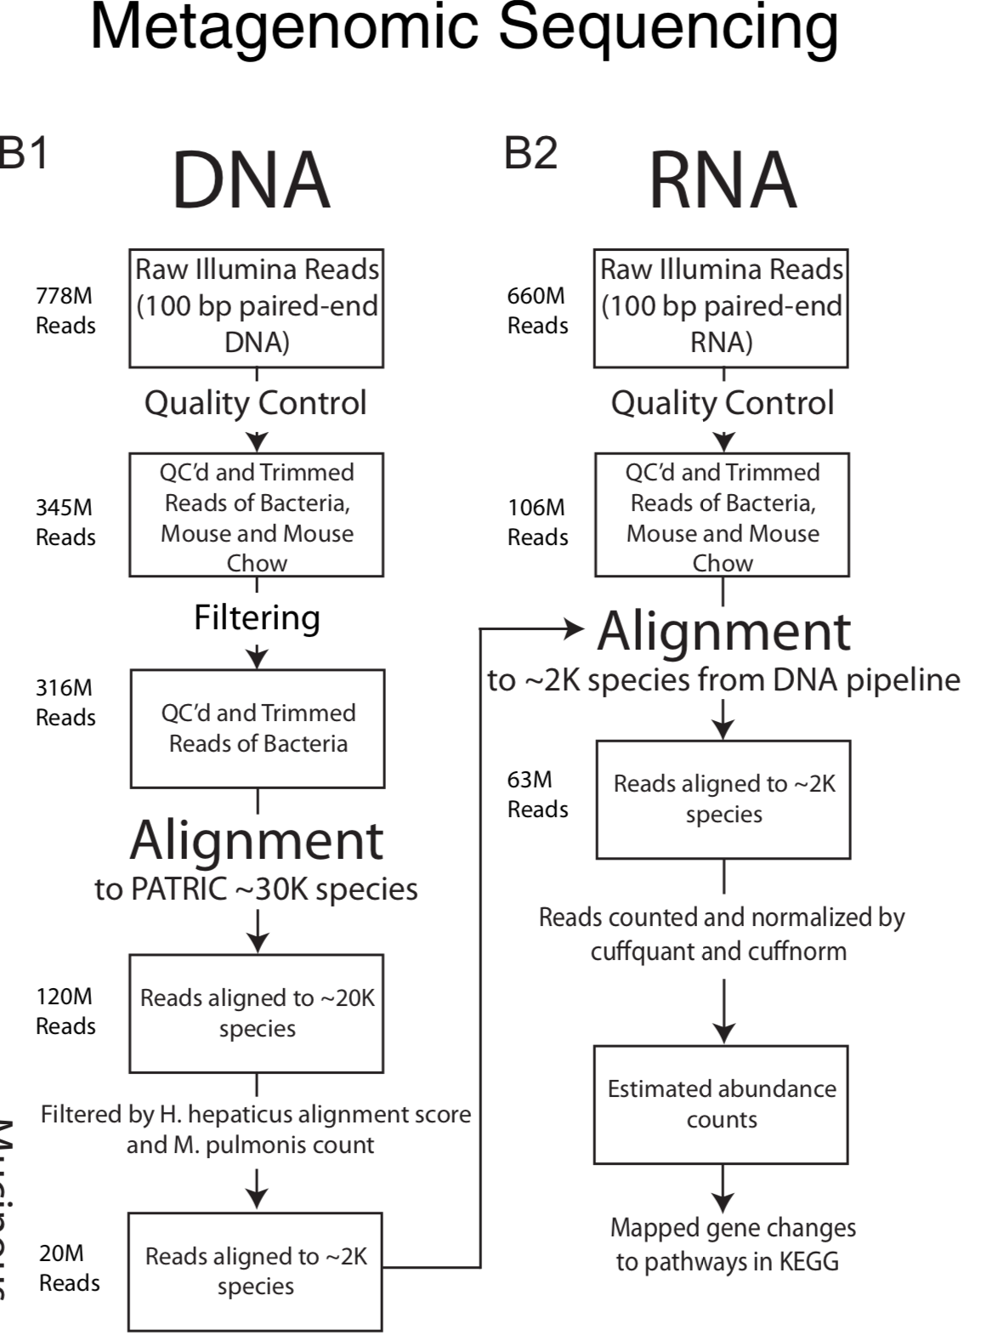
Bioinformatic methods
RNA and DNA was quality controlled, then bacterial fraction was separated from host.
Reads aligned to known bacterial genomes in PATRIC database using Taxoner64 DNA Alignment used minimum cutoff from H. hepaticus (positive control) and maximum count equal to Mycoplasma pulmonis (negative control)
RNA alignment using Bowtie2 quantified/normalized with cuffquant/cuffnorm
Remaining reads were mapped to Kyoto Encyclopedia of Genes and Genomes (KEGG) pathways

Slide 5
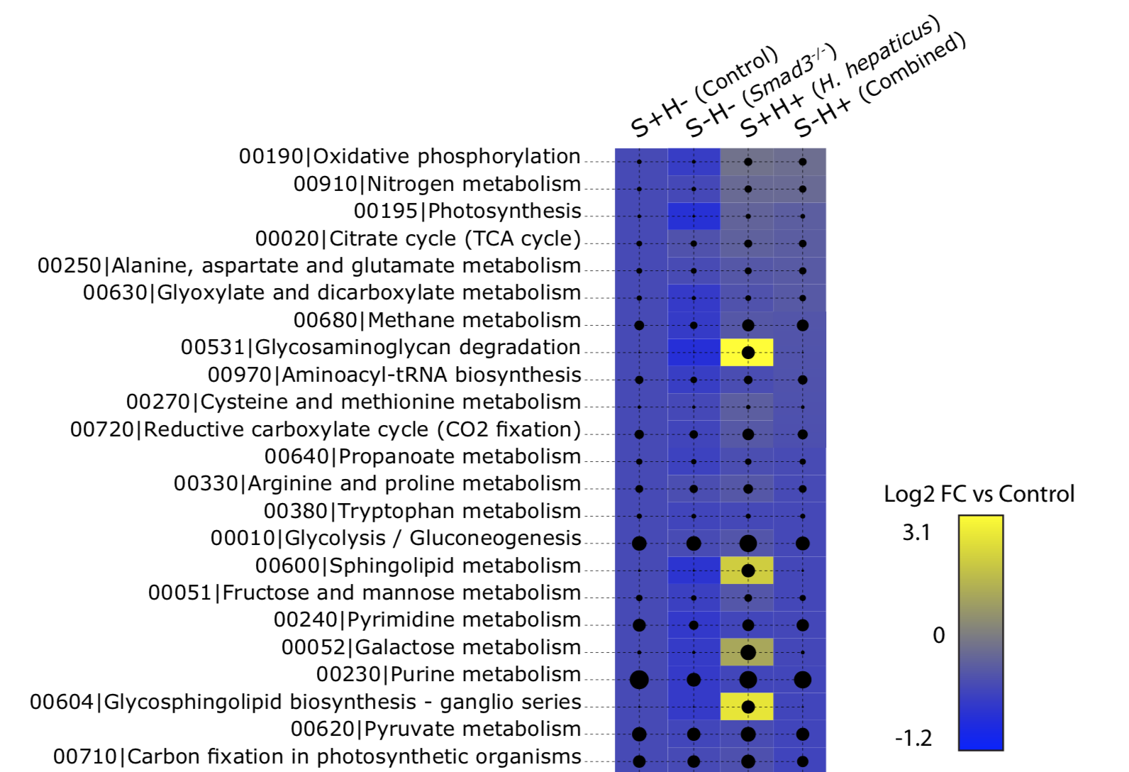
estimated expression by KEGG pathway
Examined the
top 37 pathways
with the highest
overall RNA counts
...

Slide 6
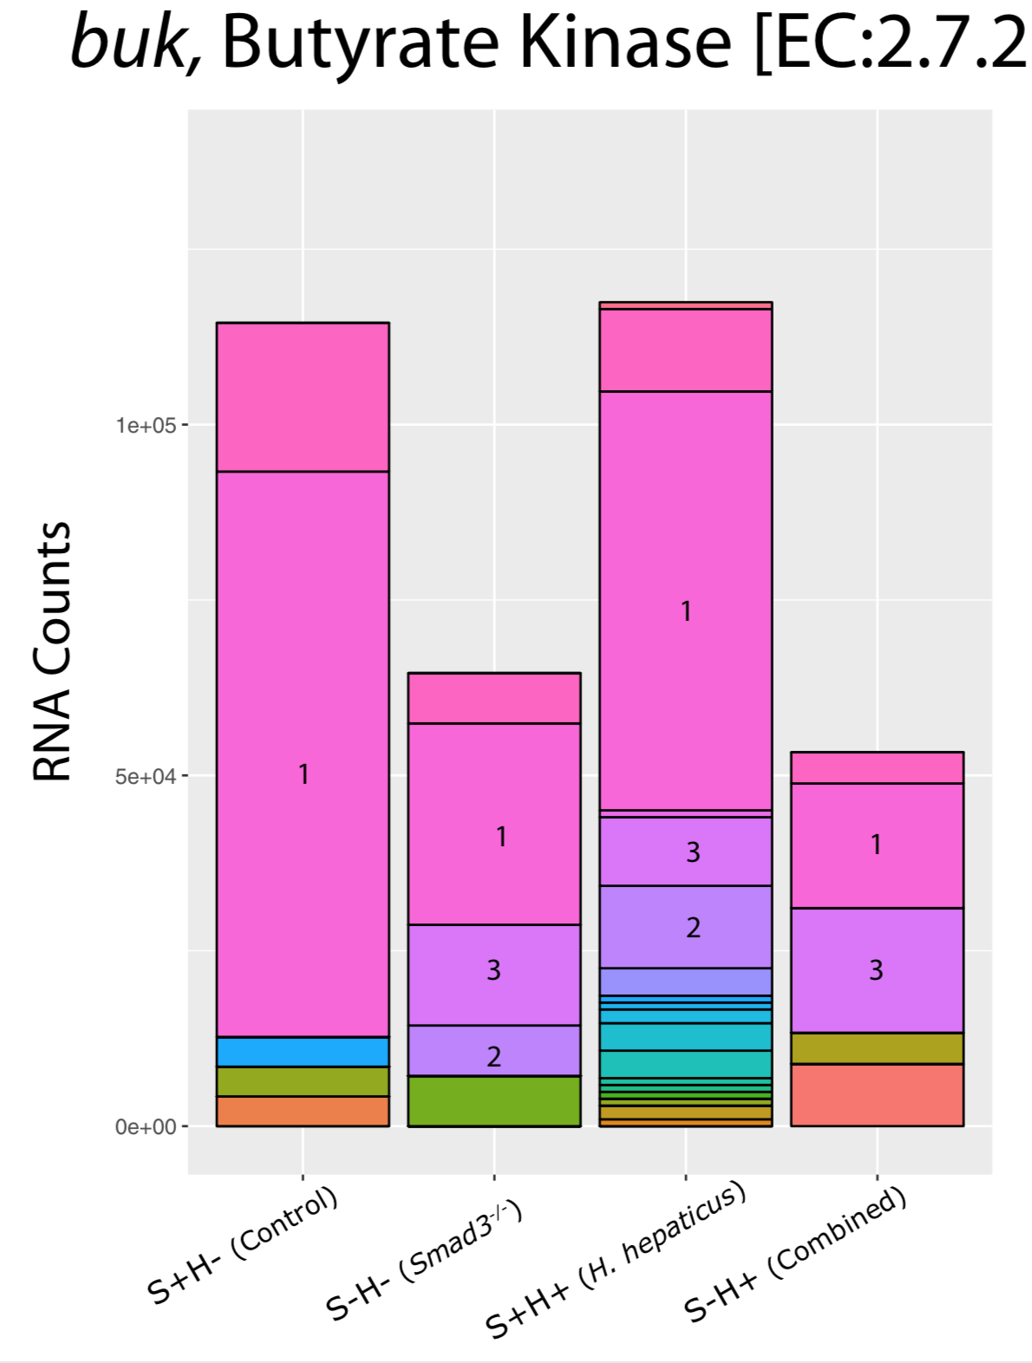

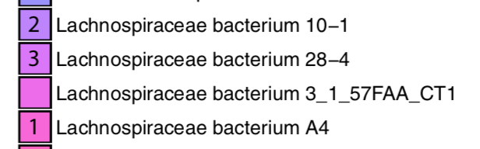
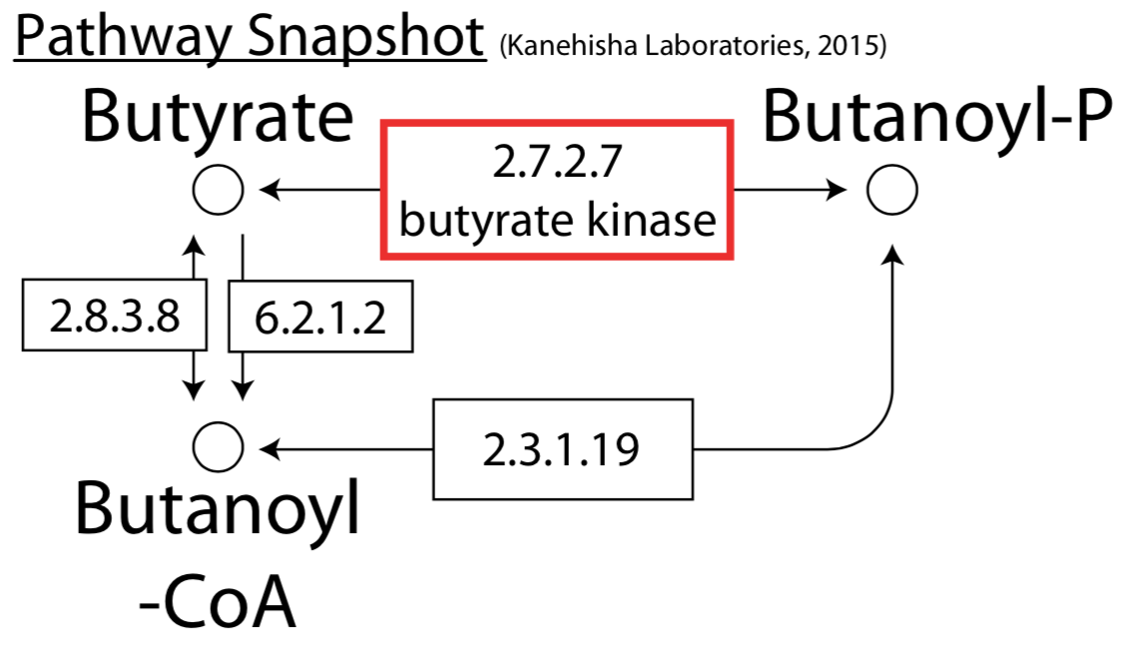
Butyrate metabolism
Buk, a key butyrate gene,
found to reduce RNA counts
in the Smad3^{􏰅-􏰅} and combined effects
Lachnospiraceae bacterium A4 responsible for
decreased RNA counts of butyrate kinase

Slide 7
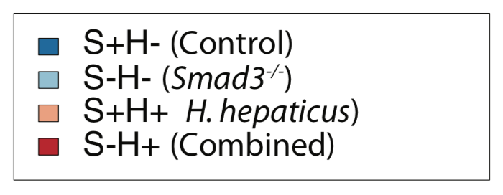
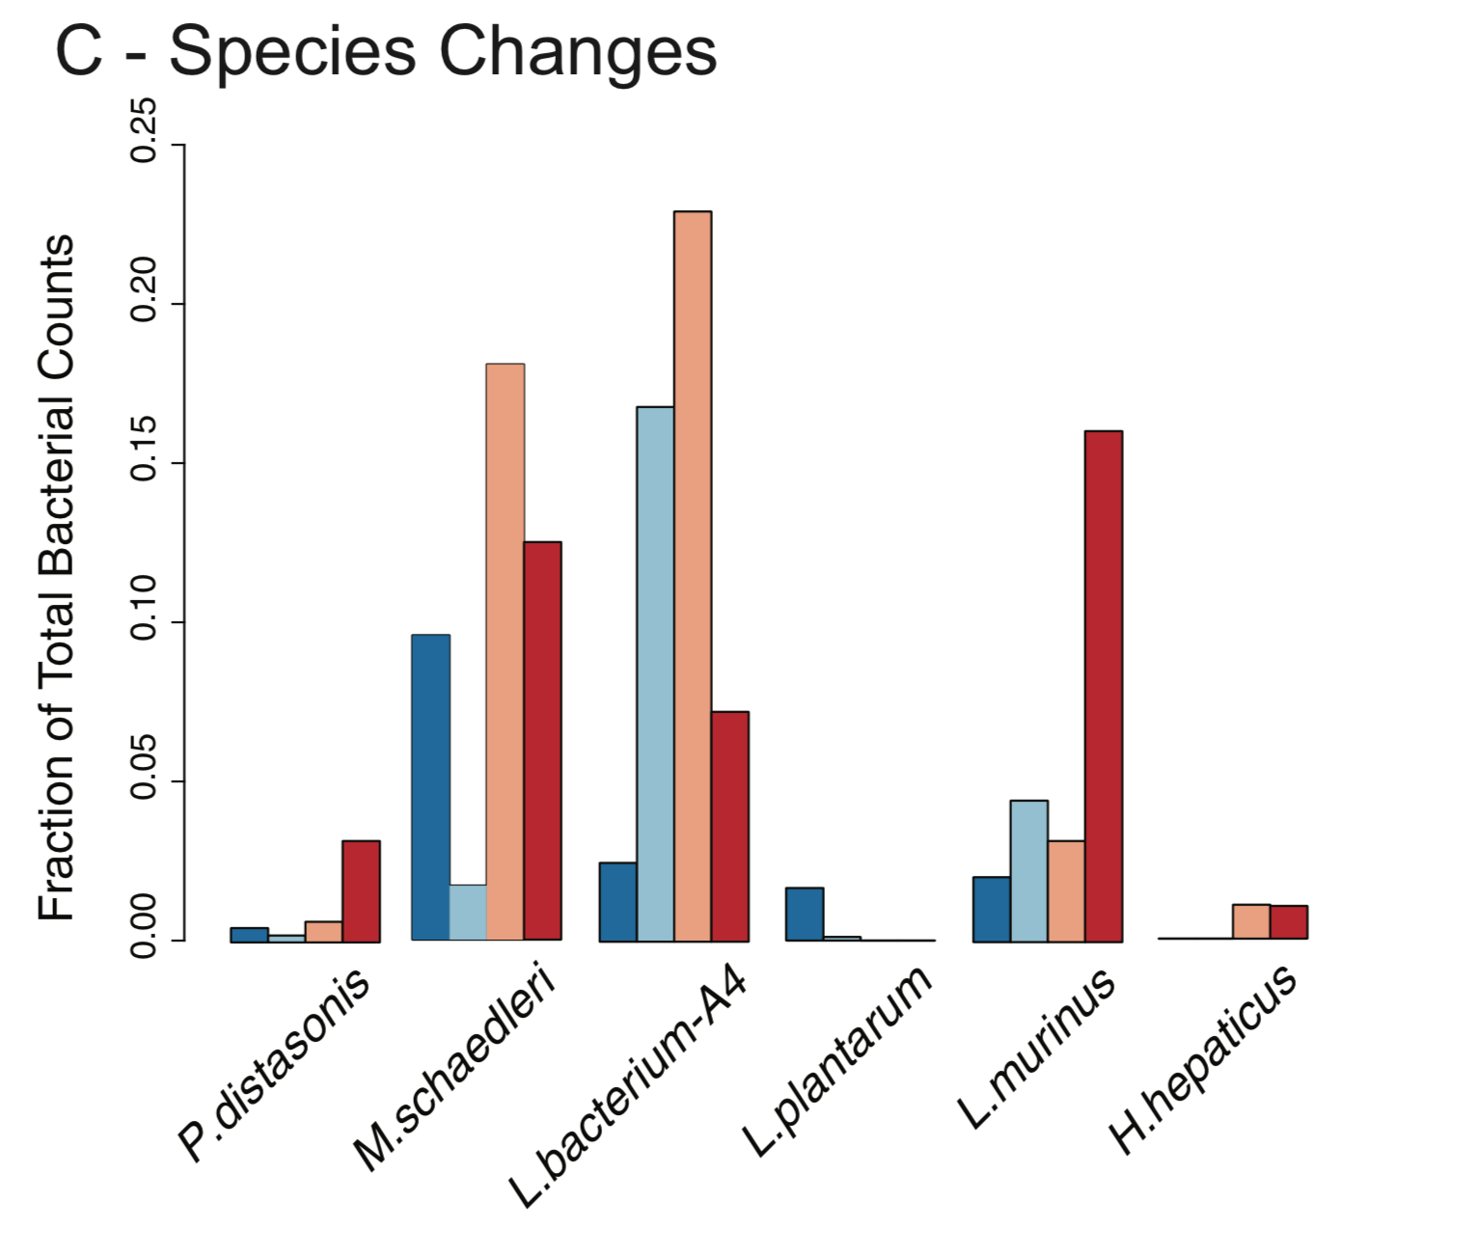
Taxonomic changes species level
Lachnospiraceae bacterium A4
(phylum Firmicutes) decreases in
abundance in the combined
and Smad3- effects.
A Lachnospiraceae species,
little studied, literature suggests
anti-inflammatory role.

Slide 8
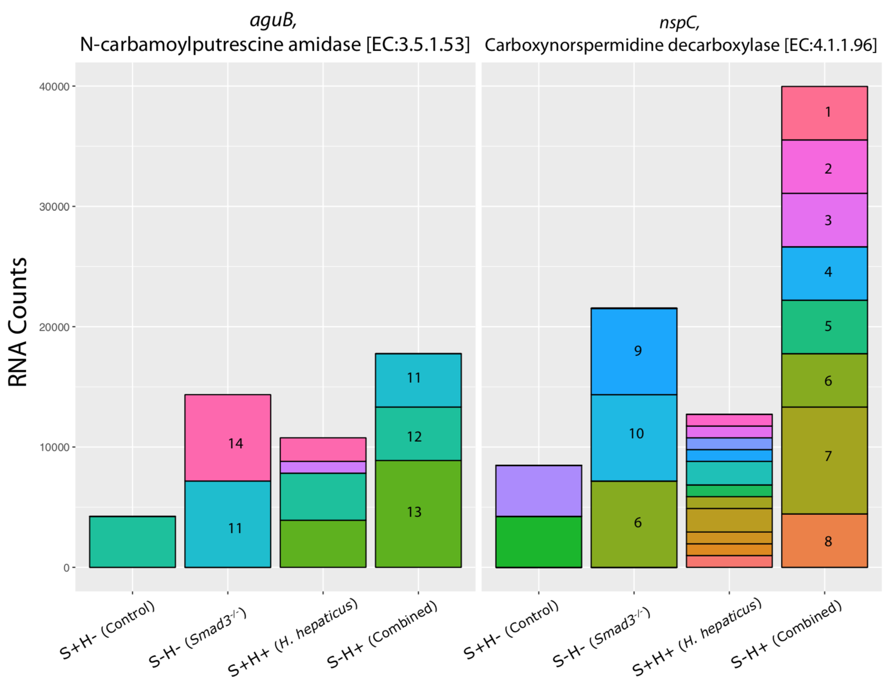
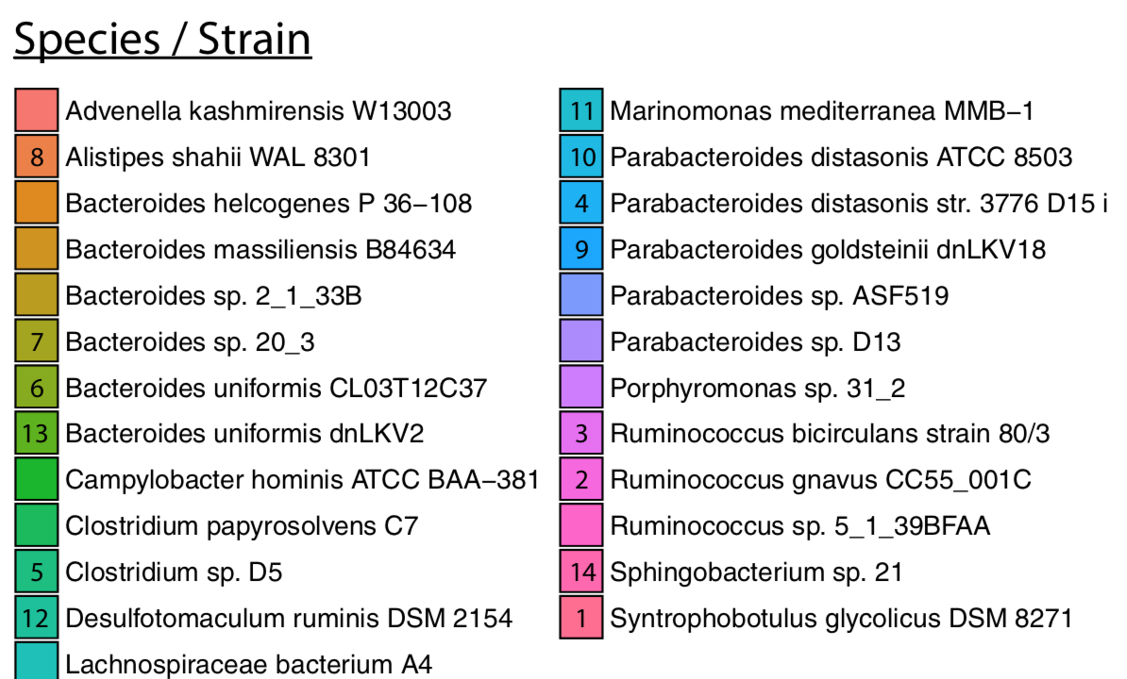
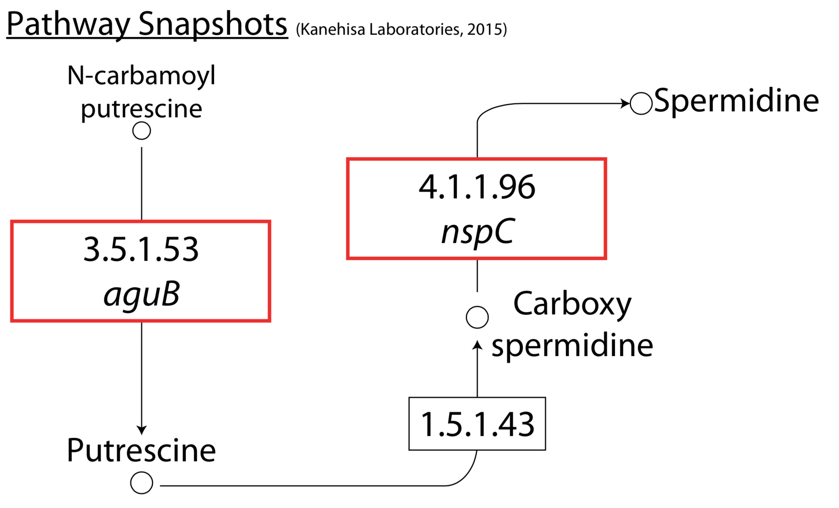
Arginine and proline metabolism
Observed upshift in RNA counts for genes
involved in the production of putrescine and spermidine.
Occurs in the SMAD3 and combined effects
Novel finding that gut bacteria are
possibly responsible for increased polyamine transcription

Slide 9


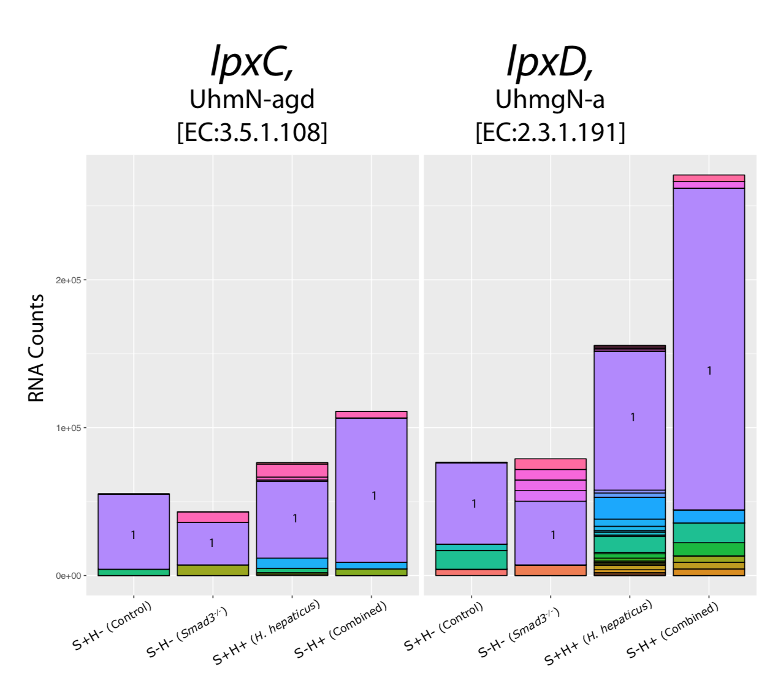
Lipopolysaccharide (LPS) biosynthesis
LPS associated with inflammatory response
Increase in LPS pathway biosynthesis genes
in H. hepaticus-only and combined effects
However, M. schaedleri. is responsible
not H. hepaticus
May result in shift to proinflammatory state

Slide 10
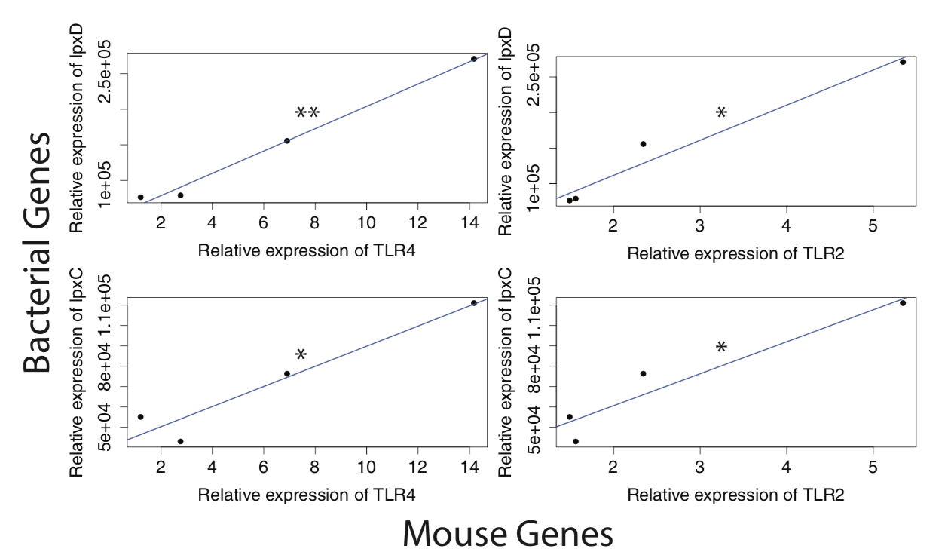
Bacteria LPS correlated to host TRL expression
Increased RNA counts of LPS genes in bacteria
lpxC and lpxD correlate significantly with
expression of host mucosal epithelial TLR genes
Tlr2 and Tlr4 in Smad3⁻ and H+ mice.

Slide 11


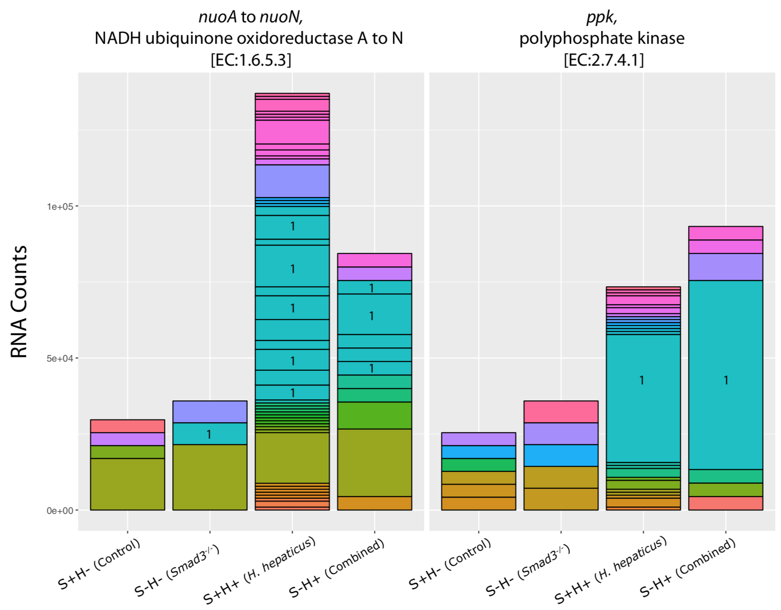
Oxidative phosphorylation
OXPHOS surprisingly shows most
change in RNA counts, normally occurs
in oxic environments, colon is anoxic.
H. hepaticus most responsible, rapid
growth may deplete oxygen
increase in OXPHOS points to an increase
in reactive oxygen and nitrogen species
(RONS) which may be causing the
oxidative damage to DNA, RNA or
proteins leading to cancerous state.

Slide 12
Summary
Loss of SMAD3 is associated with changes in bacterial RNA counts in the butyrate and polyamine synthesis pathways
Adding H. hepaticus, increases in LPS and OXPHOS pathways’ RNA counts, suggesting an increase in the proinflammatory and free radical status of the colonic epithelium
Either changes alone is insufficient to promote carcinogenesis. Their combination and possibly a reduction of probiotic species seem to be necessary to reach the “tipping point” for tumorigenesis

